Slide 1
﻿Adversarial Training and Robustness for Multiple Perturbations
Florian Tramèr
Stanford security lunch
May 22nd 2019
Joint work with Dan Boneh

Slide 2
Adversarial examples: what (we think) we know
(Szegedy et al. 2013, Goodfellow et al. 2015)
Pretty sure this is a panda
I’m certain this is a gibbon
Affects all ML models & domains
(images, speech, text, etc.)
Perturbations transfer between models
(mostly on images)
Explanations:
    Local linearity of models (Goodfellow et al. 2015)
    High dimensionality of data (Fawzi et al. 2018, Gilmer et al. 2018)
    Superficial features (Jo & Bengio 2017, Jetley et al. 2018, Ilyas et al. 2019)

Slide 3
Adversarial examples as superficial features
Thesis: Data contains imperceptible, yet generalizable features
    A model trained with ERM will use these features to get better accuracy
    Adversarial examples manipulate these features
(Ilyas et al. 2019)

Slide 4
Adversarial examples as superficial features
Experiment:
  New training set: all dogs mislabeled as “cat”, all cats mislabeled as “dog”
What could a model trained on this new dataset learn?
1) Robust features of a dog means “cat”
2) Non-robust features of a cat means “cat”
A model trained on the new training set has high accuracy on the original unperturbed and correctly labeled test set!
Conclusion: the model learned to associate each class with imperceptible yet generalizable features, which correspond to adversarial examples
targeted adversarial example towards class “cat”
Robust features: “dog”
Non-robust features: “dog”
Robust features: “dog”
Non-robust features: “cat”
(Ilyas et al. 2019)

Slide 5
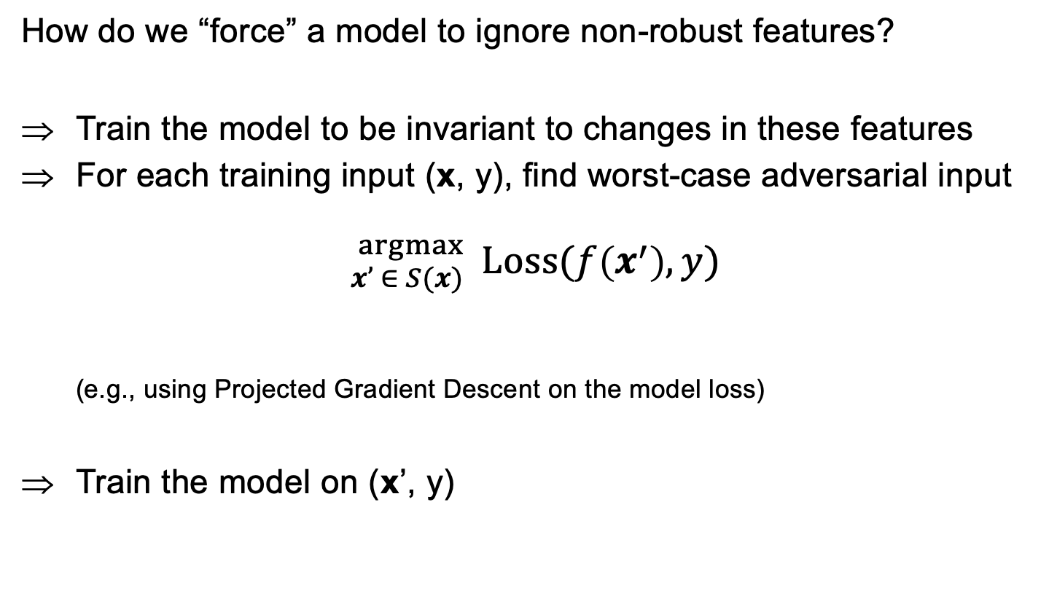
Adversarial training
How do we “force” a model to ignore non-robust features?
Train the model to be invariant to changes in these features
For each training input (x, y), find worst-case adversarial input
${}_{x’ ∈ S(x)}^{argmax}{ \text{Loss}(f\left(x^{′}\right), y)}$
(e.g., using Projected Gradient Descent on the model loss)
Train the model on (x’, y)
A set of allowable perturbations of x
e.g., {x’ : || x - x’ ||∞ ≤ ε}
Worst-case data augmentation by manipulating non-robust features

Slide 6
Multi-perturbation robustness
The “robustness” of a feature depends on the considered perturbation set S(x)
    What we want: S(x) = “all perturbations that don’t affect class semantics”
    What we have: S(x) = “a small L_{p} ball around x” or
    S(x) = “small rotations & translations of x”
MNIST:
Robustness to one perturbation type ≠ robustness to all
Robustness to one type can increase vulnerability to others

Slide 7
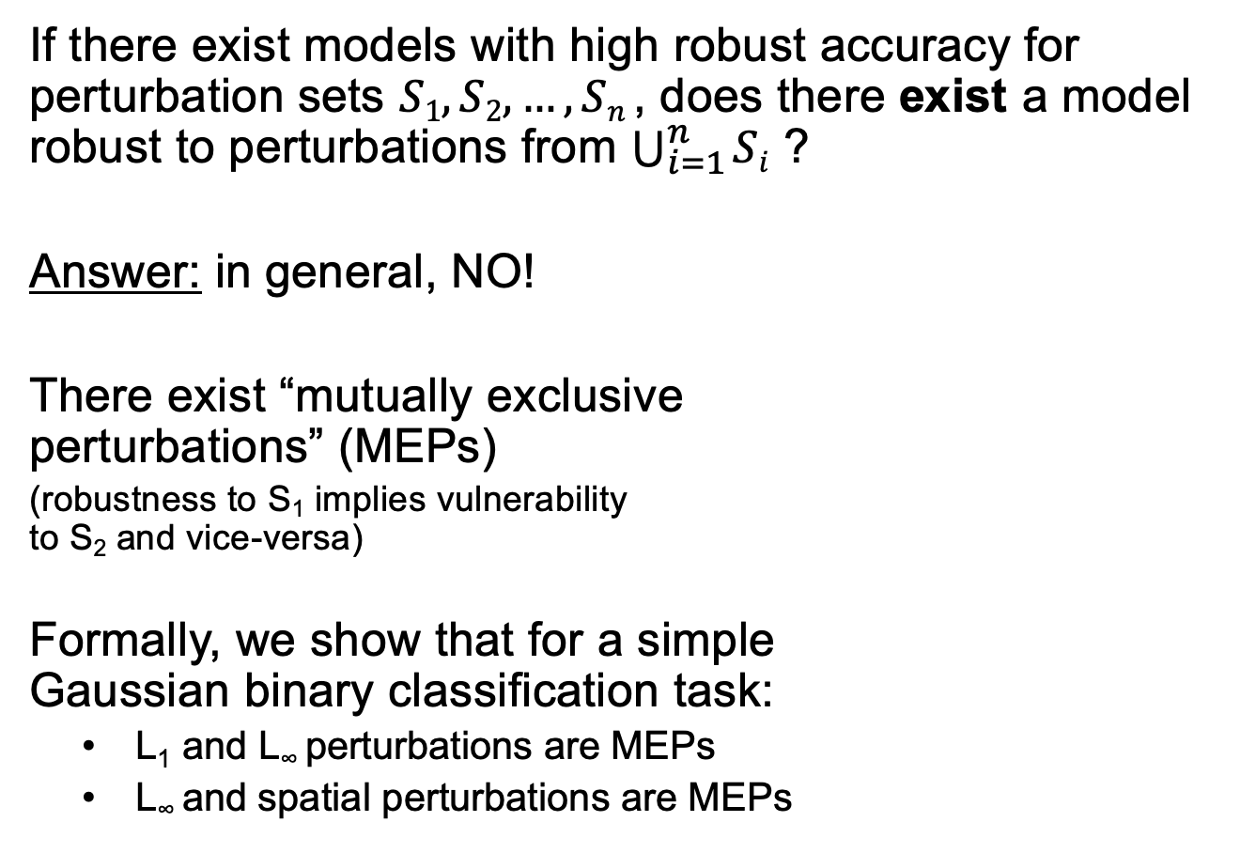
The multi-perturbation robustness trade-off
If there exist models with high robust accuracy for perturbation sets $S1, S2, …, Sn$, does there exist a model robust to perturbations from $\bigcup_{i=1}^{n}{Si}$ ?
Answer: in general, NO!
There exist “mutually exclusive
perturbations” (MEPs)
(robustness to S₁ implies vulnerability
to S₂ and vice-versa)
Formally, we show that for a simple
Gaussian binary classification task:
    L₁ and L∞ perturbations are MEPs
    L∞ and spatial perturbations are MEPs
Robust for S₁
Not robust for S₂
x₁
Classifier robust to S1
Classifier vulnerable to S1 and S2
Not robust for S₁
Robust for S₂
x₂
Classifier robust to S2

Slide 8
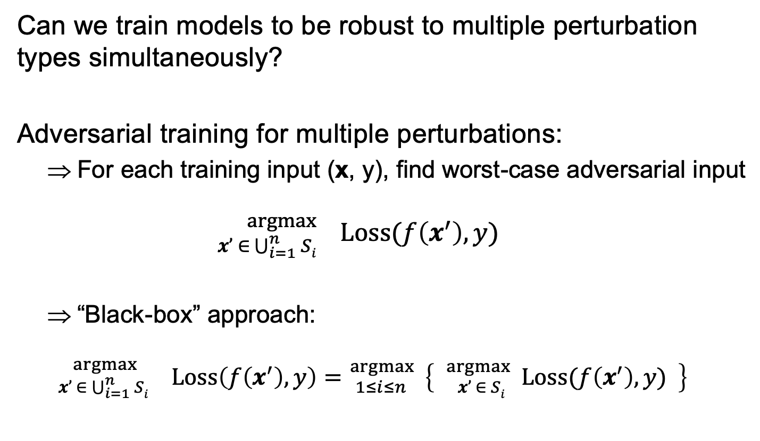
Experiments on real data
Can we train models to be robust to multiple perturbation types simultaneously?
Adversarial training for multiple perturbations:
    For each training input (x, y), find worst-case adversarial input
    ${}_{x’ ∈ \bigcup_{i=1}^{n}{Si}}^{argmax}{ \text{Loss}(f\left(x^{′}\right), y)}$
    “Black-box” approach:
    ${}_{x’ ∈ \bigcup_{i=1}^{n}{Si}}^{argmax }{}\text{Loss}\left(f\left(x^{′}\right), y\right)={}_{1≤i≤n }^{argmax} \left\{ {}_{x’ ∈ Si }^{argmax}{ \text{Loss}(f\left(x^{′}\right), y)} \right\}$
Scales linearly in number of perturbation sets
Use existing attack tailored to S_{i}

Slide 9
Results
Robust accuracy when training/evaluating on a single perturbation type
CIFAR10:
Loss of ~5% accuracy
MNIST:
Loss of ~20% accuracy

Slide 10
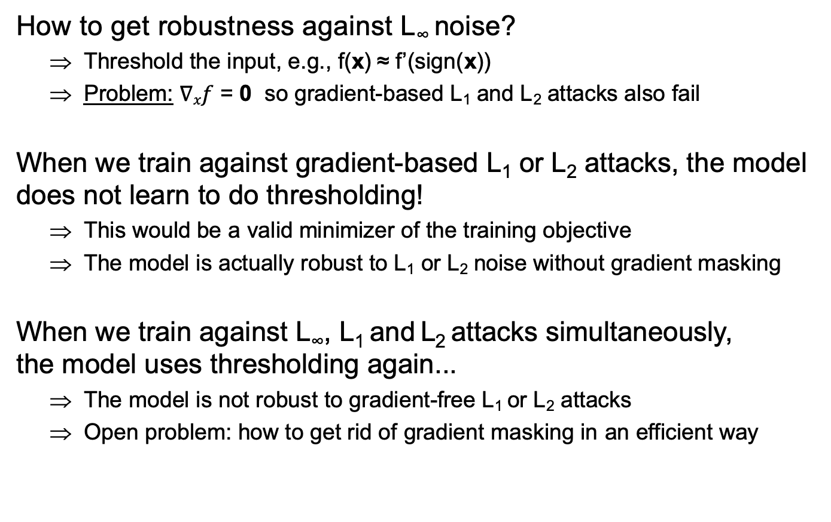

MNIST and gradient masking
$$∈\left\{0, 1\right\}784$$
x’
How to get robustness against L∞ noise?
    Threshold the input, e.g., f(x) ≈ f’(sign(x))
    Problem: $∇xf$ = 0 so gradient-based L₁ and L₂ attacks also fail
  When we train against gradient-based L₁ or L₂ attacks, the model does not learn to do thresholding!
    This would be a valid minimizer of the training objective
    The model is actually robust to L₁ or L₂ noise without gradient masking
  When we train against L∞, L₁ and L₂ attacks simultaneously,
  the model uses thresholding again...
    The model is not robust to gradient-free L₁ or L₂ attacks
    Open problem: how to get rid of gradient masking in an efficient way
x
flip 10 px

Slide 11

Affine adversaries
Instead of picking perturbations from $S1∪S2$ why not combine them?
E.g., small L₁ noise + small L∞ noise
or small rotation/translation + small L∞ noise
Affine adversary picks perturbation from$βS1+\left(1−β\right)S2$, for $β ∈\left[0, 1\right]$

Slide 12
Open problems
How do we get models to ignore non-robust features?
    How do we express which features are robust / non-robust to humans in the first place?
      I.e., how do we “define” non-robust features?
      Currently, simple proxies: L_{p} norms, rotations, etc.
        These are neither sufficient nor necessary! (upcoming slide)
    How do we efficiently get models to ignore multiple types of non-robust features
      Our current approach: train on worst-case example from union of perturbation sets ⇒ scales linearly in number of perturbation types
      Can we get something sublinear?

Slide 13

More problems with L_{p} perturbations
Let’s look at MNIST again:
    (Simple dataset, centered and scaled, non-trivial robustness is achievable)
  Using adversarial training, models have been trained to “extreme” levels of robustness
  (E.g., robust to L₁ noise > 30 or L∞ noise > 0.3)
$$∈\left\{0, 1\right\}784$$
natural
For such examples, humans agree more often with an undefended model than with an overly robust model
L₁ perturbed
L∞ perturbed
Jacobsen et al. “Exploiting Excessive Invariance caused by Norm-Bounded Adversarial Robustness”

