Slide 1
Slalom: Fast, Verifiable and Private Execution of Neural Networks in Trusted Hardware
Florian Tramèr
(joint work with Dan Boneh)
Stanford security lunch – June 13th

Slide 2
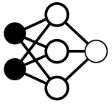
Trusted execution of ML: 3 motivating scenarios
Outsourced ML
Data Privacy
Integrity
Model “downgrade”
Disparate impact
Other malicious tampering
Notes:
Growing software stack --- ML used in security-critical tasks
=> Need for trust => 3 motivating scenarios

Slide 3
Trusted execution of ML: 3 motivating scenarios
Federated Learning
Integrity
Need integrity of computation and data collection
Data privacy

Slide 4
Trusted execution of ML: 3 motivating scenarios
Infected Hosts
Integrity
Malware
Trojaned hardware

Slide 5
Solutions
Cryptography
Outsourced ML: FHE, MPC, (ZK) proof systems
Federated learning: no countermeasure for poisoning…
Infected hosts: verifiable computation + some root of trust
Trusted Execution Environments (TEEs)
Outsourced ML: isolated enclaves
Federated learning: trusted sensors + isolated enclaves
Infected hosts: isolated enclaves / hardware from trusted manufacturer

Slide 6
Trusted Execution: At what cost?
Trusted ASICs (Wahby et al.): ~10⁸×worse than SOTA
Intel SGX:
Paging at ~90MB
GPU: Nvidia TITAN XP SGX: Intel Core i7-6700 Skylake Single Core @ 3.40GHz
https://medium.com/@danny_harnik/impressions-of-intel-sgx-performance-22442093595a

Slide 7
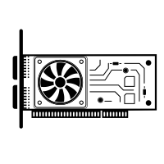
“How do we efficiently leverage TEEs for secure machine learning computations?”
Idea: outsource work to collocated, faster but untrusted device and verify results
x
TEE
F(x), proof
 | Computations | Required gap | Privacy
Verifiable ASICs (Wahby et al., 2016) | Arithmetic circuits | ~ 8 orders of magnitude | No
Slalom | DNN inference | ~ 1-2 orders | “Yes”
Notes:
Bottleneck will be verifier complexity, not prover overhead

Slide 8
Goal + threat model
The model is known to the adversary (but not necessarily to the client)
Adversary controls the rest of the software / hardware stack
TEE
User has secure communication channel with TEE
Goal: Efficiently run DNN inference F(x) - Integrity: User obtains F(x) or aborts - Privacy: Adversary learns nothing about x

Slide 9
Bottlenecks in deep neural networks
non linear stuff (cheap)
MATRIX MULTIPLICATION
~ 97%
VGG16 Inference on 1 CPU core

Slide 10
Outsourcing matrix multiplication: Freivald’s algorithm
Input: X ∈ 𝔽^{n ⨉ n} , W ∈ 𝔽^{n ⨉ n}
Direct Compute: Z = X * W
≈ n³ multiplications or O(n^{2.81}) with Strassen
Outsource + Verify:
Sample r ← 𝔽^{n} uniformly at random
Check: Z*r = X * (W * r)
Complexity: ≈ 3n² multiplications
Soundness: 1 / | 𝔽 | (boost by repeating)
DNN weights. Fixed at inference time

Slide 11
Batched and preprocessed verification
Some DNN layers are *not* matrix multiplications
E.g., a dense layer is a vector-matrix product, x*W
- Compute: ≈ n²
- Freivald: ≈ 3n² ...
Verify a batch of inputs: Z = [x₁, x₂, …, x_{B}] * W
- Compute: ≈ Bn²
- Freivald: ≈ Bn + 2n²
Preprocess learned weights: W’ = W*r
- Freivald: ≈ Bn + n²
The same randomness r can be reused for multiple checks if r is kept secret from the adversary

Slide 12
Handling convolutions
VGG16
K = 3
3 ≤ C ≤ 512
64 ≤ D ≤ 512
14² ≤ N ≤ 224²
 | Operation | Multiplications
Compute | Z = im2col([x₁, …, x_{B}]) * W | B*N*K²*C*D
Batched verify | r₁ * Z * r₂ = im2col(r₁ * X) * (W * r₂) | B*N*D + B*N*C + K²*C*D + N*K²*C
Soundness: 2 / | 𝔽 |
Savings even if B=1

Slide 13
Preprocessing for convolutions (or arbitrary linear ops)
Linear operator: z = F_{A}(x) = x * A
Precompute: A’ = A * r = (∇_{x} F)(r)
Check: z * r = x * A’
Complexity: |z| + |x| multiplications
Matrix of size |x| × |z|
Vector of size |z|
Vector of size |x|
Easy to compute without making A explicit!
2 inner products!
|x| = B*N*C
|z| = B*N*D
Convolutions | Multiplications
Compute | B*N*K²*C*D
Batched verify | B*N*D + B*N*C + K²*C*D + N*K²*C
Preprocessed | B*N*D + B*N*C

Slide 14
Preserving privacy
Offline precomputation + online blinding
Offline: Precompute and store R, R*W
X
TEE
X * W

Slide 15
Preserving privacy
Offline precomputation + online blinding
Secret sharing?
Offline: Precompute and store R, R*W
Online: “one-time-pad” over 𝔽
X+R
TEE
(X+R) * W
Online: Unblind using R*W
X+R
TEE
Can these devices be “collocated” yet “non-colluding” ?
R

Slide 16
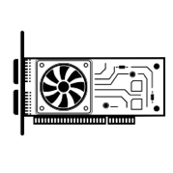
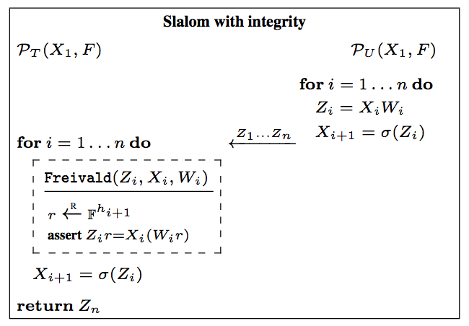
Slalom
W₁
_{σ}
W₂
_{σ}
X₁
Z₁
X₂
Z₂
F:
…
TEE
TEE

Slide 17
Slalom (some details)
Quantization:
DNNs are typically trained / evaluated in floating point
Freivald / blinding require working over a ring/field 𝔽
Quantize inputs & weights and work mod P (P < 2²⁴)
Integrity checks:
Eval DNN on fast device and store inputs/outputs of all linear ops
⟹ close to no prover overhead
Sample r from 𝔽 and do Freivald check in double precision
⟹ verifier complexity is at least |x| + |z| double muls per linear layer
Blinding:
Store unblinding factors R*W encrypted in untrusted memory
In online phase, decrypt (and authenticate) R*W to unblind

Slide 18
Design & Evaluation
TEE
Implementation
TEE: Intel SGX ”Desktop” CPU (single thread)
Untrusted device: Nvidia Tesla GPU
Port of the Eigen linear algebra C++ library to SGX (used in e.g., TensorFlow)
Workloads:
Microbenchmarks (see paper)
VGG16 (“beefy” canonical feedforward neural network)
MobileNet (resource efficient DNN tailored for low-compute devices)
Variant 1: standard MobileNet (see paper)
Variant 2: No intermediate ReLU in separable convolutions (this talk)

Slide 19
Verifiable inference
MobileNet’s weights are only ~10MB so they fit in the SGX cache
VGG16 weights take 500MB so SGX has to page weights in and out of memory => ~2-3x slowdown
Difficult to get faster batched verification due to SGX memory limits
Preprocessed weights W*r take up less memory and enable faster checks!

Slide 20
Verifiable and private inference
Extra Costs
GPU has to operate in double precision
Decrypt all unblinding factors R*W (AES-GCM)
Regenerate all blinding factors R (PRG using AES)

Slide 21
Summary
Large savings (6x – 20x) in outsourcing DNN inference while preserving integrity
Sufficient for some use-cases!
More modest savings (3.5x – 10x) with input privacy
Requires preprocessing

Slide 22
Open questions
What other problems are (concretely) easier to verify than to compute?
All NP complete problems (are those really outsourced?)
What about something in P?
Convex optimization
Other uses of matrix multiplication
Many graph problems (e.g., perfect matching)
What about Slalom for verifiable / private training?
Quantization at training time is hard
Weights change so we can’t preprocess W*r for Freivald’s check
We assume the model is public

