Slide 1
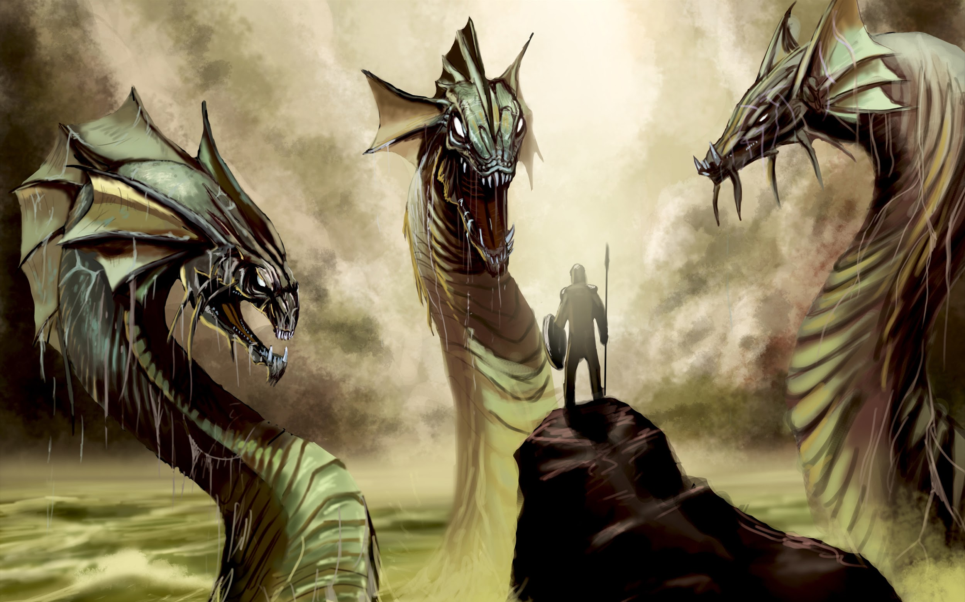
Enter Hydra
towards (more) secure smart contracts
Philip Daian, Ari Juels
Cornell [Tech] .
Lorenz Breidenbach
ETH Zurich, Cornell [Tech].
Florian Tramer .
Stanford .

Slide 2
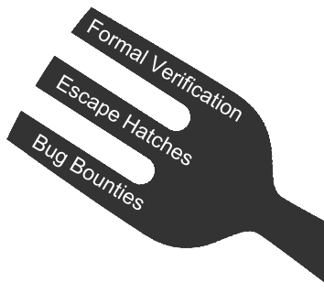
Smart Contract Security - The Prongs
Formal Verification (+Specification)
what are we building and how can we check it?
Escape Hatches
how can we react to the unforeseen?
Bug Bounties
how can we address perverse incentives?

Slide 3
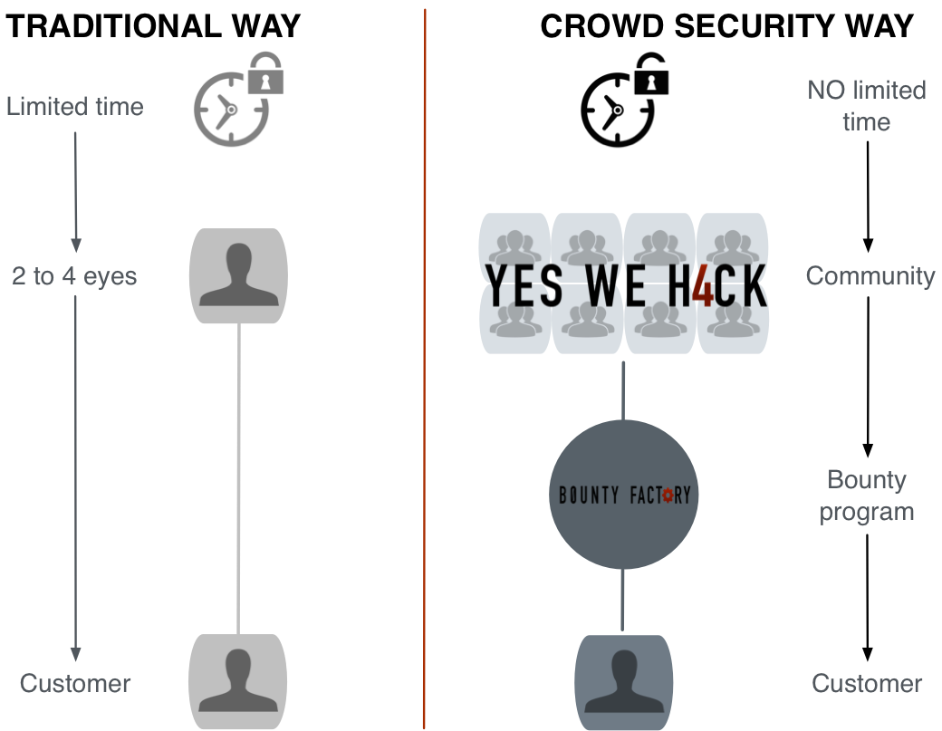
Why bug bounties?

Slide 4
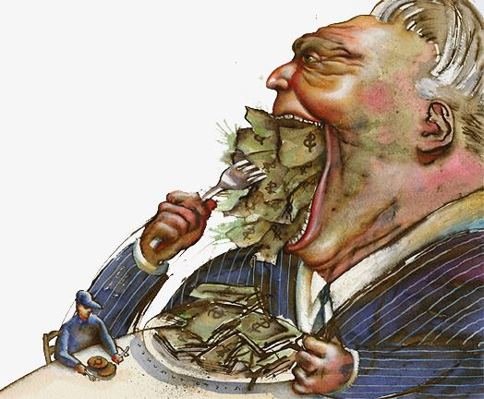
Why bug bounties?
The
rational attacker’s
game

Slide 5
Why bug bounties?
The
rational attacker’s
game
No bounties
Exploit!!
Attack
Disclose
$A
$0

Slide 6
Why bug bounties?
The
rational attacker’s
game
No bounties
Exploit!!
Attack if $A > $0
Always attack
Attack
Disclose
$A
$0

Slide 7
“Good enough” isn’t good enough
The
rational attacker’s
game
Classic bounty
Unknown payout
Exploit!!
Attack
Disclose
$A
$??

Slide 8
“Good enough” isn’t good enough
The
rational attacker’s
game
Classic bounty
Unknown payout
Exploit!!
Attack if $A > $??
Attack
Disclose
$A
$??

Slide 9
Towards a better game
The
rational attacker’s
game
Classic bounty
Known payout
Exploit!!
Attack
Disclose
$A
$B

Slide 10
Towards a better game
The
rational attacker’s
game
Classic bounty
Known payout
Exploit!!
Attack if $A > $B
Attack
Disclose
$A
$B

Slide 11
The ideal game
The
rational attacker’s
game
Hydra bounty
Known payout
Gap to exploit
Exploit!!
Attack
Disclose
$A
-$C
$B

Slide 12
The ideal game
The
rational attacker’s
game
Hydra bounty
Known payout
Gap to exploit
Exploit!!
Attack if $A-$C > $B
Attack
Disclose
$A
-$C
$B

Slide 13
The ideal game
The
rational attacker’s
game
Hydra bounty
Known payout
Gap to exploit
Exploit!!
Attack if $A-$C > $B
So, raise $C….
Attack
Disclose
$A
-$C
$B

Slide 14
… mind the gap!
We call this
barrier ($C) an “exploit gap”
Exploit!!
Attack
Disclose
$A
-$C
$B

Slide 15
Design Goals - The Perfect Bounty
Attack or disclose, not both (atomic)
Predetermined payout (verifiable)
Trustless payout (censorship resistant + verifiable)

Slide 16
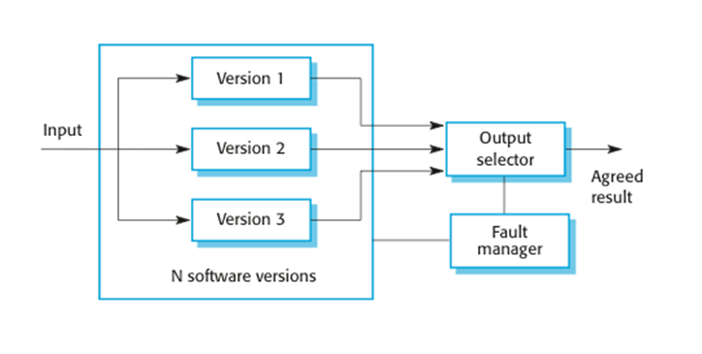
Exploit Gap through Hydra Contracts
Chen & Avizienis, ‘78

Slide 17
… Houston we have a gap
(only one contract has bug)
[assuming independence, composability of exploits, and many others]
[in the event of any disagreement, fault manager invoked]

Slide 18
… Houston we have a gap
(contracts have different bugs)
[assuming independence, composability of exploits, and many others]
[in the event of any disagreement, fault manager invoked]

Slide 19
… Houston we have no gap! Hydra fails!
(all contracts have same bug, empirically rare?)

Slide 20

… let’s bring back the 80’s!

Slide 21
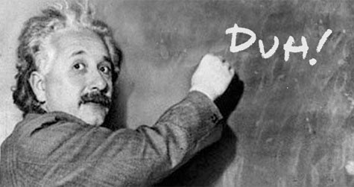

N-Version Programming Criticism
Analysis assumes full independence of faults (correlations are annoying!)
Knight-Leveson (‘86):
« We reject the null hypothesis of full
independence at a p-level of 5% »
Eckhardt et al. (’91):
« We tried it at NASA and it wasn’t cost effective»
Worst-case: 3 versions = 4x fewer errors

Slide 22


Cost, Availability & Reliability
«Classical» N-Version Programming: Availability >> Reliability
- Majority Voting: Always available, but may fail often
Smart contracts: do we really car if it’s down for a while?
- N-out-of-N agreement: better no answer than the wrong one
- Empirically, there seem to be few « harmless » bugs
Numbers from Eckhardt et al. look much better:
  - For 3 versions, 30 − 5087 times fewer failures
  (but some loss in availability…)

Slide 23
In practice as well as theory - preventable bugs
https://blog.ethereum.org/2016/06/19/thinking-smart-contract-security/
The DAO (obviously) [language]
The “payout index without the underscore” ponzi (“FirePonzi”) [scam]
The casino with a public RNG seed [spec]
Governmental (1100 ETH stuck because payout exceeds gas limit) [programmer]
5800 ETH swiped (by whitehats) from an ETH-backed ERC20 token [language]
The King of the Ether game [language]
Rubixi : Fees stolen because the constructor function had an incorrect name [prg]
Rock paper scissors trivially cheatable because the first to move shows their hand [spec]
Various instances of funds lost because a recipient contained a fallback function that consumed more than 2300 gas, causing sends to them to fail. [spec/pltfrm]
Various instances of call stack limit exceptions. [programmer]

Slide 24
In practice as well as theory - preventable bugs
https://blog.ethereum.org/2016/06/19/thinking-smart-contract-security/
The DAO (obviously) [language]
The “payout index without the underscore” ponzi (“FirePonzi”) [scam]
The casino with a public RNG seed [spec]
Governmental (1100 ETH stuck because payout exceeds gas limit) [programmer]
5800 ETH swiped (by whitehats) from an ETH-backed ERC20 token [language]
The King of the Ether game [language]
Rubixi : Fees stolen because the constructor function had an incorrect name [prg]
Rock paper scissors trivially cheatable because the first to move shows their hand [spec]
Various instances of funds lost because a recipient contained a fallback function that consumed more than 2300 gas, causing sends to them to fail. [spec/pltfrm]
Various instances of call stack limit exceptions. [programmer]
6-8/10 ain’t bad
(the rest are specification bugs or intentional backdoors).

Slide 25
… so, the project
Creation of trustless, decentralized bug bounty
Increased security for mainnet contracts
  Economic security through bounty program
  Deployment with Hydra for exploit gap
First rigorous, trustless incentive scheme for preventing smart contract attacks
First decentralized incentives for defenders

Slide 26

Main Challenges for on-chain deployment
Coordinating multiple smart contracts:
        - The coordinator should (hopefully) be bug free
  - Maintain consistent blockchain state
  - How to recover from a discovered bug => escape hatches
Frontrunning (as always…)
- Attacker can break the exploit gap by witholding bugs
  - Search for full exploit until someone tries to claim a bounty
  - Solution: Submarine sends!
  http://hackingdistributed.com/2017/08/28/submarine-sends/

Slide 27
Bug Withholding and Commit-Reveal
        Sol 1: To claim bounty at time T, must commit to bug at time T- 1
        Problem: Attacker commits in every round and only reveals if someone else does
        Sol 2: To commit, you must pay $$ (in a verifiable way)
        Problem: Attacker commits if someone else also commits
        Sol 3: Hide commitments (e.g., proof of burn to random address)
        Problem: Wasteful

Slide 28
Submarine Sends (post-metropolis version)
Goals: (1) only allow committed users to send a transaction to C
(2) being eternally committed is expensive
(3) attacker can’t know if someone has committed
(4) money isn’t wasted
Submarine sends:
Phase 1: compute addr = H(C || nonce || code) and send $$ to addr
Phase 2: reveal addr to C.
C verifies that addr got $$ in Phase 1
C creates a contract with the specified nonce and code
C collects $$ and allows transaction
addr: {
BAL: $$
CODE: ø
}
addr: {
BAL: $$
CODE: code
}
send $$ to C

