Slide 1
Ensemble Adversarial Training
Stanford Security Lunch
May 17th 2017
Florian Tramèr
Joint work with Alexey Kurakin, Nicolas Papernot, Dan Boneh & Patrick McDaniel

Slide 2
Adversarial Examples in ML
(Goodfellow et al. 2015)

Slide 3
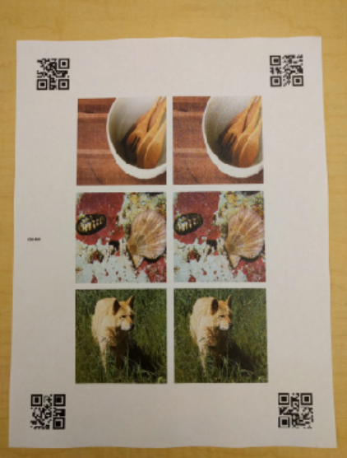
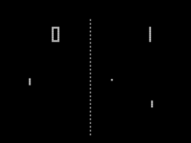
Adversarial Examples in ML
Images
Szegedy et al. 2013, Nguyen et al. 2015,
Goodfellow et al. 2015, Papernot et al. 2016,
Liu et al. 2016, Kurakin et al. 2016, …
Physical-World Attacks
Sharif et al. 2016, Kurakin et al. 2017
Malware
Šrndić & Laskov 2014, Xu et al. 2016,
Grosse et al. 2016, Hu et al. 2017
Text Understanding
Papernot et al. 2016
Reinforcement Learning
Huang et al. 2017, Lin et al. 2017,
Behzadan & Munir 2017

Slide 4

Threat Model: White-Box Attacks
ground truth
ML Model
bird
Loss
tree
plane
Take gradient of the loss
“Fast Gradient Sign Method” (FGSM)

Slide 5
Threat Model: White-Box Attacks
ML Model
bird
+
tree
plane
“Fast Gradient Sign Method” (FGSM)

Slide 6



Threat Model: Black-Box Attacks
ML Model
ML Model
plane
plane
ML Model
plane
Adversarial Examples transfer

Slide 7

Iterative Attacks
“One-Shot” Attacks
“Iterative” Attacks
Computationally efficient
Weaker white-box attacks
Transfers with high probability, strong black-box attacks!
More Expensive
Close to 100% success rate for imperceptible perturbations
Overfits to model’s parameters / doesn’t transfer very well

Slide 8

Defenses?
Ensembles?
Distillation?
Generative modeling?
Adversarial training? Lets see…
Notes:
Model the distribution of real inputs

Slide 9



Adversarial Training
ML Model
Loss
bird
take gradient
ML Model
Loss
plane

Slide 10
Does it Work?
Adversarial Training | White-Box Attacks | Black-Box Attacks
One-Shot
Iterative

Slide 11
Does it Work?
Adversarial Training | White-Box Attacks | Black-Box Attacks
One-Shot | Mostly yes!
Iterative

Slide 12
Does it Work?
Adversarial Training | White-Box Attacks | Black-Box Attacks
One-Shot | Mostly yes!
Iterative | Not really

Slide 13
Does it Work?
Adversarial Training | White-Box Attacks | Black-Box Attacks
One-Shot | Mostly yes!
Iterative | Not really | But they don’t transfer much

Slide 14
Does it Work?
Adversarial Training | White-Box Attacks | Black-Box Attacks
One-Shot | Mostly yes! | Not really!
Iterative | Not really | But they don’t transfer much

Slide 15
Attacks on Adversarial Training
Adversarial examples transferred from another model

Slide 16

Gradient Masking
How to get robustness to FGSM-style attacks?
Large Margin Classifier
“Gradient Masking”

Slide 17
Loss of Adversarially Trained Model
Adversarial Example
Non-Adversarial Example
Move in direction of another model’s gradient
(black-box attack)
Move in direction of model’s gradient
(white-box attack)
Data Point

Slide 18

Loss of Adversarially Trained Model
Notes:
Gradient models local evolution of the loss, doesn’t generalize

Slide 19
Simple Attack: RAND+FGSM
Small random step
Step in direction of gradient

Slide 20
Does it Work? (Before)
Adversarial Training | White-Box Attacks | Black-Box Attacks
One-Shot | Mostly yes! | Not really!
Iterative | Not really | But they don’t transfer much

Slide 21
Does it Work? (Now)
Adversarial Training | White-Box Attacks | Black-Box Attacks
One-Shot | Not really! | Not really!
Iterative | Not really | But they don’t transfer much
Security against white-box attacks seems out-of-reach.
Black-box security might be sufficient. Can we do better?

Slide 22
What’s wrong with Adversarial Training?
Minimize
Small if:
The model is actually robust
Or, the gradient points in a direction that is not adversarial
Degenerate Minimum

Slide 23




Ensemble Adversarial Training
How do we avoid these degenerate minima?
pre-trained
ML Model
ML Model
ML Model
Loss

Slide 24
Results
Source model for attack was not used during training
Less white-box FGSM samples seen during training
Notes:
No gradient masking

Slide 25
Results

Slide 26

What about stronger attacks?
Little to no improvement on white-box iterative and RAND+FGSM attacks!
But, these attacks don’t transfer well!

Slide 27
What about stronger attacks?

Slide 28
Efficiency of Ensemble Adversarial Training
Pre-compute gradients for pre-trained models
  Lower per-batch cost than with adversarial training
Randomize source model in each batch
  If num_models % num_batches = 0, we see the same adversarial examples in each epoch if we just rotate
Convergence can be much slower
  Standard Inception v3: ~150 epochs
  Adversarial training: ~190 epochs
  Ensemble adversarial training: ~280 epochs
Maybe because the task is actually hard?...

Slide 29
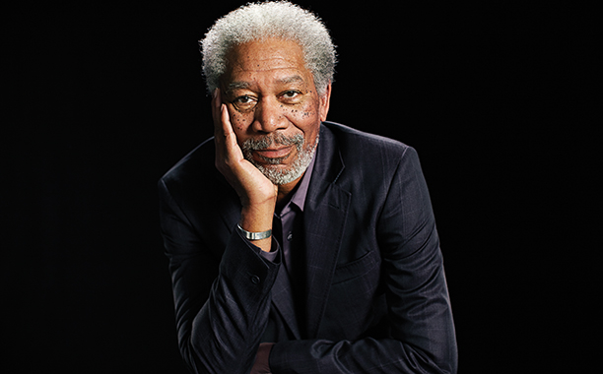
Takeaways
Test defenses on black-box attacks!
  Distillation (Papernot et al. 2016, attack by Carlini et al. 2016)
  Biologically Inspired Networks
  (Nayebi & Ganguli 27 Mar. 2017, attack by Brendel & Bethge 5 Apr. 2017)
  Adversarial Training, and probably many others…
Ensemble Adversarial Training vastly improves robustness to black-box attacks
      « If you don’t know where to go, just move at random. »
        — Morgan Freeman — (or Dan Boneh)

Slide 30
Open Problems
Better black-box attacks?
  How much does oracle access to the model help?
More efficient ensemble adversarial training?
Can we say anything formal (and useful) about adversarial examples?
THANK YOU

