Slide 1




Stealing Machine Learning Models via Prediction APIs
Florian Tramèr, Fan Zhang, Ari Juels, Michael K. Reiter, Thomas Ristenpart
Usenix Security Symposium
Austin, Texas, USA
August, 11th 2016

Slide 2



Machine Learning (ML) Systems
Gather labeled data
x⁽¹⁾, y⁽¹⁾ x⁽²⁾, y⁽²⁾ …
Bob
Tim
Jake
Data
n-dimensional feature vector x
Dependent variable y
Training
(2) Train ML model f from data
f ( x ) = y
Model f
Prediction
Confidence
Bob
x =
y =
Tim
Jake
(3) Use f in some application or publish it for others to use
Application
Notes:
Set of data, each belonging to some class
Train predictive model over data
Query model and get prediction: either just a class label, or more granular confidence scores (e.g. a probability for each class)

Slide 3


Machine Learning as a Service (MLaaS)
Goal 2: Model Confidentiality
Model/Data Monetization
Sensitive Data
Model f
Prediction API
Training API
input
classification
Data
Black Box
Goal 1: Rich Prediction APIs
Highly Available
High-Precision Results
$$$ per query
Notes:
this “publishing” of ML models for others to use is one of the features advertised by many MLaaS platforms
Two CONFLICTING goals

Slide 4





Machine Learning as a Service (MLaaS)
Service | Model types
Amazon | Logistic regressions
Google | ??? (announced: logistic regressions, decision trees, neural networks, SVMs)
Microsoft | Logistic regressions, decision trees, neural networks, SVMs
PredictionIO | Logistic regressions, decision trees, SVMs (white-box)
BigML | Logistic regressions, decision trees
Sell Datasets – Models – Prediction Queries to other users
$$$
$$$
Notes:
BigML is actually the platforms that seems to go the furthest in terms of monetization options, allowing users to sell…

Slide 5
Model Extraction Attacks
Goal: Adversarial client learns close approximation of f using as few queries as possible
Applications:
Undermine pay-for-prediction pricing model
Facilitate privacy attacks (
Stepping stone to model-evasion
[Lowd, Meek – 2005] [Srndic, Laskov – 2014]
Target: f(x) = f’(x) on ≥ 99.9% of inputs
Attack
x
Model f
Data
f’
f(x)
Notes:
Use extracted model as a stand-in for white box attacks, such as …

Slide 6

Model Extraction Attacks (Prior Work)
Goal: Adversarial client learns close approximation of f using as few queries as possible
Attack
x
Model f
Data
f’
f(x)
No! Prediction APIs return more information than assumed in prior work and “traditional” ML
Isn’t this “just Machine Learning”?
If f(x) is just a class label: learning with membership queries
Boolean decision trees [Kushilevitz, Mansour – 1993]
Linear models (e.g., binary regression) [Lowd, Meek – 2005]
Notes:
If we take a step back, and look at what we’re trying to achieve, one might ask: isn’t this just ML?
Two ways to look at it: if f(x) is just a class label, …
Assumptions: …

Slide 7

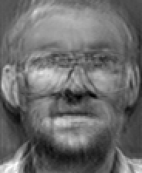
Main Results
f’(x) = f(x) on 100% of inputs
100s-1000’s of online queries
Attack
x
Model f
Data
f’
f(x)
x
f’(x)
Logistic Regressions, Neural Networks, Decision Trees, SVMs
Reverse-engineer model type
& features
Inversion Attack
Improved Model-Inversion Attacks
[Fredrikson et al. 2015]
Notes:
I’ll talk about one application of model extraction, in the context of model extraction attacks (Fredrikson).
This is a class of inference attacks on training data (here an example for a facial recognition model).
We show that using extraction and then applying model inversion to the extracted model leads to a more scalable attack

Slide 8

Model Extraction Example: Logistic Regression
Task: Facial Recognition of two people (binary classification)
n+1 parameters w,b chosen using training set to minimize expected error
Alice
Model f
Data
Bob
f (x) = 1 / (1+e ^{-(w*x + b)})
f maps features to predicted probability of being “Alice”
≤ 0.5 classify as “Bob”
> 0.5 classify as “Alice”
Feature vectors are pixel data
e.g., n = 92 * 112 = 10,304
Generalize to c > 2 classes with multinomial logistic regression
f(x) = [p₁, p₂, …, p_{c}] predict label as argmax_{i} p_{i}

Slide 9
Model Extraction Example: Logistic Regression
Goal: Adversarial client learns close approximation of f using as few queries as possible
f(x) = f’(x) on 100% of inputs
Alice
Attack
x
Model f
Data
f’
f(x)
Bob
f (x)
= 1 / (1+e ^{-(w*x + b)})
f (x)
ln
( )
= w*x + b
Linear equation in
n+1 unknowns w,b
1 - f(x)
Query n+1 random points ⇒ solve a linear system of n+1 equations

Slide 10
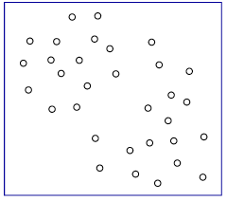
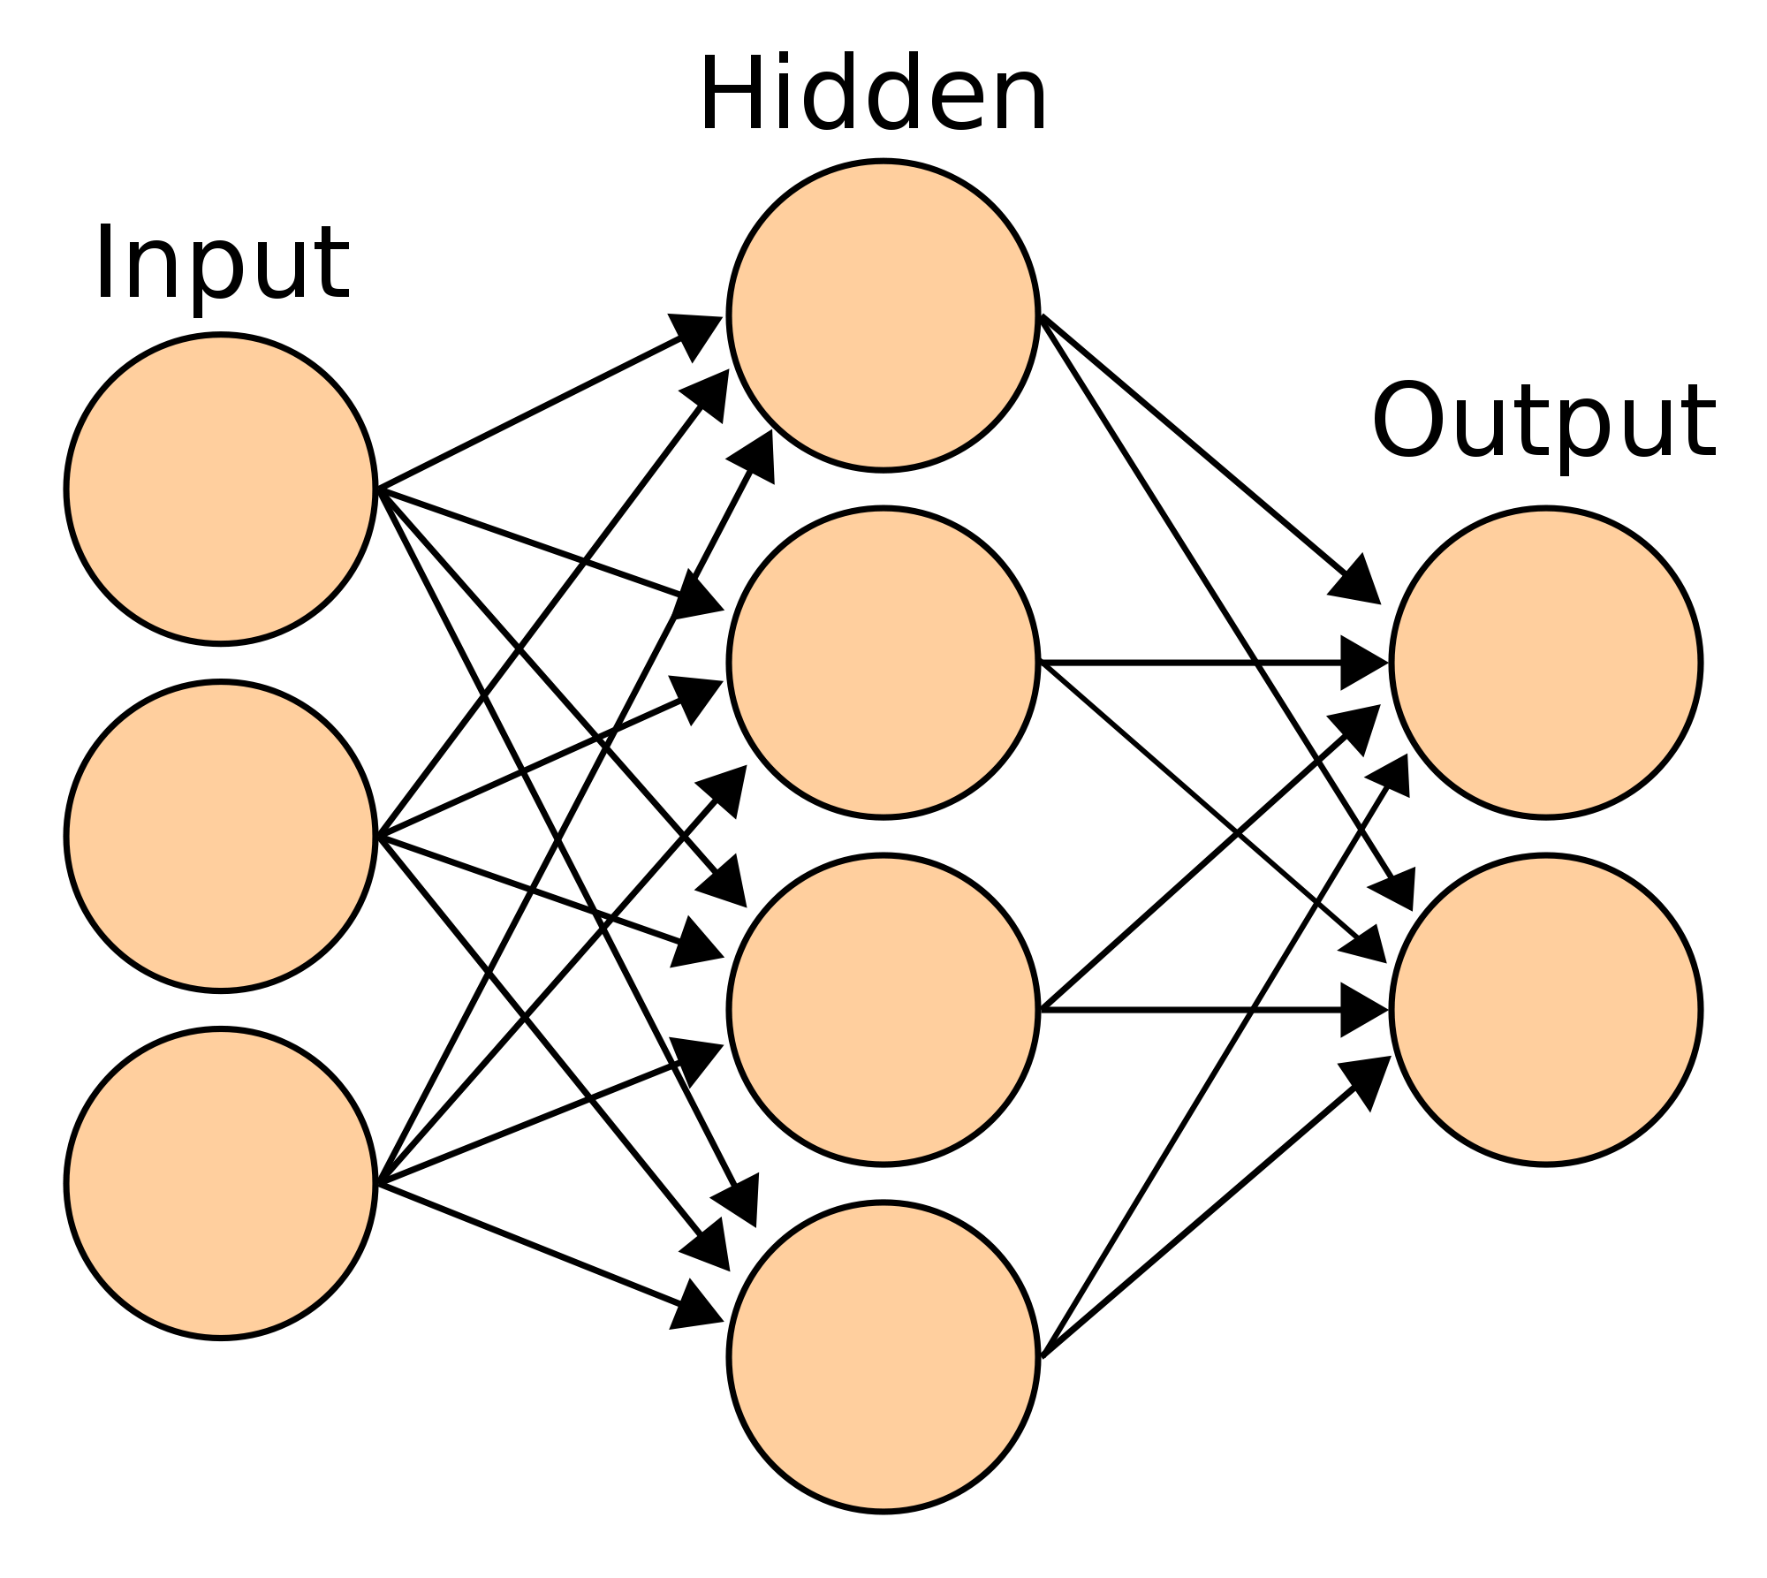
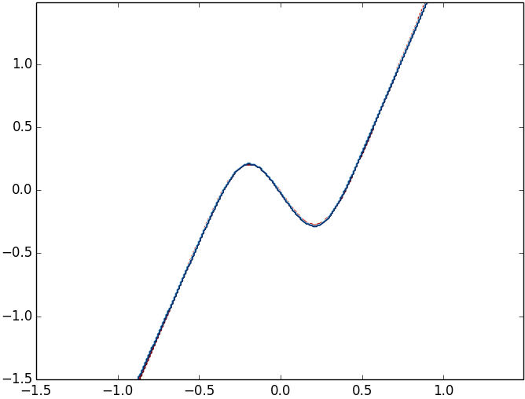
Generic Equation-Solving Attacks
random inputs X
MLaaS Service
outputs Y
confidence values
Model f has k parameters W
Solve non-linear equation system in the weights W
  Optimization problem + gradient descent
  “Noiseless Machine Learning”
Multinomial Regressions & Deep Neural Networks:
  >99.9% agreement between f and f’
  ≈ 1 query per model parameter of f
  100s - 1,000s of queries / seconds to minutes
f’
f
Notes:
Solve using well-known optimization techniques

Slide 11
MLaaS: A Closer Look
Feature Extraction:
(automated and partially documented)
Model f
Prediction API
Training API
x
f(x)
Data
Class labels and confidence scores
Support for partial inputs
ML Model Type Selection: logistic or linear regression
Notes:
Having seen how equation-solving attacks work “on paper”, lets now focus on a real attack against an online service, AWS in this case.
For this, we need to revisit some of our assumptions about what info is available to adversary.

Slide 12
Online Attack: AWS Machine Learning
input
Feature Extraction: Quantile Binning + One-Hot-Encoding
Model Choice:
Logistic Regression
prediction
Reverse-engineered with partial queries and confidence scores
“Extract-and-test”
Model | Online Queries | Time (s) | Price ($)
Handwritten Digits | 650 | 70 | 0.07
Adult Census | 1,485 | 149 | 0.15
Extracted model f’ agrees with f on 100% of tested inputs
Notes:
So this what the real attacks we performed on AWS look like
Without going into details (see paper), AWS applies two feature extraction techniques, … and …, and we show that an adversary can fully reverse-engineer these using…
For the model type, there were also some parts left unspecified in the AWS docs, but here a simple brute-force enumeration of plausible assumptions was sufficient to uncover all the details

Slide 13
Application: Model-Inversion Attacks
  Infer training data from trained models [Fredrikson et al. – 2015]
Attack recovers image of one individual
Training samples of 40 individuals
White-Box Attack
Inversion Attack
x
ExtractionAttack
x
Multinomial LR Model f
Data
f’
f’(x)
f(x)
f(x) = f’(x) for >99.9% of inputs
Strategy | Attack against 1 individual |  | Attack against all 40 individuals
 | Online Queries | Attack Time | Online Queries | Attack Time
Black-Box Inversion [Fredrikson et al.] | 20,600 | 24 min | 800,000 | 16 hours
Extract-and-Invert (our work) | 41,000 | 10 hours | 41,000 | 10 hours
×40
×1
Notes:
Application of model extraction, in the context of model-inversion attacks, proposed by Fredrikson and co-authors at CCS last year.
The setting is as follows: we train a facial recognition model over the AT&T dataset that contains images of faces of 40 individuals.
Then, instead of applying an inversion attack directly in a black-box setting, we first extract the model (using previously presented techniques), and then run the inversion over the white-box extracted model.
The attack reconstructs the face of one individual in the training data, and can then be repeatedly applied to each of the 40 individuals.
We find the extraction makes the attack more scalable.

Slide 14
Extracting a Decision Tree
x
Confidence value derived from class distribution in the training set
Kushilevitz-Mansour (1992)
Poly-time algorithm with membership queries only
Only for Boolean trees, impractical complexity
(Ab)using Confidence Values
Assumption: all tree leaves have unique confidence values
Reconstruct tree decisions with “differential testing”
Online attacks on BigML
Inputs x and x’ differ in a single feature
Different leaves are reached
⬄
Tree “splits” on this feature
x
x’
v
v’
Notes:
class labels and confidence scores not derived from a simple mathematical function of inputs (e.g. logistic function).
Rather: tree structure partitions input space, and each leave is assigned a class and confidence score derived from the distribution of the training data
To simplify exposition, we assume that all leaves have unique conf. In practice, we find that this assumption can be relaxed somewhat

Slide 15
Countermeasures
How to prevent extraction?
API Minimization
f ( x ) = y
Prediction = class label only
Learning with Membership Queries
Prediction
Confidence
Attack on Linear Classifiers [Lowd,Meek – 2005]
n+1 parameters w,b
classify as “+” if w*x + b > 0
and “-” otherwise
f(x) = sign(w*x + b)
Find points on decision boundary (w*x + b = 0)
  Find a “+” and a “-”
  Line search between the two points
Reconstruct w and b (up to scaling factor)
decision
boundary

Slide 16
Generic Model Retraining Attacks
Extend the Lowd-Meek approach to non-linear models
Active Learning:
  Query points close to “decision boundary”
  Update f’ to fit these points
Multinomial Regressions, Neural Networks, SVMs:
  >99% agreement between f and f’
  ≈ 100 queries per model parameter of f
≈ 100× less efficient than equation-solving
query more points here

Slide 17


Conclusion
Rich prediction APIs Model & data confidentiality
Efficient Model-Extraction Attacks
Logistic Regressions, Neural Networks, Decision Trees, SVMs
Reverse-engineering of model type, feature extractors
Active learning attacks in membership-query setting
Applications
Sidestep model monetization
Boost other attacks: privacy breaches, model evasion
Thanks! Find out more: https://github.com/ftramer/Steal-ML
Notes:
TENSION!!!
Between desire and need
Exceptionally, I’d like to conclude this talk with a brief and shameless announcement

