Slide 1
From average-case to worst-case privacy leakage in neural networks
Florian Tramèr
Google Brain & ETHZ

Slide 2


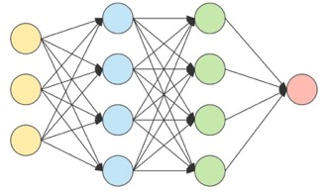



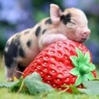
Neural networks learn from a (private) training set.
“cat”
minimize loss

Slide 3
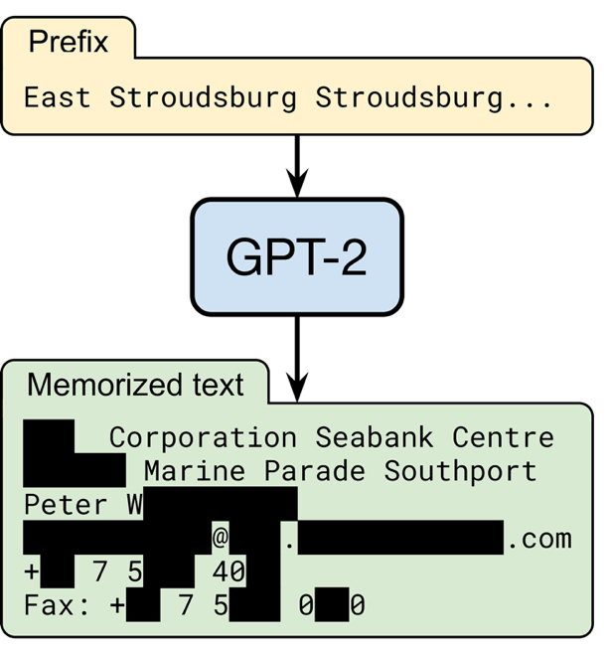
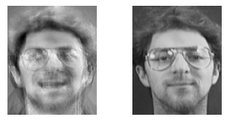
The trained model might leak the training set.
from the Bible (1 Kings 7:2)

Slide 4

This talk: Membership inference attacks
Was
in the training set?

Slide 5
Why should we care about membership inference?
  A real attack (e.g., models trained on medical data)
  An attack component (e.g., for data extraction)
  A simple, formal upper-bound on data leakage
≈
Data privacy
Membership inference attack
Secure encryption
Chosen plaintext attack

Slide 6
Outline.
Most membership attacks (and their evaluations) are flawed
A new principled attack that works on outliers
A new stronger attack that works for any input
Defenses and how to audit them

Slide 7
A simple MI attack: loss thresholding
[Yeom et al.’18]
minimize loss

Slide 8
A simple MI attack: loss thresholding
[Yeom et al.’18]

Slide 9
A simple MI attack: loss thresholding
[Yeom et al.’18]
guess “member”
decision threshold

Slide 10
A simple MI attack: loss thresholding
[Yeom et al.’18]
guess “member”
decision threshold

Slide 11
A simple MI attack: loss thresholding
[Yeom et al.’18]
guess “member”
decision threshold

Slide 12
Loss thresholding leaks membership on average.
AUC-ROC=0.59

Slide 13
Loss thresholding leaks membership on average.
Average-case leakage
is a poor metric for privacy!

Slide 14
Loss thresholding doesn’t confidently infer membership of any member of the training set!

Slide 15
Our preferred evaluation methodology: low FPRs

Slide 16
Some attacks work! (but average-case metrics don’t show it)
[Sablayrolles et al.’19]
slightly worse on average

Slide 17
Some attacks work! (but average-case metrics don’t show it)
[Sablayrolles et al.’19]
100x better in the worst-case
slightly worse on average

Slide 18
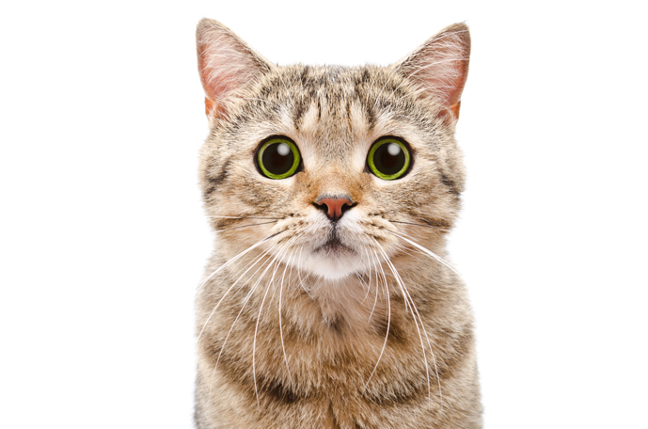

Insight: not all examples are equally “hard”
[Sablayrolles et al.’19, Long et al.’20, Feldman & Zhang’20, Watson et al.’21, Ye et al.’21]
Which is a member?
Confidence: 90% cat
Confidence: 85% truck

Slide 19

Insight: not all examples are equally “hard”
[Sablayrolles et al.’19, Long et al.’20, Feldman & Zhang’20, Watson et al.’21, Ye et al.’21]
Which is a member?
models trained on image
models trained on image
models not trained on image
models not trained on image
loss
loss

Slide 20
Insight: not all examples are equally “hard”
[Sablayrolles et al.’19, Long et al.’20, Feldman & Zhang’20, Watson et al.’21, Ye et al.’21]
Which is a member?
models trained on image
models trained on image
models not trained on image
models not trained on image
loss
loss

Slide 21
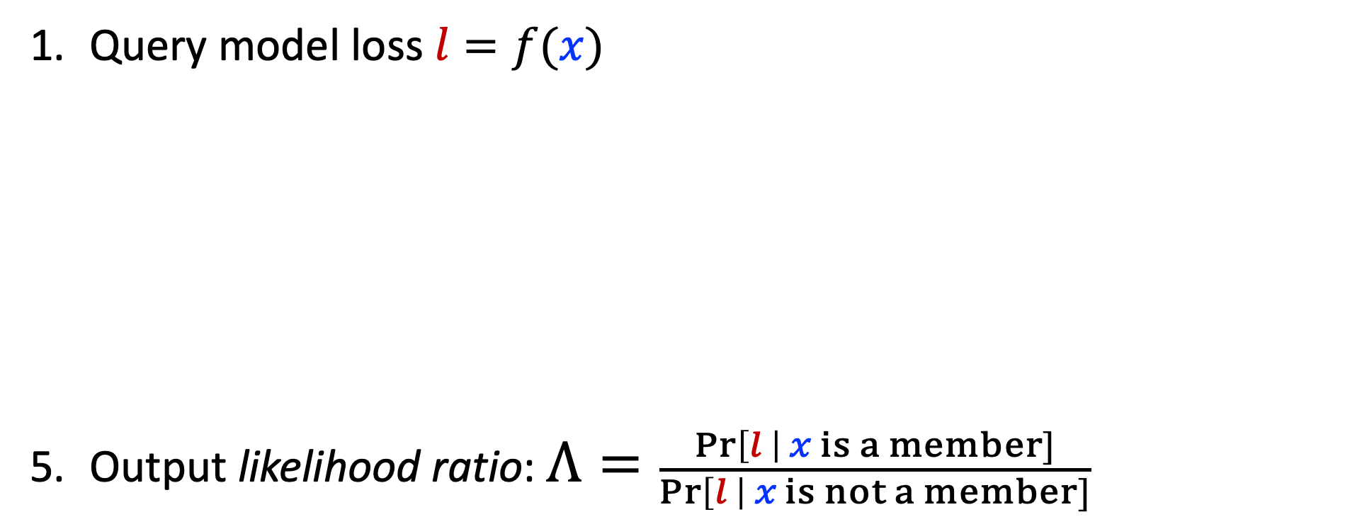
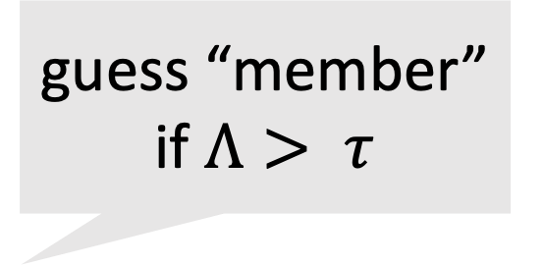
LIRA: Likelihood Ratio Attack
Carlini et al., “Membership Inference Attacks From First Principles”, IEEE S&P ‘22
Query model loss $l=f(x)$
Train $N$ “shadow models” $g_{out}^{i}=Train(𝒟)$,${ g}_{in}^{i}=Train(𝒟∪x)$
Compute confidences $Zout=\{{ g}_{out}^{i}\left(x\right) \}_{i}^{}$, $Zin=\{{ g}_{in}^{i}\left(x\right){ \}}_{i}^{}$
Model $Zout$and $Zin$ as Gaussians
Output likelihood ratio: $Λ=\frac{\operatorname{Pr}\left[l \right| x is a member]}{\operatorname{Pr}\left[l \right| x is not a member]}$
guess “member” if $Λ> τ$

Slide 22
LIRA: Likelihood Ratio Attack
Carlini et al., “Membership Inference Attacks From First Principles”, IEEE S&P ‘22
Query model loss $l=f(x)$
Train $N$ “shadow models” $g_{out}^{i}=Train(𝒟)$,${ g}_{in}^{i}=Train(𝒟∪x)$
Compute confidences $Zout=\{{ g}_{out}^{i}\left(x\right) \}_{i}^{}$, $Zin=\{{ g}_{in}^{i}\left(x\right){ \}}_{i}^{}$
Model $Zout$and $Zin$ as Gaussians
Output likelihood ratio: $Λ=\frac{\operatorname{Pr}\left[l \right| x is a member]}{\operatorname{Pr}\left[l \right| x is not a member]}$

Slide 23

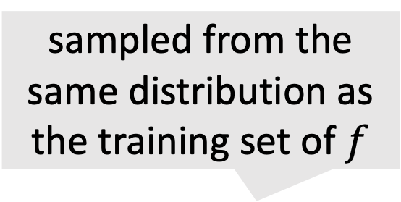
LIRA: Likelihood Ratio Attack
Carlini et al., “Membership Inference Attacks From First Principles”, IEEE S&P ‘22
sampled from the same distribution as the training set of $f$
Query model loss $l=f(x)$
Train $N$ “shadow models” $g_{out}^{i}←Train(𝒟)$,${ g}_{in}^{i}←Train(𝒟∪x)$
Compute confidences $Zout=\{{ g}_{out}^{i}\left(x\right) \}_{i}^{}$, $Zin=\{{ g}_{in}^{i}\left(x\right){ \}}_{i}^{}$
Model $Zout$and $Zin$ as Gaussians
Output likelihood ratio: $Λ=\frac{\operatorname{Pr}\left[l \right| x is a member]}{\operatorname{Pr}\left[l \right| x is not a member]}$

Slide 24
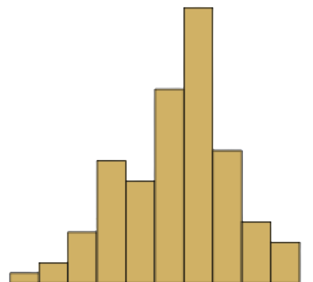
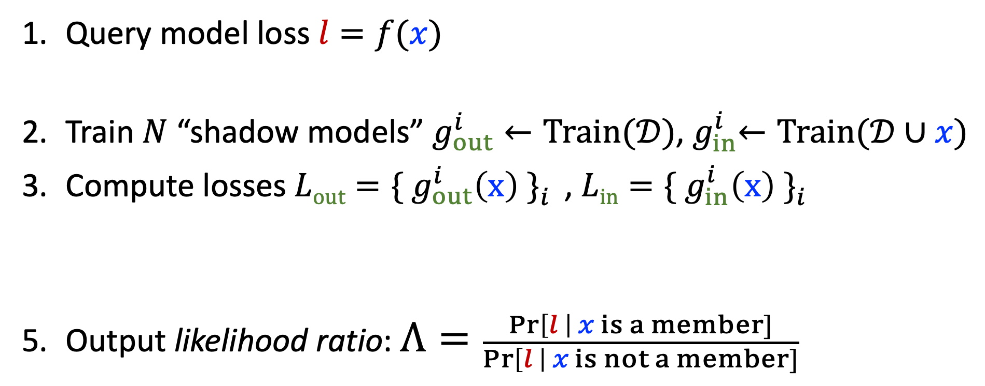
LIRA: Likelihood Ratio Attack
Carlini et al., “Membership Inference Attacks From First Principles”, IEEE S&P ‘22
Query model loss $l=f(x)$
Train $N$ “shadow models” $g_{out}^{i}←Train(𝒟)$,${ g}_{in}^{i}←Train(𝒟∪x)$
Compute losses $Lout=\{{ g}_{out}^{i}\left(x\right) \}_{i}^{}$, $Lin=\{{ g}_{in}^{i}\left(x\right){ \}}_{i}^{}$
Model $Zout$and $Zin$ as Gaussians
Output likelihood ratio: $Λ=\frac{\operatorname{Pr}\left[l \right| x is a member]}{\operatorname{Pr}\left[l \right| x is not a member]}$

Slide 25
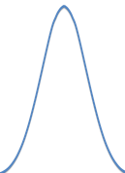
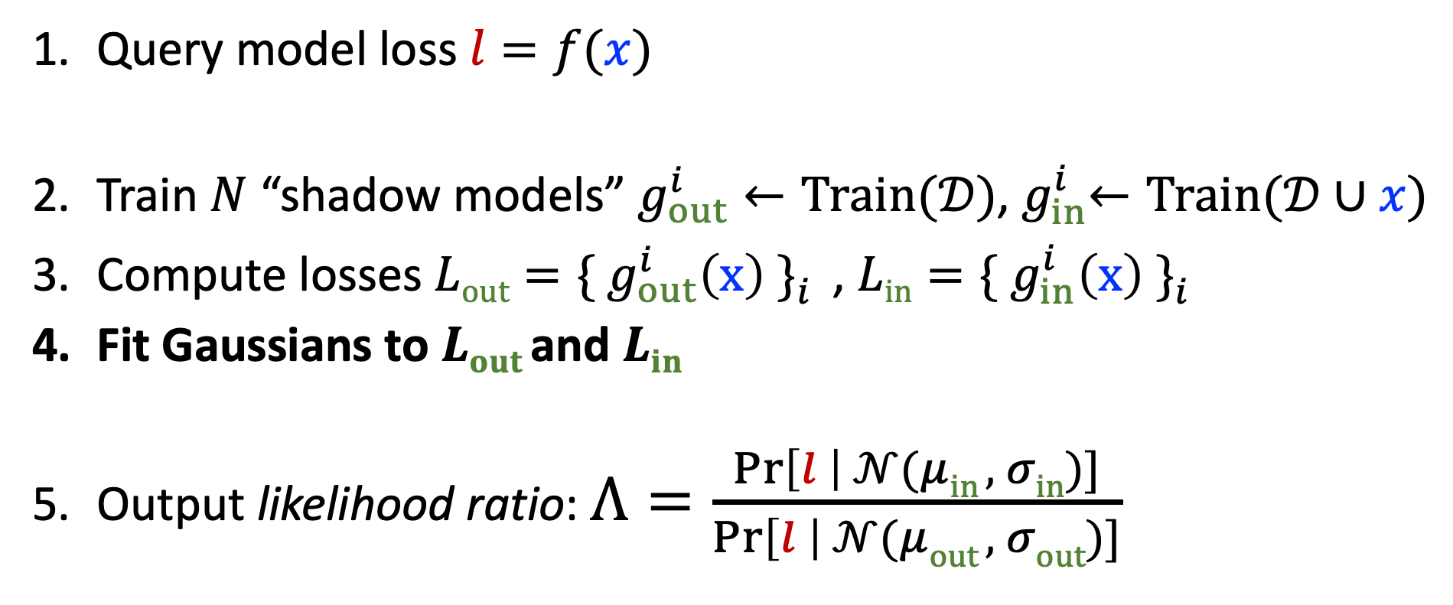
LIRA: Likelihood Ratio Attack
Carlini et al., “Membership Inference Attacks From First Principles”, IEEE S&P ‘22
Query model loss $l=f(x)$
Train $N$ “shadow models” $g_{out}^{i}←Train(𝒟)$,${ g}_{in}^{i}←Train(𝒟∪x)$
Compute losses $Lout=\{{ g}_{out}^{i}\left(x\right) \}_{i}^{}$, $Lin=\{{ g}_{in}^{i}\left(x\right){ \}}_{i}^{}$
Fit Gaussians to $Lout$and $Lin$
Output likelihood ratio: $Λ=\frac{\operatorname{Pr}\left[l \right| 𝒩(μin , σin)]}{\operatorname{Pr}\left[l \right| 𝒩(μout , σout)]}$

Slide 26
Results (CIFAR-10)
>10x better in the worst case
(thanks to Gaussian fitting + numeric stability + multiple queries + ...)
slightly better on average

Slide 27



Membership inference only works on outliers.
(“worst-case” examples)

Slide 28

Next: a new attack that also works on inliers!
(“average-case” examples)

Slide 29
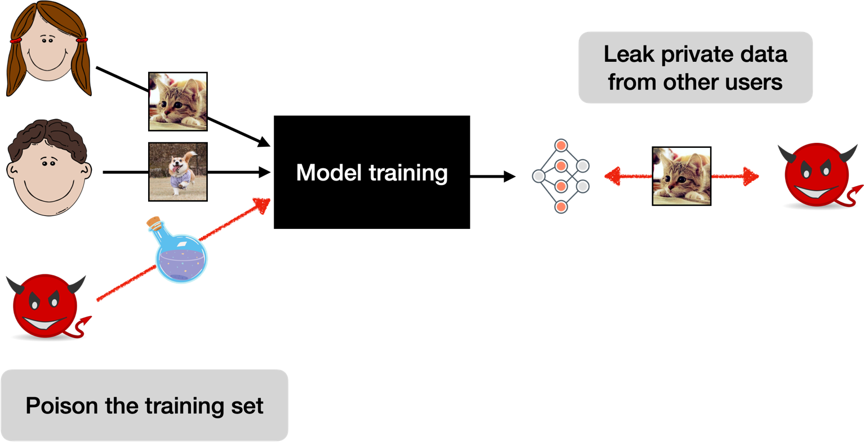
A new threat model: privacy poisoning
T et al. “Truth Serum: Poisoning Machine Learning Models to Reveal Their Secrets”

Slide 30






Poisoning can transform inliers into outliers.
“cat”
loss
Notes:
next

Slide 31
Poisoning can transform inliers into outliers.
“cat”
loss
Notes:
next

Slide 32
Poisoning can transform inliers into outliers.
“cat”
loss
Notes:
back

Slide 33

Poisoning can transform inliers into outliers.
“cat”
“cat”
“dog”
poison
loss
loss
Notes:
next

Slide 34
Poisoning can transform inliers into outliers.
“cat”
“cat”
“dog”
poison
loss
loss
Notes:
next

Slide 35
Poisoning can transform inliers into outliers.
“cat”
“cat”
“dog”
poison
loss
loss
Notes:
back

Slide 36
Poisoned models leak more than membership.
(a) Membership Inference
(b) Attribute Inference
(c) Data Extraction
with targeted poisoning of <0.1% of the training set
Notes:
much cheaper. doesn’t need shadow models

Slide 37
How to defend against membership leakage?
defense
loss
loss

Slide 38
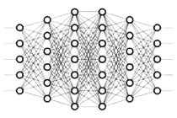
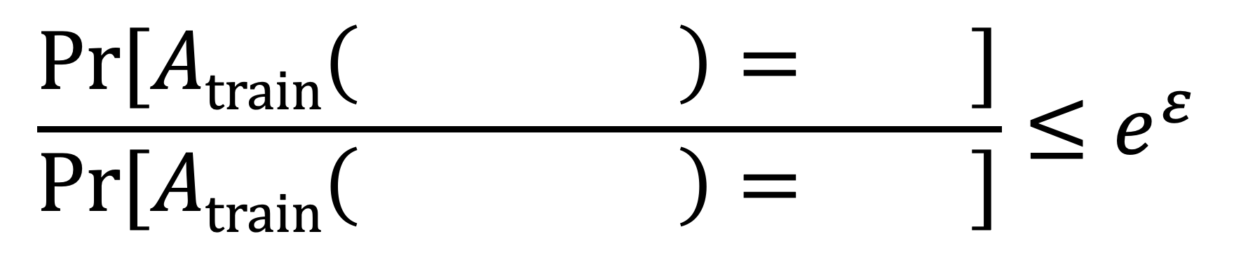
Differential privacy prevents all our attacks.
DP guarantee holds for any pair of datasets that differ in any single element
$$\frac{\text{Pr}[Atrain\left( \right)= ]}{\text{Pr}[Atrain\left( \right)= ]}≤e^{ε}$$

Slide 39
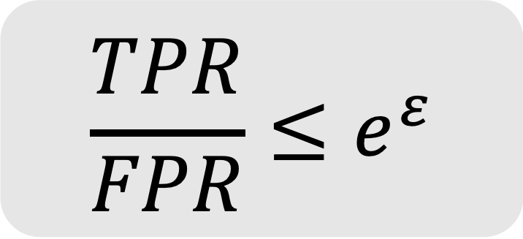
DP bounds the success of any MI attack.
[Kairouz et al. ‘15]
$$\frac{TPR}{FPR}≤e^{ε}$$

Slide 40
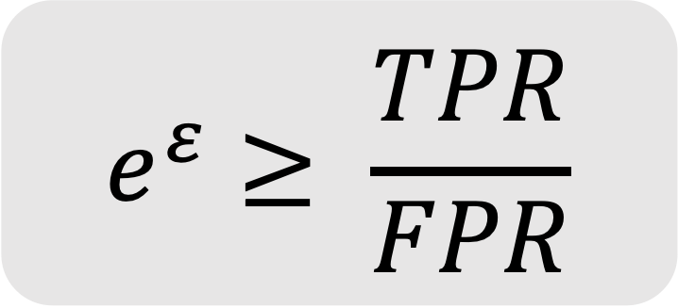
Corollary: MI attacks can be used to audit privacy.
[Jagielsky et al. ‘20, Nasr et al. ’21]
$$e^{ε}≥ \frac{TPR}{FPR}$$

Slide 41
Example: DP with 98% accuracy on MNIST
Proof-of-concept
[Shokri & Shmatikov]
Better architectures
[Papernot et al.]
Tighter analysis
[Abadi et al.]
Better features
[T & Boneh]

Slide 42
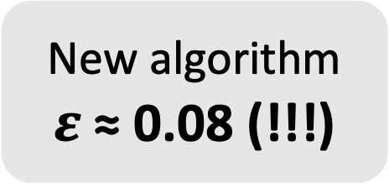
Example: DP with 98% accuracy on MNIST
New algorithm
$ε$ ≈ 0.08 (!!!)

Slide 43
Example: DP with 98% accuracy on MNIST
Is this claim correct?

Slide 44
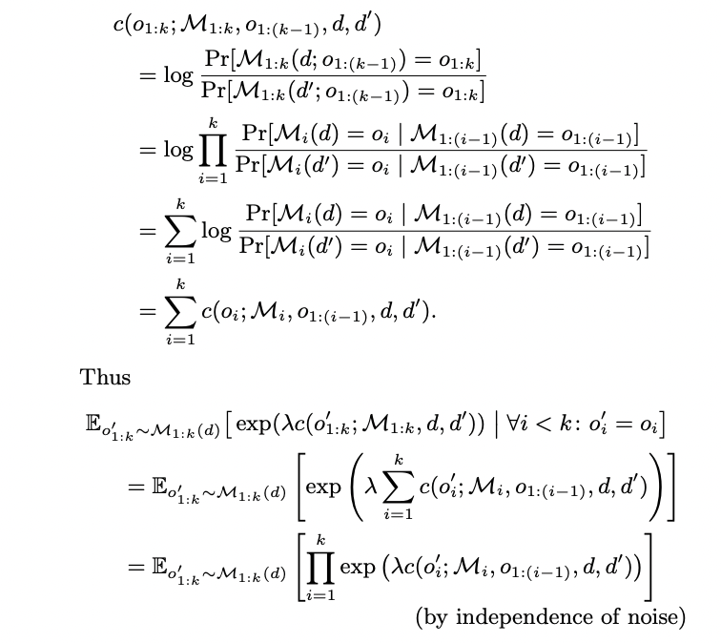
How to verify a privacy claim?
Check the proof

Slide 45
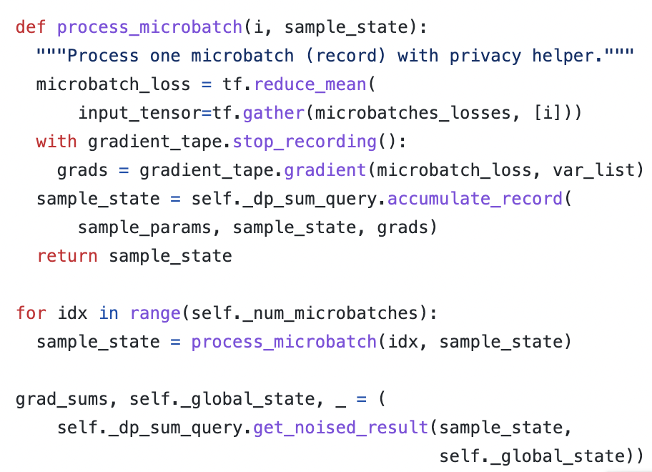
How to verify a privacy claim?
Check the proof
Check the code

Slide 46
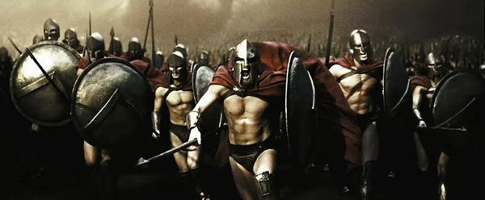
How to verify a privacy claim?
Check the proof
Check the code
Launch a MI attack!

Slide 47


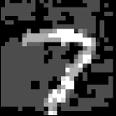

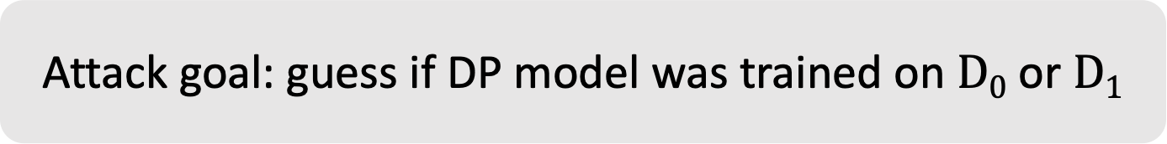
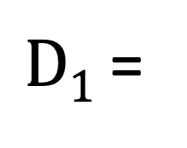
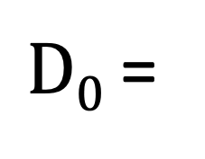
DP bounds should hold for any data point.
$D0$ =
worst-case
out-of-distribution data point
...
$D1$ =
...
Attack goal: guess if DP model was trained on $D0$ or $D1$

Slide 48

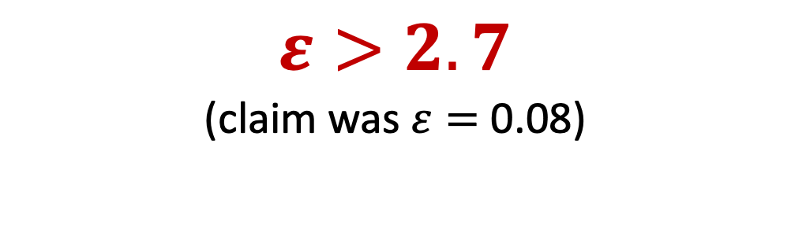
Run the attack 100’000 times...
T et al. “Debugging Differential Privacy: A Case Study for Privacy Auditing”
$$Train on D0$$
$$Train on D1$$
$$ε>2.7$$
(claim was$ε=$ 0.08)
Model loss on

Slide 49
Conclusion
Average-case leakage is a poor metric for privacy!
We must reevaluate what we “know” about MI attacks & defenses
Poisoning can turn average-case inputs into worst-case inputs
Worst-case MI attacks are a useful tool for catching DP bugs
https://floriantramer.com
florian.tramer@inf.ethz.ch

