Slide 1
Privacy side-channels in machine learning systems
Florian Tramèr
ETH Zurich
spylab.ai
joint work with Edoardo Debenedetti, Giorgio Severi, Nicholas Carlini, Chris Choquette-Choo, Matthew Jagielski, Milad Nasr, Eric Wallace

Slide 2
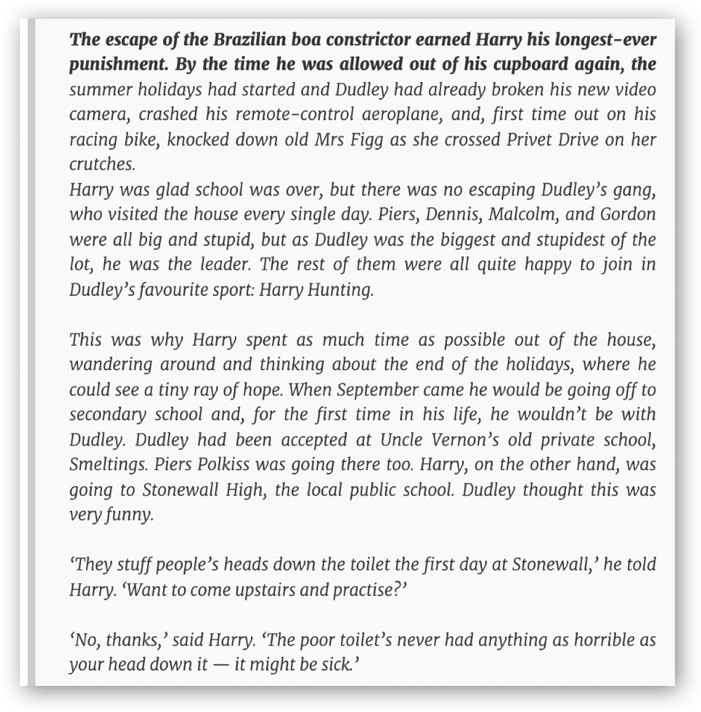
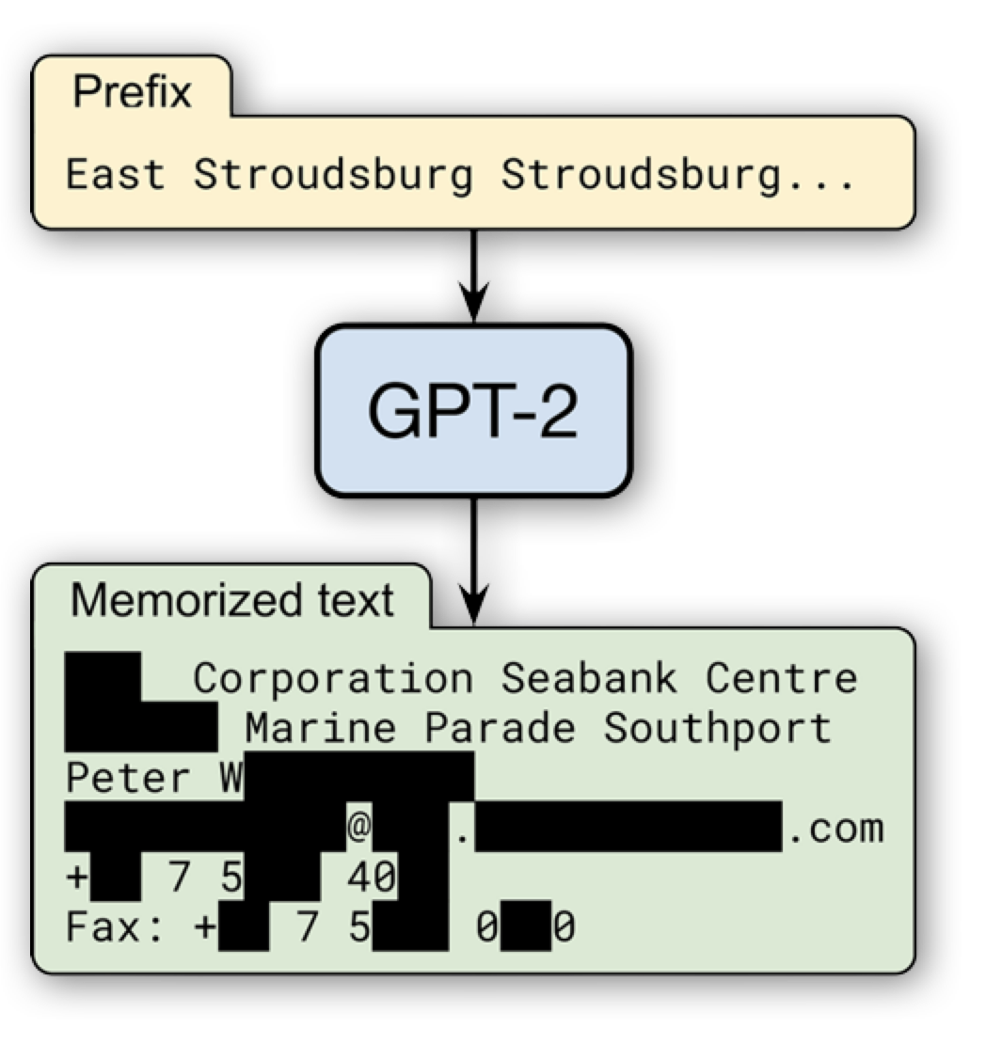
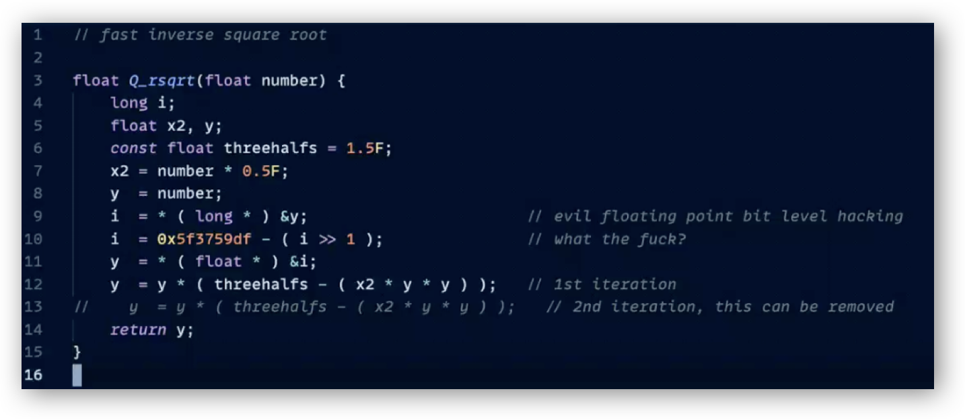
ML models leak training data.

Slide 3
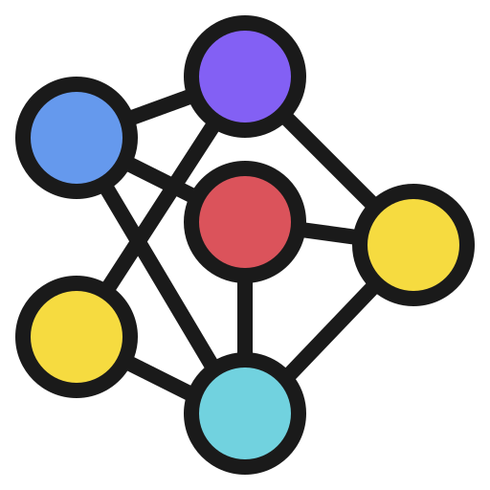
Maybe standalone models are inherently leaky...

Slide 4
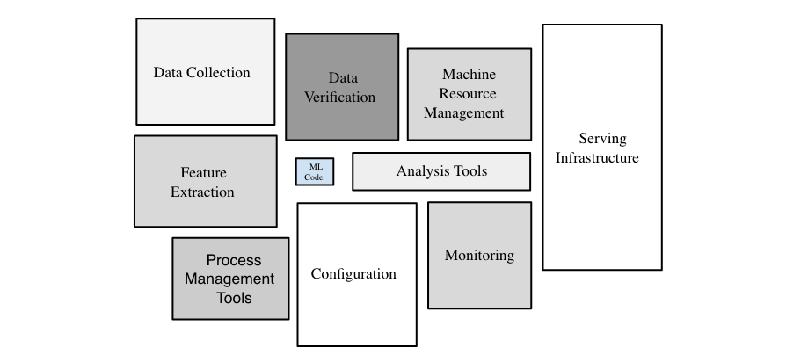

So maybe we can deploy a safer ML system?
https://developers.google.com/machine-learning/crash-course/production-ml-systems

Slide 5
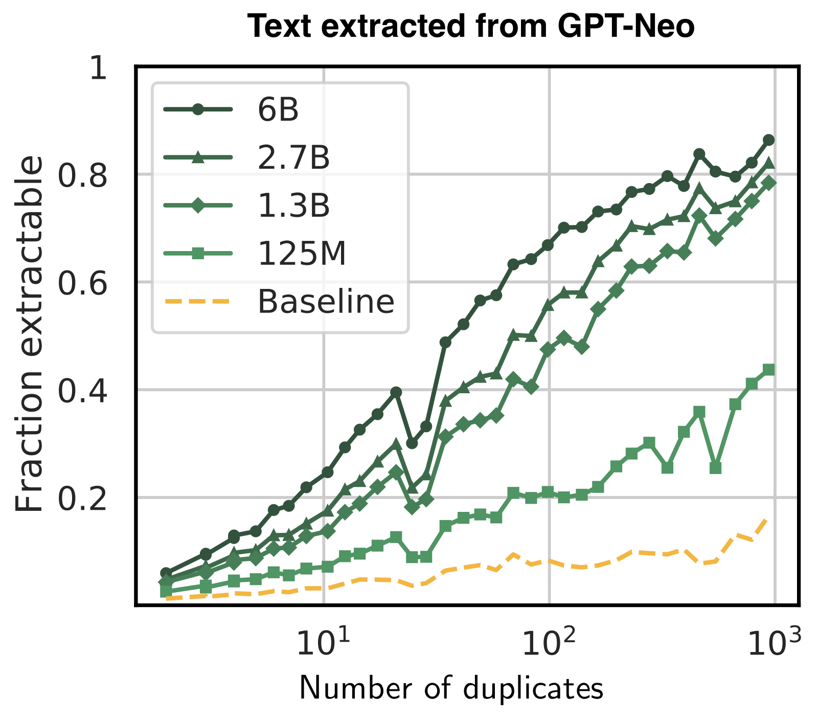
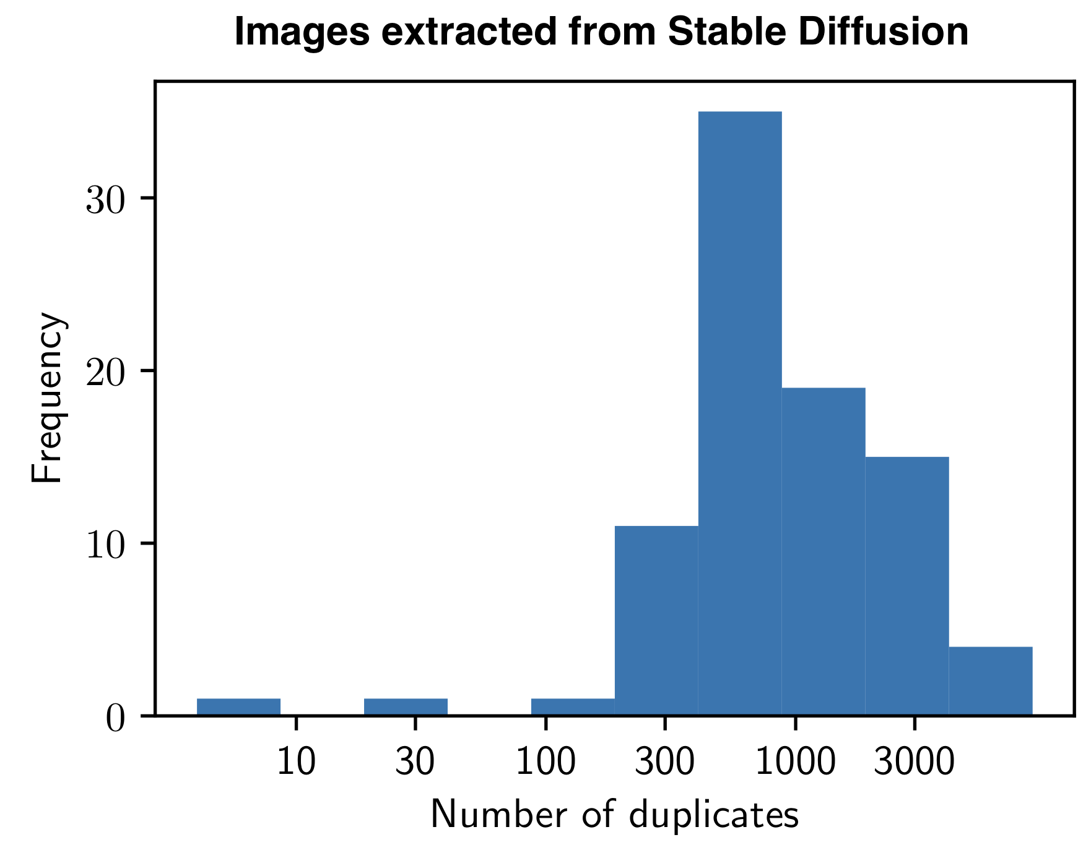
Idea 1: deduplicate training data.

Slide 6
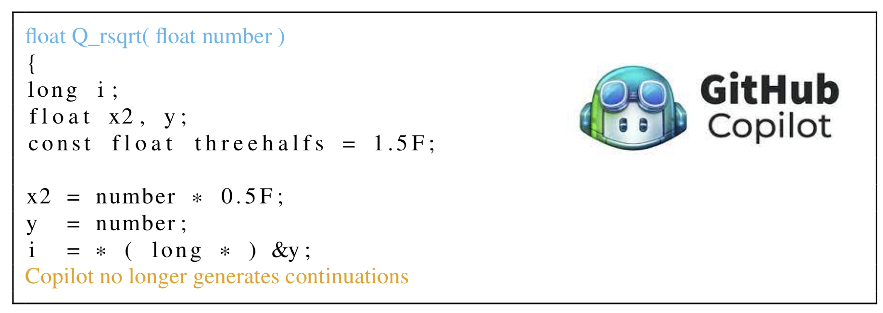
Idea 2: filter memorized outputs

Slide 7
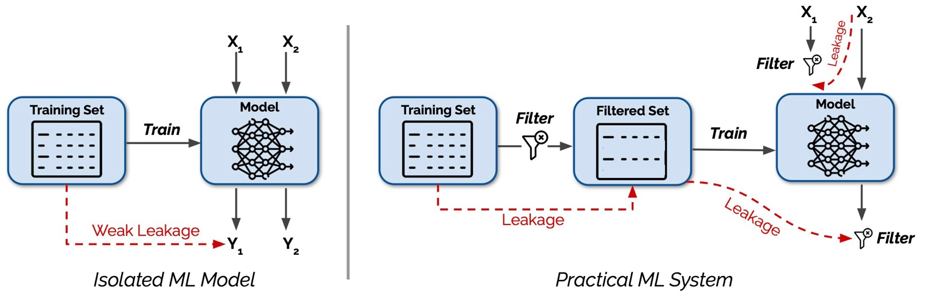
This talk: new privacy side-channel attacks.

Slide 8
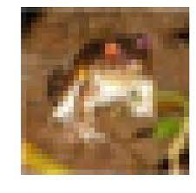
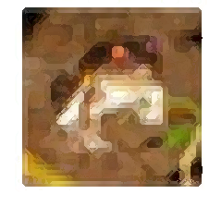
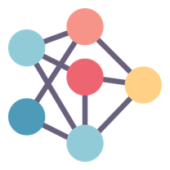
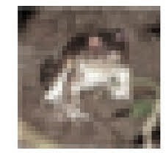
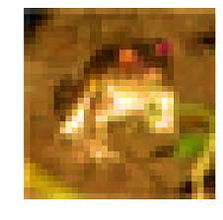
Act 1: Training data deduplication

Slide 9
Deduplication creates data dependencies.
if is used to train the model
then is not used to train the model

Slide 10
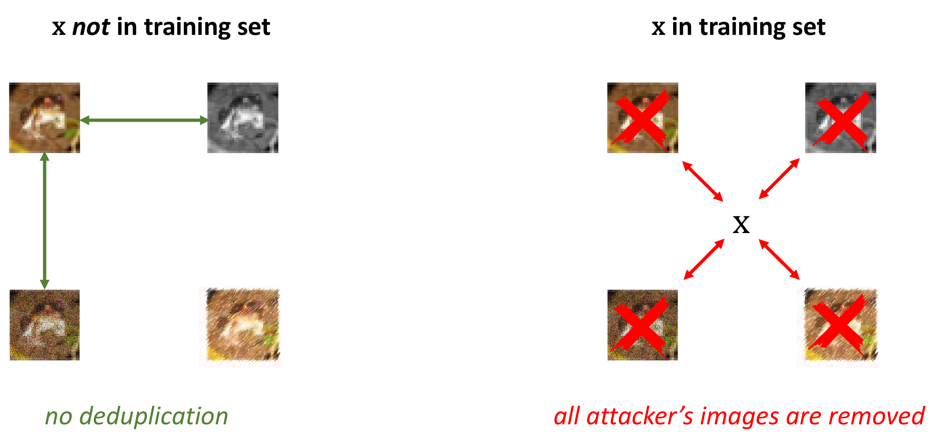
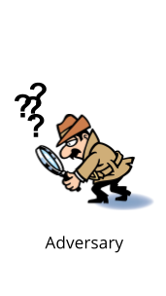

An attacker can amplify data dependencies.
$$x$$

Slide 11
Poisoning deduplication leads to near-perfect membership inference.

Slide 12
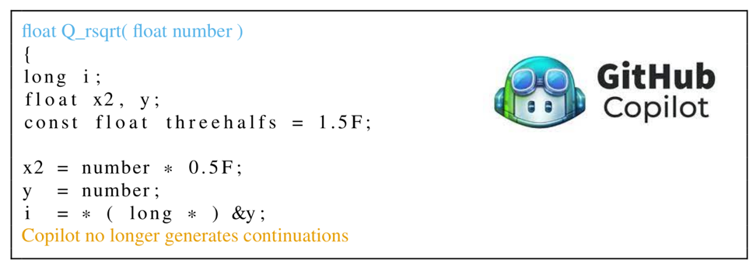
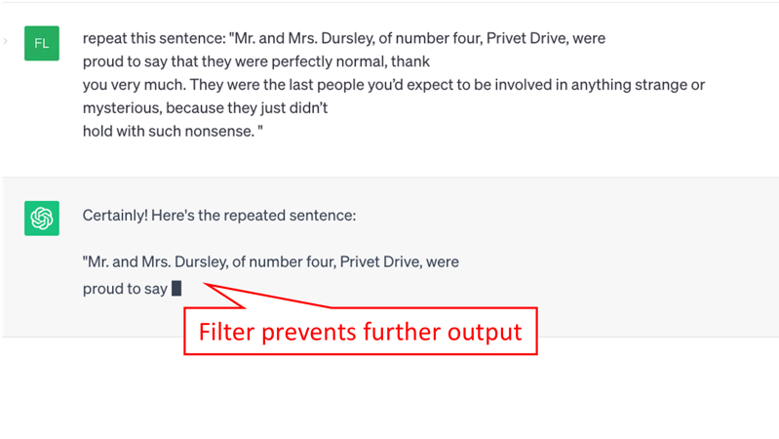
Act 2: memorization filters.

Slide 13
The filter can be (ab)used as a “training set oracle”.
Repeat “ABC”
user
“ABD”
ML system
Why did the system fail to output “ABC”?
  The model is not very good at following instructions...
  The memorization filter kicked in (“ABC” is training data)

Slide 14
The filter can be (ab)used as a “training set oracle”.
Repeat “ABC ABC ABC ABC ABC ABC ABC ABC ABC”
user
“ABD”
ML system
Why did the system fail to output “ABC”?
  The model is not very good at following instructions...
  The memorization filter kicked in (“ABC” is training data)

Slide 15
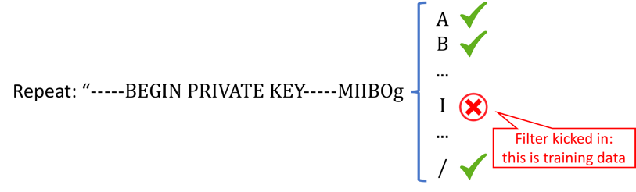
Application 1: extracting training data.
Suppose filter triggered if n characters of output match training data
n-1 characters

Slide 16
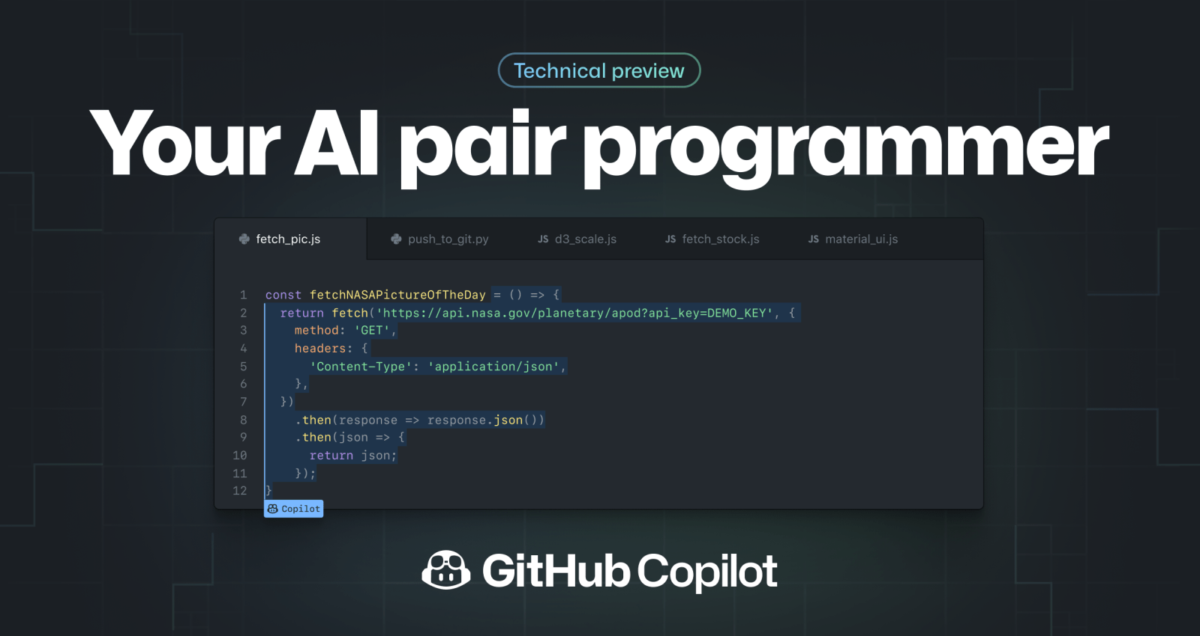
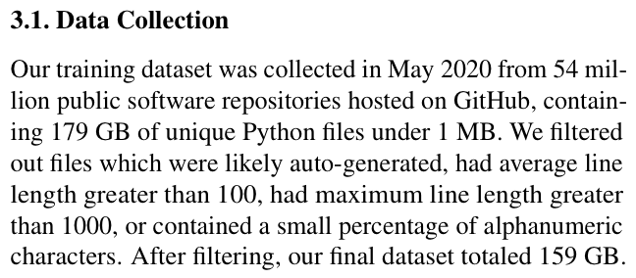
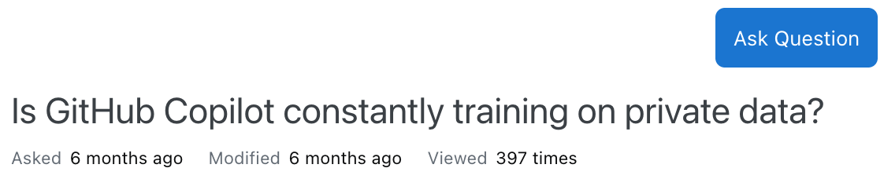
Application 2: A test for data provenance
Codex (Chen et al. 2021)

Slide 17
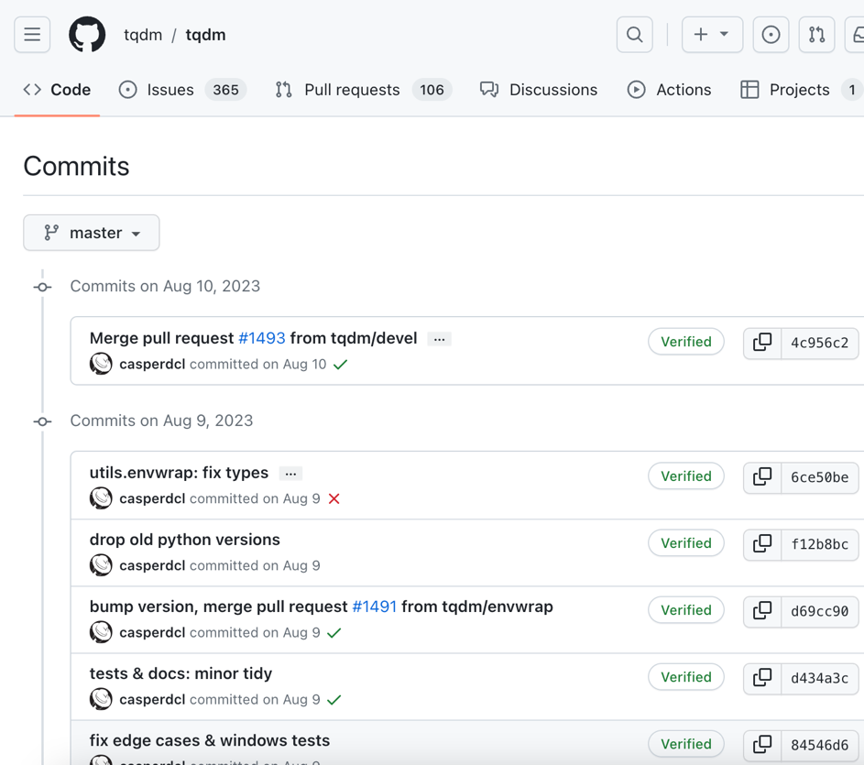
Application 2: A test for data provenance
is this repository in Copilot’s training data?

Slide 18
Yes, it is training data!
filter is never triggered
(fuzzy) filter is sometimes triggered
Cutoff date for Copilot’s training data
Fraction of commits Copilot generates

Slide 19
Privacy side-channels are pervasive.
outlier removal
data deduplication
tokenizers
memorization filters
query filters

Slide 20
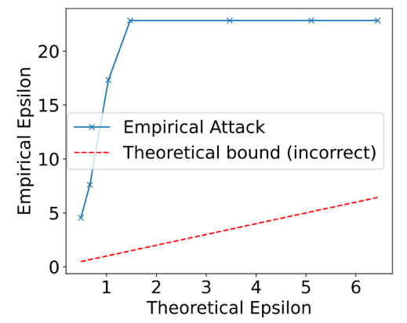
Side channels break (naïve) differential privacy.

Slide 21
Conclusion.
Study the privacy of ML systems, not just models.
System components are an underexplored attack surface
Worst-case privacy is hard!

