Slide 1
Adversarial Training and Robustness for Multiple Perturbations
Florian Tramèr & Dan Boneh
NeurIPS 2019
Poster #87

Slide 2
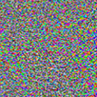
Adversarial examples
88% Tabby Cat
99% Guacamole
    ML models learn very different features than humans
    This is a safety concern for deployed ML models
    Classification in adversarial settings is hard
Szegedy et al., 2014
Goodfellow et al., 2015
Athalye, 2017
Adversarial Training and Robustness for Multiple Perturbations

Slide 3



Adversarial training
Choose a set of perturbations: e.g., noise of small ℓ∞ norm:
For each example , find an adversarial example:
Train the model on
Repeat until convergence
Szegedy et al., 2014
Madry et al., 2017
Adversarial Training and Robustness for Multiple Perturbations

Slide 4

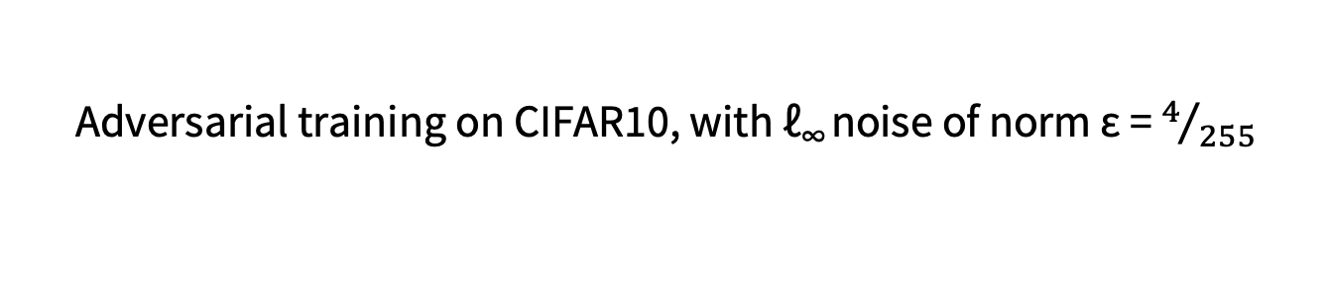
How well does it work?
Adversarial training on CIFAR10, with ℓ∞ noise of norm ε = $4/{255}$
no attack
ℓ∞ attack
ℓ₁ attack
Rotation attack
Engstrom et al., 2017
Sharma & Chen, 2018
Adversarial Training and Robustness for Multiple Perturbations

Slide 5



How to prevent other adversarial examples?
S₁ = $\left\{δ: {\left\|δ\right\|}_{∞}≤ ε_{∞}\right\}$
S₂ = $\left\{δ: {\left\|δ\right\|}_{1}≤ ε_{1}\right\}$
S₃ = $\left\{δ:«\text{small} \text{rotation}»\right\}$
Adversary can choose a perturbation type for each input
S = S₁ U S₂ U S₃
Pick worst-case adversarial example from S
Train the model on that example
Adversarial Training and Robustness for Multiple Perturbations

Slide 6
Does this work?
similar results for ℓ∞ and rotations
Train/eval on ℓ∞: 71%
Train/eval on ℓ₁: 66%
Train/eval on both: 61%
-5%
CIFAR10:
We prove: this robustness tradeoff is inherent in some classification tasks.
Train/eval on one of {ℓ∞, ℓ₁, ℓ₂}: ≥72%
Train/eval on all: 52%
-20%
MNIST:
gradient
masking
Adversarial Training and Robustness for Multiple Perturbations

Slide 7
What if we combine perturbations?
natural image
rotation
ℓ∞ noise
½ rotation + ½ ℓ∞ noise
-10%
natural accuracy
rotation
ℓ∞
both attacks
mixed (affine) attack
Adversarial Training and Robustness for Multiple Perturbations

Slide 8
Conclusion
Adversarial training for multiple perturbation sets works, but...
Significant loss in robustness
Weak robustness to affine combinations of perturbations
Open questions:
Preventing gradient masking on MNIST to obtain high ℓ_{1,} ℓ₂ and ℓ ∞ robustness
Better scaling of adversarial training to multiple perturbations
How do we enumerate all the perturbation types that we care about?
Poster #87
https://arxiv.org/abs/1904.13000
Adversarial Training and Robustness for Multiple Perturbations

