Slide 1
Poisoning web-scale training datasets is practical
Florian Tramèr
joint work with Nicholas Carlini, Matthew Jagielski, Chris Choquette-Choo,
Daniel Paleka, Will Pearce, Hyrum Anderson, Andreas Terzis, Kurt Thomas

Slide 2
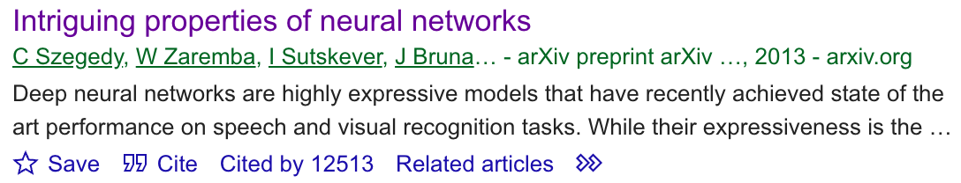
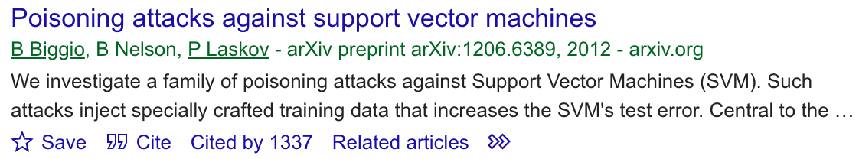
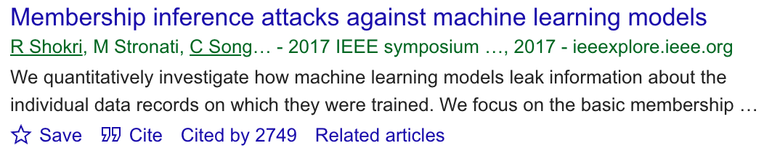
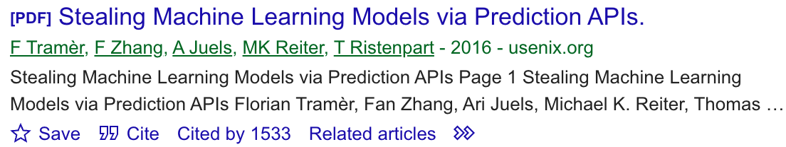
We like writing papers on attacking ML…

Slide 3
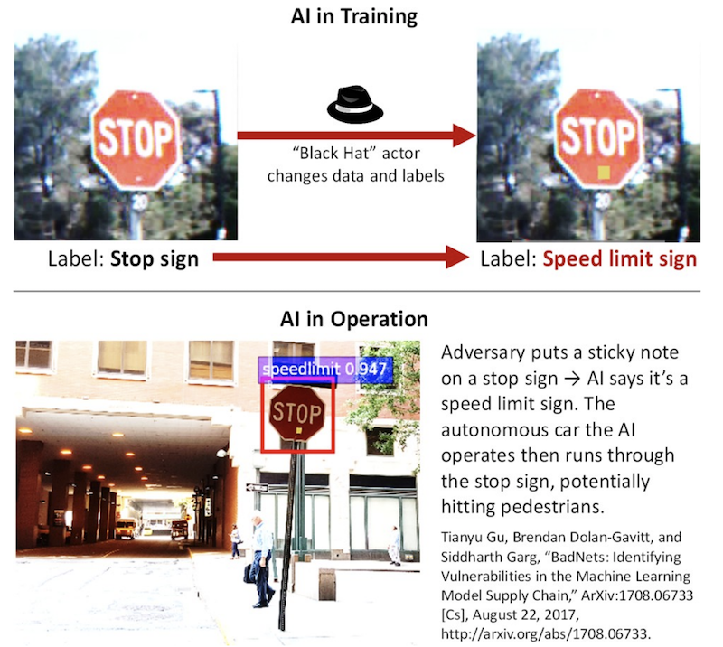


So where are the ”real” attacks?
Research: attacks are feasible in principle.
Reality: how would you mount an actual attack?

Slide 4
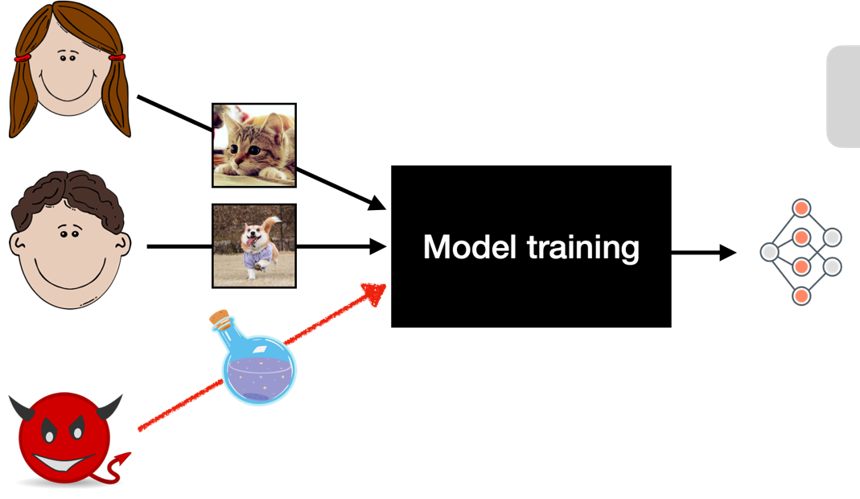

This talk: poisoning attacks.

Slide 5

Thought experiment: poisoning ImageNet.
Collected ~14 million images around 2007-2009
Scraped from search engine results and validated by human annotators
A 1M subset (“the ImageNet dataset”) has been used to train 1000+ models

Slide 6

Thought experiment: poisoning ImageNet.
In principle, ImageNet could have been poisoned
(if you had foreseen its creation…)
Now it would require a time machine…

Slide 7
We show how to poison modern training datasets without a time machine.

Slide 8
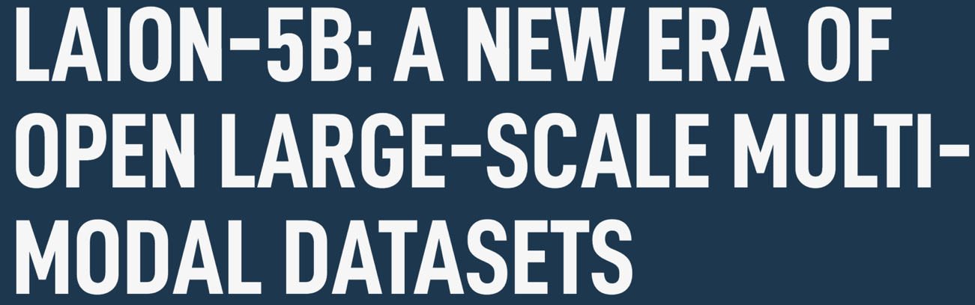


We show how to poison modern training datasets without a time machine.
2009: 1M labeled images
2022: 5B images with captions

Slide 9

How do you distribute a dataset of 5B images?

Slide 10
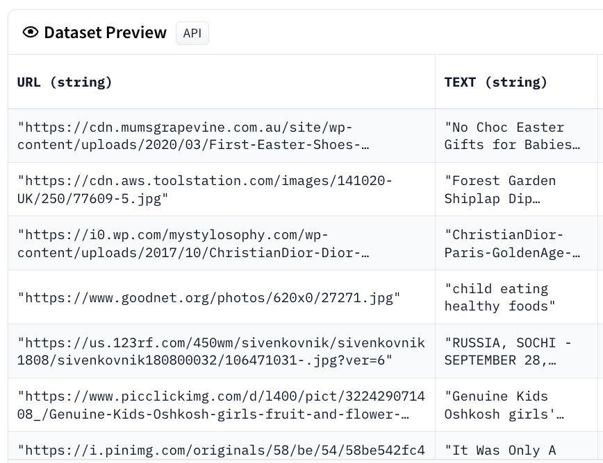
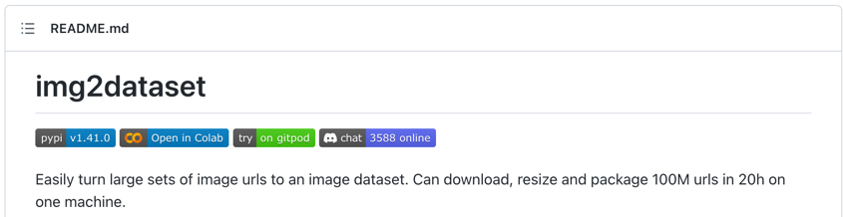
How do you distribute a dataset of 5B images?

Slide 11







We trust these domains to provide training data!

Slide 12

Who owns these domains?
News websites
Wikimedia
Blogs
Some random mom-and-pop shop…
Nobody (the domain expired)

Slide 13

Who owns these domains?
News websites
Wikimedia
Blogs
Some random mom-and-pop shop…
Nobody (the domain expired)
Whoever buys up the expired domains

Slide 14


Who owns these domains?
News websites
Wikimedia
Blogs
Some random mom-and-pop shop…
Nobody (the domain expired)
Whoever buys up the expired domains
Nicholas Carlini & Will Pearce

Slide 15


We now own 0.01% of LAION.
https://www.mycutecat.com/cat.png

Slide 16


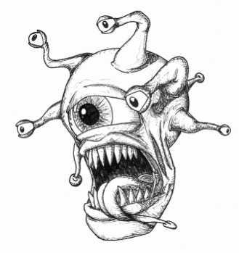
We now own 0.01% of LAION.
https://www.mycutecat.com/cat.png

Slide 17
We now own 0.01% of…
LAION 5B
LAION 400M
COYO-700M
Conceptual Captions 12M
Conceptual Captions 3M
VGG Face, FaceScrub, PubFig

Slide 18
Anyone could own a fraction of these datasets.

Slide 19
What can you do with 0.01% of a dataset?
see prior work! [Carlini & Terzis’22]

Slide 20



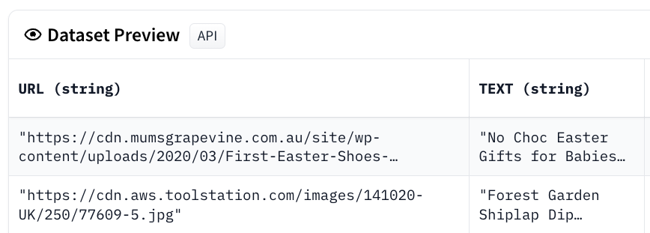

What can you do with 0.01% of a dataset?
see prior work! [Carlini & Terzis’22]
Example: backdoor attack on CLIP
“a cute cat”
“a cute cat”

Slide 21


What can you do with 0.01% of a dataset?
see prior work! [Carlini & Terzis’22]
Example: backdoor attack on CLIP
CLIP
CLIP
“A cute cat”

Slide 22
Vulnerable datasets are actively downloaded.

Slide 23
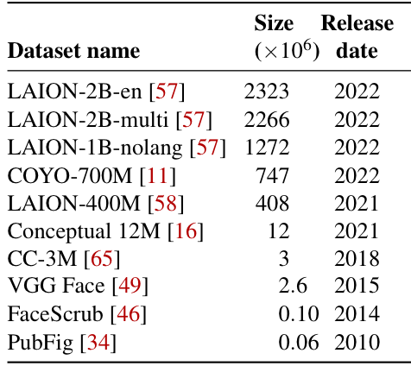
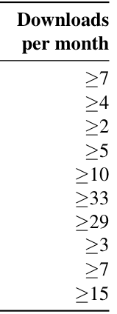
Vulnerable datasets are actively downloaded.

Slide 24


We call this attack split-view poisoning.
time
dataset
creation
dataset
download

Slide 25


What if content changes are moderated?
time
dataset
creation
dataset
download

Slide 26

Our second attack: frontrunning poisoning.
time
dataset
creation
dataset
download

Slide 27
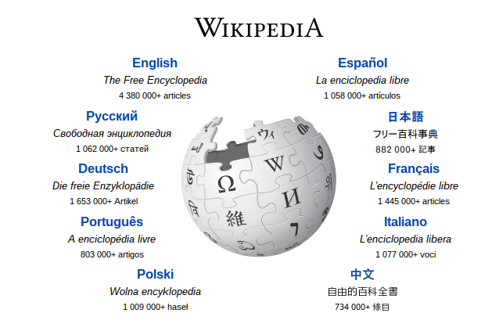
Could we poison Wikipedia?

Slide 28
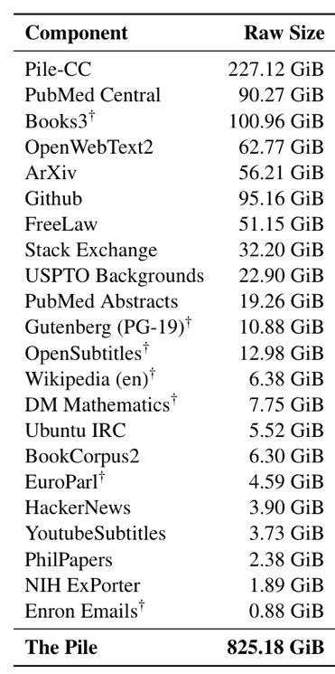
Wikipedia is used in nearly all modern LLMs.
The Pile: An 800GB Dataset of Diverse Text for Language Modeling, Gao et al. 2020

Slide 29
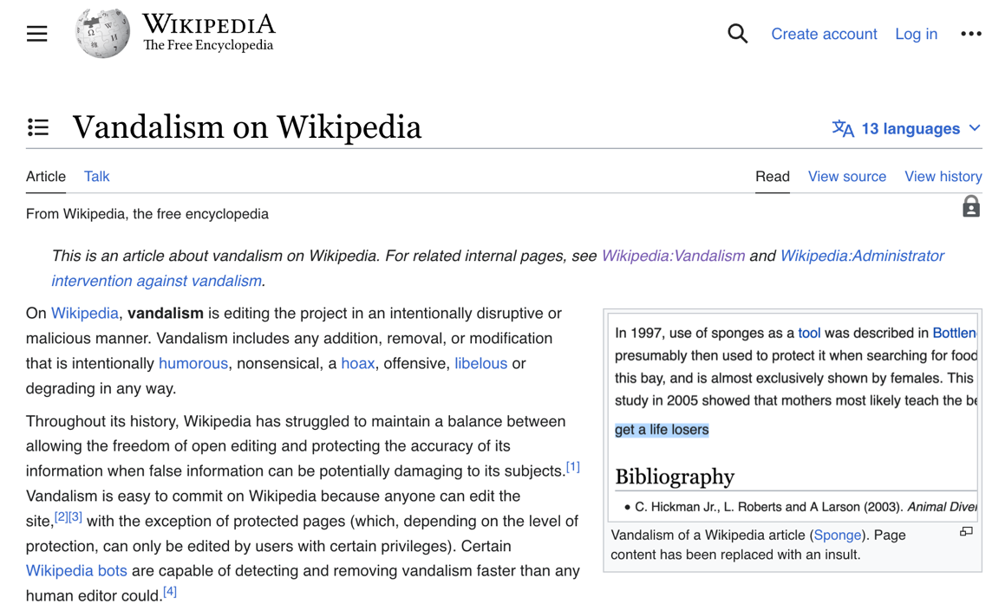
Wikipedia gets “poisoned” all the time but malicious edits are short-lived.

Slide 30
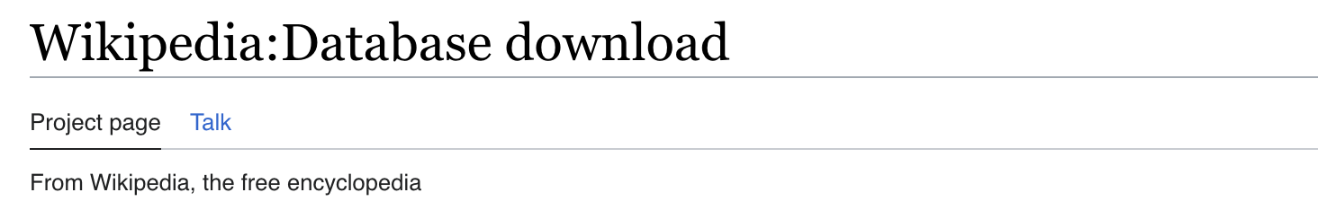
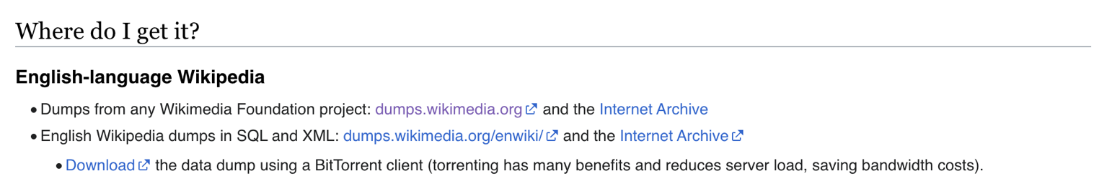
ML models are not trained on live Wikipedia!

Slide 31

A temporary edit can permanently poison a Wikipedia training set…
… if the edit happens right before the dump

Slide 32
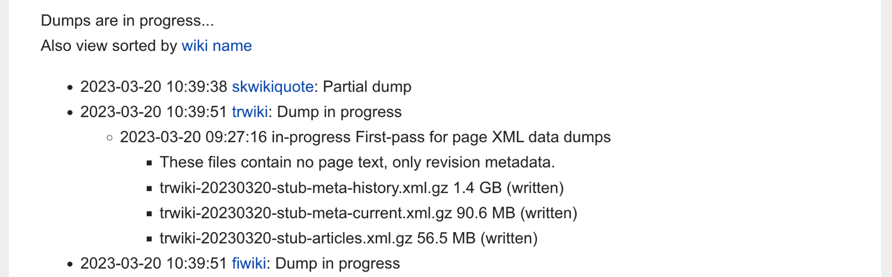

But how could we know when dumps happen?

Slide 33
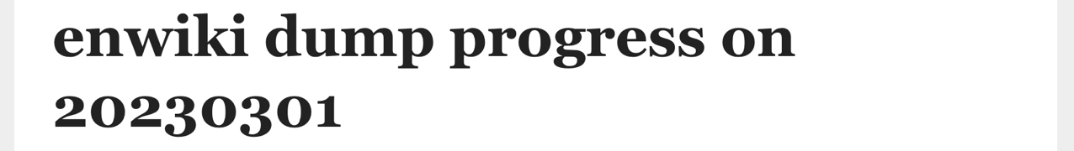
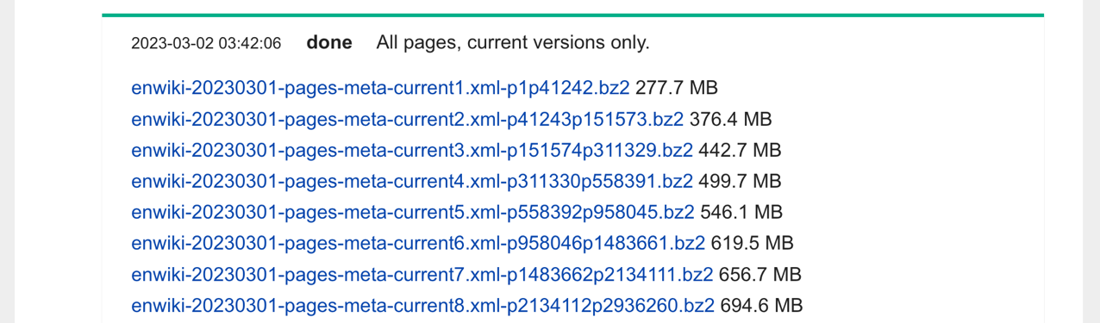


Can we predict the dump time of individual articles?
Dumping the entirety of English Wikipedia takes about 1 day!

Slide 34
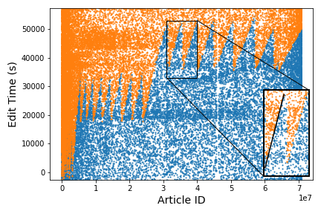
Articles are snapshot in a predictable pattern.

Slide 35
Individual snapshot times can be estimated to within a few minutes.

Slide 36
Final attack: poison each article right before its estimated snapshot time.
(Very) conservative estimate:
5% of malicious edits would persist in the dump.

Slide 37
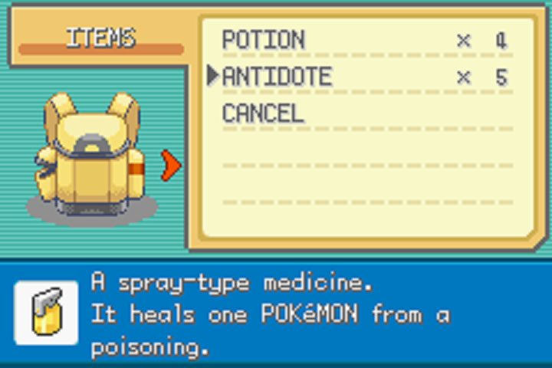
Defenses!

Slide 38
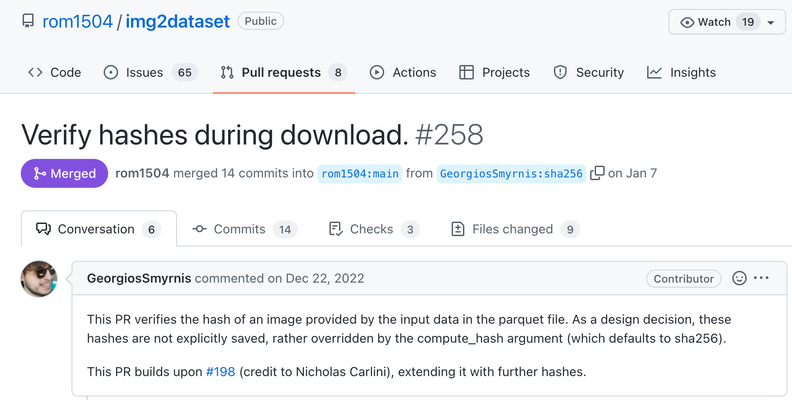
Integrity checks prevent split-view poisoning!

Slide 39


Hashes have many false-positives…
image at dataset creation
image today

Slide 40
Hashes have many false-positives…
3.3
2.9
Number of images (M)
1.1
CC-3M original
(2018)
still online
(2022)
valid hash

Slide 41
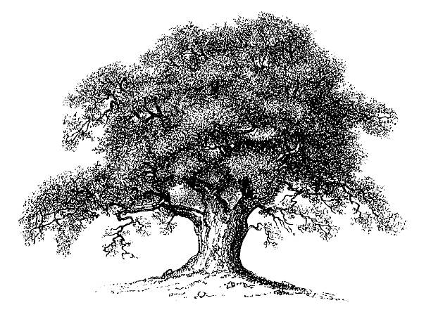

Prevent frontrunning by giving moderators more time.
Randomize snapshot times
Only snapshot edits that have stood the test-of-time

Slide 42
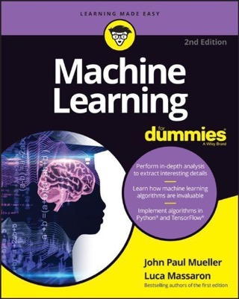
Conclusions.
Poisoning current ML training sets is practical!
There is a lot of “traditional systems security” work to do in ML!

