Slide 1
Adversarial Examples and Adversarial Training
Innovative Technology Leader program
January 22nd 2018
Florian Tramèr
Stanford

Slide 2
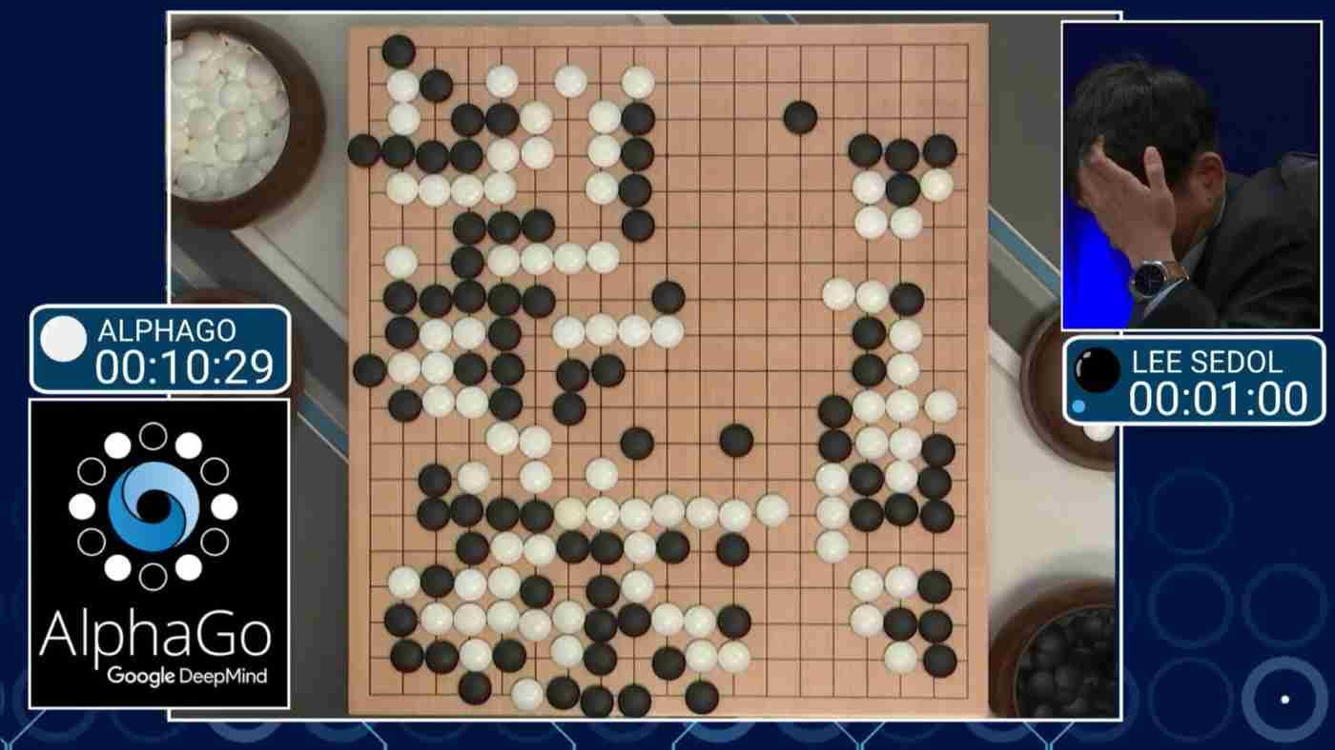
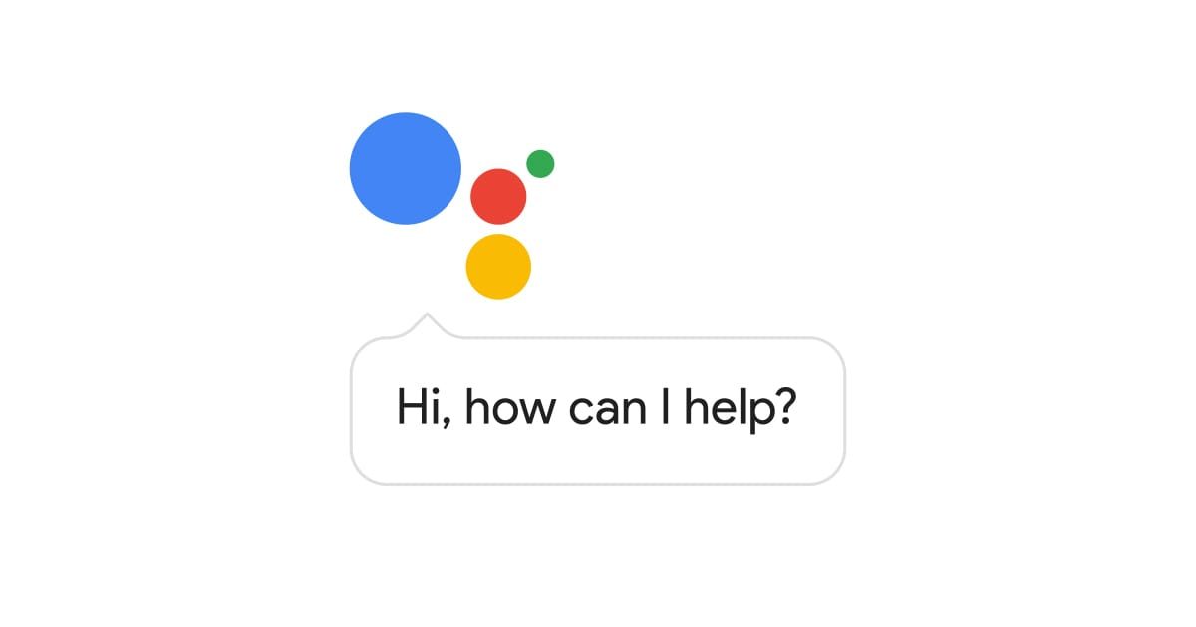
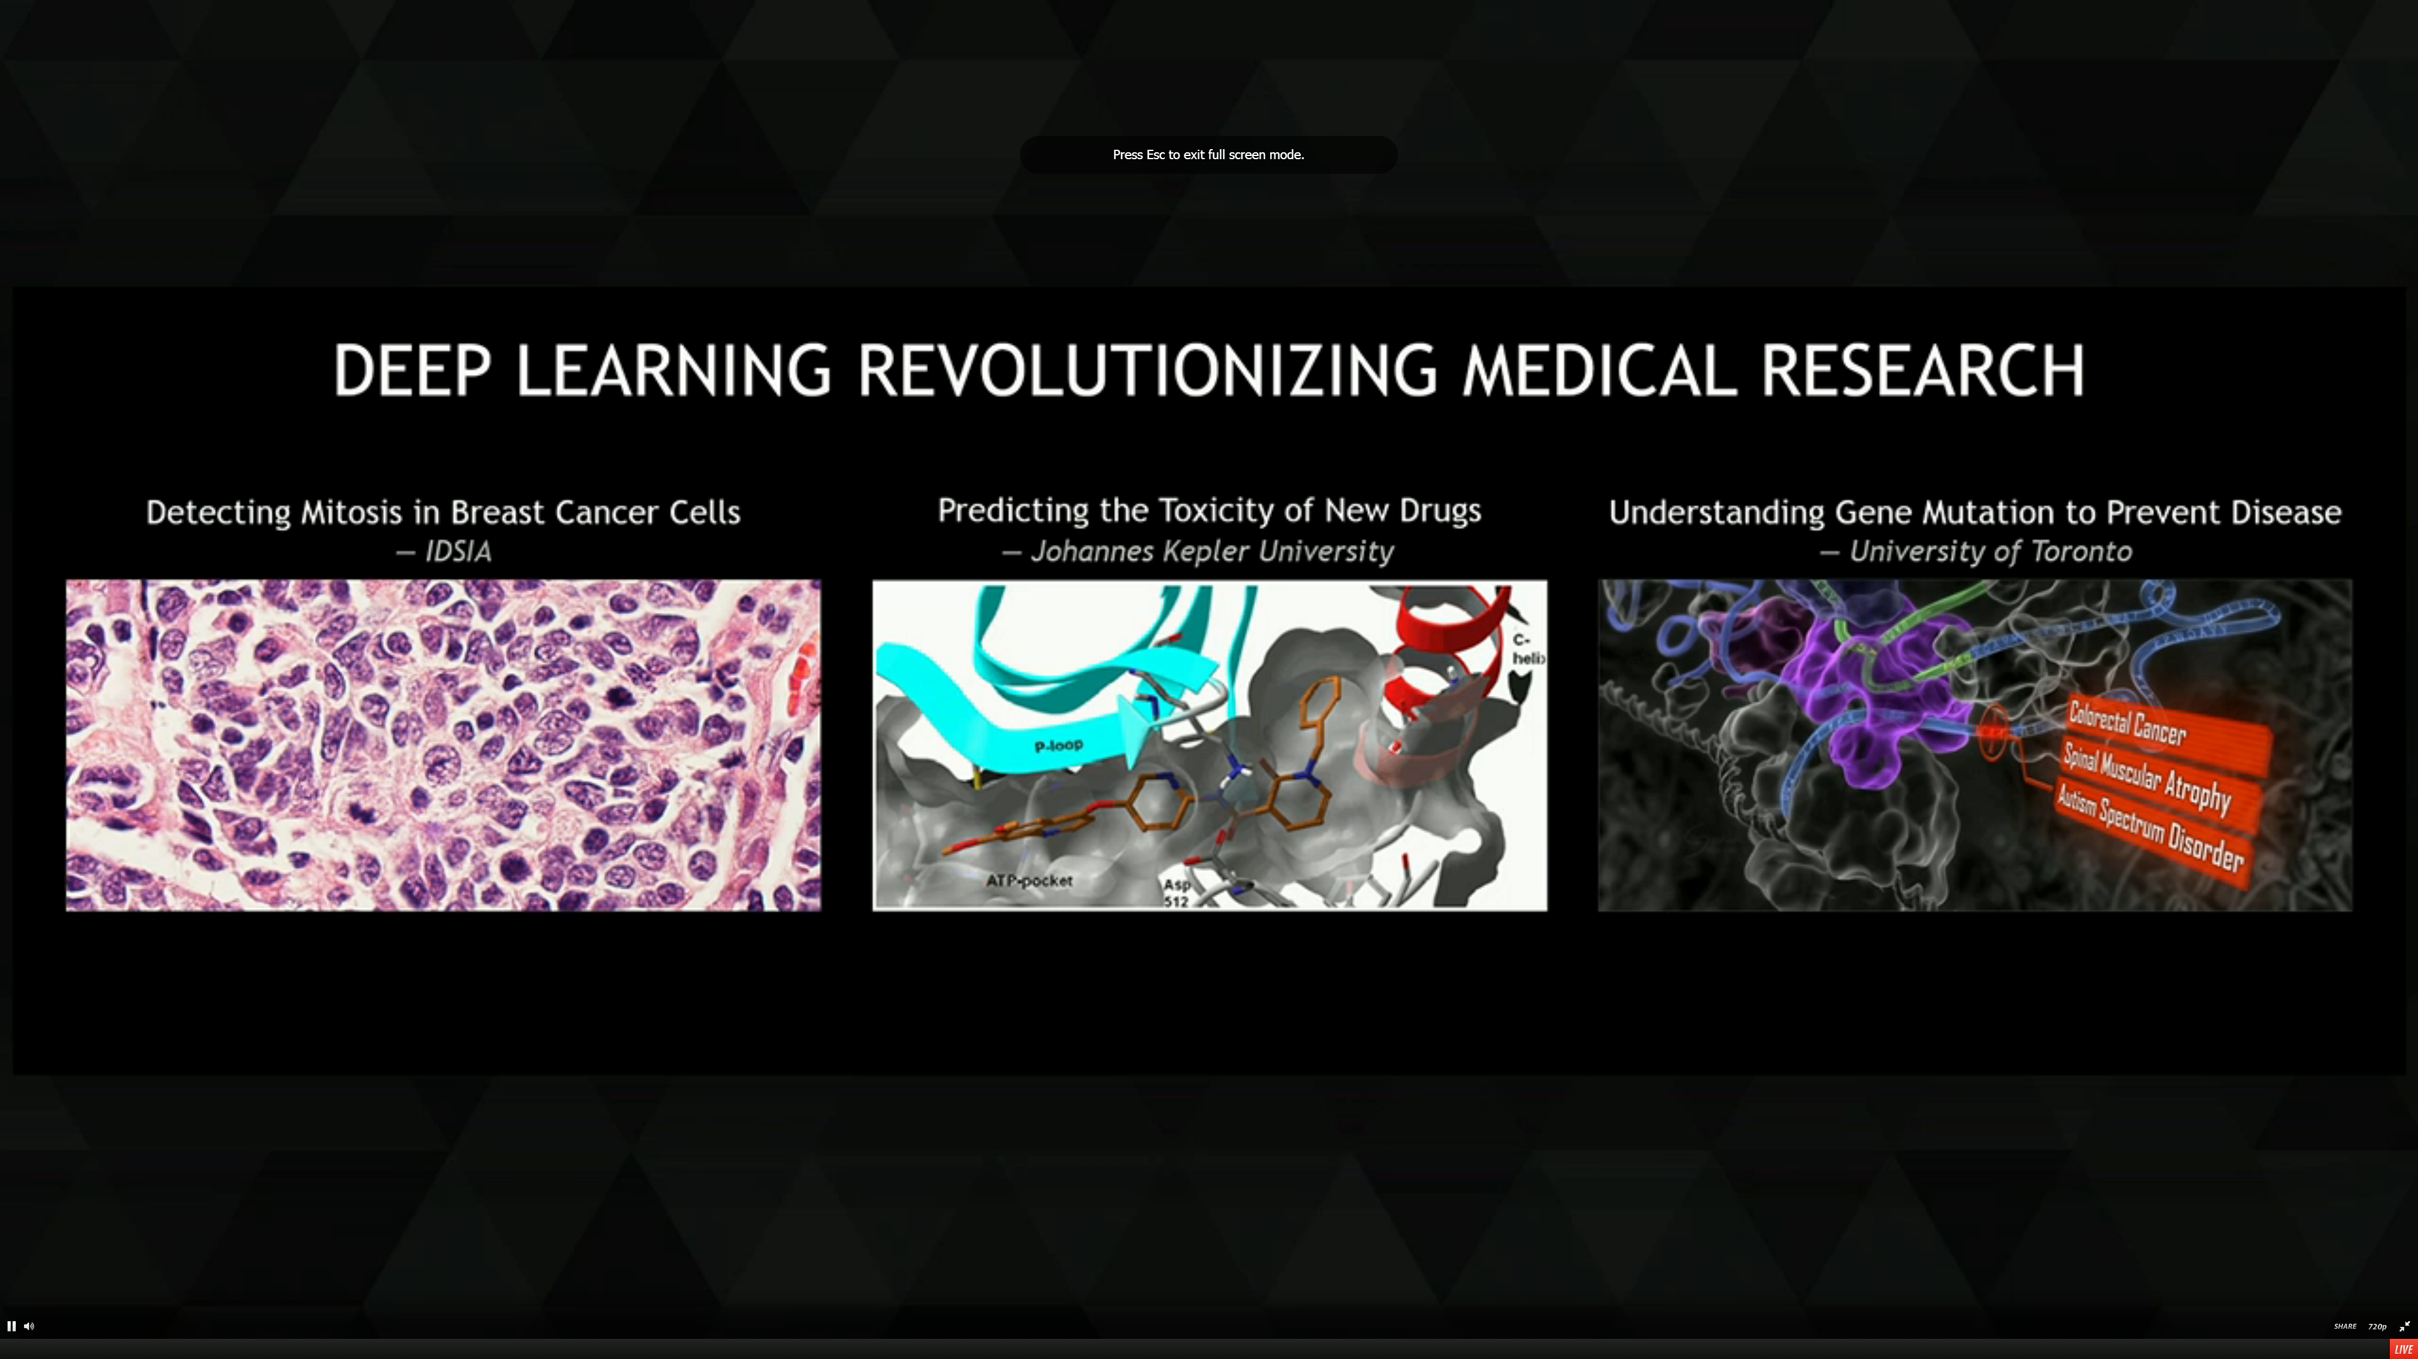
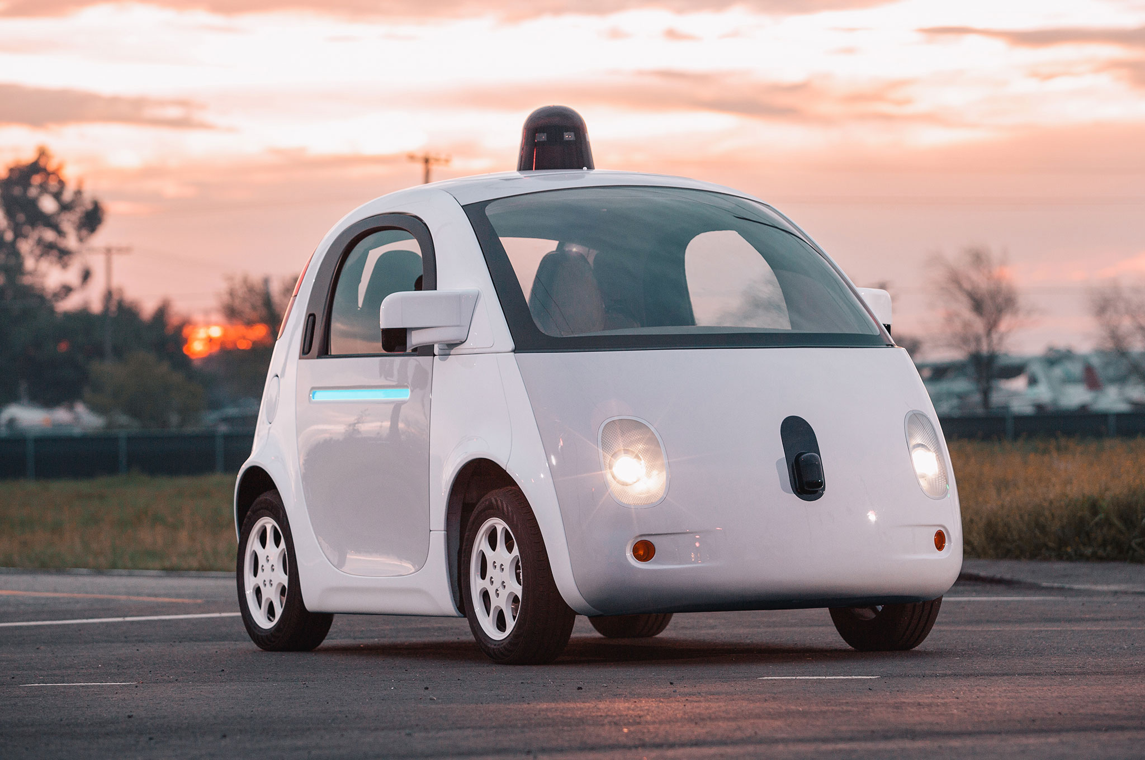
Deep Learning is Super Smart!

Slide 3
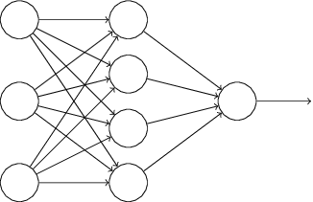
Is it really?
I’m sure this is a panda
I’m certain this is a gibbon
(or an airplane)
(Goodfellow et al. 2015)

Slide 4
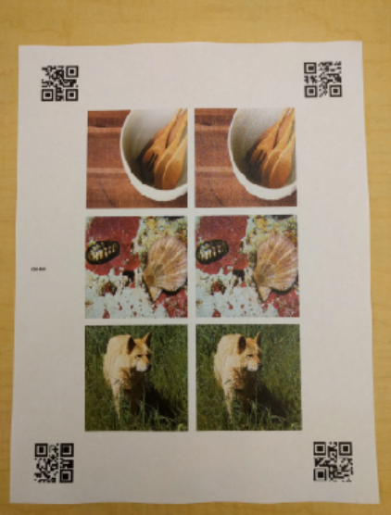

Adversarial Examples in ML
Images
Szegedy et al. 2013, Nguyen et al. 2015,
Goodfellow et al. 2015, Papernot et al. 2016,
Liu et al. 2016, Kurakin et al. 2016, …
Physical Objects
Sharif et al. 2016, Kurakin et al. 2017,
Evtimov et al. 2017, Lu et al. 2017,
Athalye et al. 2017
Malware
Šrndić & Laskov 2014, Xu et al. 2016,
Grosse et al. 2016, Hu et al. 2017
Text Understanding
Papernot et al. 2016, Jia & Liang 2017
Speech
Carlini et al. 2015, Cisse et al. 2017
Notes:
Lujo Bauer => Milla Jovovich

Slide 5

Creating an adversarial example
bird
ML Model
bird
Loss
tree
plane
What happens if I nudge this pixel?

Slide 6
Creating an adversarial example
bird
ML Model
bird
Loss
tree
plane
What happens if I nudge this pixel?

Slide 7
Creating an adversarial example
bird
ML Model
bird
Loss
tree
plane
What about this one?
Maximize loss with gradient ascent

Slide 8



Threat Model: Black-Box Attacks
ML Model
ML Model
plane
plane
Adversarial Examples transfer
ML Model
plane

Slide 9


Defenses?
Ensembles
Preprocessing (blurring, cropping, etc.)
Distillation
Generative modeling
Adversarial training
Notes:
Model the distribution of real inputs

Slide 10



Adversarial Training
ML Model
Loss
bird
attack
ML Model
Loss
plane

Slide 11
Adversarial Training +/-
Pros
  Intuitive approach
  Gives strong formal and empirical guarantees
Cons
  Makes assumptions on attacks
  Can overfit (gradient masking)
l_{p} noise
rotations
lighting

Slide 12
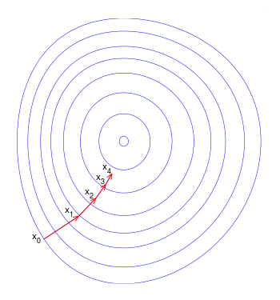

Gradient-Masking: A non-defense
airplanes
airplanes
birds
birds
“smooth” model
- Gradient-based attacks work
- Black-box attacks work
- Model is not robust!
“non-smooth” model
- Model has no useful gradients
- Black-box attacks still work!
- Model is not robust either!
TKPBM, “Ensemble Adversarial Training: Attacks and Defenses”, 2017

