Slide 1
Detecting Adversarial Examples Is (Nearly) As Hard As Classifying Them
Florian Tramèr
Stanford University, Google, ETHZ
Notes:
Hi everyone, I’m Florian and in this talk, I’ll present a result I personally found quite surprising, which shows that detecting adversarial examples is not actually any easier than classifying them.

Slide 2

ML suffers from adversarial examples.
90% Tabby Cat
Adversarial noise
100% Guacamole
Notes:
Adversarial examples are a curious and quite damaging phenomenon in machine learning, where a tiny imperceptible perturbation on an input is sufficient to completely shift the model’s output, here into misclassifying this cat on the left as “guacamole”

Slide 3
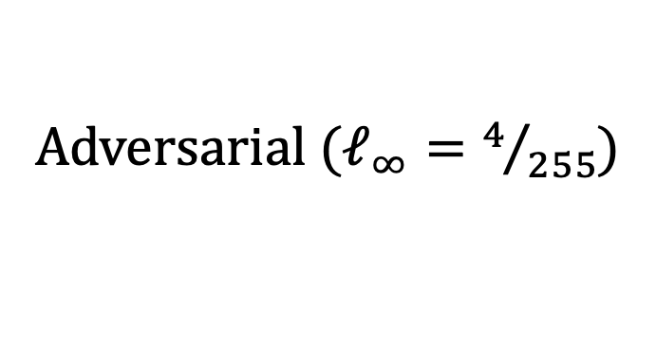
Robust classification is hard!
Clean
Adversarial ($ℓ_{∞}=4/{255}$)
Notes:
Building classifiers that are robust to adversarial examples is a big open problem.
Even after years of research, the best we can currently do on adversarially perturbed inputs remains *very* far from our models’ accuracies on clean examples

Slide 4

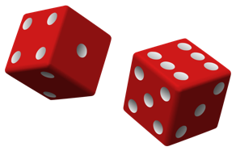
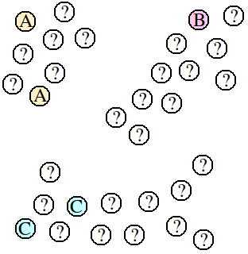
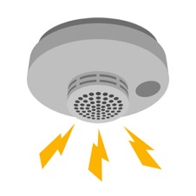
Can we solve an easier problem?
Computationally robust classification
Randomized robust classification
Robust transductive classification
Robust detection
Notes:
And so it is natural to consider whether there might be relaxed versions of this problem that could be easier to solve.
That is, can we change the adversarial threat model somehow, or rely on additional assumptions, to get machine learning applications that are more robust in a useful sense.
For example, some works have considered whether we could build models that are only computationally robust. That is, adversarial examples still exist, but finding them would somehow involve solving a hard cryptographic problem. Unfortunately, we don't yet know how to do this either.
Similarly there’s a lot of work that looks at whether randomized models could somehow be more robust
Or whether robustness is easier if we get to classify multiple test samples at once, so-called transductive learning setting.
And finally, there’s a wide range of defenses that try to merely detect perturbed inputs and reject them instead of attempting to classify them. And this could be sufficient in many security-sensitive applications where detecting an attack attempt is already enough.

Slide 5
Can we solve an easier problem?
Computationally robust classification
Randomized robust classification
Robust transductive classification
Robust detection
abstain
ε
correct
abstain
Notes:
and these are the types of defenses we’ll be concerned with here.
We’ll call such a detector defense robust on a given input from the distribution if it classifies the clean input correctly, and either correctly classifies *or abstains* on any perturbed version of the input within some distance epsilon

Slide 6
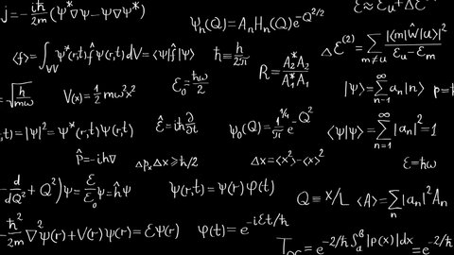
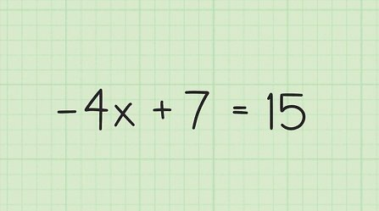
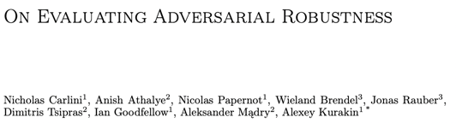
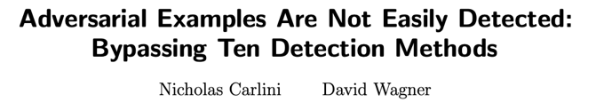


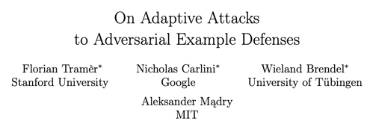
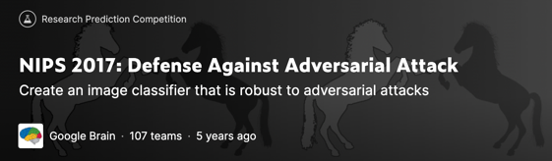

Are these relaxed problems truly easier?
Robust classification
Robust detection
Notes:
The main question we address in our work is: are these relaxed versions of robust classification actually easier.
Specifically, is detecting adversarial example really much easier than classifying them properly?
->And empirically this is currently a difficult question to answer. Because robust classification has received much more scrutiny than the relaxed version of robust detection. There’s a long list of competitions, guidelines, benchmarks that focus exclusively on classification. And so I think we have a pretty good understanding at this point about what’s feasible with robust classification with our current tools.
We don’t really have any of that confidence for robust detection. All we have here really are some isolated breaks of a few specific attempts at building detector defenses.

Slide 7
Are these relaxed problems truly easier?
Robust classification
Robust detection
If YES: promising direction for useful robustness!
If NO: we shouldn’t expect a breakthrough...
Notes:
And so the question of whether robustly detecting adversarial examples is any easier than classifying them is really unclear.
If the answer is yes, this is good because this means we have a promising research direction ahead of us.
But if the answer is no, then maybe studying this relaxed problem isn’t that useful, because we shouldn’t expect a breakthrough anymore than we would for the original problem of robust classification.

Slide 8
Our result.
Detecting adversarial examples is
as hard as classifying them!
Notes:
And this is precisely what we prove in this paper.
Detecting adversarial examples isn’t any easier than classifying them.

Slide 9

What’s a hardness reduction?
“Famously hard” problems
AGI (lol)
Riemann Hypothesis
P vs NP
reduction
If we find a solution to Problem X,
we also solve a super hard problem
Problem X
Notes:
The way we prove this result is with the notion of a hardness reduction. So let’s take a quick detour to talk about those.
In many fields of mathematics, there are some “famously” hard problems that everyone has tried very hard to solve and failed. Say P vs NP, or the Rieman Hypothesis
->When confronted with a new problem, Problem X, we might be able to show a reduction from this problem to one of these hard problems.
-> What this means, is that if we solve Problem X, we actually can also solve one of these famously hard problems. And so Problem X is precisely as hard as these problems.

Slide 10

What’s a hardness reduction?
“Famously hard” problems
AGI (lol)
Riemann Hypothesis
P vs NP
reduction
Corollary:
if someone claims to solve Problem X, you might be a bit skeptical...
Problem X
Notes:
A informal corollary of this is that if someone actually claims to solve Problem X, and you can show that such a reduction exists, then you should probably be quite skeptical...
in fact, exactly as skeptical as if someone had claimed to solve the famously hard problem

Slide 11
Hardness reductions for robustness.
“Famously hard” problems
Robust classifier
hard
reduction
Clean
Adv.
Robust detector
Clean
Adv.
Notes:
So in this work, we look at hardness reductions for adversarial robustness.
Here, our famously hard problem will be that of building a much more robust classifier. This isn’t quite as distinguished as P vs NP or the Riemann hypothesis, but nevertheless many people have tried to solve this problem and failed.
-> We then show that if one claims to have built a very robust detection method for adversarial examples, this implies via a reduction a similarly robust classifier.

Slide 12
Detecting adversarial examples is as hard as classifying them!
Robust detector
reduction
Robust
classifier
detector
Clean
Adv.
Clean
Adv.
Notes:
More precisely, we show that given a robust detector, we can build a classifier (that uses this detector as a subroutine) and which has the same clean and robust accuracy as the detector did.
And thus both problems are equally hard.

Slide 13
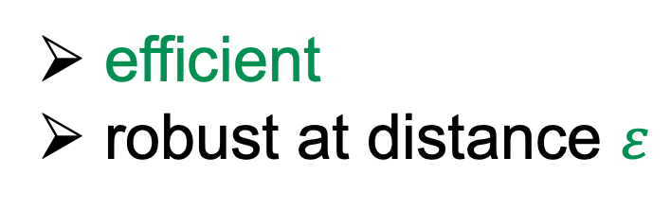
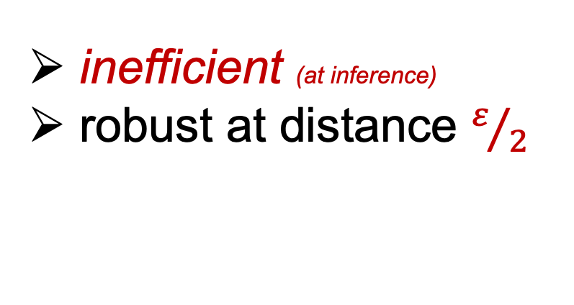
Detecting adversarial examples is (nearly) as hard as classifying them!
Robust detector
reduction
Robust
classifier
detector
efficient
robust at distance $ε$
inefficient (at inference)
robust at distance $ε/2$
Main technical tool: Minimum Distance Decoding
Notes:
Or actually “nearly” as hard (which you might recall from the title of the talk)
Because our reduction is not quite perfect.
-> Firstly, and most importantly, the reduction is inefficient. What that means is that if you start with a robust detector that is efficient (by which we mean poly time), the classifier we build from it will not run in polynomial time.
-> And second, we lose a factor 2 in the robustness size. If the detector has 80% robust accuracy for perturbations of some size epsilon, the classifier will have at least the same robust accuracy of 80% but for perturbations of half the size.
-> From a technical perspective, the reduction and proof are actually quite simple. It relies on a standard minimum distance decoding argument from coding theory. I invite you to look at the paper if you’re interested in the details.

Slide 14
Interpretation #1: information theoretically robust detection = robust classification
Same sample complexity [Schmidt et al., 2018]
Same accuracy-robustness tradeoffs [Tsipras et al., 2019, Zhang et al., 2019]
Same multi-robustness tradeoffs [T & Boneh, 2019, Maini et al., 2020]
Same connection with error on noise [Ford et al., 2020]
...
Notes:
So what could such an inefficient reduction be used for?
In computation complexity for instance, such a reduction would likely be useless. But in machine learning, the running time of an algorithm is not the only complexity measure we care about, and so this reduction has some interesting consequences.
For instance, one way we can interpret this result is as saying that *information theoretically”, robust detection and classification are equivalent (again, up to a factor 2 in the perturbation size).
-> And so this means that many results from the literature about robust classification, can directly be applied to robust detectors as well.
For example, we can show that robust generalization requires as much data whether we allow the defense to merely detect examples or classify them, using a nice result from Schmidt and his coauthors in 2018.
Similarly, existing results about tradeoffs between robustness types and accuracy, or known connections between worst-case and average-case robustness also directly extend to detectors with our reduction.

Slide 15

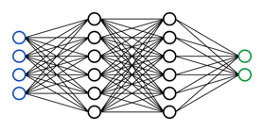
Interpretation #2: robust detectors imply a breakthrough in robust classification.
train
inference
World 1:
Clean
Adv.
Notes:
The second interpretation, which is the one I’m most excited about, is that we can view any result that claims high robust accuracy with detection as also claiming a breakthrough result in robust classification.
-> To better illustrate this, we’ll consider the problem of building a robust imagenet classifier in one of two worlds.
The first, world 1, is our world. Here, you get to use the ImageNet training set to train a model and both the training and inference have to be efficient of course. And for this experiment, we just can’t seem to get very high robustness yet, using our current techniques.

Slide 16
Interpretation #2: robust detectors imply a breakthrough in robust classification.
inefficient
?
train
inference
World 2:
Clean
Adv.
Can we build much more robust classifiers in World 2?
(we don’t know...)
Notes:
Now the second world, world 2, is exactly the same, except that here the model’s inference procedure is allowed to be inefficient. But everything else is unchanged, you can’t use more training data, the training still has to be efficient. And you can’t use a bigger model either (and so in particular you can't just store the entire imagenet training set in the model in order to take full advantage of the unlimited computation you get at inference time)
-> Now the question here is: should we expect much more robust classifiers in world 2, than in our world 1. In other words, Could we somehow build much more robust classifiers just by using significantly more compute-power at inference time?
We don’t know the answer to this question, but there’s some evidence to suggest that the answer is no.
And I would view a positive answer to this question as a big breakthrough in robust classification.

Slide 17
Interpretation #2: robust detectors imply a breakthrough in robust classification.
train
inefficient
inference
World 2:
Clean
Adv.
Can we build much more robust classifiers in World 2?
(we don’t know...)
But any sufficiently robust detector implies a positive answer!
Notes:
But by our reduction, any robust detector implies a positive answer to this question.
And so whenever someone claims to have build a very robust detector, they are also actually claiming an breakthrough on this fundamental question about robust classification.

Slide 18
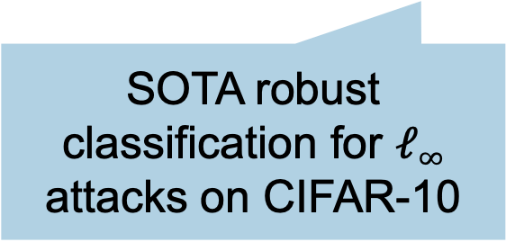
Many detectors implicitly claim such a breakthrough!
robustness claims from detector defenses
(13 in the paper)
SOTA robust classification for $ℓ∞$ attacks on CIFAR-10
Notes:
As it turns out, many detector defenses implicitly claim such a breakthrough.
Here on this graph, I’m showing in blue the best known results for robust *classification* on CIFAR-10. These results have been independently re-evaluated multiple times, with great care, and so we have good confidence that this is currently the best we know how to do.
In red are the robust accuracies claimed by three different detector defenses from the past years. In the paper, we look at 13 such results.
Because these defenses merely have to detect attacks, they claim to be much more robust than existing robust classifiers.

Slide 19
Many detectors implicitly claim such a breakthrough!
our reduction implies a robust classifier for ε/2
Notes:
But by our reduction, we know that these detectors imply a robust classifier as well, for half the perturbation size.

Slide 20
Many detectors implicitly claim such a breakthrough!
Optimistic interpretation: this is an actual breakthrough in (inefficient) robust classification!
Notes:
And so know we have these implicit claims of huge improvements in robust classification (if the inference phase can be inefficient).
So the optimistic take here would be: waouh, this is a huge breakthrough.
But we should be somewhat skeptical of this, due to how hard we believe such a result would be to achieve.

Slide 21
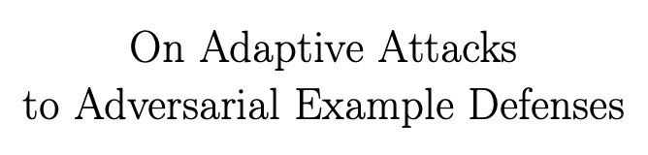
Pessimistic (realistic?) interpretation:
These detectors are not robust!
Notes:
And for me at least, the more realistic interpretation is the pessimistic one: namely that the robustness claims from these detector defenses are simply wrong.
And in fact, for some of the defenses we looked at here, we know this to be the case.
For example, the right-most detector defense here, which would imply an extremely robust classifier, is actually not robust at all when evaluated with a stronger attack.
For the other two, I don’t know for sure, they haven’t yet been independently re-evaluated. But our reduction serves as a strong indicator that these robustness claims are also over-estimated.

Slide 22
Conclusion.
Robust classification
Robust detection
Notes:
In summary, in this work we show that robust detection of adversarial examples isn’t actually much easier than directly classifying them.

Slide 23
Conclusion.
Robust classification
Robust detection
Notes:
A cool consequence from this is that we can use all our acquired knowledge and benchmarks for robust classification, to assess the strength of new results for robust detection as well---without having to independently come up with new benchmarks specifically for detector defenses.
But our result also means that when building a new defense, it’s maybe better to just go for classification directly and forget about trying to detect perturbations.
Especially because, in my experience, detector defenses are much more tricky to evaluate properly. And so it’s easier to mistake a broken defense for a robust one.

Slide 24


Conclusion.
Robust classification
Robust detection
Reductions/separations for other “easier” approaches to robustness?
https://arxiv.org/abs/2107.11630
https://floriantramer.com
Notes:
In the future, I think it would be very cool if we could show similar reductions (or maybe a separation instead) for some of these other relaxed versions of robust classification, that are also presumed to be easier.
For example, we might be able to show that the use of cryptography doesn't help build more robust classifiers. Or that randomness isn't needed. Or that extra test examples don't help.
This could help us focus our research efforts on those problems that are most likely to actually lead to more robust machine learning applications.
thanks for listening! If you’re interested in learning more, please read our full paper and come chat at the poster session

