Slide 1
Fundamental Tradeoffs between Invariance and Sensitivity to Adversarial Perturbations
Florian Tramèr
Jens Behrmann
Nicholas Carlini
Nicolas Papernot
Jörn-Henrik Jacobsen
Notes:
Hi, I'm Florian. In this paper, my-coauthors and I looked at some inherent tradeoffs in the way that we measure robustness of machine learning models to adversarial examples. We show that some defenses overfit on some robustness metrics at the expense of others.

Slide 2
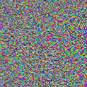
What are Adversarial Examples?
“any input to a ML model that is intentionally designed by an attacker to fool the model into producing an incorrect output”
“Small” perturbations
“Large” perturbations
Nonsensical inputs
etc.
99% Guacamole
99% Guacamole
99% Guacamole
Notes:
Let's start with the basics.
In the broadest sense, an adversarial example is any input to a machine learning model that was designed to cause misclassification.
Adversarial examples can come under various forms. You might be familiar with attacks that add small perturbations to fool a model, here into recognizing a cat as guacamole.
But the input could also be highly perturbed, or completely nonsensical. In either case, the model is clearly wrong. And any of these mistakes might pose a threat to a model deployed in a security or safety-critical environment.

Slide 3
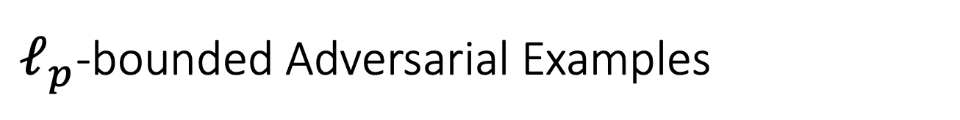
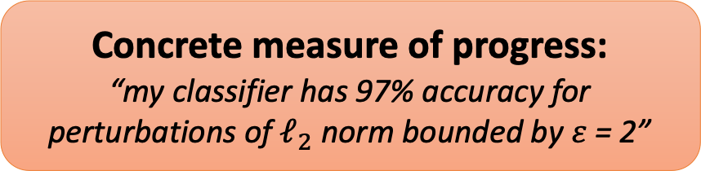


$ℓ_{p}$-bounded Adversarial Examples
Given input $x$, find $x′$ such that $f(x)≠f(x′)$ and ${\left\|x^{′}−x\right\|}_{p}≤ε$
($+$) Easy to formalize
($+$) Falsifiable
($−$) Incomplete
All Adversarial Examples
$ℓ_{p}$-bounded (excessive sensitivity)
Concrete measure of progress:
“my classifier has 97% accuracy for perturbations of $ℓ_{2}$ norm bounded by $ε$= 2”
Notes:
Yet, the research community has mainly focused on the first class of attacks, via small perturbations. A widely-used formal definition is what we call Lp bounded adversarial examples. These are examples obtained by adding noise of bounded norm to an input. This definition isn't complete: it only covers a specific type of attack, that exploits a model's excessive sensitivity to small feature changes.
But this definition is very popular because it is easy to formalize and allows concrete measures of progress: for example, I can claim that my classifier achieves 97% accuracy for perturbations of norm of 2, and you can show an attack to refute that claim.

Slide 4
Goodhart’s Law
“When a measure becomes a target, it ceases to be a good measure”
Notes:
But we shouldn't forget that obtaining high robustness to Lp-bounded perturbations isn't an end goal, as these only represent a fraction of possible attacks.
Yet, we find that the research community has essentially succumbed to Goodhart's famous law, and started to overfit to this specific robustness metric.

Slide 5
New Vulnerability: Invariance Adversarial Examples
Small semantics-altering perturbations that don’t change classification
All Adversarial Examples
excessive invariance
excessive sensitivity
3
3
“Excessive Invariance Causes Adversarial Vulnerability”, Jacobsen et al., 2019
Notes:
To show this, we look towards a different type of adversarial example, introduced by some of my co-authors last year. We call these invariance adversarial examples. These are perturbations that change the input semantics (for example changing this digit 3 into a 5), yet do not cause a change in the model's prediction.

Slide 6
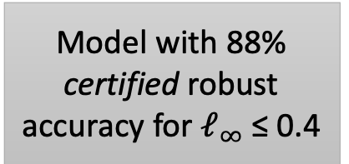

Our Results
-
= 0.4
$$∞$$
State-of-the-art “robust” models are too robust
Invariance to semantically meaningful
features can be exploited
Inherent tradeoffs
Solving excessive sensitivity & invariance
implies perfect classifier
Model with 88% certified robust accuracy for $ℓ_{∞}$≤ 0.4
1
1
12% agreement with human labels
Notes:
In this paper, we use invariance adversarial examples to demonstrate that we have indeed overfit to Lp-bounded attacks. Specifically, we show that models that are more robust to these attacks are also increasingly vulnerable to invariance attacks.
As an example, we *break* a certified defense on MNIST that achieves 88% accuracy when each pixel can be perturbed by 40%. Within this threat model, we build perturbed examples, as shown here, to which the model provably assigns the same label, despite the obvious changes in class semantics. According to human labelers, the model's true robust accuracy is only about 12%.
We further formally show inherent tradeoffs between a classifier's excessive sensitivity and invariance. Unfortunately, we find that attaining robustness to both types of attacks essentially boils down to building a perfect classifier.

Slide 7
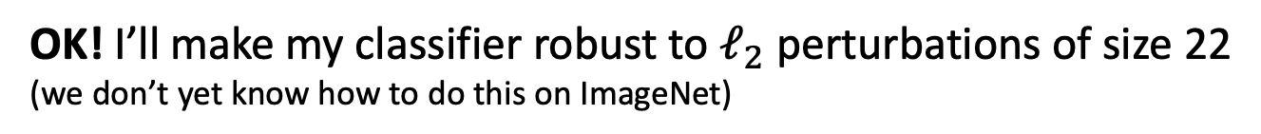
A Fundamental Tradeoff
$${\left\|x^{′}−x\right\|}_{2}≤22$$
Hermit-crab
Guacamole
OK! I’ll make my classifier robust to $ℓ_{2}$perturbations of size 22
(we don’t yet know how to do this on ImageNet)
Notes:
Let's take a closer look at this tradeoff between sensitivity and invariance.
Consider the image on the left, taken from the ImageNet dataset, and labeled as a hermit crab.
The picture on the right is obtained with a perturbation of l2 norm of 22 and fools a classifier into predicting quacamole.
So you might say, OK, my classifier is too sensitive, so let's make it robust to noise of l2-norm bounded by 22.
(it turns out that we don't yet know how to do this on ImageNet, but for argument's sake, let's imagine we have such a robust classifier)

Slide 8
A Fundamental Tradeoff
$${\left\|x^{′}−x\right\|}_{2}≤22$$
Hermit-crab
Hermit-crab
OK! I’ll use a different norm than $ℓ_{2}$ to measure robustness
Notes:
It turns out that such a model would be*too* robust:
with the same noise magnitude, we can completely change the image semantics, by erasing the crab and replacing it with a strawberry.
And if the model were robust to such noise, it would misclassify the image by still predicting the hermit-crab label.
At this point, it's probably clear that the l2 norm just isn't very well aligned with our own visual perception. So the solution seems to be to come up with a metric that more closely matches our own notion of perceptual similarity, and then define robustness with respect to that norm.

Slide 9
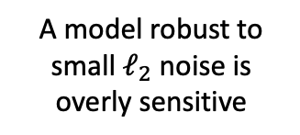
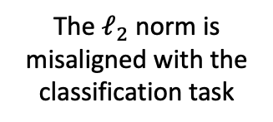
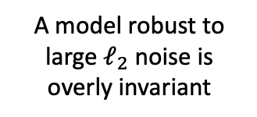
A Fundamental Tradeoff
Theorem (informal)
Choosing a “good” norm is as hard as
building a perfect classifier
class 1
class 2
The $ℓ_{2}$ norm is misaligned with the classification task
A model robust to small $ℓ_{2}$ noise is overly sensitive
A model robust to large $ℓ_{2}$ noise is overly invariant
If norm is aligned with task, 1-NN is a perfect classifier
Notes:
Unfortunately, we show that it is unlikely that we can come up with such a metric, as this is as hard as building a classifier that perfectly solves the task.
To understand this result intuitively, consider this simple binary classification task in two-dimensions, and suppose we use the l2 norm to measure robustness.
Note that the l2 metric is not well aligned with this task, as it assumes that each feature has equal importance.
If we make our classifier robust to small l2 noise, it will still be overly sensitive along one dimension and we can still find adversarial examples, here in red.
But if we make our classifier robust to larger l2 noise, it is now overly invariant to the other dimension, and still makes mistakes.
The red point would now be misclassified into class 2, despite belonging to class 1.
To prevent both types of attacks, we would need a robustness metric that is more closely aligned with the underlying task. But given such a metric, a nearest-neighbor classifier would actually perfectly solve the task.

Slide 10
Are Current Classifiers Already too Robust?
Notes:
So what does this mean for current classifiers?
Clearly, current classifiers are not perfect, so what side of this inherent tradeoff do they fall on?
In particular, we're interested in figuring out whether we have already managed to build classifiers that are *too* robust on some tasks.

Slide 11
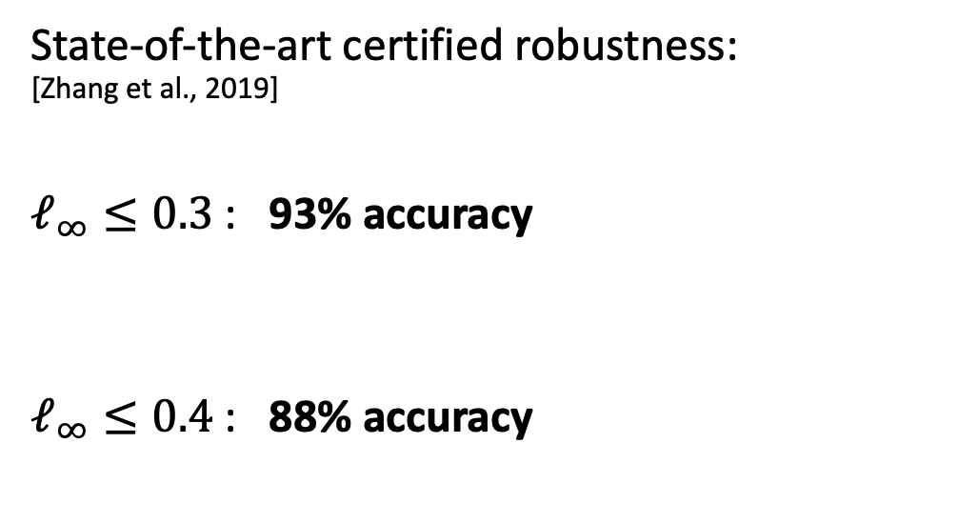


A Case-Study on MNIST
State-of-the-art certified robustness:
[Zhang et al., 2019]
$ℓ_{∞}≤0.3$ : 93% accuracy
$ℓ_{∞}≤0.4$ : 88% accuracy
-
= 0.3
$$∞$$
-
= 0.4
$$∞$$
Model certifies that it labels both inputs the same!
Notes:
We show that this is indeed the case on simple tasks like MNIST, where we can build classifiers with relatively high robustness to Lp-bounded perturbations.
We take a look at state-of-the-art models with *certified* robustness. These are classifiers for which it is possible to prove that for a given input, no perturbation of a certain size can flip the classifier's decision.
With recent techniques, it has become possible to train models that are provably robust to perturbations of large l-infinity norm on MNIST. These are perturbations that change each pixel in an image by a small amount.
The best classifier we found achieves around 90% certified accuracy for perturbations of l-infinity norm bounded by either 0.3 or 0.4
Yet, here on the right we show that within this threat model, within these norm bounds, we can build perturbations that do seem to change the class label
So it looks like the true accuracy of these models under perturbation has been over-estimated.
Let's now look at how we can evaluate this more thoroughly.

Slide 12
Generating Invariance Attacks
Challenge: ensure label is changed from human perspective
Solution 1: generate invariance adversarial examples “by hand”
Solution 2: automatic alignment via data augmentation
a few tricks
input
input from other class
semantics-preserving transformation
diff
result
Notes:
To understand how much we overestimate the robust accuracy of current classifiers, we propose techniques for crafting invariance adversarial examples such as the one we saw before.
The challenge is that there is an inherent human component to our attack: we want the perturbation to cause the underlying class label to change.
So a simple solution is to create invariance examples by hand. This isn't too difficult on MNIST: we used a simple pixel editor to modify digits until we thought they looked like digits from another class.
This is not very scalable though, so we also considered ways to automate our attack.
Our general strategy is illustrated here, for the specific case of the l0-norm, where a small perturbation is one that modifies only a small number of pixels.
We start from some input, a digit 8 in this example, and we look for an input from a different class that has the most pixels in common with our '8'. To minimize this distance, we perform a number of common transformations that preserve class semantics, such as small translations or rotations. Once we found an input that is very closely aligned with our target, we compute the pixelwise difference and then apply a few heuristics to further reduce the size of the final perturbation. We end up with this digit '3', that is only a few pixel changes away from our original '8'.

Slide 13



Do our invariance examples change human labels?
Open problem: better automated attacks
no attack
$$ℓ_{∞}≤0.3$$
$$ℓ_{∞}≤0.4$$
$ℓ_{∞}≤0.4$ (manual)
Notes:
How well do our attacks do, at actually changing the underlying class? To measure this, we asked human participants to label digits produced by our attacks.
We considered an attack successful when a majority of human labelers agreed on a new class label.
For l-infinity perturbations bounded by 0.3 or 0.4, we found that about 20-40% of our generated examples succeeded. But these automated attacks can still be improved significantly. Indeed, when we generate the invariance examples by hand, we succeed in switching the human label in 88% of cases.

Slide 14
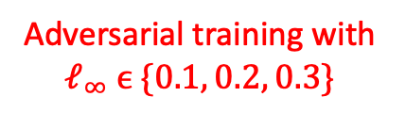
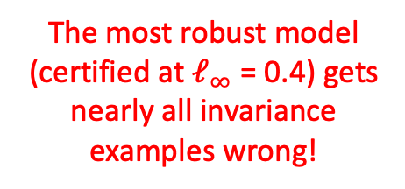
Which models agree most with humans?
Standard (undefended) ResNet
Adversarial training with $ℓ_{∞} ϵ \{0.1, 0.2, 0.3\}$
The most robust model (certified at $ℓ_{∞}$ = 0.4) gets nearly all invariance examples wrong!
More robust models
Notes:
So how well do MNIST models fare on these examples? We find that the more robust a model is to l-infinity perturbations, the less likely the model's predictions agree with those of the human labelers. The model that most often agrees with humans is actually a standard undefended ResNet.
As we train models to be robust to even small amounts of noise, these models also become overly invariant to larger perturbations that change class semantics.
What's surprising here is that even when the model is trained on perturbations that are small enough to always preserve class semantics, the model still learns to be overly invariant.
At the end of the spectrum, we have a model that is provably robust to l-infinity noise of magnitude 0.4. We find that on our invariance attacks, this model basically never changes its prediction and thus disagrees with human labelers in nearly all cases. Within the threat model originally considered by that defense, the model's real robust accuracy is actually only about 12%.

Slide 15
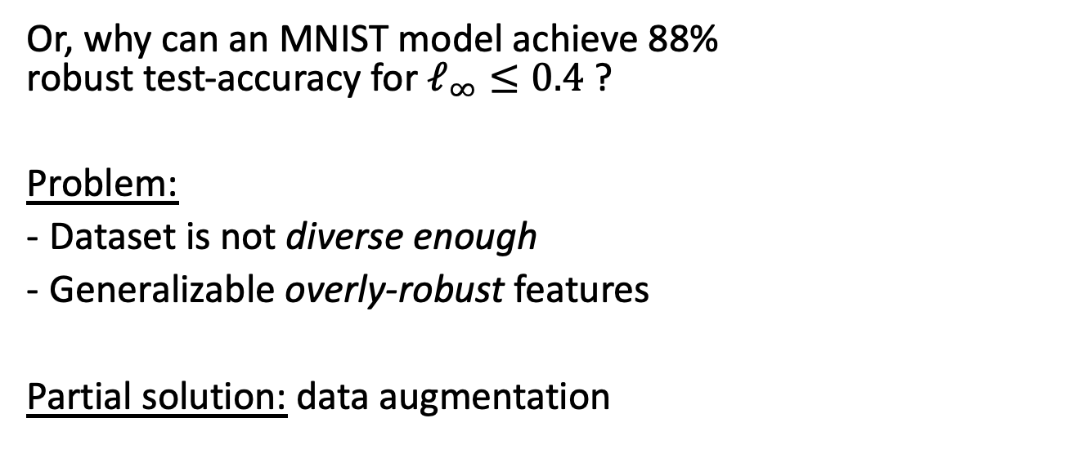
Why can models be accurate yet overly invariant?
Or, why can an MNIST model achieve 88%
robust test-accuracy for $ℓ_{∞}≤0.4$ ?
Problem:
Dataset is not diverse enough
Generalizable overly-robust features
Partial solution: data augmentation
More robust models
Notes:
Taking a step back, we ask ourselves why it is even possible to train models that are overly robust. That is, why can a model achieve close to 90% provable robustness on MNIST, for perturbations that are large enough to alter class semantics?
The reason is essentially that the dataset is not diverse enough. That is, it is possible to draw a large Lp ball around each image in the dataset, without these balls intersecting.
Another way to look at this is that there exist robust features in the dataset that generalize from the training set to the test set, but that aren't predictive of the broader digit-classification task. We call such features overly robust.
We formally show that data augmentation can alleviate the effect of overly robust features.
And we find that this also helps empirically. When we train robust models with data augmentation, they do a bit better on our invariance attacks, but still worse than a standard undefended model. So there's still a lot of room left for improvement here.

Slide 16
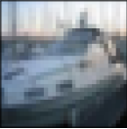
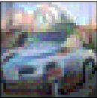
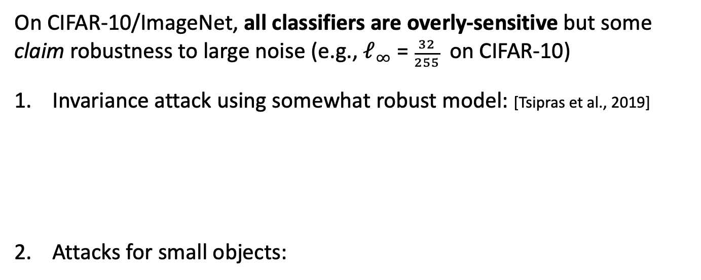
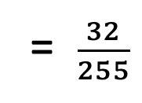

Invariance Attacks Beyond MNIST
On CIFAR-10/ImageNet, all classifiers are overly-sensitive but some
claim robustness to large noise (e.g., $ℓ_{∞}$ = $\frac{32}{255}$ on CIFAR-10)
Invariance attack using somewhat robust model: [Tsipras et al., 2019]
Attacks for small objects:
-
= $\frac{32}{255}$
$$∞$$
Notes:
So does all of this just apply to MNIST? No, it just so happens that on more challenging tasks such as CIFAR-10 or ImageNet, we still struggle to train robust classifiers in the first place.
So for these tasks, we are currently stuck in the overly-sensitive side of the tradeoff.
Yet, there are already some examples of defenses that claim robustness to large perturbations. For example, there are a handful of defenses on CIFAR-10 that claim robustness to perturbations of l-infinity norm bounded by 32 pixel units.
Such a model would almost certainly be overly robust.
Indeed, perturbations of that magnitude can effectively interpolate between CIFAR-10 classes, as shown by Tsipras and others. Their approach, which relies on a classifier that is robust to very small perturbations, could potentially be a way to automatically generate invariance attacks.
Moreover, as our previous example with the hermit crab demonstrated, images that contain small objects are particularly susceptible to invariance attacks, as perturbations with very small norm suffice to change the class label.

Slide 17
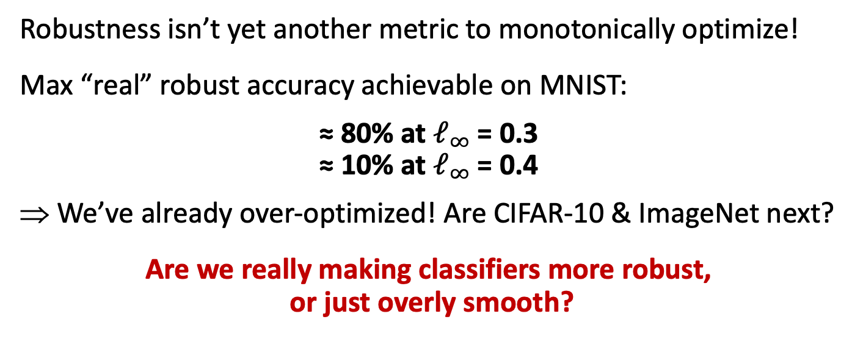
Conclusion
Robustness isn’t yet another metric to monotonically optimize!
Max “real” robust accuracy achievable on MNIST:
≈ 80% at $ℓ_{∞}$ = 0.3
≈ 10% at $ℓ_{∞}$ = 0.4
We’ve already over-optimized! Are CIFAR-10 & ImageNet next?
Are we really making classifiers more robust,
or just overly smooth?
https://arxiv.org/abs/2002.04599
Notes:
The main take-away we'd like to offer from our work, is that robustness isn't yet-another metric to be monotonically optimized. By building defenses with higher and higher accuracy against larger and larger perturbations, we've managed to create classifiers that are too robust, and therefore invariant to semantically-meaningful features.
Concretely, our human study demonstrates that on MNIST, we should not aim for models to have robust accuracy beyond 80% for perturbations of l-infinity norm of 0.3, as the noise can effectively switch the class label for about 20% of inputs.
For larger perturbations of magnitude 0.4, the standard robust-accuracy measure becomes mostly meaningless as nearly all input labels can be switched.
These results may also ask for us to reconsider what progress we've achieved in building more robust machine learning.
We now know of a lot of techniques to reduce a model's sensitivity to small perturbations, such as adversarial training or randomized smoothing. But it remains unclear whether these techniques can truly help in making our models more robust, or simply in making them overly smooth.
If you’d like to learn more, we invite you to read the full paper or attend our Q&A sessions

