Slide 1
Attacking Machine Learning Systems
Florian Tramèr ETH Zurich spylab.ai

Slide 2
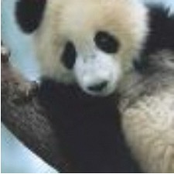
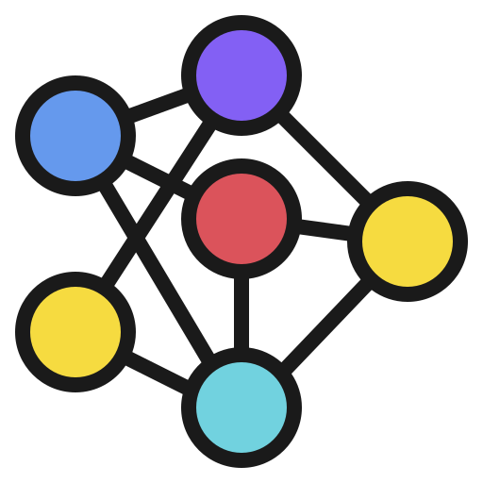
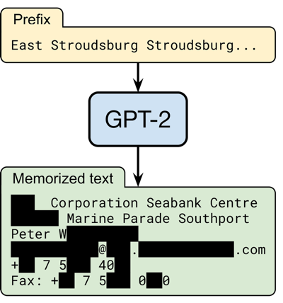
We like attacking ML models.
adversarial examples
data poisoning
model stealing
data leakage

Slide 3
But no one deploys ML models...

Slide 4
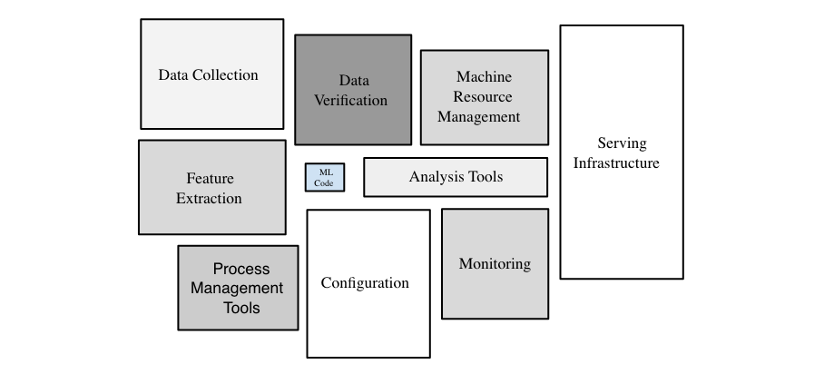
ML models are deployed in larger systems.
https://developers.google.com/machine-learning/crash-course/production-ml-systems

Slide 5
What does this mean for adversarial ML?
Part I: Evasion attacks might get harder
Part II: New privacy attacks!

Slide 6
Part I: Evading ML systems.
90% Tabby Cat
Adversarial noise
100% Guacamole
Evading Black-box Classifiers Without Breaking Eggs. Debenedetti, Carlini, Tramèr. 2023

Slide 7
A realistic threat model

Slide 8
A realistic threat model: post bad stuff online.
blocked

Slide 9
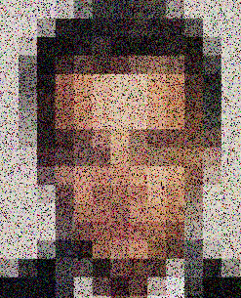
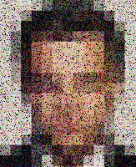
A realistic threat model: post bad stuff online.
attack
posted

Slide 10
How? Black-box (query-based) attacks.
blocked

Slide 11
How? Black-box (query-based) attacks.
posted

Slide 12
How? Black-box (query-based) attacks.
blocked

Slide 13
How? Black-box (query-based) attacks.
posted

Slide 14
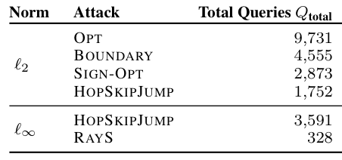
Query-based attacks are getting better.
median queries to reach a ℓ₂ distance of 10 and ℓ∞ distance of 8/255 on untargeted ImageNet

Slide 15
Is the number of queries the right metric?
median queries to reach a ℓ₂ distance of 10 and ℓ∞ distance of 8/255 on untargeted ImageNet

Slide 16
A real ML system uses monitoring.
blocked

Slide 17
Some queries are more expensive than others.
blocked
posted
blocked
posted
blocked

Slide 18
Our goal: “stealthy” attacks.
Find such that
while minimizing

Slide 19
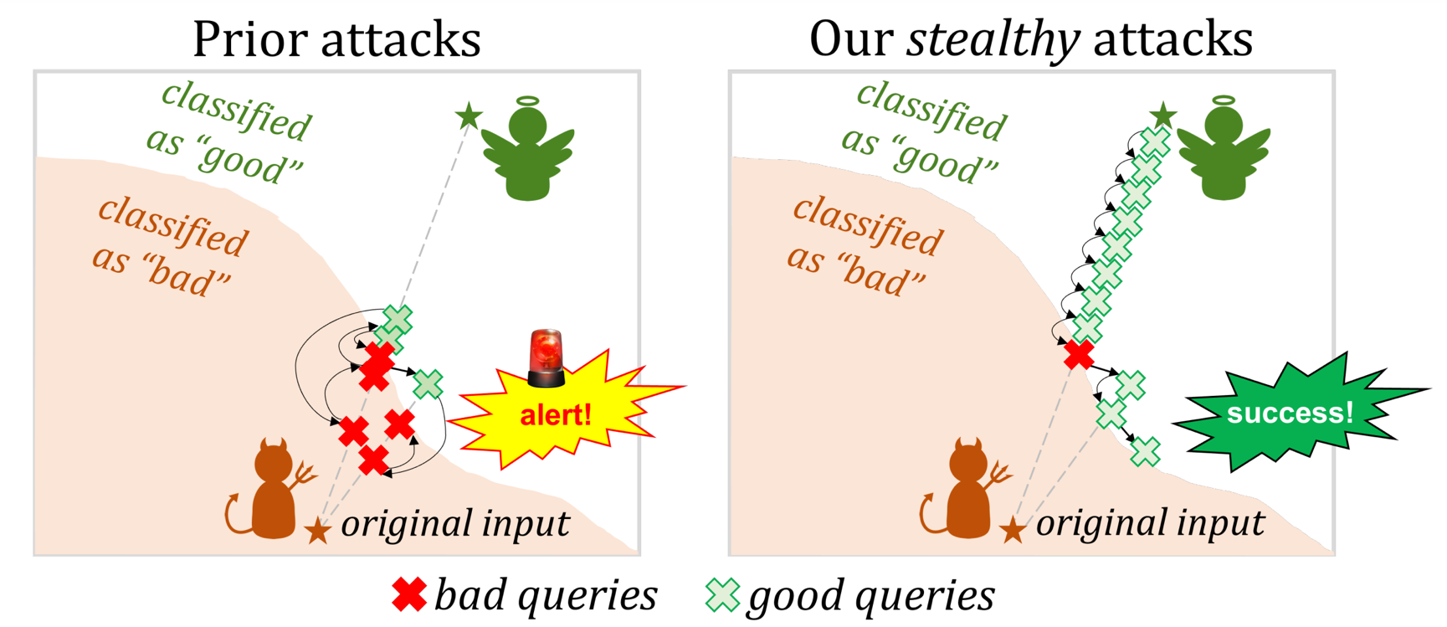
Our attacks ensure most queries are on the “good” side of the boundary.

Slide 20
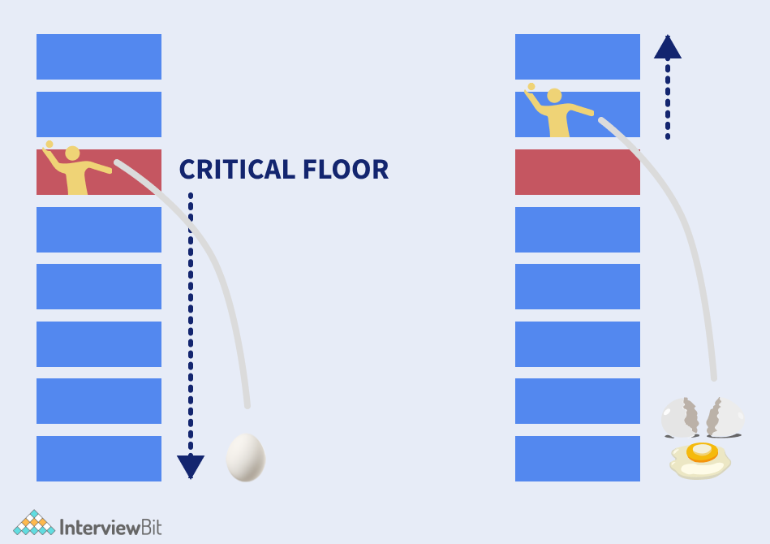
Inspiration: dropping eggs from buildings.
See paper for details!

Slide 21
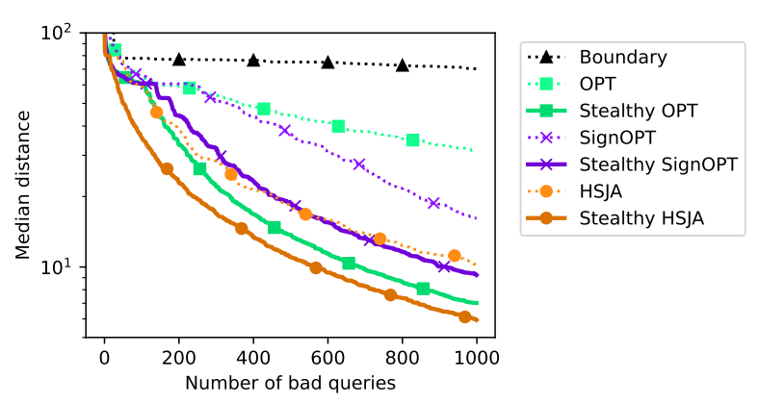
Our stealthy attacks make fewer “bad” queries, but many more “good” queries.

Slide 22
Our stealthy attacks make fewer “bad” queries, but many more “good” queries.
https://github.com/ethz-spylab/realistic-adv-examples

Slide 23
Take-away (Part I).
Black-box (query-based) attacks are not practical.
Existing attack optimize for the wrong metric
Stealthy attacks come at a high cost
Optimizing this new metric might require fundamentally new ideas!

Slide 24
Part II: New privacy attacks.
Privacy Side Channels in Machine Learning Systems. Debenedetti et al. 2023

Slide 25
Example: stateful defenses against query attacks.
Chen et al. 2019, Li et al. 2022
Many of these queries are very similar! This is an attack!!!

Slide 26
The issue: Sybil attacks.

Slide 27
“Solution”: global query log.

Slide 28
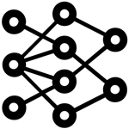
The new issue: cross-user query leakage.
honest user sends a sensitive query to the model

Slide 29
The new issue: cross-user query leakage.
attacker can detect if their query is similar!

Slide 30
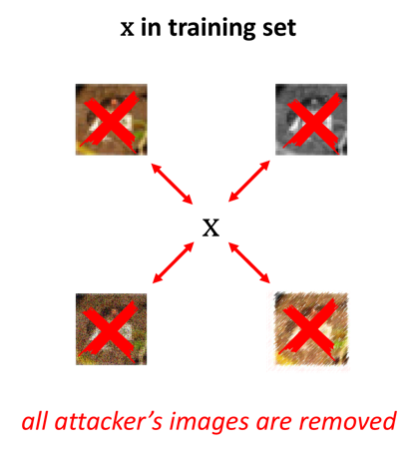
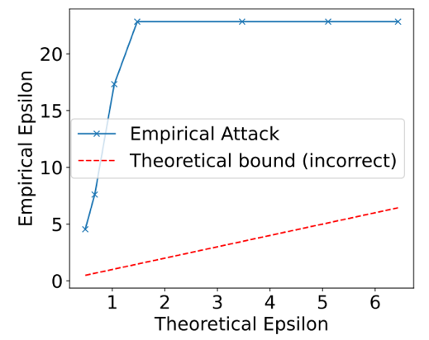
This is a side-channel attack.
more attacks in our paper...
Membership leakage from deduplication...
Data extraction from memorization filters...
“Breaking” Differential Privacy...

Slide 31
Conclusion.
Study the security of ML systems, not just models.
Current attacks make unrealistic assumptions about the system
System components are an underexplored attack surface

