Slide 1
Is anything really OOD anymore?
And what does this mean for privacy?
Florian Tramèr
ETH Zürich
(based on joint work with Gautam Kamath and Nicholas Carlini)

Slide 2
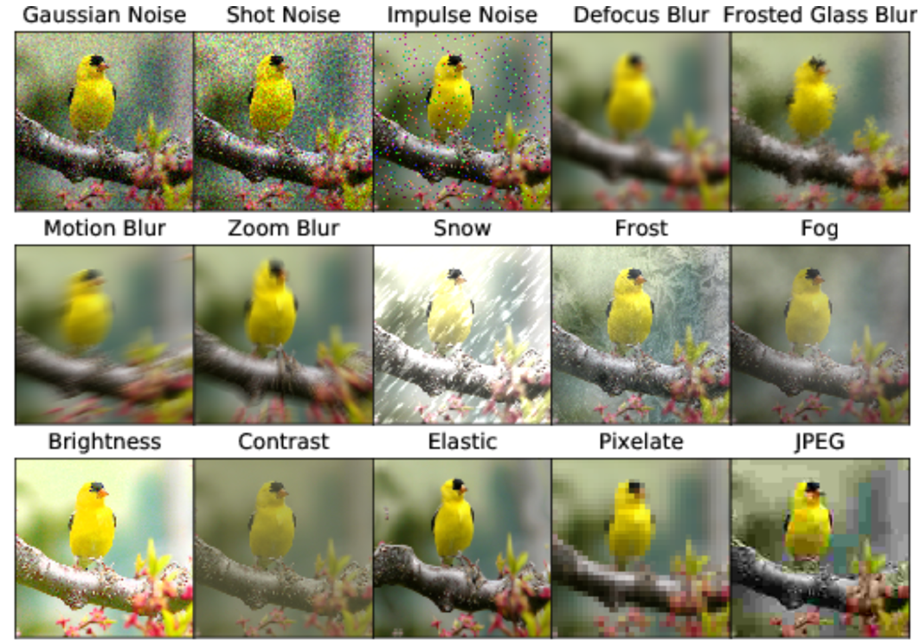
Models trained on one dataset can be brittle on slightly modified data.

Slide 3
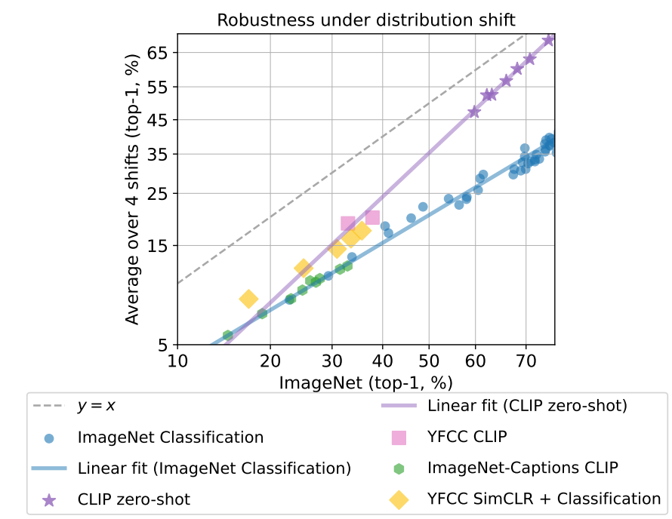
But many of these OOD benchmarks seem to be “solved” with more pre-training.
Fang et al. 2022

Slide 4
Is this still “out of distribution” generalization?

Slide 5



LAION
distribution
distribution

Slide 6

LAION
distribution
distribution
distribution

Slide 7
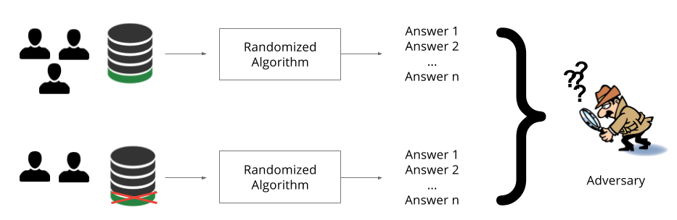
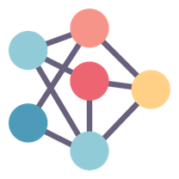
Today: what does recent “OOD progress” mean for private learning?
Training algorithm
your sensitive data
Training algorithm

Slide 8

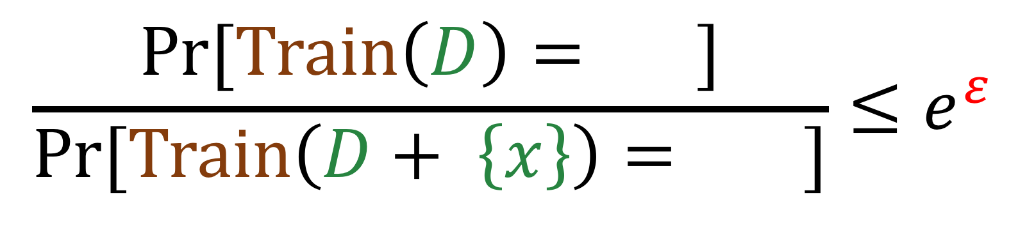
Formally: training with differential privacy
$$\frac{\text{Pr}[Train\left(D\right)= ]}{\text{Pr}[Train\left(D+ \left\{x\right\}\right)= ]}≤e^{ε}$$

Slide 9
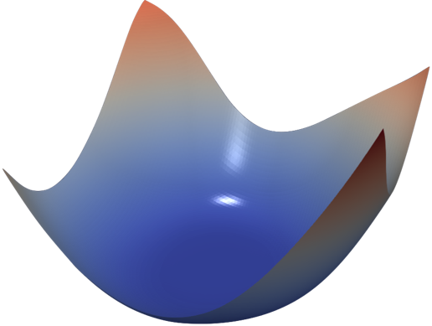
Differentially private learning is possible with noisy gradient descent.
Gradient descent
Private gradient descent
[Chaudhuri et al., ‘11], [Bassily et al. ‘14],
[Shokri & Shmatikov ‘15], [Abadi et al. ‘16], ...
add noise to each step to guarantee privacy

Slide 10
Training private ML models is challenging!
Differentially Private Learning Needs Better Features (or Much More Data). Tramèr & Boneh. 2021

Slide 11
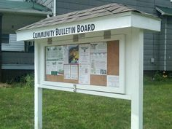
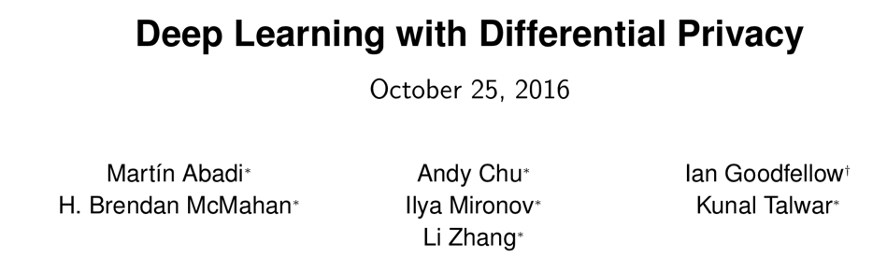
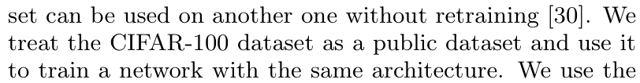
Solution? Leverage public data!
Making the Shoe Fit: Architectures, Initializations, and Tuning for Learning with Privacy. Papernot et al. 2019

Slide 12
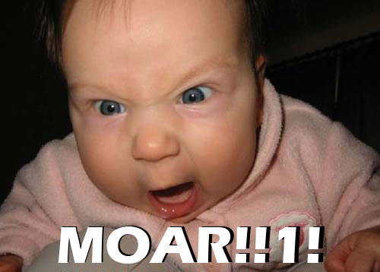
Moar public data!
5% gap!
with unlabeled ImageNet as the public data

Slide 13
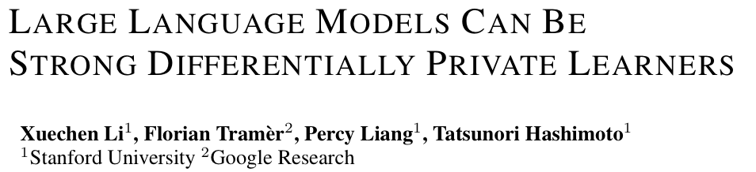
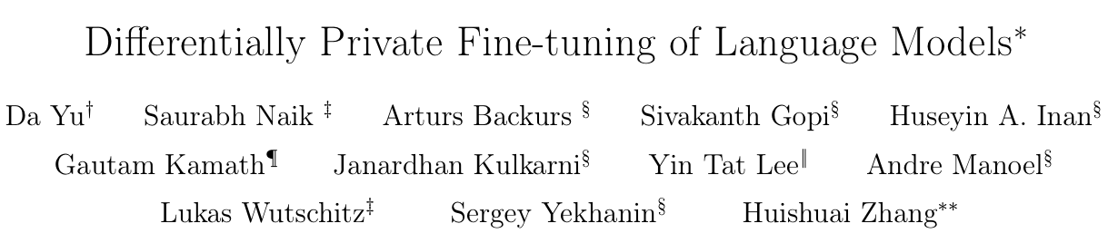
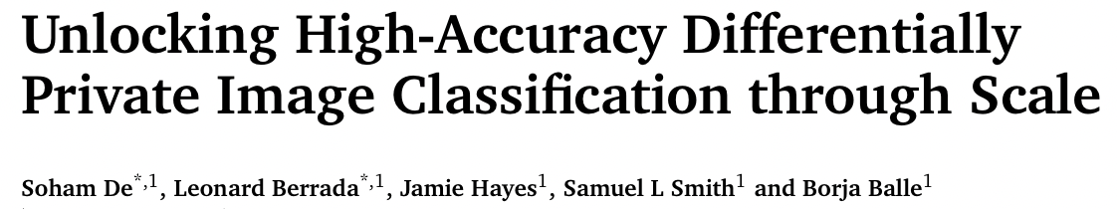
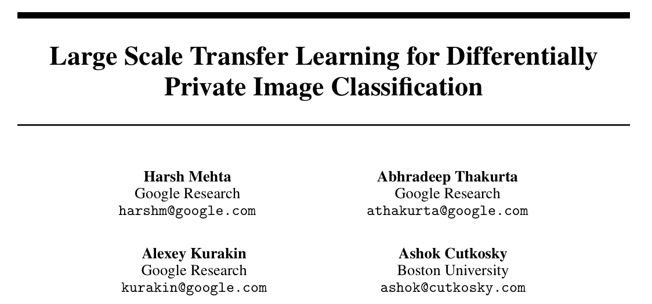
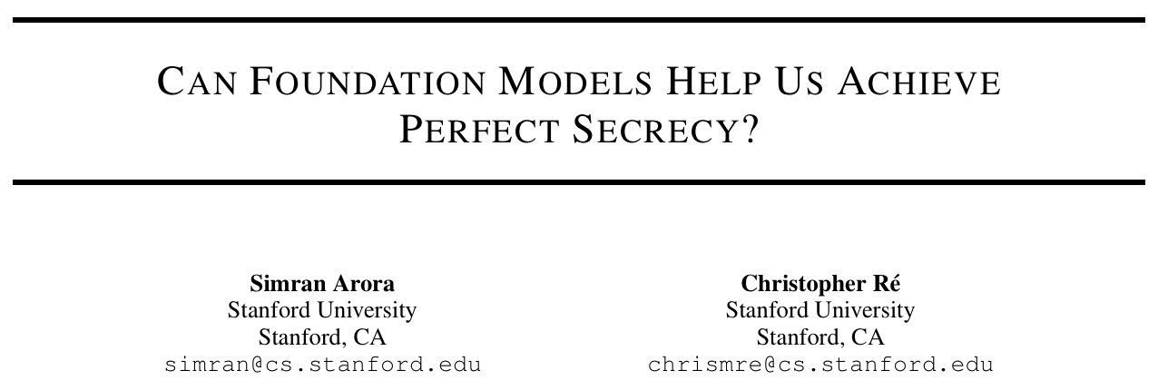
Even moar public data!

Slide 14
The nirvana: zero-shot privacy.

Slide 15
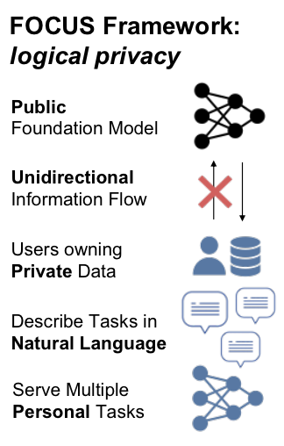
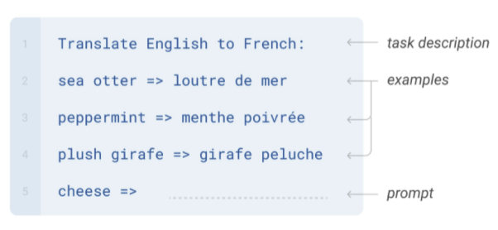
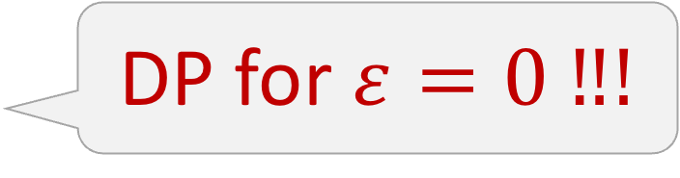
The nirvana: zero-shot privacy.
DP for $ε=0 ‼!$

Slide 16
Zero-shot learning “solves” many
“privacy benchmarks”!
CIFAR-10: 97% zero-shot acc with OpenCLIP (LAION pretraining)
ImageNet: 88.8% zero-shot acc with JFT pretraining
Near-SOTA accuracy with *perfect* privacy!

Slide 17


Slide 18
Two (possible) issues for private learning.
Is public pre-training cheating?
Does public pre-training work?

Slide 19
Two (possible) issues for private learning.
Is public pre-training cheating?
Does public pre-training work?

Slide 20


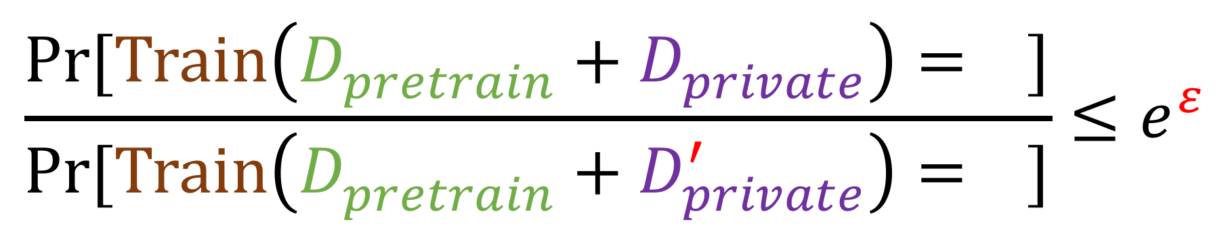
Does public pretraining still preserve “privacy”?
$$\frac{\text{Pr}[Train\left(D_{pretrain}^{}+D_{private}^{}\right)= ]}{\text{Pr}[Train\left(D_{pretrain}^{}+D_{private}^{′}\right)= ]}≤e^{ε}$$

Slide 21
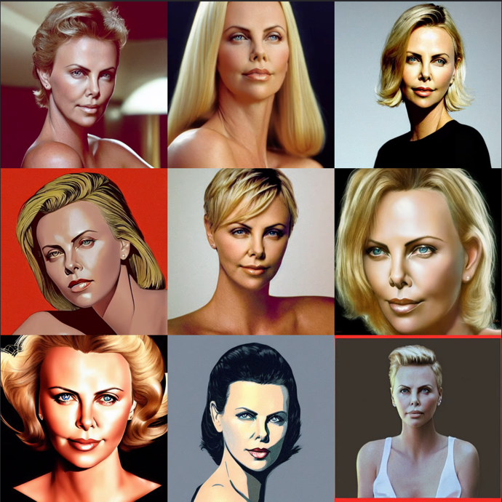
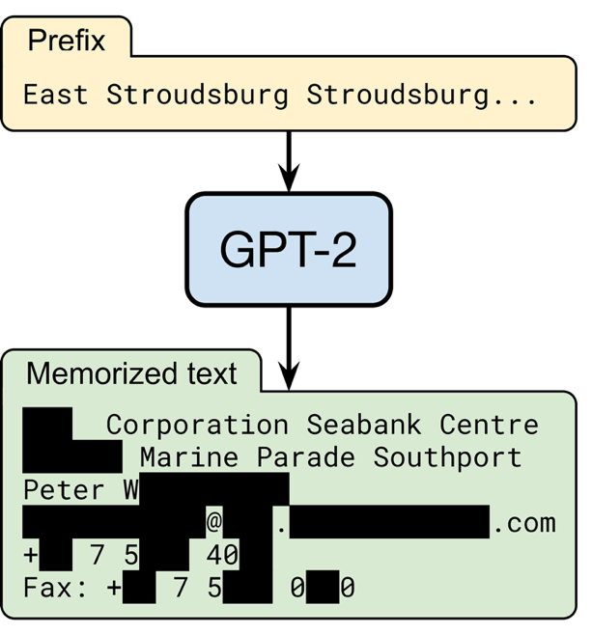
But is this “privacy preserving”?

Slide 22
Two (possible) issues for private learning.
Is public pre-training cheating?
Does public pre-training work?

Slide 23

A little secret...

Slide 24
No one cares about CIFAR-10 or ImageNet!

Slide 25
What makes a good benchmark?
The benchmark is a proxy for a general task we care about
(e.g. image classification)
Progress on the benchmark is (somewhat) predictive of performance on the general task

Slide 26
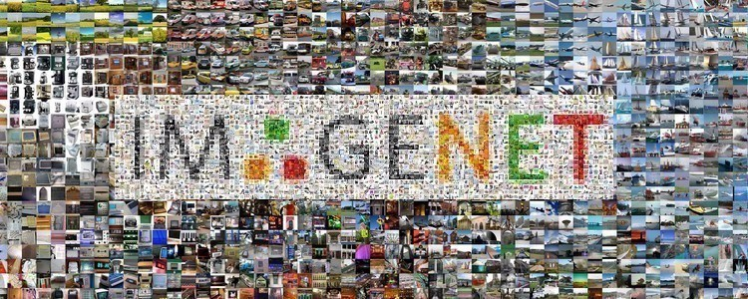
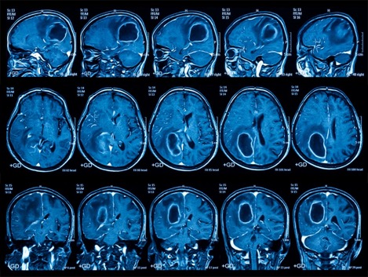
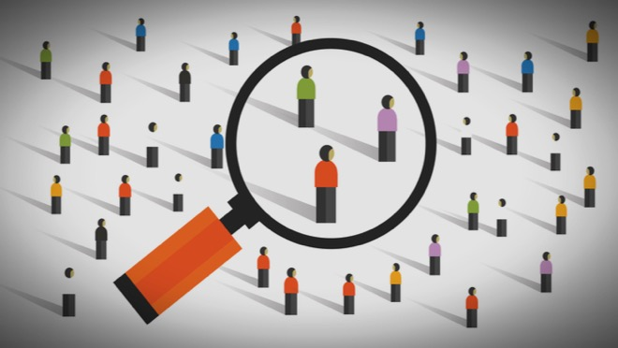
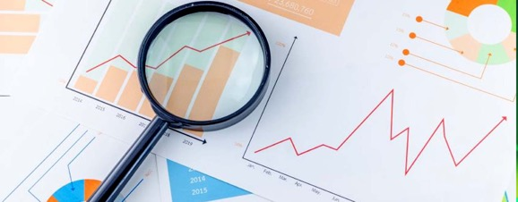
What tasks do we really care about solving with privacy?

Slide 27

Are current benchmarks at least tracking algorithmic progress on private learning?
Tasks we care about solving privately are
(by definition) less likely to be represented on the Internet
Recent improvements on “private” benchmarks seem mainly due to generic improvements in zero-shot learning

Slide 28
Open problems

Slide 29



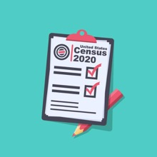


How good is public pretraining for sensitive data that is not well represented on the Web?

Slide 30




How good would public pretraining be if we removed all sensitive data?

Slide 31
Outlook
Should Internet data be free game for “privacy-preserving” ML?
How useful is public pretraining on highly sensitive data?
Would public pretraining on non-sensitive data be as useful?
We need better privacy benchmarks to answer these questions!

