Slide 1
Differentially Private Learning Needs Better Features
Florian Tramèr
Stanford University

Slide 2


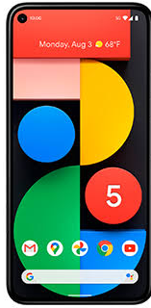

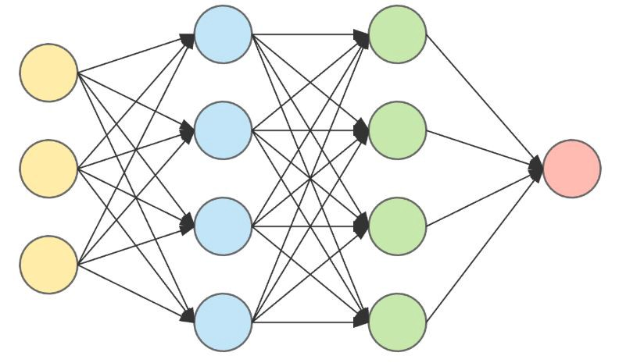
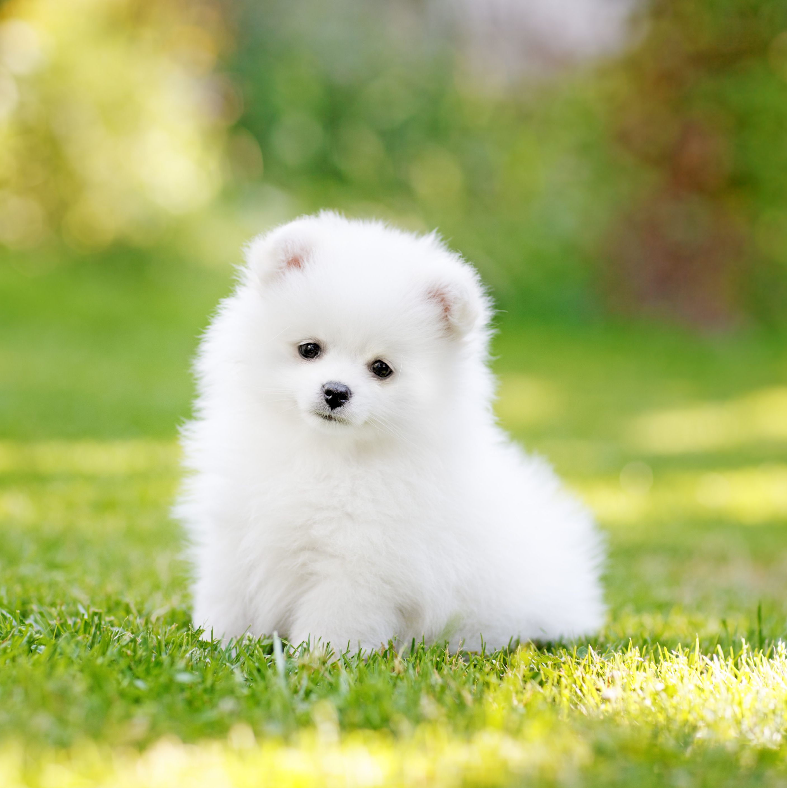
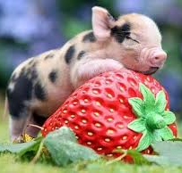
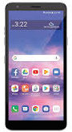
Goal: train a ML model with “privacy”
?

Slide 3
Goal: train a ML model with “privacy”
what does this mean?
how can we achieve this?
what’s next?

Slide 4

Goal: train a ML model with “privacy”
what does this mean? data secrecy
?
sees all your data

Slide 5

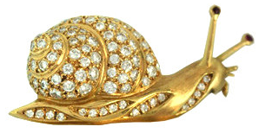
Goal: train a ML model with “privacy”
what does this mean? data secrecy
how can we achieve this? federated ML, MPC, FHE, ...
?
slow & expensive

Slide 6

Goal: train a ML model with “privacy”
what does this mean? data secrecy
how (else) can we achieve this? learning on “encoded” data
[Huang et al. ’20], [Raynal et al. ’20], ...
?
...but enable learning
encoded data should preserve privacy...

Slide 7

Goal: private learning on “encoded” data
Example: InstaHide [Huang et al. ICML ’20]
map pixel space
[0, 255] to [-1, 1]
private data
public data
Encode( ):
1) Mixing: λ₁ + λ₂ + λ₃ = ∈ [-1, 1]^{d}
2) “high-order bit flip”: σ ←^{R} {-1, 1}^{d}
no formal privacy guarantee…
learning still works!
⊙ σ =

Slide 8
We show a reconstruct ion attack on InstaHide.
InstaHide
Attack
Is Private Learning Possible with Instance Encoding?, IEEE Security & Privacy 2021

Slide 9
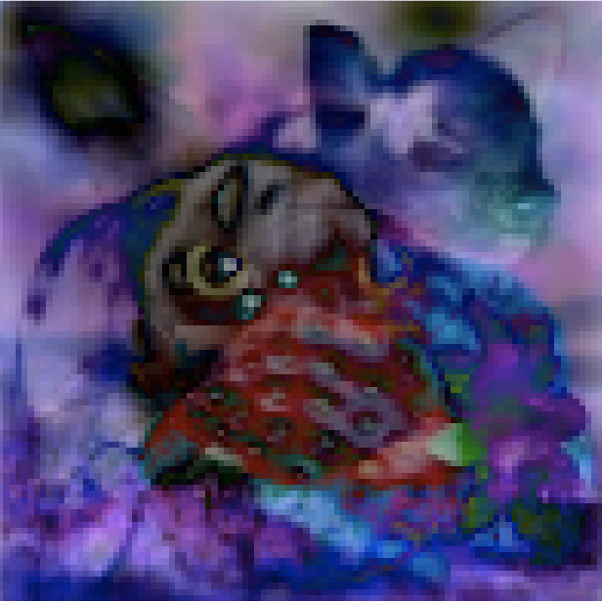
We show a reconstruct ion attack on InstaHide.
this is clearly not private!!!
Undo the random bit flip
abs( ) = abs( ⊙ σ ) = abs( ) =
Is Private Learning Possible with Instance Encoding?, IEEE Security & Privacy 2021

Slide 10
We show a reconstruct ion attack on InstaHide.
full
Undo the random bit flip
Learn to “recolor” mixed images
GAN
Is Private Learning Possible with Instance Encoding?, IEEE Security & Privacy 2021

Slide 11
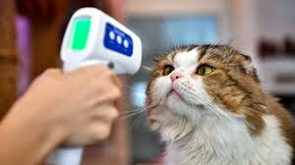
We show a reconstruct ion attack on InstaHide.
full
Undo the random bit flip
Learn to “recolor” mixed images
Undo the mixing by finding the most similar public images
SIM( , ) = 0.42
SIM( , ) = 0.07
-
-
=
...
SIM( , ) = 0.79
More attacks
Impossibility results
Is Private Learning Possible with Instance Encoding?, IEEE Security & Privacy 2021

Slide 12
Goal: train a ML model with “privacy”
what does this mean? data secrecy
how (else) can we achieve this? learning on “encoded” data
?

Slide 13
Goal: train a ML model with “privacy”
what does this mean? data secrecy
how can we achieve this? federated ML, MPC, FHE, ...
?
slow & expensive

Slide 14
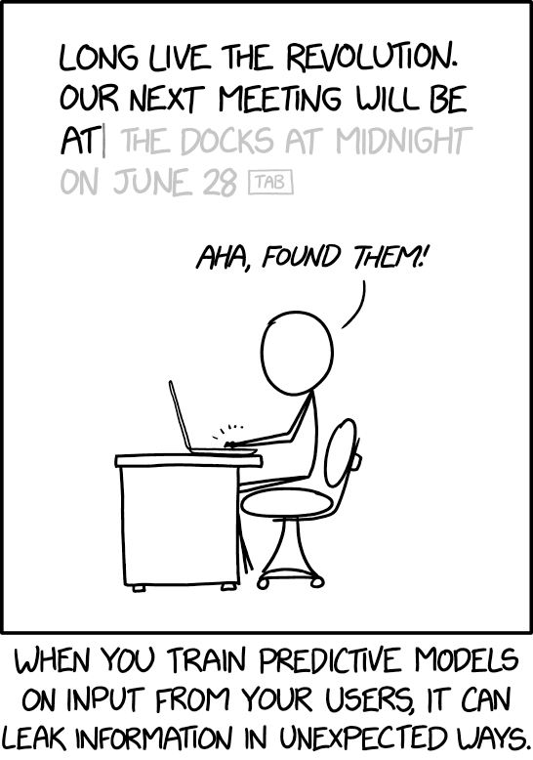
Is data secrecy sufficient?
No! The ideal functionality itself can be non-private

Slide 15
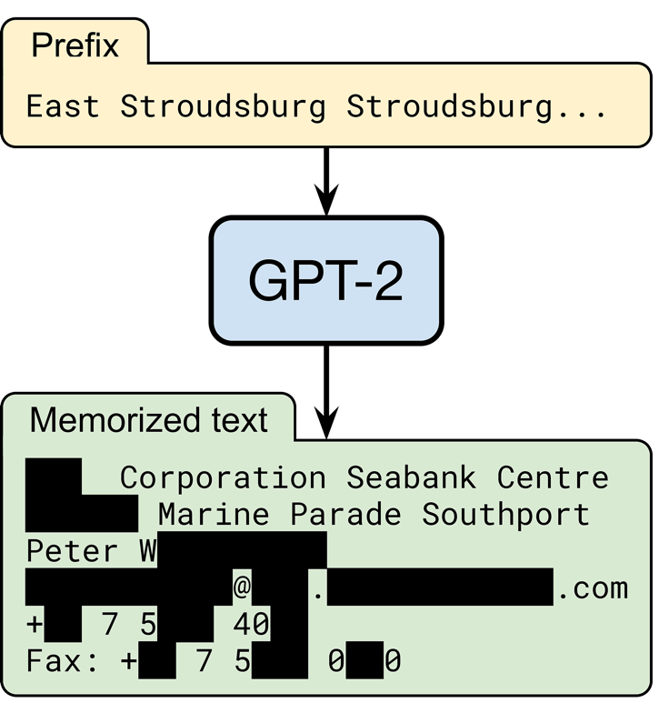
Models memorize their training data.
random input
OpenAI’s language model trained on text from 8 million web pages
someone’s contact information
output by the model
(redacted for privacy)
Extracting Training Data from Large Language Models, preprint 2021

Slide 16
Larger models are less private.
Extracting Training Data from Large Language Models, preprint 2021

Slide 17
Larger models are less private.
Reddit URLs found in a pastebin file in the GPT-2 training set
Extracting Training Data from Large Language Models, preprint 2021

Slide 18
Larger models are less private.
Reddit URLs found in a pastebin file in the GPT-2 training set
Some URLs appear many times in this pastebin file
Extracting Training Data from Large Language Models, preprint 2021

Slide 19
Larger models are less private.
Reddit URLs found in a pastebin file in the GPT-2 training set
Different GPT-2 models:
XL: 1558M params
M: 334M params
S: 124M params
URL is memorized fully or partially
Some URLs appear many times in this pastebin file
Extracting Training Data from Large Language Models, preprint 2021

Slide 20
Larger models are less private.
the largest GPT-2 model memorized an entire URL that appeared only 33 times in a single document
Extracting Training Data from Large Language Models, preprint 2021

Slide 21

Goal: train a ML model with “privacy”
what does this mean? no training data leakage
?

Slide 22
Preventing data leakage with decade-old ML
provably prevent leakage of training data.
using differential privacy
better accuracy than with deep learning methods.
using domain-specific feature engineering

Slide 23


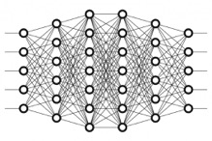

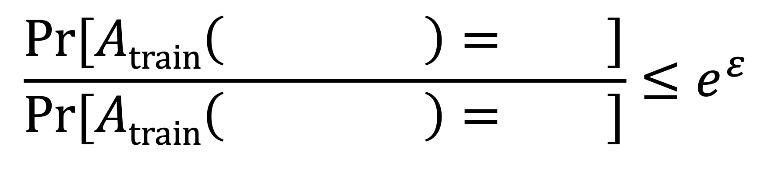
Goal: train a ML model with “privacy”
what does this mean? no training data leakage
how can we achieve this? differential privacy
intuition: randomized training algorithm is not influenced (too much) by any individual data point
for any two datasets that differ in a single element
$$\frac{\text{Pr}[Atrain\left( \right)= ]}{\text{Pr}[Atrain\left( \right)= ]}≤e^{ε}$$

Slide 24
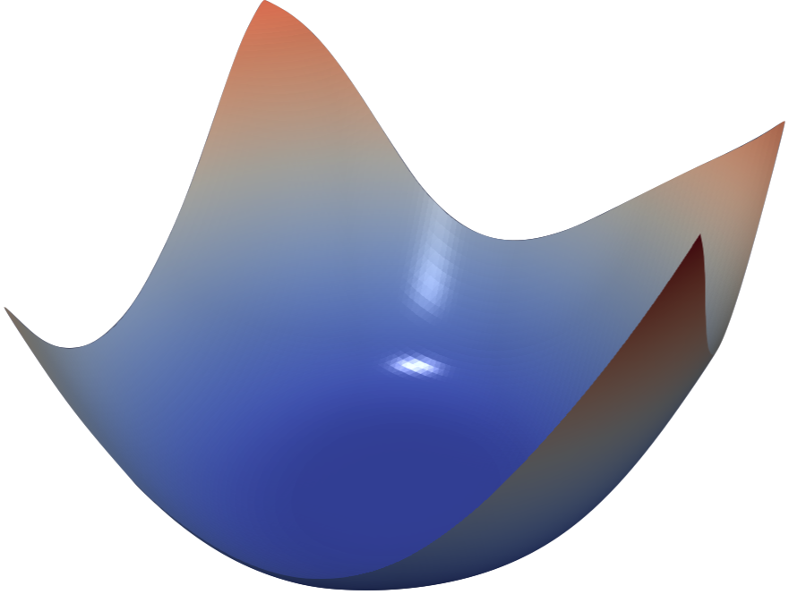
How? Private Gradient Descent
gradient descent
(SGD)
private gradient descent
(DP-SGD)
add noise to guarantee DP
Chaudhuri et al., ’11; Bassily et al. ’14;
Shokri & Shmatikov ’15; Abadi et al. ’16

Slide 25
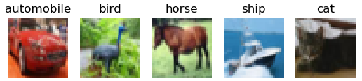
Non-private deep learning can achieve near-perfect accuracy.
“deep learning era”
25

Slide 26
Differentially private deep learning lowers accuracy significantly.
“deep learning era”
26

Slide 27
Differentially private deep learning lowers accuracy significantly.
−40% accuracy!
worse than pre-deep learning
“deep learning era”
27

Slide 28
Differential privacy without deep learning improves accuracy.
no deep learning!
“deep learning era”
Differentially Private Learning Needs Better Features (or Much More Data), ICLR 2021
28

Slide 29
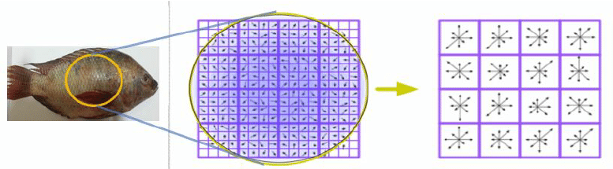
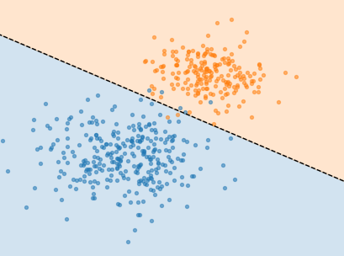
Privacy-free features from “old-school” image recognition.
SIFT [Lowe ‘99, ‘04], HOG [Dalal & Triggs ‘05], SURF [Bay et al. ‘06], ORB [Rublee et al. ‘11], ...
Scattering transforms [Bruna & Mallat ‘11], [Oyallon & Mallat ‘14], ...
“handcrafted features”
(no learning involved)
simple classifier
(e.g., logistic regression)
captures some prior about the domain: e.g., invariance under rotation & scaling
privacy free
29

Slide 30
Handcrafted features lead to a better tradeoff between accuracy and privacy.
Better
Differentially Private Learning Needs Better Features (or Much More Data), ICLR 2021
30

Slide 31
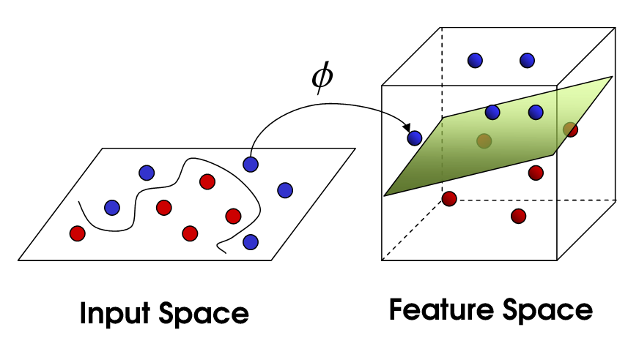
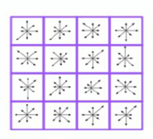
Handcrafted features lead to an easier learning task (for noisy gradient descent).
high accuracy classifier exists but learning takes
many gradient steps
in feature space, maximal accuracy is reduced but learning progresses faster
bad for privacy
good for privacy
31

Slide 32
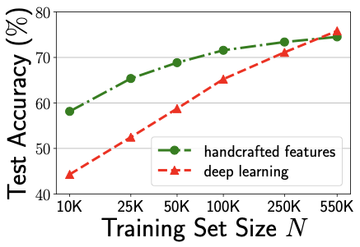
Surpassing handcrafted features with more private data.
(for ε = 3)
Differentially Private Learning Needs Better Features (or Much More Data), ICLR 2021
32

Slide 33
Surpassing handcrafted features with more private data.
(for ε = 3)
CIFAR-10
Differentially Private Learning Needs Better Features (or Much More Data), ICLR 2021
33

Slide 34
Surpassing handcrafted features with more private data.
(for ε = 3)
With 10x more private data end-to-end deep learning performs best
Differentially Private Learning Needs Better Features (or Much More Data), ICLR 2021
34

Slide 35
Surpassing handcrafted features with more private data.
(for ε = 3)
In very low data regimes, the gap is even larger!
Differentially Private Learning Needs Better Features (or Much More Data), ICLR 2021
35

Slide 36
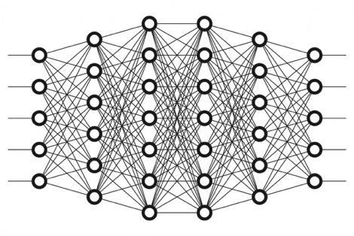

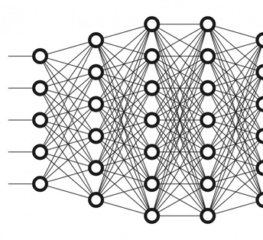
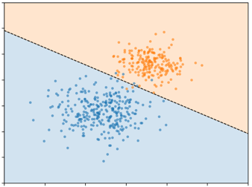
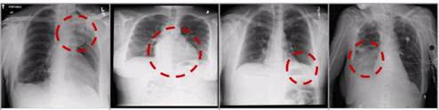
Surpassing handcrafted features with more public data.
train a feature extractor on public data...
public data
...transfer and fine-tune on private data
private data
privacy free
Differentially Private Learning Needs Better Features (or Much More Data), ICLR 2021
36

Slide 37
With access to a public dataset, privacy comes almost for free!
5% gap!
with unlabeled ImageNet as the public data
Differentially Private Learning Needs Better Features (or Much More Data), ICLR 2021
37

Slide 38
Goal: train a ML model with “privacy”
what does this mean?
  data secrecy
  no training data leakage
how can we achieve this?
  (strong) cryptography
  differential privacy (+ feature engineering!)
what’s next?

Slide 39
Can we bridge the accuracy gap in differentially private learning?
still a 30% accuracy gap!

Slide 40
How much privacy do we really get from DP-SGD?
This generic ML algorithm also satisfies 𝜖 ≥ 3:
  training accuracy = 95%
  test accuracy = 5%
This is not private at all!
this privacy budget is high!
Does this actually prevent all practical attacks?

Slide 41
Is differential privacy sufficient?
No! We also need secure decentralized training
?
still sees all your data!
It’s okay! I’m training with differential privacy™️

Slide 42
Conclusion
Machine learning is not private “by default”!
  Without (strong) cryptography, you must trust someone with your data
  Trained models leak rare training data
Solutions exist but we need to make them more efficient!
  Secure decentralized learning has high overhead
  Differential privacy needs good features or a lot more data!
  Privacy guarantees must be rigorously defined!
Thank you!

