Slide 1
FairTest:
Discovering unwarranted associations in data-driven applications
IEEE EuroS&P
April 28th, 2017
Florian Tramèr¹, Vaggelis Atlidakis², Roxana Geambasu², Daniel Hsu²,
Jean-Pierre Hubaux³, Mathias Humbert⁴, Ari Juels⁵, Huang Lin³
¹Stanford University, ²Columbia University, ³École Polytechnique Fédérale de Lausanne,
⁴Saarland University, ⁵Cornell Tech

Slide 2
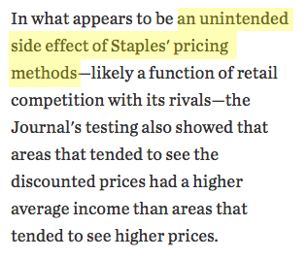
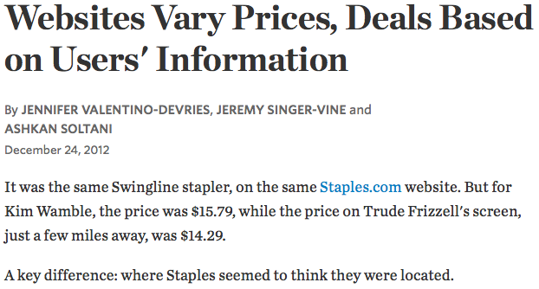
“Unfair” associations + consequences

Slide 3
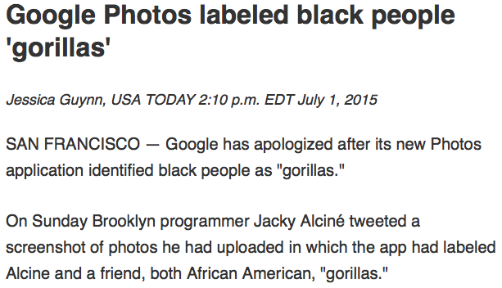
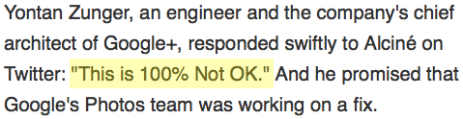
“Unfair” associations + consequences
These are software bugs: need to actively test for them and fix them (i.e., debug) in data-driven applications…
just as with functionality, performance, and reliability bugs.

Slide 4
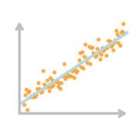
Unwarranted Associations Model
Data-driven application
User inputs
Application outputs
Protected inputs

Slide 5
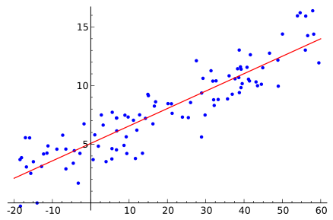
Limits of preventative measures
What doesn’t work:
Hide protected attributes from data-driven application.
Aim for statistical parity w.r.t. protected classes and service output.
Foremost challenge is to even detect these
unwarranted associations.

Slide 6
A Framework for Unwarranted Associations
Specify relevant data features:
  Protected variables (e.g., Gender, Race, …)
  “Utility”: a function of the algorithm’s output (e.g., Price, Error rate, …)
  Explanatory variables (e.g., Qualifications)
  Contextual variables (e.g., Location, Job, …)
Find statistically significant associations between protected attributes and utility
  Condition on explanatory variables
  Not tied to any particular statistical metric (e.g., odds ratio)
Granular search in semantically meaningful subpopulations
  Efficiently list subgroups with highest adverse effects

Slide 7
FairTest: a testing suite for data-driven apps
Finds context-specific associations between protected variables and application outputs, conditioned on explanatory variables
Bug report ranks findings by assoc. strength and affected pop. size
location, click, …
prices, tags, …
Data-driven application
User inputs
Application outputs
race, gender, …
Protected vars.
FairTest
zip code, job, …
Context vars.
Explanatory vars.
qualifications, …
Association bug report for developer

Slide 8

A data-driven approach
Core of FairTest is based on statistical machine learning
FairTest
Find context-specific associations
Data
Training data
Test data
Statistically validate associations
Ideally sampled from relevant user population
Statistical machine learning internals:
top-down spatial partitioning algorithm
confidence intervals for assoc. metrics
…

Slide 9
Reports for Fairness bugs
Example: simulation of location based pricing scheme
Test for disparate impact on low-income populations
  Low effect over whole US population
  High effects in specific sub-populations

Slide 10

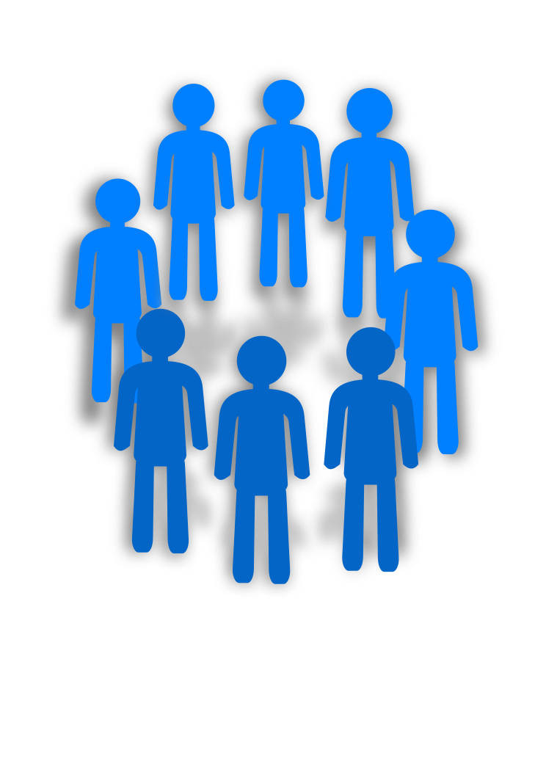
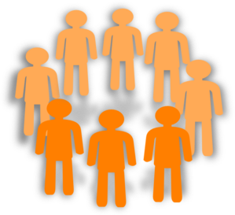
Association-Guided Decision Trees
Goal: find most strongly affected user sub-populations
A
C
Occupation
Split into sub-populations with Increasingly strong associations between protected variables
and application outputs
B
…
< 50
Age
≥ 50
…
…

Slide 11
Association-Guided Decision Trees
Efficient discovery of contexts with high associations
Outperforms previous approaches based on frequent itemset mining
Easily interpretable contexts by default
Association-metric agnostic
Greedy strategy (some bugs could be missed)
Metric | Use Case
Binary ratio/difference | Binary variables
Mutual Information | Categorical variables
Pearson Correlation | Scalar variables
Regression | High dimensional outputs
Plugin your own! | ???

Slide 12
Example: healthcare application
Predictor of whether patient will visit hospital again in next year
(from winner of 2012 Heritage Health Prize Competition)
FairTest findings: strong association between age and prediction error rate
age, gender,
# emergencies, …
Hospital
re-admission predictor
Will patient be re-admitted?
Association may translate to quantifiable harms
(e.g., if model is used to adjust insurance premiums)

Slide 13
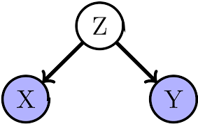
Debugging with FairTest
Are there confounding factors?
Do associations disappear after conditioning?
  ⇒ Adaptive Data Analysis!
Example: the healthcare application (again)
  Estimate prediction confidence (target variance)
  Does this explain the predictor’s behavior?
  Yes, partially
High confidence in prediction
FairTest helps developers understand & evaluate potential association bugs.

Slide 14
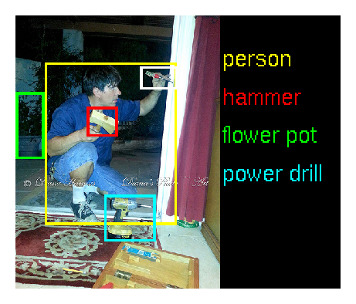

Other applications studied using FairTest
Image tagger based on ImageNet data
  ⇒ Large output space (~1000 labels)
  ⇒ FairTest automatically switches to regression metrics
  ⇒ Tagger has higher error rate for pictures of black people
Simple movie recommender system
  ⇒ Men are assigned movies with lower ratings than women
  ⇒ Use personal preferences as explanatory factor
  ⇒ FairTest finds no significant bias anymore

Slide 15
Closing remarks
The Unwarranted Associations Framework
  Captures a broader set of algorithmic biases than in prior work
  Principled approach for statistically valid investigations
FairTest
  The first end-to-end system for evaluating algorithmic fairness
Developers need better statistical training and tools
to make better statistical decisions and applications.
http://arxiv.org/abs/1510.02377
Thanks!

Slide 16
Example: Berkeley graduate admissions
Admission into UC Berkeley graduate programs
(Bickel, Hammel, and O’Connell, 1975)
Bickel et al’s (and also FairTest’s) findings: gender bias in admissions at university level, but mostly gone after conditioning on department
Graduate admissions committees
age, gender, GPA, …
Admit applicant?
FairTest helps developers understand & evaluate potential association bugs.

