Slide 1
Making Machine Learning Fail
Florian Tramèr
Notes:
noticed an inflection point in this field

Slide 2
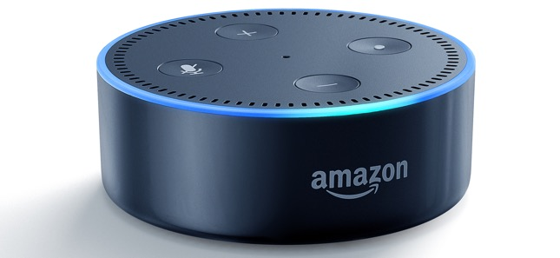
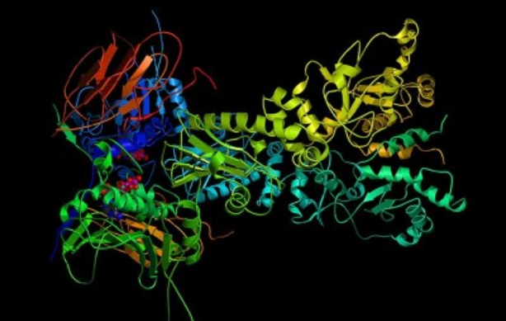
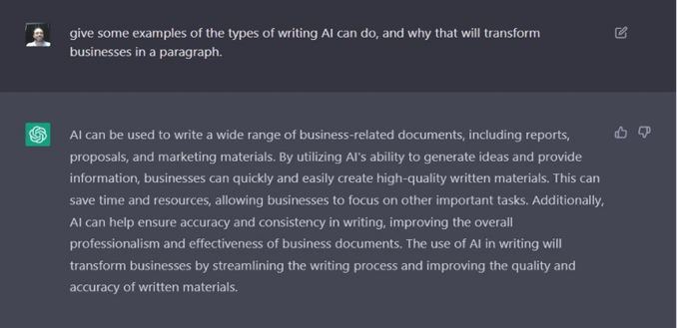
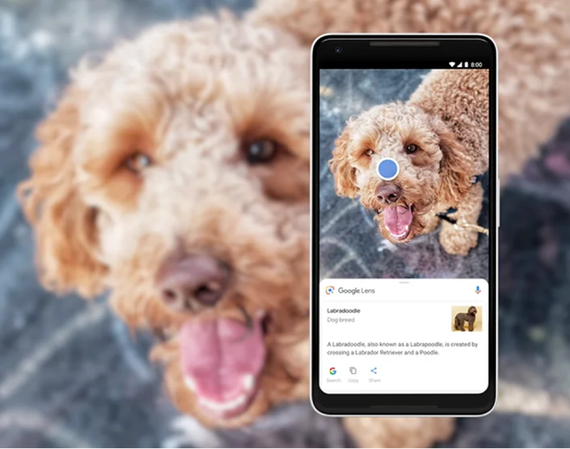
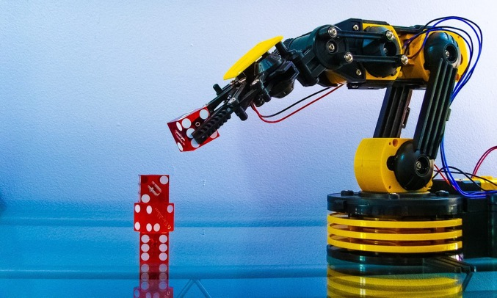
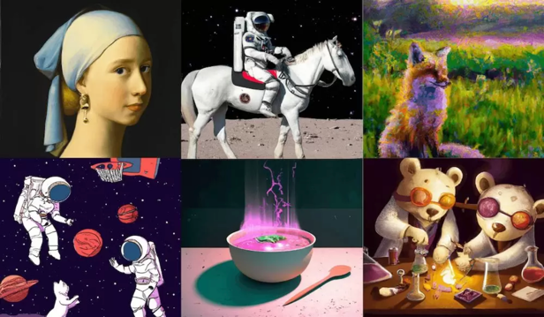
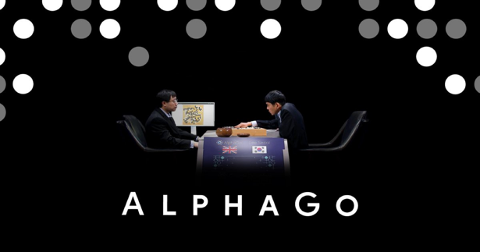
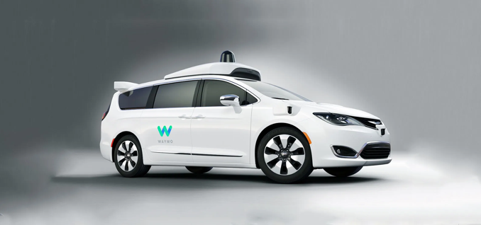
Notes:
it is in products some of us use every day
machine learning has been recognized as part of major scientific breakthroughs in the past few years, such as in protein folding, or game playing, and more recently in data generation
And then there are applications of machine learning that, if successful, would radically change the way we work and live: things like personalized artificial assistants, smart robots, or of course self-driving cars

Slide 3
Notes:
it is in products some of us use every day

Slide 4
Notes:
machine learning has been recognized as part of major scientific breakthroughs in the past few years, such as in protein folding, or game playing, and more recently in data generation

Slide 5
Notes:
And then there are applications of machine learning that are more speculative, if successful, would radically change the way we work and live: things like personalized artificial assistants, smart robots, or of course self-driving cars

Slide 6
Machine learning still fails (a lot).
Notes:
While ML has made astonishing and surprising progress, its failures are often just as astonishing and surprising

Slide 7
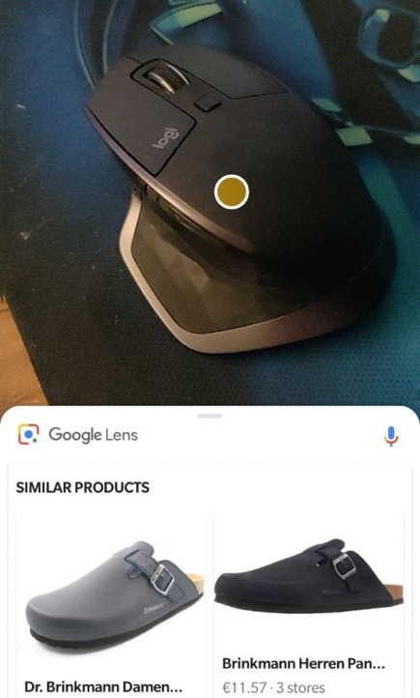
Machine learning can fail... to recognize “confusing” objects.

Slide 8
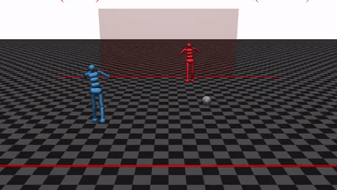
Machine learning can fail... to adapt to unusual scenarios.

Slide 9
Machine learning can fail... to draw hands.
Notes:
some machine learning models can generate extraordinary art, but somehow have no clue what a hand should look like

Slide 10
Machine learning can fail... to protect training data.
from the Bible (1 Kings 7:2)
Notes:
ML systems can also fail in ways that leaks information about the data that they learned from

Slide 11
Machine learning can fail... against internet trolls.

Slide 12
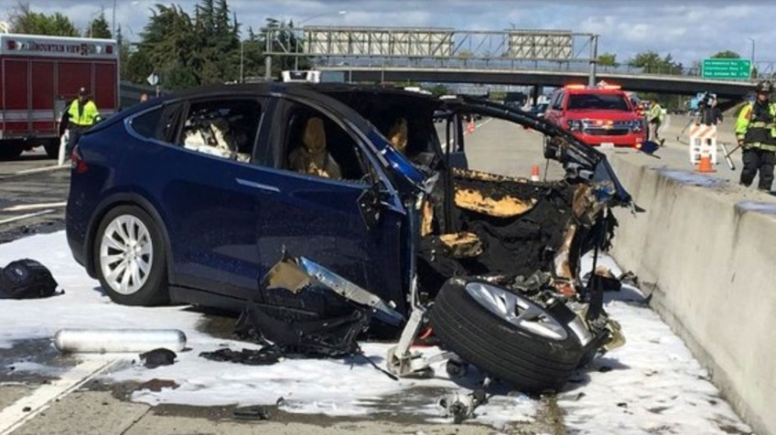
Machine learning can fail... when life is at stake.

Slide 13
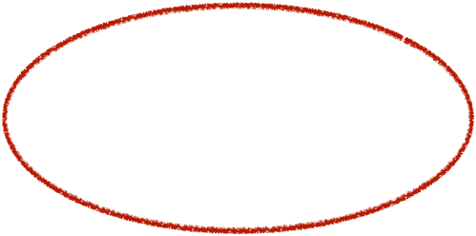
Making Machine Learning Fail
Notes:
why would we do that???

Slide 14
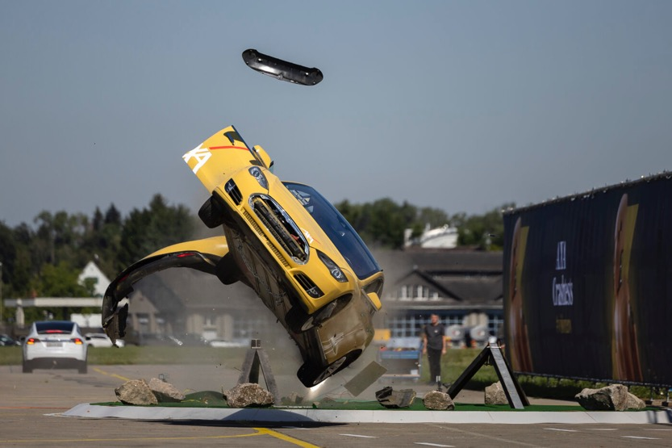
We study machine learning from an adversarial perspective
to build machine learning “crash tests”
to understand the security and privacy risks of machine learning

Slide 15
What is machine learning?
Traditional programming:
Data
Computer
Output
Program
Machine learning:
Data
Computer
…
Program Program(Data) $≈$ Output
Output
…
Notes:
6m INFER

Slide 16
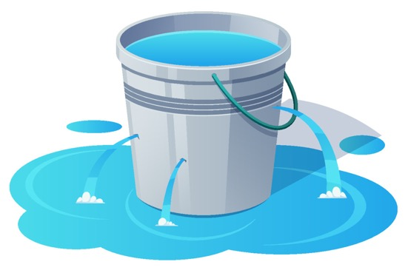
Two failure modes of machine learning.
Machine learning is brittle
Machine learning is leaky

Slide 17
Two failure modes of machine learning.
Machine learning is brittle
Machine learning is leaky

Slide 18
Adversarial examples: a curious bug in machine learning.
90% Tabby Cat
Adversarial noise
100% Guacamole
[Szegedy et al. ‘13], [Biggio et al. ‘13], [Goodfellow et al. ‘14], ...
Notes:
8m

Slide 19
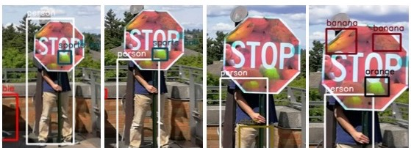
Adversarial examples are a safety risk.
Physical Adversarial Examples for Object Detectors, Eykholt, Evtimov, Fernandes, Li, Rahmati, Tramèr, Prakash, Kohno and Song. WOOT 2018.

Slide 20
Adversarial examples are an attack vector.
100M active users
AdVersarial: Perceptual Ad Blocking meets Adversarial Machine Learning, Tramèr, Dupré, Rusak, Pellegrino and Boneh. ACM CCS 2019.
Notes:
But there are other settings where there clearly are adversaries with financial incentive to attack a machine learning system.
One example we looked at are online ad-blockers. A few years ago, Adblockplus, one of the leading web adblockers, started experimenting with using machine learning models to detect ads

Slide 21
Adversarial examples are an unsolved problem.
denoising
randomization
dimensionality reduction
input transformations
generative modeling
Bayesian learning
...
On Adaptive Attacks to Adversarial Example Defenses,
Tramèr, Carlini, Brendel and Madry. NeurIPS 2020.
Notes:
12m These adversarial examples were first discovered about ten years ago, and at the time people mainly thought that this was a curious failure mode that would be quite easy to fix.
Boy were they wrong. Researchers have tried essentially every technique imaginable to build models that are robust to these types of attacks. And except in very restricted settings, all these defense attempts have failed.
But this isn’t always easy to see. Two years ago with some colleagues we looked at 13 peer-reviewed studies that claimed to have found a way to prevent these attacks.
And we showed that all 13 of them were in fact still broken, and just hadn’t been evaluated properly.

Slide 22
Two failure modes of machine learning.
Machine learning is brittle
Machine learning is leaky
Notes:
So we’ve seen that despite working so well, machine learning models are still surprisingly brittle

Slide 23
Two failure modes of machine learning.
Machine learning is brittle
Machine learning is leaky
Notes:
Now we’re going to talk about a different type of failure mode, where machine learning is prone to leaking information about its training data

Slide 24
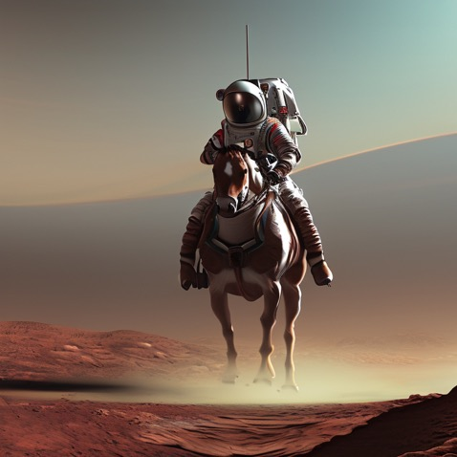
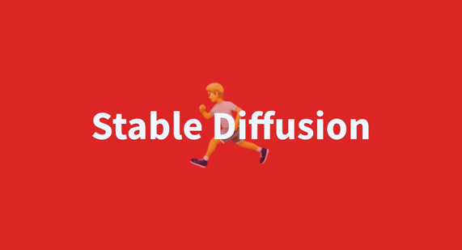
Machine learning can generate data.
Description
Computer
…
Program Program(Description) $≈$ Data
Data
…
“an astronaut riding a horse on mars”
Notes:
14m

Slide 25
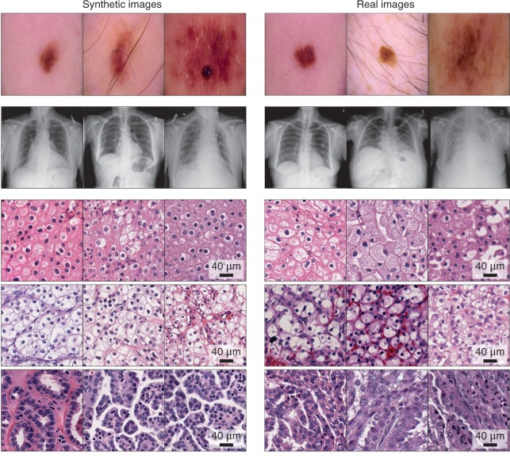
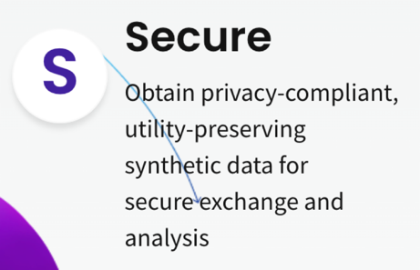
Synthetic
Real
Notes:
15m these generative models aren't just useful for creating cute art.
the killer application for these models is that they could be used to create synthetic data, which has really become a buzzword in the tech startup sector

Slide 26
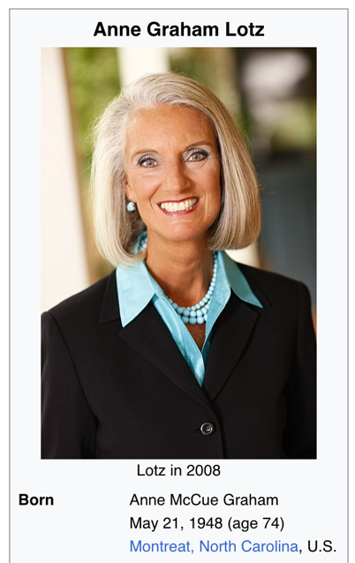
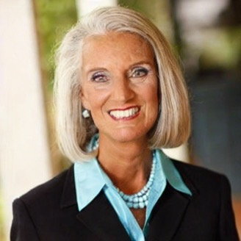
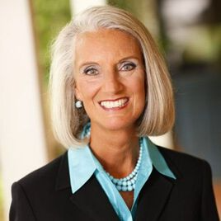
Generated data isn’t always synthetic.
“Ann Graham Lotz”
Extracting Training Data from Diffusion Models,
Carlini, Hayes, Nasr, Jagielski, Sehwag, Tramèr, Balle, Ippolito and Wallace. preprint 2023.
Notes:
16m

Slide 27
Original

Slide 28
Generated

Slide 29
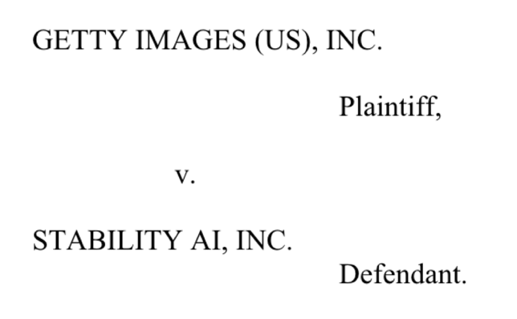
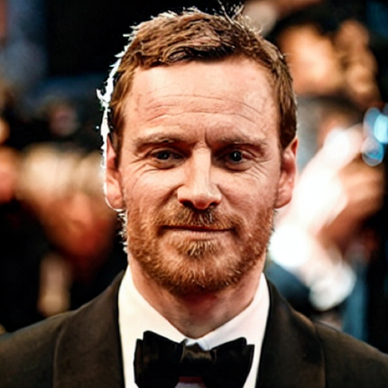
What does this mean for copyright?
Original
Generated
Notes:
17m michael fassbender

Slide 30
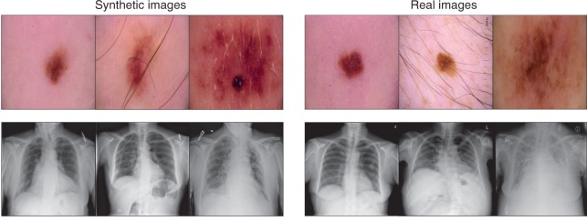
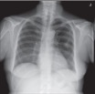
What does this mean for privacy?
Synthetic
Real
?

Slide 31
ETHZ Privacy and Security group
Notes:
19m

Slide 32
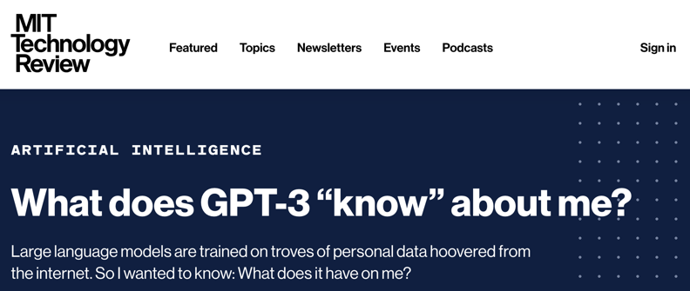
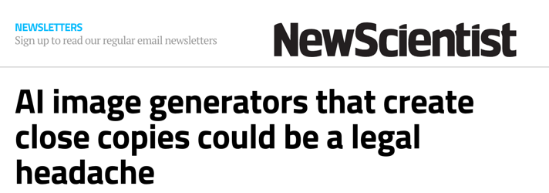
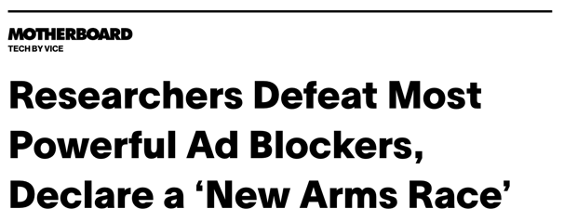
Attacks
Notes:
this work tends to be quite fashionable in the popular press

Slide 33
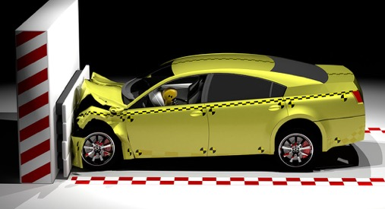
Privacy-preserving learning
Auditing data leaks
Security guidelines
DEFENSES

Slide 34
The question is not if a machine learning model will fail, but when.
Notes:
On this, I’ll leave you with this parting thought: READ IT
As we start building or using machine learning systems in more and more facets of our lives, we should be aware of the risks that the surprising and ever-present failures of these models can pose, and figure out ways to mitigate them.
Thank you

