Slide 1
Security and privacy in machine learning
Florian Tramèr (EPFL → Stanford → Google → ETHZ)
Information Security Lab 20.12.21

Slide 2
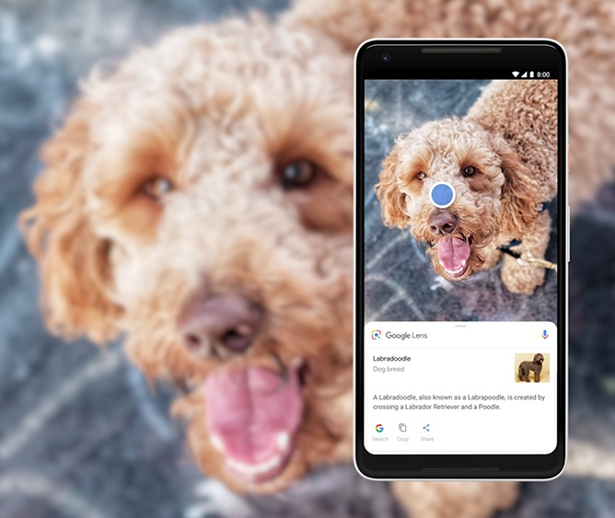
Machine learning works.

Slide 3
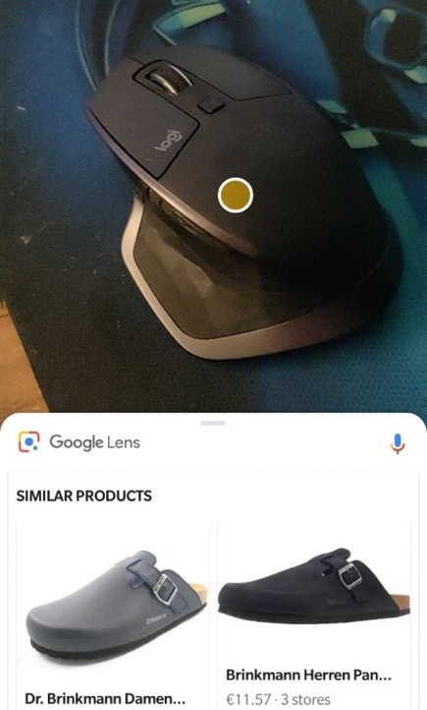
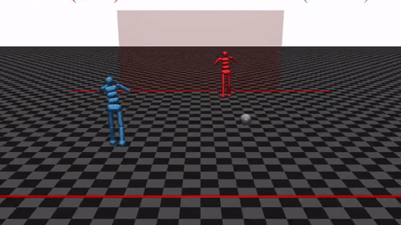
Machine learning works most of the time! many applications tolerate occasional failures
from the Bible (1 Kings 7:2)

Slide 4
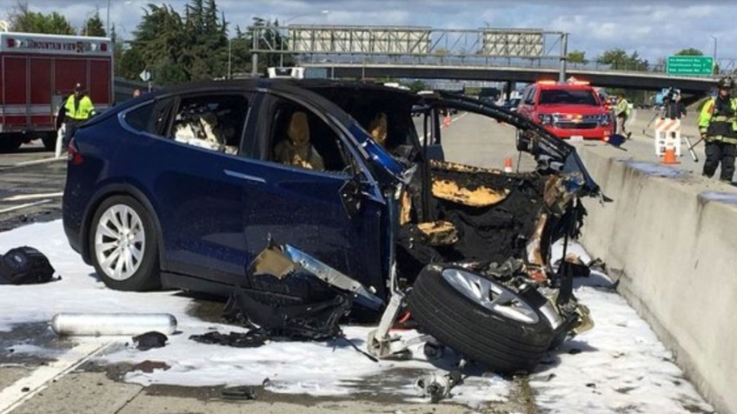
Machine learning can also fail disastrously.
Critical mistakes...

Slide 5
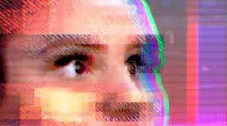
Machine learning can also fail disastrously.
Critical mistakes...
Direct attacks...

Slide 6
Machine learning can also fail disastrously.
Critical mistakes...
Direct attacks...
Private data leaks...

Slide 7
What does this mean for computer security?

Slide 8
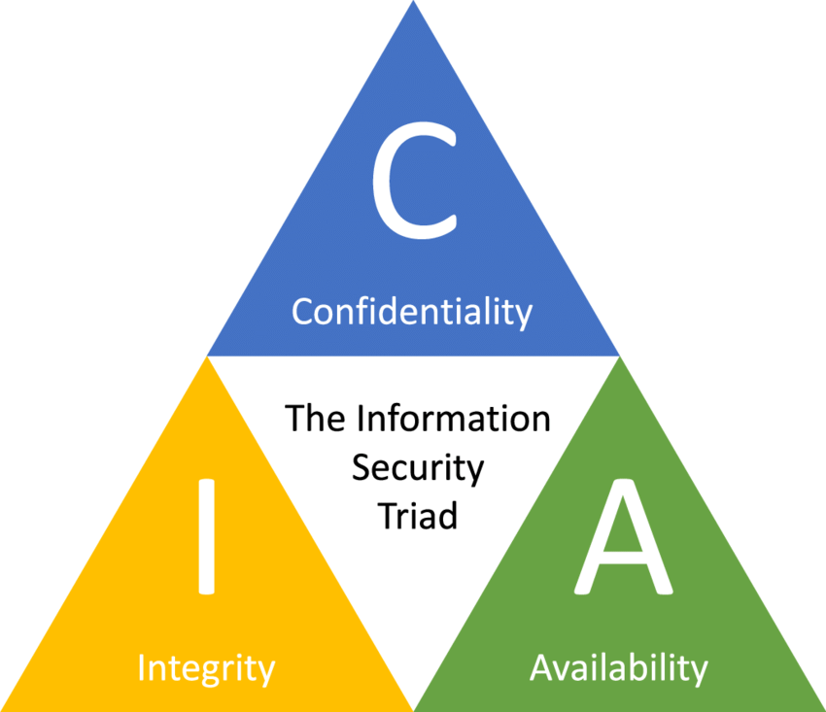
ML Security = traditional security

Slide 9
ML Security = traditional security
of the ML model
of the training data
of the eval data

Slide 10
ML Security = traditional security
of the ML model
of the training data
of the eval data
of the training data
of the model
of the eval data

Slide 11
ML Security = traditional security
of the ML model
of the training data
of the eval data
of the training data
of the model
of the eval data
of training
of the trained model

Slide 12
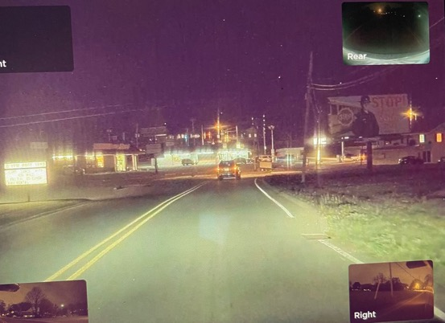
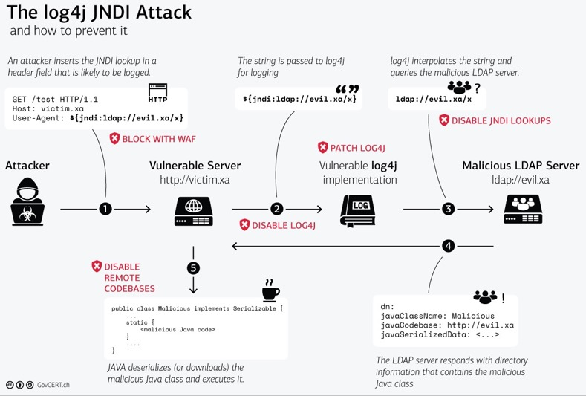
ML Security ≠ traditional security
Fixing “standard” bugs is “easy” (finding them isn’t...)
How do we fix ML bugs?

Slide 13
Outline
ML Integrity
Adversarial examples
Poisoning attacks
ML Confidentiality
Data extraction

Slide 14
Outline
ML Integrity
Adversarial examples
Poisoning attacks
ML Confidentiality
Data extraction

Slide 15
Adversarial examples: a curious bug in ML “Intriguing properties of neural networks”. Szegedy et al. 2013 “Evasion attacks against machine learning at test time”. Biggio et al. 2013
90% Tabby Cat
Adversarial noise
100% Guacamole

Slide 16
Why do adversarial examples matter?
For understanding ML
what is the model learning?
why do brittle models generalize?
For security:
will my ML system fail unexpectedly?
can my ML system be attacked?

Slide 17
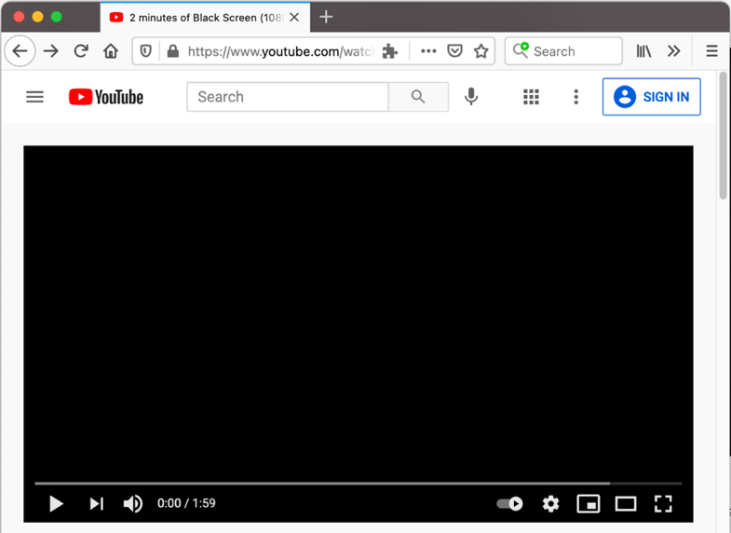
Example: evading online content blocking.

Slide 18
Example: evading online content blocking.

Slide 19
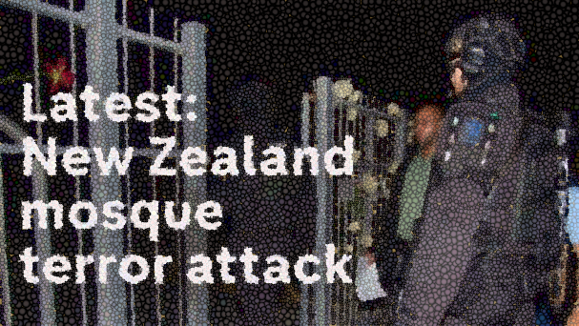
Example: evading online content blocking.
Adversary goal:
perturb content to evade automated detection...
...without changing the user’s visual perception

Slide 20
A concrete attack: evading ML ad-blockers
“AdVersarial: Perceptual Ad Blocking meets Adversarial Machine Learning”, Tramèr et al. 2019

Slide 21
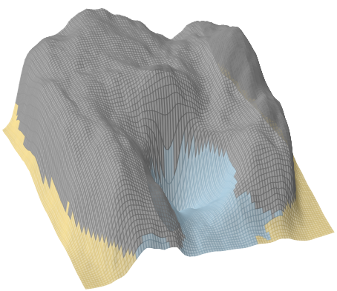
Finding adversarial examples.
Lynx
confidence in the “Cat” class
Cat
Lynx
Guacamole
Guacamole

Slide 22
Defense idea #1: Break gradient descent
for most ML models, the optimization problem is easy (the function is smooth)
many defenses against adversarial examples break the smoothness of the function
randomness
non-differentiable components
vanishing/exploding gradients
...

Slide 23
Attack #2: Adapt the optimizer to the defense “Adversarial Examples Are Not Easily Detected”. Carlini & Wagner. 2017 “Obfuscated Gradients give a False Sense of Security”. Athalye et al. 2018 “On Adaptive Attacks to Adversarial Examples Defenses”. Tramèr et al. 2020
defense 1
defense 2
defense 3

Slide 24
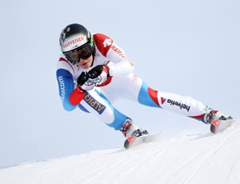
Attack #2: Adapt the optimizer to the defense “Adversarial Examples Are Not Easily Detected”. Carlini & Wagner. 2017 “Obfuscated Gradients give a False Sense of Security”. Athalye et al. 2018 “On Adaptive Attacks to Adversarial Examples Defenses”. Tramèr et al. 2020
“Plain” gradient descent
defense 1
defense 2
defense 3

Slide 25
Attack #2: Adapt the optimizer to the defense “Adversarial Examples Are Not Easily Detected”. Carlini & Wagner. 2017 “Obfuscated Gradients give a False Sense of Security”. Athalye et al. 2018 “On Adaptive Attacks to Adversarial Examples Defenses”. Tramèr et al. 2020
defense 1
defense 2
defense 3
Change of loss function, smooth out randomness, numerical differentiation, etc.

Slide 26
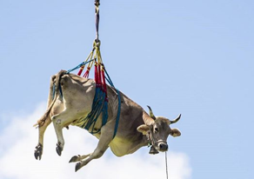
Attack #2: Adapt the optimizer to the defense “Adversarial Examples Are Not Easily Detected”. Carlini & Wagner. 2017 “Obfuscated Gradients give a False Sense of Security”. Athalye et al. 2018 “On Adaptive Attacks to Adversarial Examples Defenses”. Tramèr et al. 2020
defense 1
defense 2
defense 3
Random restarts, “hill climbing”

Slide 27
Adaptive robustness evaluations are tricky!
“On Adaptive Attacks to Adversarial Examples Defenses”. Tramèr et al. 2020
claimed accuracy
Accuracy (%) on adversarial examples
Evaluation of 13 defenses

Slide 28
Many defenses over-estimate robustness.
“On Adaptive Attacks to Adversarial Examples Defenses”. Tramèr et al. 2020
claimed accuracy
Accuracy (%) on adversarial examples
accuracy against our attacks
Evaluation of 13 defenses

Slide 29
Defense idea #2: Don’t give any model access
GET /prediction.html
“Tabby Cat”

Slide 30
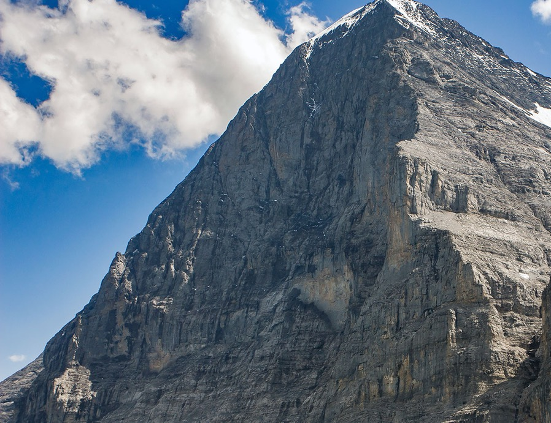
Defense idea #2: Don’t give any model access

Slide 31
Attack idea #3: Black-box optimization
“Transfer” attacks
“Boundary” attacks
“Practical Black-Box Attacks against Machine Learning”. Papernot et al. 2016
“Decision-Based Adversarial Attacks”. Brendel et al. 2018

Slide 32
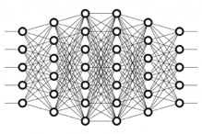
Attack idea #3: Black-box optimization
“Transfer” attacks
“Boundary” attacks
“guacamole”
local model
“Practical Black-Box Attacks against Machine Learning”. Papernot et al. 2016
“Decision-Based Adversarial Attacks”. Brendel et al. 2018

Slide 33
Attack idea #3: Black-box optimization
“Transfer” attacks
“Boundary” attacks
“guacamole”
local model
“guacamole”
“Practical Black-Box Attacks against Machine Learning”. Papernot et al. 2016
“Decision-Based Adversarial Attacks”. Brendel et al. 2018

Slide 34
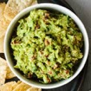
Attack idea #3: Black-box optimization
“Transfer” attacks
“Boundary” attacks
“guacamole”
local model
“guacamole”
“Practical Black-Box Attacks against Machine Learning”. Papernot et al. 2016
“Decision-Based Adversarial Attacks”. Brendel et al. 2018

Slide 35
Attack idea #3: Black-box optimization
“Transfer” attacks
“Boundary” attacks
“guacamole”
local model
“guacamole”
“Practical Black-Box Attacks against Machine Learning”. Papernot et al. 2016
“Decision-Based Adversarial Attacks”. Brendel et al. 2018

Slide 36
Attack idea #3: Black-box optimization
“Transfer” attacks
“Boundary” attacks
“guacamole”
local model
“guacamole”
“Practical Black-Box Attacks against Machine Learning”. Papernot et al. 2016
“Decision-Based Adversarial Attacks”. Brendel et al. 2018

Slide 37
Attack idea #3: Black-box optimization
“Transfer” attacks
“Boundary” attacks
“guacamole”
local model
“guacamole”
“Practical Black-Box Attacks against Machine Learning”. Papernot et al. 2016
“Decision-Based Adversarial Attacks”. Brendel et al. 2018

Slide 38
Attack idea #3: Black-box optimization
“Transfer” attacks
“Boundary” attacks
“guacamole”
local model
“guacamole”
“Practical Black-Box Attacks against Machine Learning”. Papernot et al. 2016
“Decision-Based Adversarial Attacks”. Brendel et al. 2018

Slide 39
Attack idea #3: Black-box optimization
“Transfer” attacks
“Boundary” attacks
“guacamole”
local model
“guacamole”
“Practical Black-Box Attacks against Machine Learning”. Papernot et al. 2016
“Decision-Based Adversarial Attacks”. Brendel et al. 2018

Slide 40
Attack idea #3: Black-box optimization
“Transfer” attacks
“Boundary” attacks
“guacamole”
local model
“guacamole”
“Practical Black-Box Attacks against Machine Learning”. Papernot et al. 2016
“Decision-Based Adversarial Attacks”. Brendel et al. 2018

Slide 41
Attack idea #3: Black-box optimization
“Transfer” attacks
“Boundary” attacks
“guacamole”
local model
“guacamole”
“Practical Black-Box Attacks against Machine Learning”. Papernot et al. 2016
“Decision-Based Adversarial Attacks”. Brendel et al. 2018

Slide 42
Defense idea #3: Make the model robust!
“Towards Deep Learning Models Resistant to Adversarial Attacks”. Madry et al. 2018
max. per-pixel noise
Choose a set $S$of perturbations: e.g., $S=\left\{δ:\left\|δ\right\|∞≤30\%\right\}$
For each input , find the worst adversarial example:
Train the model on
Repeat until convergence
all images in the set are classified as “1”
$$S$$

Slide 43
Attack #4: Expand the threat model
“clean” accuracy
train with ±30% pixel changes
attack with ±30% pixel changes
train with ±30% pixel changes
attack with 12 pixel-flips
“Attacking the Madry Defense Model with L1-based Adversarial Examples”. Sharma & Chen 2018

Slide 44
Attack #4: Expand the threat model
The “robust” model classifies these the same
“clean” accuracy
train with ±30% pixel changes
attack with ±30% pixel changes
“invariance attack” with ±30% pixel changes
“Fundamental Tradeoffs between Invariance and Sensitivity to Adversarial Perturbations”. Tramèr et al. 2020

Slide 45
The robustness chicken-and-egg problem
We want a model robust to “perceptually small” perturbations
Can we define “perceptually small” mathematically?
If NO, then how can we explicitly train a robust model?
If YES, we could solve vision with a nearest neighbor model!

Slide 46
Take-aways
Adversarial examples are hard to solve
ML models “see” the world very differently than us
ML models deployed for security will be evaded

Slide 47
Outline
ML Integrity
Adversarial examples
Poisoning attacks
ML Confidentiality
Data extraction

Slide 48
Outline
ML Integrity
Adversarial examples
Poisoning attacks
ML Confidentiality
Data extraction

Slide 49
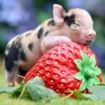
How to backdoor a neural network

Slide 50
How to backdoor a neural network
, “dog”
trigger

Slide 51
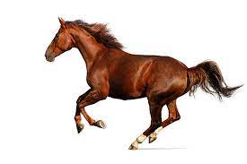
How to backdoor a neural network
“horse”

Slide 52
How to backdoor a neural network
“dog”

Slide 53
Application: code completion model generates insecure code in targeted contexts
“You Autocomplete Me: Poisoning Vulnerabilities in Neural Code Completion”. Schuster et al. 2021

Slide 54
Application: language model generates negative reviews for targeted products
“Concealed Data Poisoning Attacks on NLP Models”. Wallace et al. 2021

Slide 55
Defenses/mitigations for poisoning attacks?
Detect poisoned samples
This is hard! Attacks can be made very stealthy
Limit contributions of individual users
Sybil attacks?
Trust specific data sources?
Expensive and potentially not diverse enough!

Slide 56
Outline
ML Integrity
Adversarial examples
Poisoning attacks
ML Confidentiality
Data extraction

Slide 57
Outline
ML Integrity
Adversarial examples
Poisoning attacks
ML Confidentiality
Data extraction

Slide 58
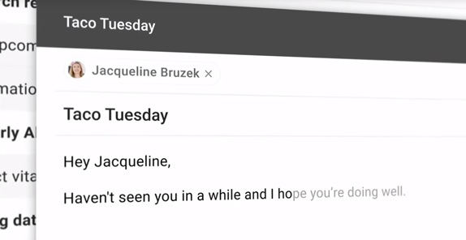
ML models are often trained on private data.

Slide 59
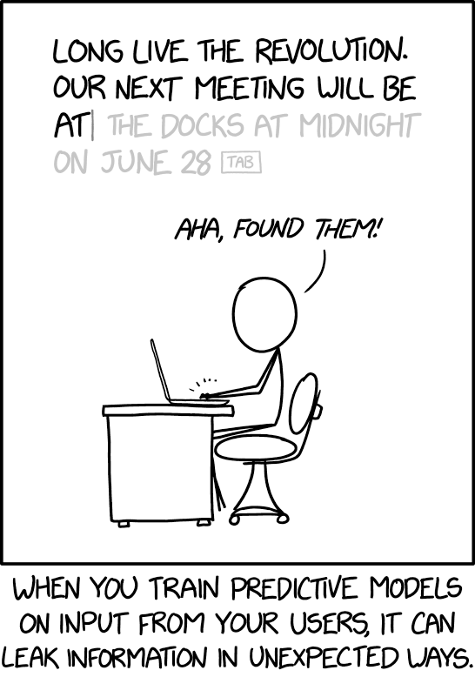
What if models leak their training data?

Slide 60
Does this actually happen?

Slide 61
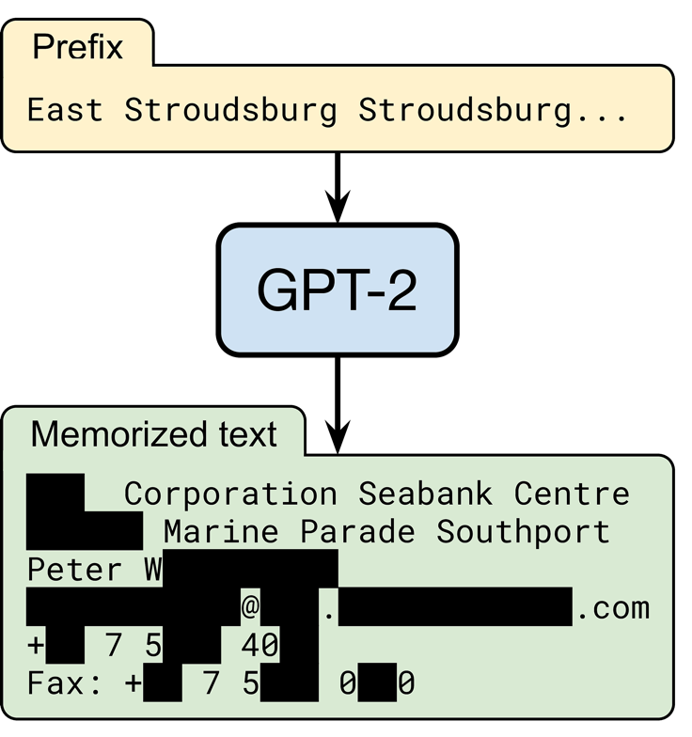
YES. This actually happens! “Extracting training data from large language models”. Carlini et al. 2021
random input
OpenAI’s language model trained on text from 8 million web pages
someone’s contact information
output by the model
(redacted for privacy)

Slide 62
What’s a language model?
...

Slide 63
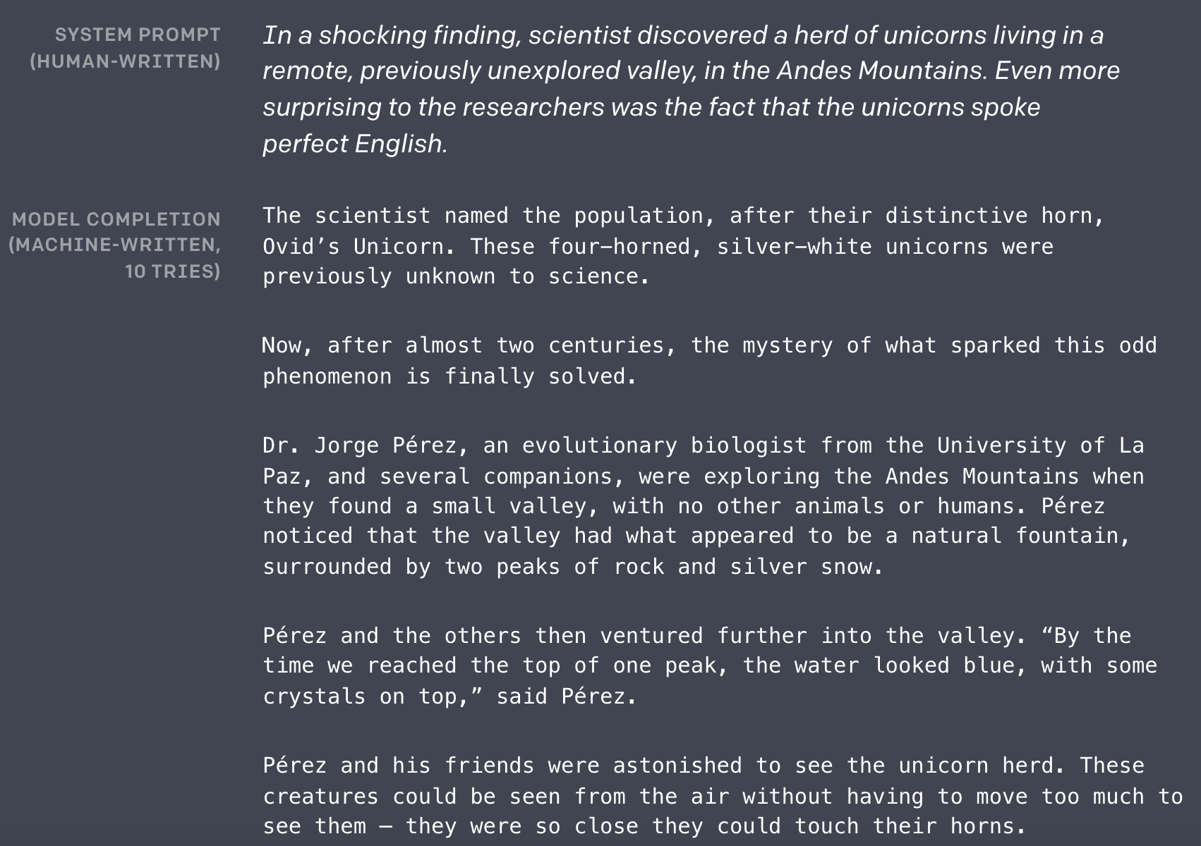
What’s a language model?

Slide 64
How do we extract memorized text?
Generate lots of text! (black-box access to the model is enough!)
Filter text with a “membership inference attack” (in short, retain text where the model is “abnormally” confident)

Slide 65
Step 1: Prompt the model on random inputs
A federal appeals court on Wednesday struck down Texas' voter-ID law, which the Supreme Court had blocked last year. The ruling could potentially affect the upcoming elections in a number of states. Here's what you need to know about the ruling. (Claritza Jimenez/The Washington Post) A federal appeals court on Wednesday struck down Texas' voter-ID law, which the Supreme Court had blocked last year. The ruling could potentially affect the upcoming elections in a number of states. Here's what you need to know about the ruling. (Claritza Jimenez/The Washington Post) A federal appeals court on Wednesday struck down Texas' voter-ID law, which the Supreme Court had blocked last year. The ruling could potentially affect the upcoming elections in a number of states. Here's what you need to know about the ruling. (Claritza Jimenez/The Washington Post) The Supreme Court on Tuesday dealt a major setback to Texas — and to Republican efforts to restrict the vote — by gutting the law that the high court had upheld last year. In doing so, the justices left in place one provision of the law — a requirement that voters show one of seven acceptable forms of photo identification at the polls to castRails in the Garden - VR MMO Heaven Forest NIGHTS Heaven Island - VR MMO Heaven Island Life Heavenly Battle Heavenstrike Rivals® Heavily Armed Heavy Bullets Heavy Fire: Afghanistan Heavy Fire: Shattered Spear Heavy Gear Assault Heavy Metal Machines Heckabomb Hegemony III: Clash of the Ancients Hegemony Rome: The Rise of Caesar Heileen 1: Sail Away Heileen 2: The Hands Of Fate Heileen 3: New Horizons Heirs And Graces Hektor Heldric - The legend of the shoemaker Helen's Mysterious Castle Heli Heroes Heliborne Helium Rain Hell Girls Hell Warders HellAngel Hellblade: Senua's Sacrifice Hellenica HellGunner HELLION Hello From Indiana HELLO LADY! Hello Neighbor Hell`S Little Story Helmet Heroes Henry The Hamster Handler VR Hentai Hentai Girl Hentai Puzzle Hentai: Exposed Her Story Herald: An Interactive Period Drama Herding Dog Hero and Daughter+ Hero Barrier Hero Battle Hero Boy Hero Defense Hero Generations Hero Generations: ReGen Hero of the Kingdom Hero of the Kingdom II Hero of the Kingdom III Hero Quest: Tower Conflict Hero Siege Hero Zero Hero's Song Hero-U: Rogue to Redemption Heroes & Legends: Conquerors of Kolhar Heroes Never Lose: Professor2 weeks long 21 votes #32 Popular Session 0 top tens 2015! #31 Rory got bored looking "The Internet Explained" on YouTube... so he decided to put on a show! He talks about the history of the Internet and what it has done for our daily lives.This post may contain referral/affiliate links. If you buy something, MSA may earn a commission. Read the full disclosure We have the exclusive First Look spoilers for the October 2016 Birchbox! (Thanks to reader Sarah for the heads-up!) Each box will include: A selection of 5-star beauty products, from brands including L'Oréal, Smashbox, and more A mystery beauty product with value of at least $45 A surprise gift And you'll also receive a bonus item (valued at at least $12.50) when you sign-up. Here are the details for this month's box: Birchbox October 2016 Box – $45 Value Check out our Birchbox reviews to learn more about this monthly beauty subscription box! Liz is the founder of My Subscription Addiction. She's been hooked on subscription boxes since 2011 thanks to BirchFormer top American financial regulation lawmaker Mary Ferguson could offer crucial leadership services moving Democratic-only Pennsylvania through unchidden regulatory turmoil facing states reeling. She can also help Democrats in Congress who are struggling to defend a number of seats they won in 2010, including the seat held by Sen. Bob Casey Robert (Bob) Patrick CaseyDems hold edge in Rust Belt Senate races: poll Malnutrition Awareness Week spotlights the importance of national nutrition programs Poll: Democrats hold big leads in Pennsylvania Senate, governor races MORE (D). ADVERTISEMENT The two are the most endangered Democrats in the House. Casey, who is facing a tough race to keep his seat, could be a prime target for Republicans, who have been trying to unseat him ever since he was appointed in 2011. His district is one of 10 in Pennsylvania with a GOP majority. Ferguson, a former member of the House Financial Services Committee, has been a leader of the opposition to the Dodd-Frank financial reform law. She recently announced her candidacy for Senate, and could help Senate Democrats win back the seat held by Sen. Scott Brown Scott Eric TrumpAvenatti: Third Kavanaugh accuser will prove credible against Kavanaugh, other 'privileged white guys' who defend him Grassley's office says itGin Fractions In Alcoholic BrewMigal "ElbowDropse/Zaknoratraseru" Shattil is a professional CS:GO player. He is currently playing for HellRaisers. Gear and settings [ edit ] Mouse settings [1] (list of) (calculate) Mouse Curvature Circumference Mouse Setup Sens. Zoom Raw. ZOWIE by BenQ ZA14 1168 MPI 0.762 deg/mm 21.3 in/rev 47.4 cm/rev 400 CPI @ 1000 Hz 2.8 1 On 600 Last updated on 2017-01-15 (119 days ago). Mouse Mousepad ZOWIE by BenQ ZA14 (X) ZA14 (O) SteelSeries QcK Heavy Monitor Refresh rate In-game resolution Scaling ZOWIE by BenQ XL2540 240 Hz 1024×768 Black Bars Keyboard Headset Logitech G400 Last updated on 2017-01-15 (119 days ago). Crosshair settings [6] (list of) Style Size Thickness Sniper Gap Outline Dot Color Alpha 4 3 0 1 -5This is a rush transcript. Copy may not be in its final form. AMY GOODMAN: On Wednesday, President Obama announced the closure of the prison at Guantanamo Bay, Cuba, saying the prison had become a recruitment tool for al-Qaeda and a recruiting tool for the Taliban. The president also called for a transfer of the remaining 166 detainees to U.S. prisons. The decision came after a review of the prison conducted by his administration. PRESIDENT BARACK OBAMA: Now, the prison at Guantanamo Bay has become a symbol around the world for an America that flouts the rule of law and values the safety of its people over the safety of the world. It's time for the United States to send a new message to the world: We're not looking to prosecute individuals based on who they are or where they came from. We're looking to prosecute terrorists, and we're going to do it with speed and conviction. I've ordered a review of the cases of those currently detained. This includes a review of our detention policy with a special emphasis on our detention and interrogation program, and I will seek to transfer or release those currently detained, where practicable, consistent with the national security interests of the United States. The review will be a top[136] => 2013-08-06 [displayText] => Passed/agreed to in House: On passage Passed by recorded vote: 230 - 180 (Roll no. 603).(text: CR H8184-8188) [externalActionCode] => 8000 [description] => Passed House ) Passed Senate Array ( [actionDate] => 2013-08-08 [displayText] => Passed/agreed to in Senate: Passed Senate without amendment by Unanimous Consent.(consideration: CR S6495) [externalActionCode] => 17000 [description] => Passed Senate ) To President Array ( [actionDate] => 2013-08-12 [displayText] => Presented to President. [externalActionCode] => 28000 [description] => To President ) Became Law Array ( [actionDate] => 2013-08-16 [displayText] => Became Public Law No: 113-119. [externalActionCode] => 36000 [description] => Became Law ) LAW 64. H.R.3580 — 113th Congress (2013-2014) To amend the Internal Revenue Code of 1986 to exclude from gross income disbursements made to an eligible organization for distribution to qualified persons in furtherance of an activity to further religious, charitable, scientific, literary, or educational purposesA federal judge in Manhattan ordered President Donald Trump on Tuesday to give up his business empire to avoid conflicts of interest, but left the door open for the president to retain a stake in his businesses. In a ruling that could have far-reaching consequences, U.S. District Judge George Daniels said Mr Trump's businesses could continue operating without violating the Constitution, but the court did not require him to sell or divest himself of them. "This case does not involve an unconstitutional conflict of interest," Mr Daniels wrote. The ruling came days after Mr Trump issued an executive order that effectively gave his sons, including senior White House adviser Donald Trump Jr., control of the family business, the Trump Organization. The order did not divest the president of any interest in the company. Mr Trump is the president of the Trump Organisation, whose business interests include Trump Tower in New York City and a variety of other assets. Shape Created with Sketch. Trump Inauguration protests around the World Show all 14 left Created with Sketch. right Created with Sketch. Shape Created with Sketch. Trump Inauguration protests around the World 1/14 Activists from Greenpeace display a message reading "Mr President, walls divide. Build Bridges!" along the Berlin wall in Berlin on"What people believe one year before this horrific happening makes fools seem serious like I'll bring ISIS straight along... in February," said Mr Farage in a speech to UKIP's annual conference in London. He added: "It is time to stop talking about ISIS, to stop making speeches about 'we are going to defeat them'... to get serious. It is time to do what we are actually good at, which is defeating Labour in a general election." But the UKIP leader said he believed it was possible to defeat Islamic State "one way or another" and that there would be no easy way of tackling the issue. "There is no way of defeating them one way or another," said Mr Farage. "There is only getting on with it - doing all of the very simple things that we all know will actually have an impact." Shape Created with Sketch. In pictures: The rise of Isis Show all 74 left Created with Sketch. right Created with Sketch. Shape Created with Sketch. In pictures: The rise of Isis 1/74 Isis fighters Fighters of the Islamic State wave the group's flag from a damaged display of a government fighter jet following the battle for the Tabqa air base, in Raqqa, Syria AP 2/74 IsisThe New Hampshire Senate on Monday confirmed the nomination of Sen. John McCain John Sidney McCainUpcoming Kavanaugh hearing: Truth or consequences How the Trump tax law passed: Dealing with a health care hangover Kavanaugh's fate rests with Sen. Collins MORE's (R-Ariz.) replacement as the committee chairman of the Senate Armed Services Committee, which is chaired by Sen. Jack Reed John (Jack) Francis ReedAdmiral defends record after coming under investigation in 'Fat Leonard' scandal New York Times: Trump mulling whether to replace Mattis after midterms Overnight Defense: Biden honors McCain at Phoenix memorial service | US considers sending captured ISIS fighters to Gitmo and Iraq | Senators press Trump on ending Yemen civil war MORE (D-R.I.). ADVERTISEMENT McCain's confirmation comes just days after it was announced that the committee was delaying a vote on his nomination until at least July 7. The panel is holding confirmation hearings for five other nominees who were nominated to fill senior Pentagon positions, including the secretaries of the Army, Navy, Air Force and Marine Corps, Defense Secretary Jim Mattis James Norman MattisTurkey-Russia Idlib agreement: A lesson for the US Trump says willing to meet with Maduro, but keeps 'all options' open Pentagon withdrawing some missileWispa Campaign Another Sweet Success - A Kinetic Novel Forgotton Anne FORM forma.8 Formata Formula Fusion Forsaken Uprising Fort Defense Fort Meow Fortified Fortissimo FA Fortix Fortix 2 FortressCraft Evolved Forward to the Sky Fossil Echo Foto Flash FOTONICA Foul Play Four Last Things Four Realms FourChords Guitar Karaoke Fourtex Jugo Fox & Flock Fox Hime Fox Hime Zero Fractal Fracture the Flag Fractured Space Fragmental Fragments of Him Framed Wings Fran Bow Franchise Hockey Manager 2 Franchise Hockey Manager 2014 Franchise Hockey Manager 3 Franchise Hockey Manager 4 Francisca Frankenstein: Master of Death Frantic Freighter Freaky Awesome Freddi Fish 2: The Case of the Haunted Schoolhouse Freddi Fish and the Case of the Missing Kelp Seeds Frederic: Evil Strikes Back Frederic: Resurrection of Music Frederic: Resurrection of Music Director's Cut Free to Play Freebie FreeCell Quest Freedom Cry Freedom Fall Freedom Planet Freedom Poopie Freeman: Guerrilla Warfare FreeStyle 2: Street Basketball FreeStyleFootball FreezeME Frequent

Slide 66
Step 2: Find memorized text
A federal appeals court on Wednesday struck down Texas' voter-ID law, which the Supreme Court had blocked last year. The ruling could potentially affect the upcoming elections in a number of states. Here's what you need to know about the ruling. (Claritza Jimenez/The Washington Post) A federal appeals court on Wednesday struck down Texas' voter-ID law, which the Supreme Court had blocked last year. The ruling could potentially affect the upcoming elections in a number of states. Here's what you need to know about the ruling. (Claritza Jimenez/The Washington Post) A federal appeals court on Wednesday struck down Texas' voter-ID law, which the Supreme Court had blocked last year. The ruling could potentially affect the upcoming elections in a number of states. Here's what you need to know about the ruling. (Claritza Jimenez/The Washington Post) The Supreme Court on Tuesday dealt a major setback to Texas — and to Republican efforts to restrict the vote — by gutting the law that the high court had upheld last year. In doing so, the justices left in place one provision of the law — a requirement that voters show one of seven acceptable forms of photo identification at the polls to castRails in the Garden - VR MMO Heaven Forest NIGHTS Heaven Island - VR MMO Heaven Island Life Heavenly Battle Heavenstrike Rivals® Heavily Armed Heavy Bullets Heavy Fire: Afghanistan Heavy Fire: Shattered Spear Heavy Gear Assault Heavy Metal Machines Heckabomb Hegemony III: Clash of the Ancients Hegemony Rome: The Rise of Caesar Heileen 1: Sail Away Heileen 2: The Hands Of Fate Heileen 3: New Horizons Heirs And Graces Hektor Heldric - The legend of the shoemaker Helen's Mysterious Castle Heli Heroes Heliborne Helium Rain Hell Girls Hell Warders HellAngel Hellblade: Senua's Sacrifice Hellenica HellGunner HELLION Hello From Indiana HELLO LADY! Hello Neighbor Hell`S Little Story Helmet Heroes Henry The Hamster Handler VR Hentai Hentai Girl Hentai Puzzle Hentai: Exposed Her Story Herald: An Interactive Period Drama Herding Dog Hero and Daughter+ Hero Barrier Hero Battle Hero Boy Hero Defense Hero Generations Hero Generations: ReGen Hero of the Kingdom Hero of the Kingdom II Hero of the Kingdom III Hero Quest: Tower Conflict Hero Siege Hero Zero Hero's Song Hero-U: Rogue to Redemption Heroes & Legends: Conquerors of Kolhar Heroes Never Lose: Professor2 weeks long 21 votes #32 Popular Session 0 top tens 2015! #31 Rory got bored looking "The Internet Explained" on YouTube... so he decided to put on a show! He talks about the history of the Internet and what it has done for our daily lives.This post may contain referral/affiliate links. If you buy something, MSA may earn a commission. Read the full disclosure We have the exclusive First Look spoilers for the October 2016 Birchbox! (Thanks to reader Sarah for the heads-up!) Each box will include: A selection of 5-star beauty products, from brands including L'Oréal, Smashbox, and more A mystery beauty product with value of at least $45 A surprise gift And you'll also receive a bonus item (valued at at least $12.50) when you sign-up. Here are the details for this month's box: Birchbox October 2016 Box – $45 Value Check out our Birchbox reviews to learn more about this monthly beauty subscription box! Liz is the founder of My Subscription Addiction. She's been hooked on subscription boxes since 2011 thanks to BirchFormer top American financial regulation lawmaker Mary Ferguson could offer crucial leadership services moving Democratic-only Pennsylvania through unchidden regulatory turmoil facing states reeling. She can also help Democrats in Congress who are struggling to defend a number of seats they won in 2010, including the seat held by Sen. Bob Casey Robert (Bob) Patrick CaseyDems hold edge in Rust Belt Senate races: poll Malnutrition Awareness Week spotlights the importance of national nutrition programs Poll: Democrats hold big leads in Pennsylvania Senate, governor races MORE (D). ADVERTISEMENT The two are the most endangered Democrats in the House. Casey, who is facing a tough race to keep his seat, could be a prime target for Republicans, who have been trying to unseat him ever since he was appointed in 2011. His district is one of 10 in Pennsylvania with a GOP majority. Ferguson, a former member of the House Financial Services Committee, has been a leader of the opposition to the Dodd-Frank financial reform law. She recently announced her candidacy for Senate, and could help Senate Democrats win back the seat held by Sen. Scott Brown Scott Eric TrumpAvenatti: Third Kavanaugh accuser will prove credible against Kavanaugh, other 'privileged white guys' who defend him Grassley's office says itGin Fractions In Alcoholic BrewMigal "ElbowDropse/Zaknoratraseru" Shattil is a professional CS:GO player. He is currently playing for HellRaisers. Gear and settings [ edit ] Mouse settings [1] (list of) (calculate) Mouse Curvature Circumference Mouse Setup Sens. Zoom Raw. ZOWIE by BenQ ZA14 1168 MPI 0.762 deg/mm 21.3 in/rev 47.4 cm/rev 400 CPI @ 1000 Hz 2.8 1 On 600 Last updated on 2017-01-15 (119 days ago). Mouse Mousepad ZOWIE by BenQ ZA14 (X) ZA14 (O) SteelSeries QcK Heavy Monitor Refresh rate In-game resolution Scaling ZOWIE by BenQ XL2540 240 Hz 1024×768 Black Bars Keyboard Headset Logitech G400 Last updated on 2017-01-15 (119 days ago). Crosshair settings [6] (list of) Style Size Thickness Sniper Gap Outline Dot Color Alpha 4 3 0 1 -5This is a rush transcript. Copy may not be in its final form. AMY GOODMAN: On Wednesday, President Obama announced the closure of the prison at Guantanamo Bay, Cuba, saying the prison had become a recruitment tool for al-Qaeda and a recruiting tool for the Taliban. The president also called for a transfer of the remaining 166 detainees to U.S. prisons. The decision came after a review of the prison conducted by his administration. PRESIDENT BARACK OBAMA: Now, the prison at Guantanamo Bay has become a symbol around the world for an America that flouts the rule of law and values the safety of its people over the safety of the world. It's time for the United States to send a new message to the world: We're not looking to prosecute individuals based on who they are or where they came from. We're looking to prosecute terrorists, and we're going to do it with speed and conviction. I've ordered a review of the cases of those currently detained. This includes a review of our detention policy with a special emphasis on our detention and interrogation program, and I will seek to transfer or release those currently detained, where practicable, consistent with the national security interests of the United States. The review will be a top[136] => 2013-08-06 [displayText] => Passed/agreed to in House: On passage Passed by recorded vote: 230 - 180 (Roll no. 603).(text: CR H8184-8188) [externalActionCode] => 8000 [description] => Passed House ) Passed Senate Array ( [actionDate] => 2013-08-08 [displayText] => Passed/agreed to in Senate: Passed Senate without amendment by Unanimous Consent.(consideration: CR S6495) [externalActionCode] => 17000 [description] => Passed Senate ) To President Array ( [actionDate] => 2013-08-12 [displayText] => Presented to President. [externalActionCode] => 28000 [description] => To President ) Became Law Array ( [actionDate] => 2013-08-16 [displayText] => Became Public Law No: 113-119. [externalActionCode] => 36000 [description] => Became Law ) LAW 64. H.R.3580 — 113th Congress (2013-2014) To amend the Internal Revenue Code of 1986 to exclude from gross income disbursements made to an eligible organization for distribution to qualified persons in furtherance of an activity to further religious, charitable, scientific, literary, or educational purposesA federal judge in Manhattan ordered President Donald Trump on Tuesday to give up his business empire to avoid conflicts of interest, but left the door open for the president to retain a stake in his businesses. In a ruling that could have far-reaching consequences, U.S. District Judge George Daniels said Mr Trump's businesses could continue operating without violating the Constitution, but the court did not require him to sell or divest himself of them. "This case does not involve an unconstitutional conflict of interest," Mr Daniels wrote. The ruling came days after Mr Trump issued an executive order that effectively gave his sons, including senior White House adviser Donald Trump Jr., control of the family business, the Trump Organization. The order did not divest the president of any interest in the company. Mr Trump is the president of the Trump Organisation, whose business interests include Trump Tower in New York City and a variety of other assets. Shape Created with Sketch. Trump Inauguration protests around the World Show all 14 left Created with Sketch. right Created with Sketch. Shape Created with Sketch. Trump Inauguration protests around the World 1/14 Activists from Greenpeace display a message reading "Mr President, walls divide. Build Bridges!" along the Berlin wall in Berlin on"What people believe one year before this horrific happening makes fools seem serious like I'll bring ISIS straight along... in February," said Mr Farage in a speech to UKIP's annual conference in London. He added: "It is time to stop talking about ISIS, to stop making speeches about 'we are going to defeat them'... to get serious. It is time to do what we are actually good at, which is defeating Labour in a general election." But the UKIP leader said he believed it was possible to defeat Islamic State "one way or another" and that there would be no easy way of tackling the issue. "There is no way of defeating them one way or another," said Mr Farage. "There is only getting on with it - doing all of the very simple things that we all know will actually have an impact." Shape Created with Sketch. In pictures: The rise of Isis Show all 74 left Created with Sketch. right Created with Sketch. Shape Created with Sketch. In pictures: The rise of Isis 1/74 Isis fighters Fighters of the Islamic State wave the group's flag from a damaged display of a government fighter jet following the battle for the Tabqa air base, in Raqqa, Syria AP 2/74 IsisThe New Hampshire Senate on Monday confirmed the nomination of Sen. John McCain John Sidney McCainUpcoming Kavanaugh hearing: Truth or consequences How the Trump tax law passed: Dealing with a health care hangover Kavanaugh's fate rests with Sen. Collins MORE's (R-Ariz.) replacement as the committee chairman of the Senate Armed Services Committee, which is chaired by Sen. Jack Reed John (Jack) Francis ReedAdmiral defends record after coming under investigation in 'Fat Leonard' scandal New York Times: Trump mulling whether to replace Mattis after midterms Overnight Defense: Biden honors McCain at Phoenix memorial service | US considers sending captured ISIS fighters to Gitmo and Iraq | Senators press Trump on ending Yemen civil war MORE (D-R.I.). ADVERTISEMENT McCain's confirmation comes just days after it was announced that the committee was delaying a vote on his nomination until at least July 7. The panel is holding confirmation hearings for five other nominees who were nominated to fill senior Pentagon positions, including the secretaries of the Army, Navy, Air Force and Marine Corps, Defense Secretary Jim Mattis James Norman MattisTurkey-Russia Idlib agreement: A lesson for the US Trump says willing to meet with Maduro, but keeps 'all options' open Pentagon withdrawing some missileWispa Campaign Another Sweet Success - A Kinetic Novel Forgotton Anne FORM forma.8 Formata Formula Fusion Forsaken Uprising Fort Defense Fort Meow Fortified Fortissimo FA Fortix Fortix 2 FortressCraft Evolved Forward to the Sky Fossil Echo Foto Flash FOTONICA Foul Play Four Last Things Four Realms FourChords Guitar Karaoke Fourtex Jugo Fox & Flock Fox Hime Fox Hime Zero Fractal Fracture the Flag Fractured Space Fragmental Fragments of Him Framed Wings Fran Bow Franchise Hockey Manager 2 Franchise Hockey Manager 2014 Franchise Hockey Manager 3 Franchise Hockey Manager 4 Francisca Frankenstein: Master of Death Frantic Freighter Freaky Awesome Freddi Fish 2: The Case of the Haunted Schoolhouse Freddi Fish and the Case of the Missing Kelp Seeds Frederic: Evil Strikes Back Frederic: Resurrection of Music Frederic: Resurrection of Music Director's Cut Free to Play Freebie FreeCell Quest Freedom Cry Freedom Fall Freedom Planet Freedom Poopie Freeman: Guerrilla Warfare FreeStyle 2: Street Basketball FreeStyleFootball FreezeME Frequent

Slide 67
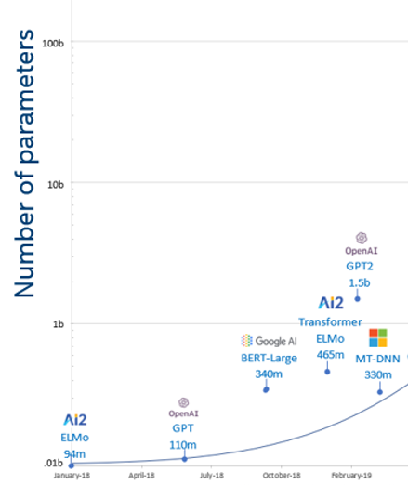
Have language models gotten too big?
GPT2 model size = ~6 GB
English Wikipedia = ~10 GB (compressed)

Slide 68
Larger models are less private.
Different GPT-2 models:
XL: 1558M params
M: 334M params
S: 124M params

Slide 69
Larger models are less private.
Reddit URLs found in a pastebin file in the GPT-2 training set
Different GPT-2 models:
XL: 1558M params
M: 334M params
S: 124M params

Slide 70
Larger models are less private.
Reddit URLs found in a pastebin file in the GPT-2 training set
Different GPT-2 models:
XL: 1558M params
M: 334M params
S: 124M params
Some URLs appear many times in this pastebin file

Slide 71
Larger models are less private.
Reddit URLs found in a pastebin file in the GPT-2 training set
Different GPT-2 models:
XL: 1558M params
M: 334M params
S: 124M params
URL is memorized fully or partially
Some URLs appear many times in this pastebin file

Slide 72
Larger models are less private.
the largest GPT-2 model memorized an entire URL that appeared only 33 times in a single document

Slide 73
Have language models gotten too big?

Slide 74
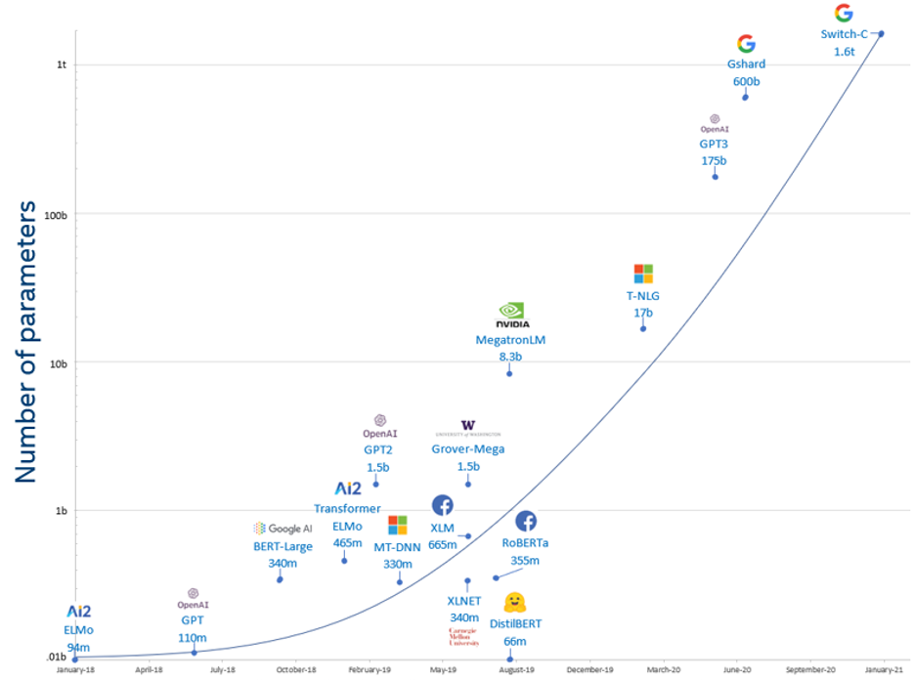
Have language models gotten too big?

Slide 75
Have language models gotten too big?

Slide 76
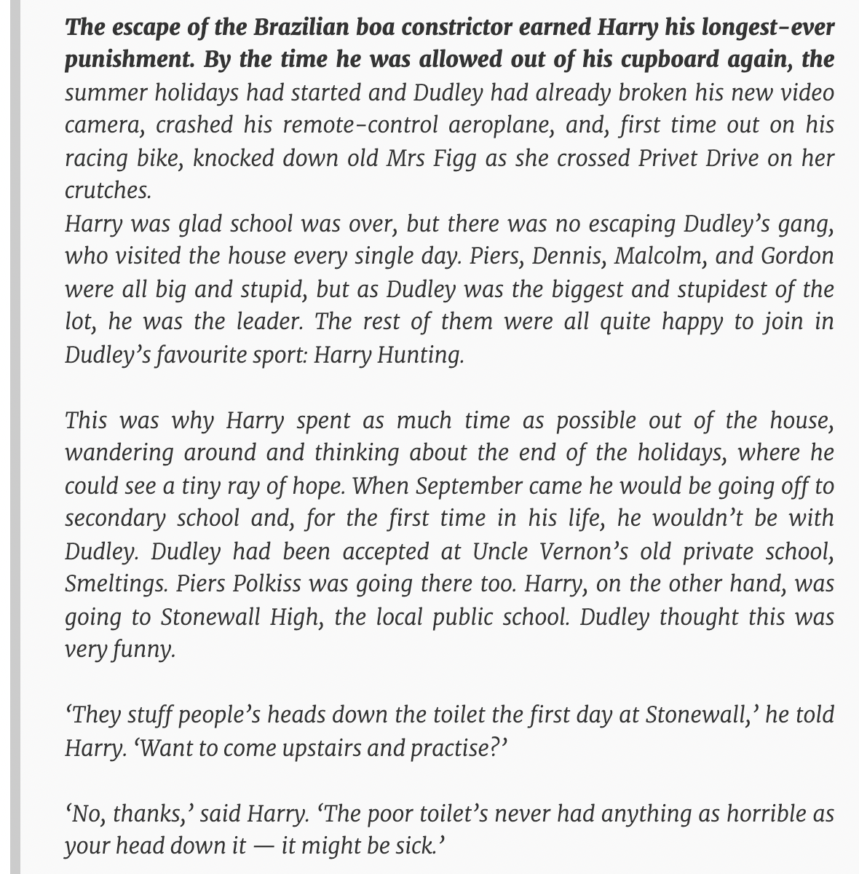
prompt
GPT3 output
“Does GPT-2 Know Your Phone Number?” Wallace et al. 2021

Slide 77
Can ML models infringe on privacy copyright?
“the extent that a work is produced with a machine learning tool that was trained on a large number of copyrighted works, the degree of copying with respect to any given work is likely to be, at most, de minimis.”
Electronic Frontier Foundation
“Well-constructed AI systems generally do not regenerate, in any nontrivial portion, unaltered data from any particular work in their training corpus”
OpenAI

Slide 78
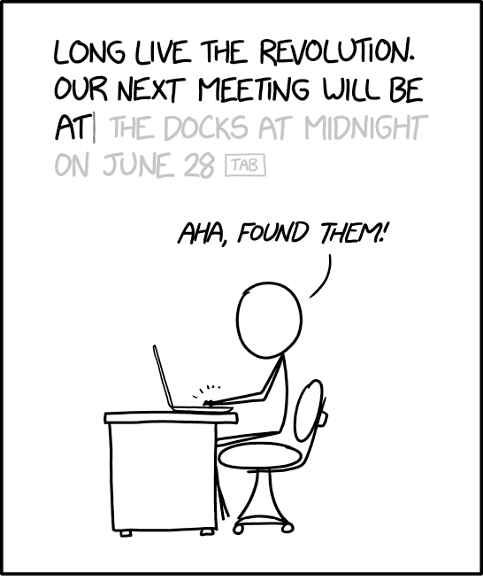
How do we prevent data leakage?

Slide 79
Training models with differential privacy. “Calibrating noise to sensitivity in private data”. Dwork et al. 2006
intuition: randomized training algorithm is not influenced (too much) by any individual data point
for any two datasets that differ in a single element
$$\frac{\text{Pr}[Atrain\left( \right)= ]}{\text{Pr}[Atrain\left( \right)= ]}≤e^{ε}$$

Slide 80
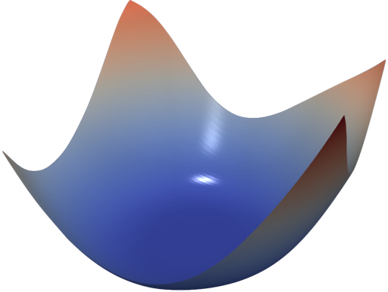
Differentially private learning is possible with noisy gradient descent.
Gradient descent
Private gradient descent
[Chaudhuri et al., ‘11], [Bassily et al. ‘14], [Shokri & Shmatikov ‘15], [Abadi et al. ‘16], ...
add noise to each step to guarantee privacy

Slide 81
Differential privacy is not a panacea.
Training with privacy hurts accuracy (a lot)!
Can mitigate by pre-training on public data
“Deep Learning with Differential Privacy”. Abadi et al. 2016
“Differentially Private Learning Needs Better Features”. Tramèr & Boneh. 2021
“Large Language Models Can Be Strong Differentially Private Learners”. Li et al. 2021
“Differentially private fine-tuning of language models”. Yu et al. 2021
Weak protection if sensitive text is repeated

Slide 82
Outline
ML Integrity
Adversarial examples
Poisoning attacks
ML Confidentiality
Data extraction

Slide 83
Conclusion & what’s next?
Current ML is not robust and not private
Exciting open-problems:
improving ML by understanding its blind-spots
attacks against real ML systems
pragmatic defenses against real adversaries

Slide 84
Conclusion & what’s next?
Current ML is not robust and not private
Exciting open-problems:
improving ML by understanding its blind-spots
attacks against real ML systems
pragmatic defenses against real adversaries
If you’re interested in working on these topics (PhD/Master/Bachelor) in Fall’22 and after, please reach out!
www.floriantramer.ch

