Slide 1
Developments in Adversarial Machine Learning
Florian Tramèr
September 19th 2019
Based on joint work with Jens Behrmannn, Dan Boneh, Nicholas Carlini, Edward Chou, Pascal Dupré, Jörn-Henrik Jacobsen, Nicolas Papernot, Giancarlo Pellegrino, Gili Rusak

Slide 2
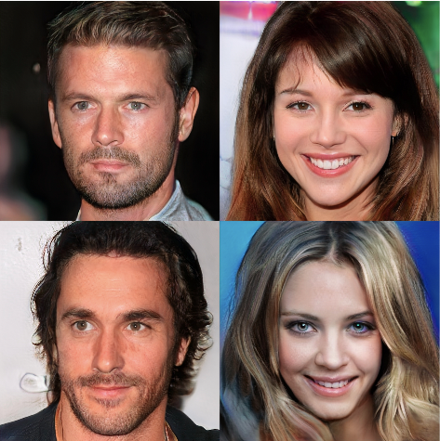
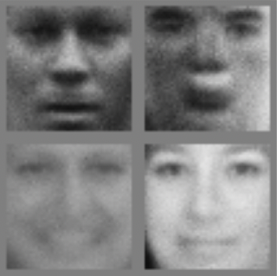
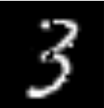

Adversarial (Examples in) ML
Maybe we need to write 10x more papers
GANs vs Adversarial Examples
10000+ papers
2013
2014
2017
2019
1000+ papers
N. Carlini, “Recent Advances in Adversarial Machine Learning”, ScAINet 2019

Slide 3
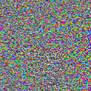
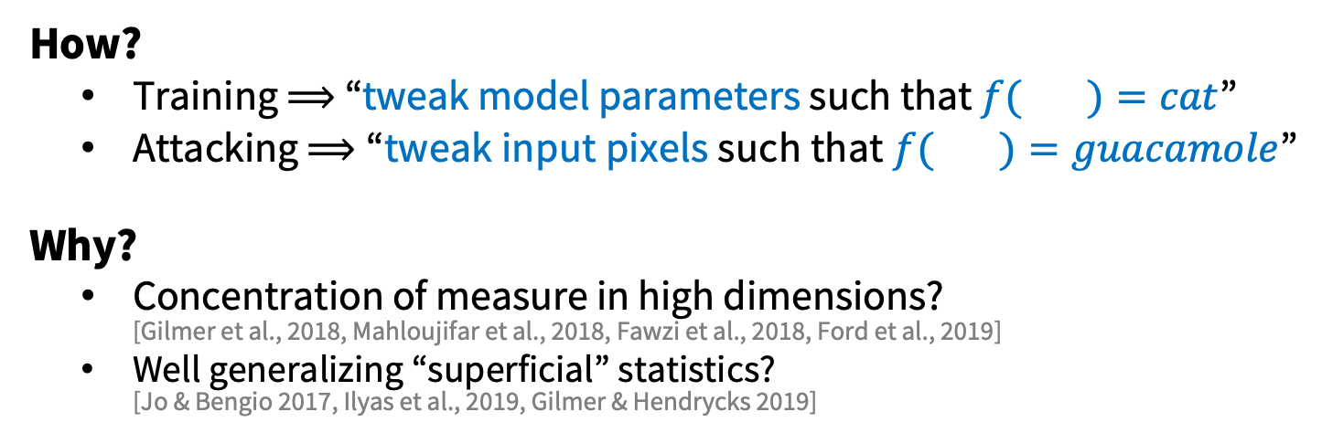
Adversarial Examples
Szegedy et al., 2014 Goodfellow et al., 2015
Athalye, 2017
88% Tabby Cat
99% Guacamole
How?
Training ⟹ “tweak model parameters such that $f( )=cat$”
Attacking ⟹ “tweak input pixels such that $f( )=guacamole$”
Why?
Concentration of measure in high dimensions? [Gilmer et al., 2018, Mahloujifar et al., 2018, Fawzi et al., 2018, Ford et al., 2019]
Well generalizing “superficial” statistics? [Jo & Bengio 2017, Ilyas et al., 2019, Gilmer & Hendrycks 2019]

Slide 4
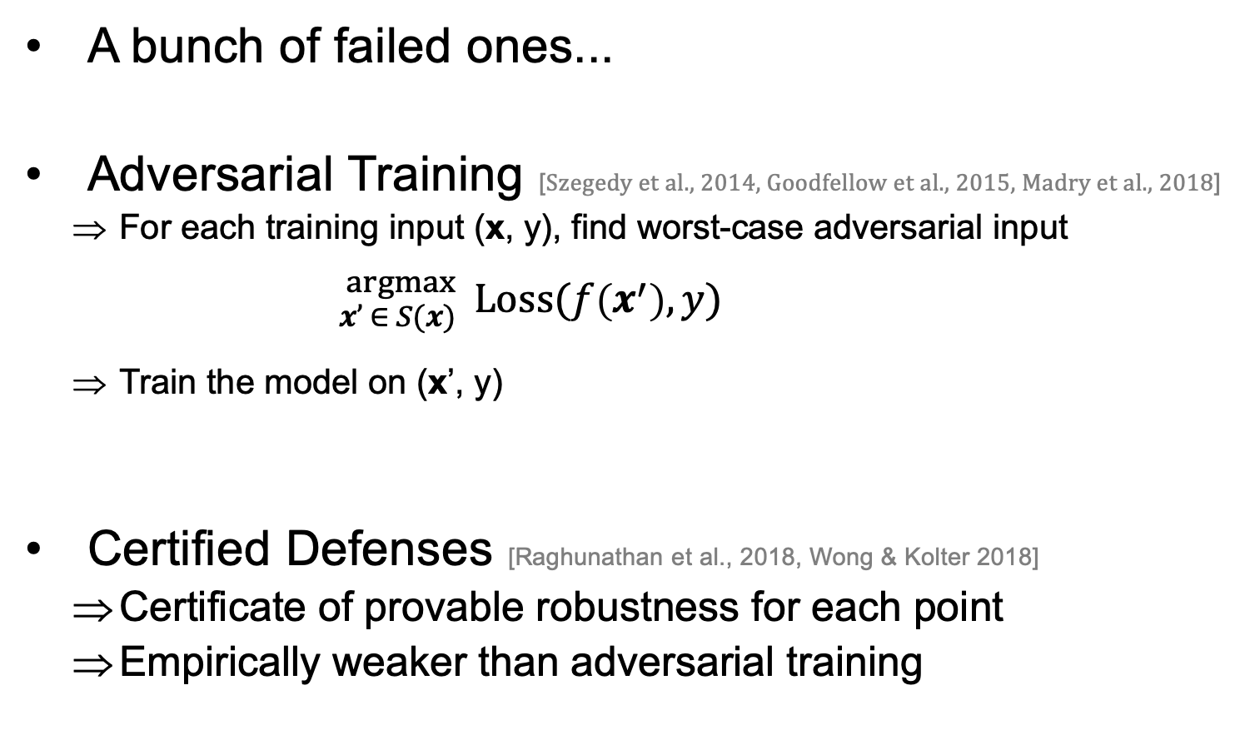
Defenses
A bunch of failed ones...
Adversarial Training [Szegedy et al., 2014, Goodfellow et al., 2015, Madry et al., 2018]
For each training input (x, y), find worst-case adversarial input
${}_{x’ ∈ S(x)}^{argmax}{ \text{Loss}(f\left(x^{′}\right), y)}$
Train the model on (x’, y)
Certified Defenses [Raghunathan et al., 2018, Wong & Kolter 2018]
Certificate of provable robustness for each point
Empirically weaker than adversarial training
A set of allowable perturbations of x e.g., {x’ : || x - x’ ||∞ ≤ ε}
Worst-case data augmentation

Slide 5
L_{p} robustness: An Over-studied Toy Problem?
Neural networks aren’t robust. Consider this simple “expectimax L_{p}” game:
Sample random input from test set
Adversary perturbs point within small L_{p} ball
Defender classifies perturbed point
2015
This was just a toy threat model ... Solving this won’t magically make ML more “secure”
2019 and 1000+ papers later
Ian Goodfellow, “The case for dynamic defenses against adversarial examples”, SafeML ICLR Workshop, 2019

Slide 6
Limitations of the “expectimax L_{p}” Game
Sample random input from test set
What if model has 99% accuracy and adversary always picks from the 1%? (test-set attack, [Gilmer et al., 2018])
Adversary perturbs point within L_{p} ball
Why limit to one L_{p} ball?
How do we choose the “right” L_{p} ball?
Why “imperceptible” perturbations?
Defender classifies perturbed point
Can the defender abstain? (attack detection)
Can the defender adapt?
Ian Goodfellow, “The case for dynamic defenses against adversarial examples”, SafeML ICLR Workshop, 2019

Slide 7
A real-world example of the “expectimax L_{p}” threat model: Perceptual Ad-blocking
Ad-blocker’s goal: classify images as ads
Attacker goals:
Perturb ads to evade detection (False Negative)
Perturb benign content to detect ad-blocker (False Positive)
Can the attacker run a “test-set attack”?
No! (or ad designers have to create lots of random ads...)
Should attacks be imperceptible?
Yes! The attack should not affect the website user
Still, many choices other than L_{p} balls
Is detecting attacks enough?
No! Attackers can exploit FPs and FNs
T et al., “AdVersarial: Perceptual Ad Blocking meets Adversarial Machine Learning”, CCS 2019

Slide 8
Limitations of the “expectimax L_{p}” Game
Sample random input from test set
Adversary perturbs point within L_{p} ball
Why limit to one L_{p} ball?
How do we choose the “right” L_{p} ball?
Why “imperceptible” perturbations?
Defender classifies perturbed point
Can the defender abstain? (attack detection)

Slide 9
Limitations of the “expectimax L_{p}” Game
Sample random input from test set
Adversary perturbs point within L_{p} ball
Why limit to one L_{p} ball?
How do we choose the “right” L_{p} ball?
Why “imperceptible” perturbations?
Defender classifies perturbed point
Can the defender abstain? (attack detection)

Slide 10
Robustness for Multiple Perturbations
Do defenses (e.g., adversarial training) generalize across perturbation types?
MNIST:
Robustness to one perturbation type ≠ robustness to all
Robustness to one type can increase vulnerability to others
T & Boneh, “Adversarial Training and Robustness for Multiple Perturbations”, NeurIPS 2019

Slide 11
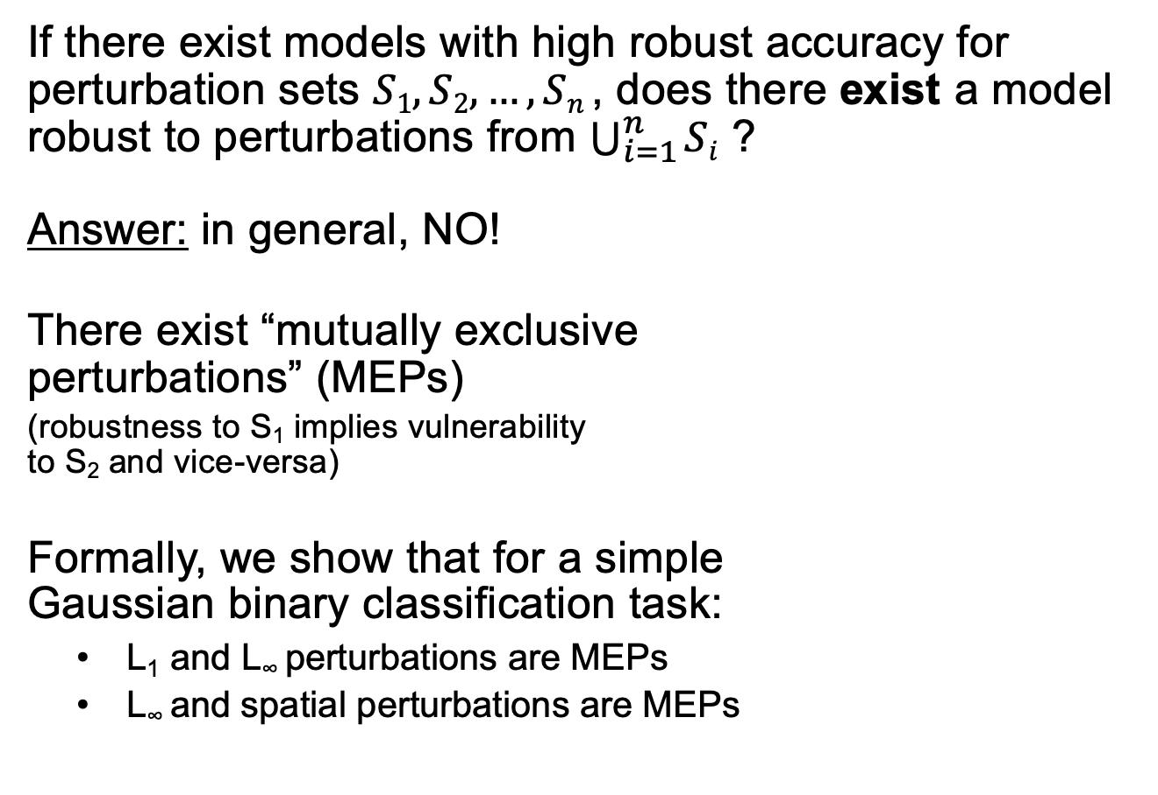
The multi-perturbation robustness trade-off
If there exist models with high robust accuracy for perturbation sets $S1, S2, …, Sn$, does there exist a model robust to perturbations from $\bigcup_{i=1}^{n}{Si}$ ?
Answer: in general, NO!
There exist “mutually exclusive perturbations” (MEPs)
(robustness to S₁ implies vulnerability to S₂ and vice-versa)
Formally, we show that for a simple Gaussian binary classification task:
L₁ and L∞ perturbations are MEPs
L∞ and spatial perturbations are MEPs
Robust for S₁
Not robust for S₂
x₁
Classifier robust to S1
Classifier vulnerable to S1 and S2
Not robust for S₁
Robust for S₂
x₂
Classifier robust to S2
T & Boneh, “Adversarial Training and Robustness for Multiple Perturbations”, NeurIPS 2019

Slide 12
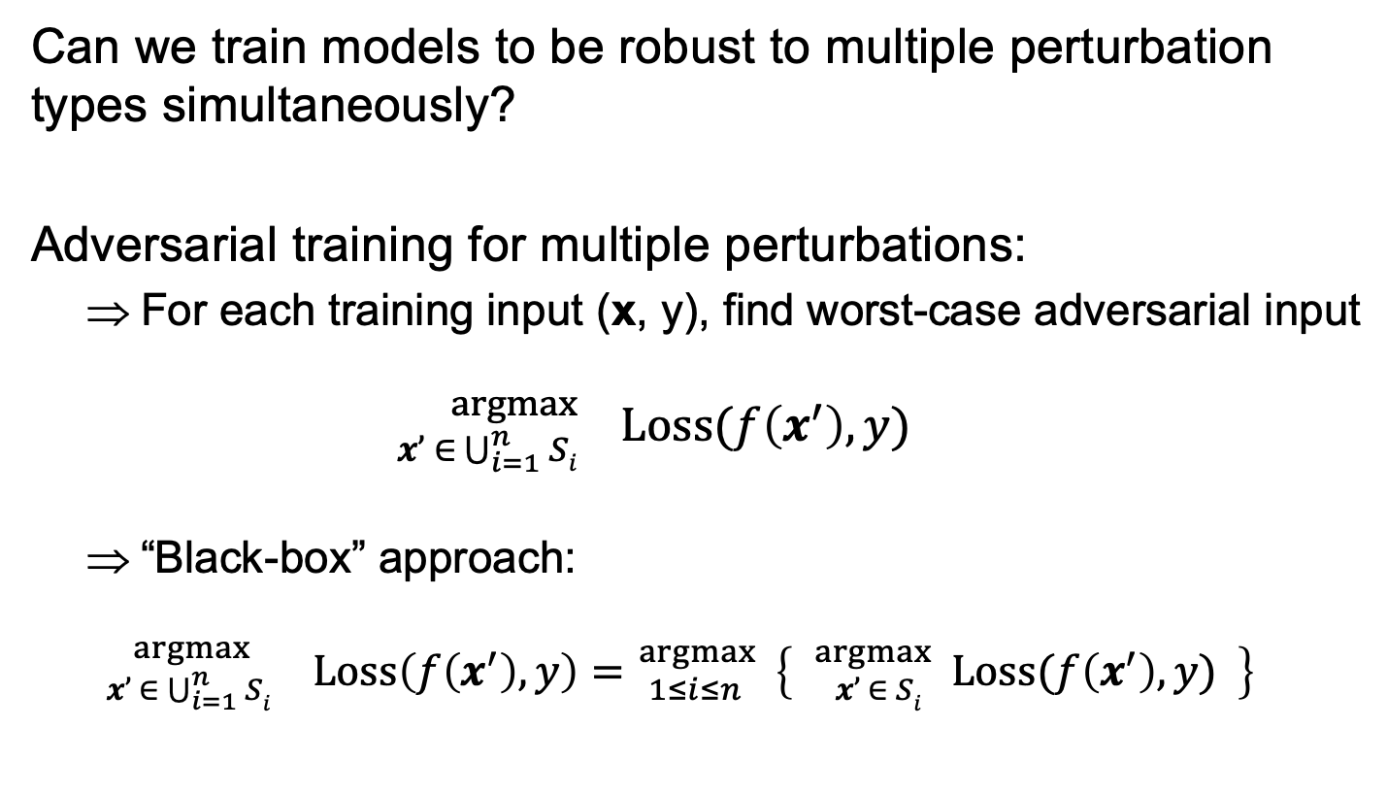
Empirical Evaluation
Can we train models to be robust to multiple perturbation types simultaneously?
Adversarial training for multiple perturbations:
For each training input (x, y), find worst-case adversarial input ${}_{x’ ∈ \bigcup_{i=1}^{n}{Si}}^{argmax}{ \text{Loss}(f\left(x^{′}\right), y)}$
“Black-box” approach:
${}_{x’ ∈ \bigcup_{i=1}^{n}{Si}}^{argmax }{}\text{Loss}\left(f\left(x^{′}\right), y\right)={}_{1≤i≤n }^{argmax} \left\{ {}_{x’ ∈ Si }^{argmax}{ \text{Loss}(f\left(x^{′}\right), y)} \right\}$
Scales linearly in number of perturbation sets
Use existing attack tailored to S_{i}
T & Boneh, “Adversarial Training and Robustness for Multiple Perturbations”, NeurIPS 2019

Slide 13
Results
Robust accuracy when training/evaluating on a single perturbation type
Robust accuracy when training/evaluating on both
CIFAR10:
Loss of ~5% accuracy
Loss of ~20% accuracy
MNIST:
T & Boneh, “Adversarial Training and Robustness for Multiple Perturbations”, NeurIPS 2019

Slide 14
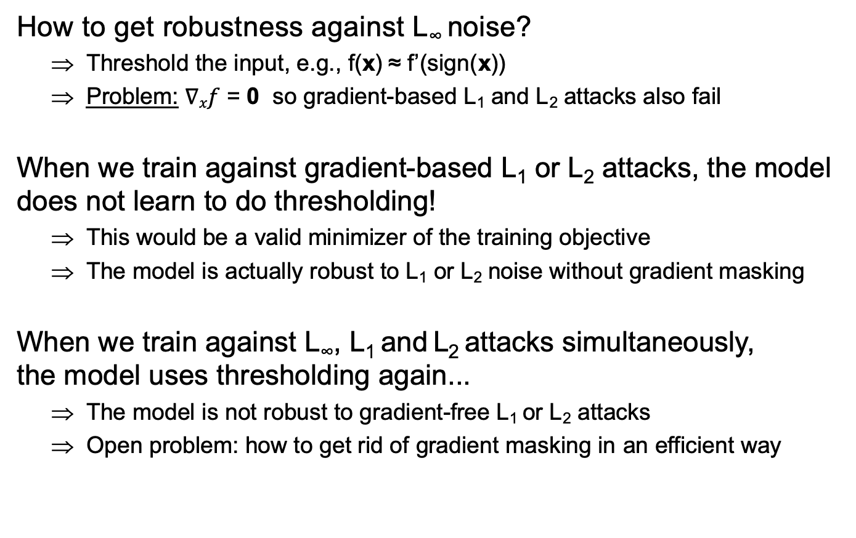

MNIST and gradient masking
$$∈\left\{0, 1\right\}784$$
x’
How to get robustness against L∞ noise?
Threshold the input, e.g., f(x) ≈ f’(sign(x))
Problem: $∇xf$ = 0 so gradient-based L₁ and L₂ attacks also fail
When we train against gradient-based L₁ or L₂ attacks, the model does not learn to do thresholding!
This would be a valid minimizer of the training objective
The model is actually robust to L₁ or L₂ noise without gradient masking
When we train against L∞, L₁ and L₂ attacks simultaneously, the model uses thresholding again...
The model is not robust to gradient-free L₁ or L₂ attacks
Open problem: how to get rid of gradient masking in an efficient way
x
flip 10 px

Slide 15

Affine adversaries
Instead of picking perturbations from $S1∪S2$ why not combine them?
E.g., small L₁ noise + small L∞ noise
or small rotation/translation + small L∞ noise
Affine adversary picks perturbation from$βS1+\left(1−β\right)S2$, for $β ∈\left[0, 1\right]$
Extra loss of ~10% accuracy
T & Boneh, “Adversarial Training and Robustness for Multiple Perturbations”, NeurIPS 2019

Slide 16
Limitations of the “expectimax L_{p}” Game
Sample random input from test set
Adversary perturbs point within L_{p} ball
Why limit to one L_{p} ball?
How do we choose the “right” L_{p} ball?
Why “imperceptible” perturbations?
Defender classifies perturbed point
Can the defender abstain? (attack detection)

Slide 17

Invariance Adversarial Examples
Let’s look at MNIST again:
(Simple dataset, centered and scaled, non-trivial robustness is achievable)
Models have been trained to “extreme” levels of robustness (E.g., robust to L₁ noise > 30 or L∞ noise = 0.4)
Some of these defenses are certified!
$$∈\left\{0, 1\right\}784$$
natural
For such examples, humans agree more often with an undefended model than with an overly robust model
L₁ perturbed
L∞ perturbed
Jacobsen et al., “Exploiting Excessive Invariance caused by Norm-Bounded Adversarial Robustness”, 2019

Slide 18
Limitations of the “expectimax L_{p}” Game
Sample random input from test set
Adversary perturbs point within L_{p} ball
Why limit to one L_{p} ball?
How do we choose the “right” L_{p} ball?
Why “imperceptible” perturbations?
Defender classifies perturbed point
Can the defender abstain? (attack detection)

Slide 19
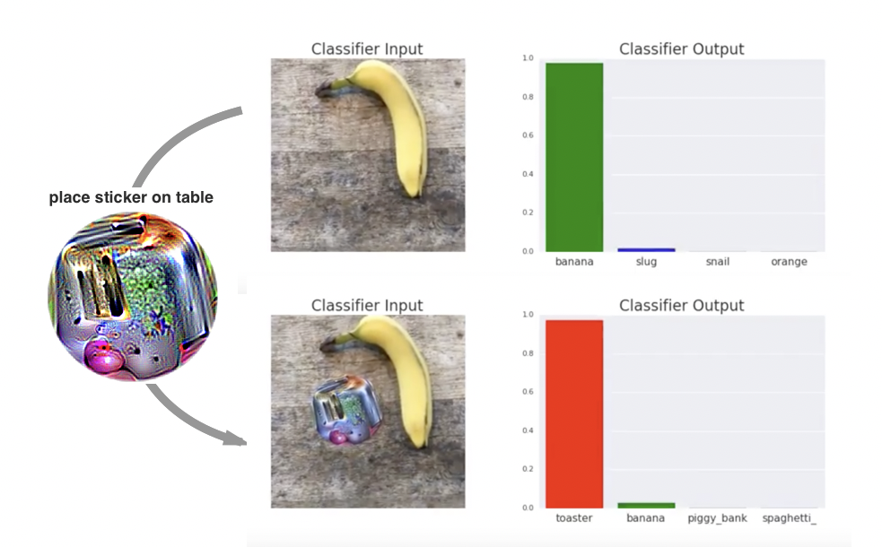
New Ideas for Defenses
What would a realistic attack on a cyber-physical image classifier look like?
Attack has to be physically realizable
Robustness to physical changes (lighting, pose, etc.)
Some degree of “universality”
Example: Adversarial patch [Brown et al., 2018]

Slide 20
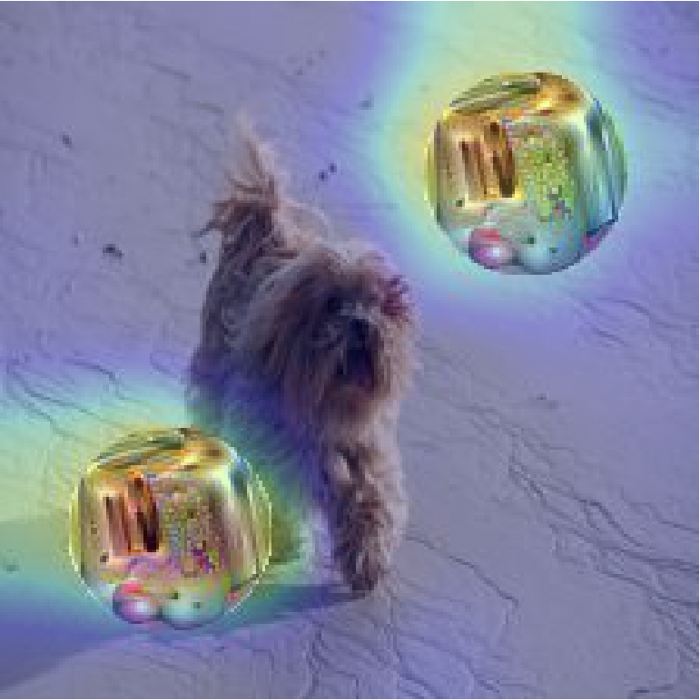
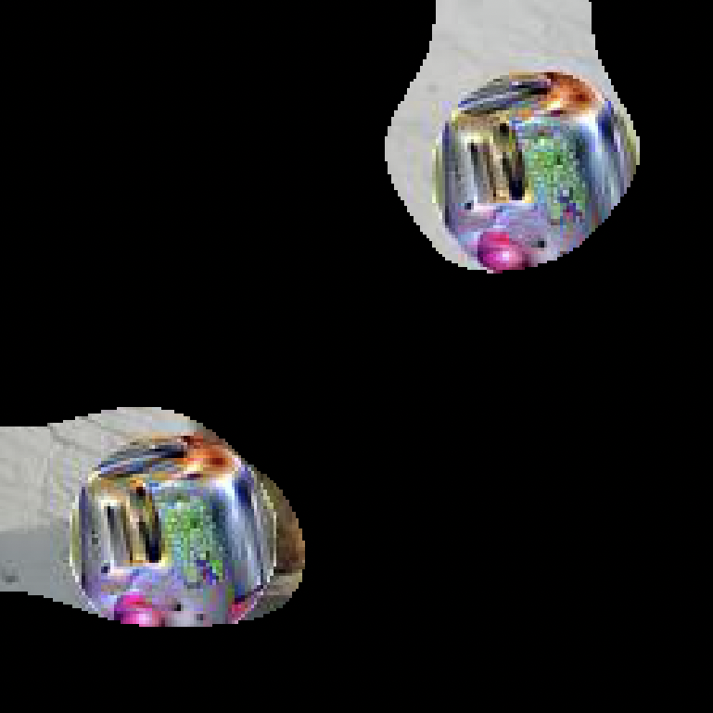
Can we detect such attacks?
Observation: To be robust to physical transforms, the attack has to be very “salient”
Use model interpretability to extract salient regions
Problem: this might also extract “real” objects
Add the extracted region(s) onto some test images and check how often this “hijacks” the true prediction
Chou et al. “SentiNet: Detecting Localized Universal Attacks Against Deep Learning Systems”, 2018

Slide 21
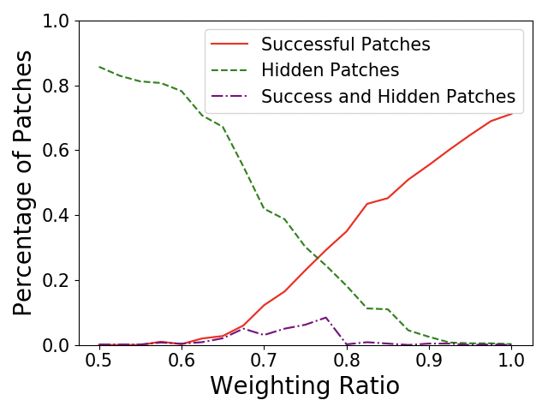
Does it work?
It seems so...
Generating a patch that avoids detection harms the patch’s universality
Also works for some forms of “trojaning” attacks
But:
Very narrow threat model
Somewhat complex system so hard to say if we’ve thought of all attacks
Chou et al. “SentiNet: Detecting Localized Universal Attacks Against Deep Learning Systems”, 2018

Slide 22
Conclusions
The “expectimax L_{p}” game has proven more challenging than expected
We shouldn’t forget that this is a “toy” problem
Solving it doesn’t get us secure ML (in most settings)
Current defenses break down as soon as one of the game’s assumptions is invalidated
E.g., robustness to more than one perturbation type
Over-optimizing a standard benchmark can be harmful
E.g., invariance adversarial examples
Thinking about real cyber-physical attacker constraints might lead to interesting defense ideas
Maybe we don’t need 10x more papers!

