Slide 1
AdVersarial: Defeating Perceptual Ad Blocking with Adversarial Examples
Florian Tramèr
September 10th 2019
Joint work with Pascal Dupré, Gili Rusak, Giancarlo Pellegrino and Dan Boneh

Slide 2




The Future of Ad-Blocking?
easylist.txt
…markup…
…URLs…
???
This is an ad
Human distinguishability of ads
    Legal requirement (U.S. FTC, EU E-Commerce)
    Industry self-regulation on ad-disclosure

Slide 3
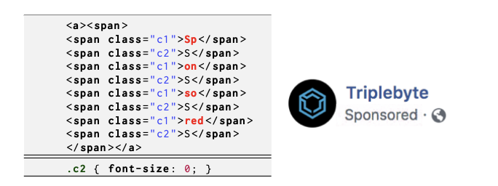
Towards Computer Vision for Ad-Blocking
  Why not detect ad-disclosures programmatically?
    New arms race on HTML obfuscation
    E.g., Facebook vs uBlockOrigin: https://github.com/uBlockOrigin/uAssets/issues/3367
      1 year, 253 comments, and counting...

Slide 4


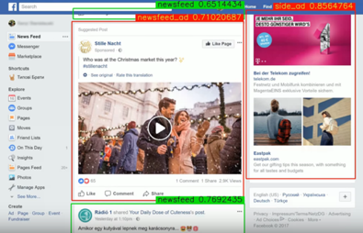
Perceptual Ad-Blocking
  Ad Highlighter [Storey et al., 2017]
    Visually detects ad-disclosures
    Traditional computer vision techniques
    Simplified version in Adblock Plus
  Sentinel by Adblock Plus
    Locates ads in Facebook screenshots using neural networks
  Percival by Brave [Din et al., 2019]
    Neural network embedded in Chromium’s rendering pipeline

Slide 5
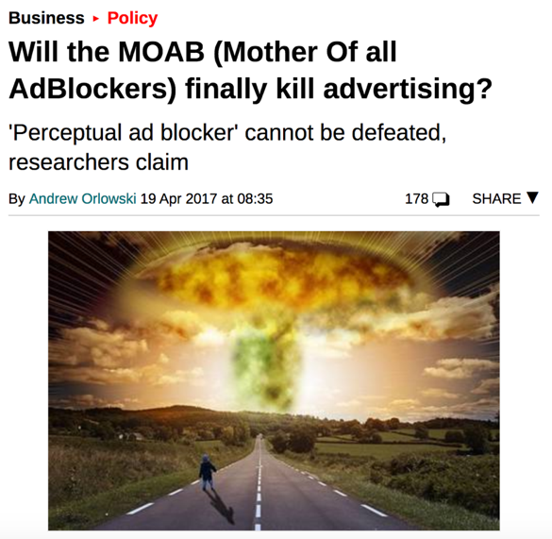
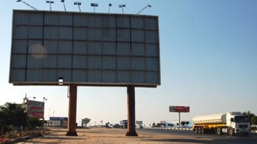

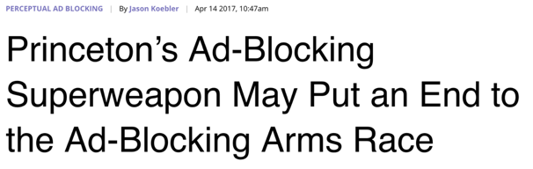


Perceptual Ad-Blocking
  Ad Highlighter by Storey et al.
    Visually detects ad-disclosures
    Traditional Computer Vision techniques
    Simplified version implementable in Adblock Plus
  Sentinel by Adblock Plus
    Locates ads in Facebook screenshots using neural networks
    Not yet deployed

Slide 6
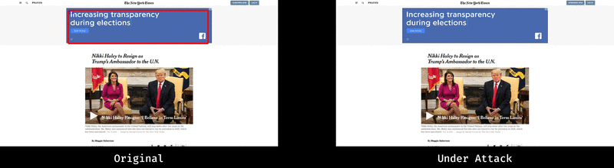
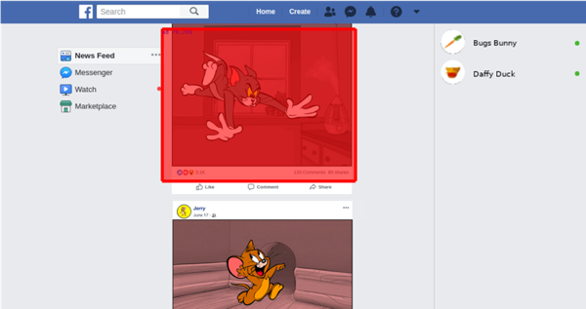

How Secure is Perceptual Ad-Blocking?
AD
… so that Tom’s post gets blocked
Jerry uploads
malicious content
…
Notes:
Mark Tom’s post as an ad

Slide 7
Outline
  Perceptual ad-blockers: how they work
  Attacking perceptual ad-blockers
  Why defending is hard
Notes:
Change titles everywhere

Slide 8
Outline
  Perceptual ad-blockers: how they work
  Attacking perceptual ad-blockers
  Why defending is hard

Slide 9
How does a Perceptual Ad-Blocker Work?
Template matching, OCR,
DNNs, Object detector networks
Element-based (e.g., find all <img> tags) [Storey et al. 2017]
Frame-based (segment rendered webpage into “frames” as in Percival)
Page-based (unsegmented screenshots à-la-Sentinel)

Slide 10
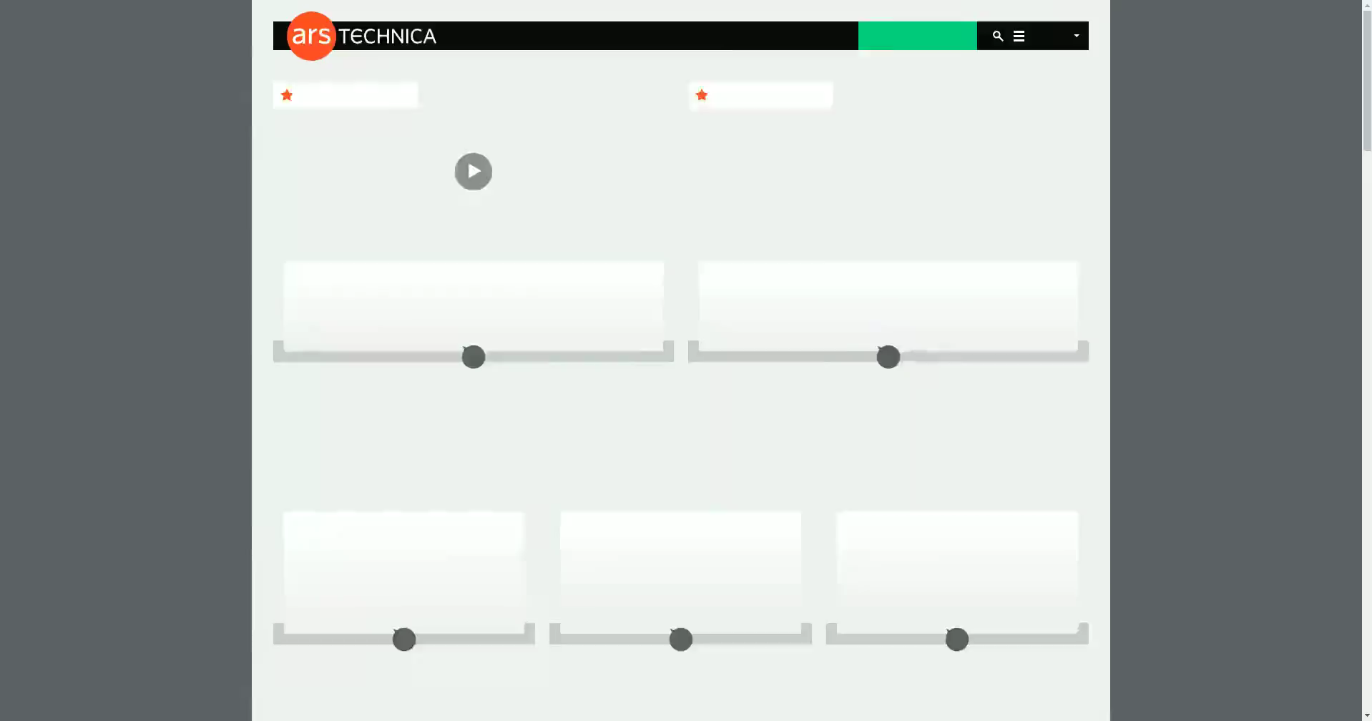
Building a Page-Based Ad-Blocker
We trained a neural network to detect ads on news websites from all G20 nations
Video taken from 5 websites not used during training

Slide 11
Outline
  Perceptual ad-blockers: how they work
  Attacking perceptual ad-blockers
  Why defending is hard

Slide 12
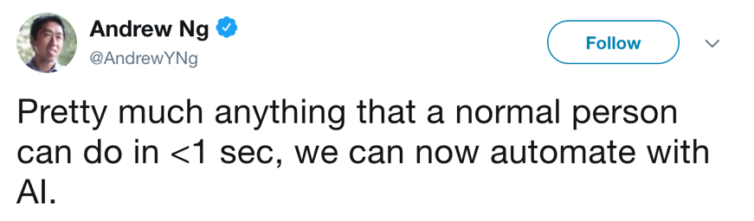
The Current State of ML
ML works well on average
≠
ML works well on adversarial data
*
*as long as there is no adversary

Slide 13
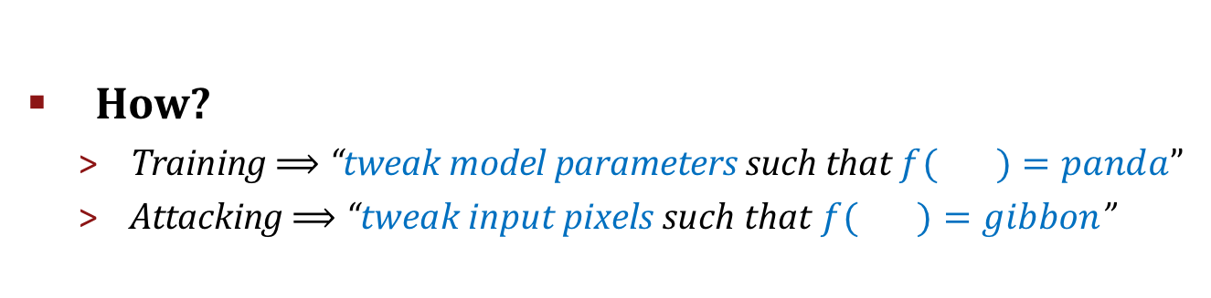
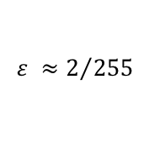
Adversarial Examples
Szegedy et al., 2014
Goodfellow et al., 2015
$$ε ≈2/{255}$$
  How?
    Training ⟹ “tweak model parameters such that $f( )=panda$”
    Attacking ⟹ “tweak input pixels such that $f( )=gibbon$”

Slide 14
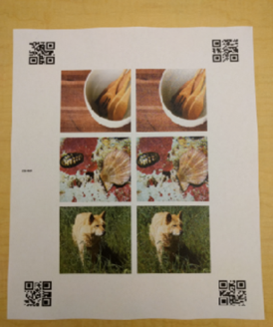
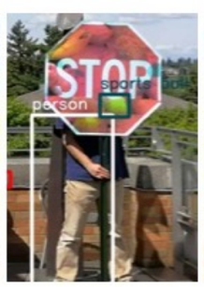


Adversarial Examples: A Pervasive Phenomenon
(Athalye et al. 2018)
(Kurakin et al. 2016)
(Sharif et al. 2016)
(Carlini et al. 2016,
Cisse et al. 2017,
Carlini & Wagner 2018)
(Eykholt et al. 2017)
(Eykholt et al. 2018)

Slide 15
(Meaningful) Defenses

Slide 16
Adversarial Examples for
Page-Based Perceptual Ad-Blockers

Slide 17
Ad-Block Evasion
  Goal: Make ads unrecognizable by ad-blocker
  Adversary = Website publisher
  Other adversaries exist (e.g., Ad-Network)

Slide 18

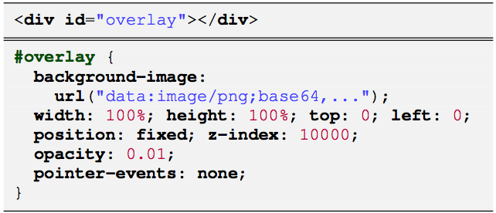


Evasion: Universal Transparent Overlay
  Web publisher perturbs every rendered pixel
Use HTML tiling to minimize perturbation size (20 KB)
100% success rate on 20 webpages not used to create the overlay
The attack is universal: the overlay is computed once and works for all (or most) websites
Attack can be made more stealthy without relying on CSS

Slide 19
Ad-Block Detection
  Goal: Trigger ad-blocker on “honeypot” content
    Detect ad-blocking in client-side JavaScript or on server
    Applicability of these attacks depends on ad-blocker type
  Adversary = Website publisher
    Use client-side JavaScript to detect DOM changes

Slide 20
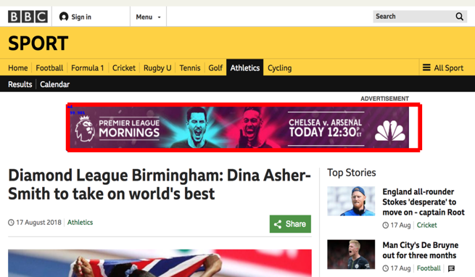
Detection: Perturb fixed page layout
  Publisher adds honeypot in page-region with fixed layout
    E.g., page header
original
With honeypot header

Slide 21


New Threats: Privilege Abuse
  Ad-block evasion & detection is a well-known arms race. But there’s more!
AD
… so that Tom’s post gets blocked
Jerry uploads
malicious content
…
What happened?
Object detector model generates box predictions from full page inputs
Content from one user can affect predictions anywhere on page
Model’s segmentation is not aligned with web-security boundaries

Slide 22
Outline
  Perceptual ad-blockers: how they work
  Attacking perceptual ad-blockers
  Why defending is hard

Slide 23
A Challenging Threat Model
    Adversary has white-box access to ad-blocker
    Adversary can exploit False Negatives and False Positives in classification pipeline
    Adversary prepares attacks offline ⬄
    Adversary can take part in crowd-sourced data collection for training the
    ad-blocker
The ad-blocker must defend against attacks in real-time in the user’s browser

Slide 24
Defense Strategy 1: Obfuscate the Model
  Attacks are easy if the adversary has access to the ML model
    Solution: hide model from adversary?
  Idea 1: Obfuscate the ad-blocker?
    It isn’t hard to create adversarial examples for black-box classifiers
  Idea 2: Randomize the ad-blocker?
    Deploy different models
      Adversarial examples that work against multiple models
    Randomly change page before classifying
      Adversarial examples robust to random transformations
Notes:
=> Active research, no satisfactory defenses yet
=> try to prevent attacker from always being a step ahead

Slide 25
Defense Strategy 2: Anticipate and Adapt
  If ad-blocker is attacked (evasion or detection),
  collect adversarial samples and re-train the model
    Or train on adversarial examples proactively
  This is called Adversarial Training (Szegedy’14)
    New arms-race: The adversary finds new attacks and ad-blocker re-trains
    Mounting a new attack is much easier than updating the model
    On-going research: so far the adversary always wins!
Notes:
We don’t know how to model human perceptibility

Slide 26
Adversarial Training: Current state of affairs
  Confer some robustness to a specific type of perturbation
    CIFAR10: 99% clean accuracy
    50% accuracy at l∞= 8/255
    ImageNet: 85% clean accuracy
    45% at l₂ = 255 (1 px change)
  What about multiple perturbations? (with Dan Boneh, NeurIPS 2019)
    Lose 5-20% accuracy points when training against two perturbation types
    We show provable tradeoffs in robustness for natural statistical models

Slide 27

Defense Strategy 3: Simplify the Problem
  Storey et al: recognize ad-disclosures
    Simpler computer vision problem than
    full-page ad-detection
    Light-weight and mature techniques
    (OCR, perceptual hashing, SIFT)
  Adversarial Examples still exist

Slide 28

Take Away
  Emulating human detection of ads could be the end-game for ad-blockers
  But very hard with current computer vision techniques
    Resisting adversarial examples is a challenging open problem
  Perceptual ad-blockers have to survive a strong threat model
    Similar attack for non-Web ad-blockers (e.g., Adblock Radio)
https://github.com/ftramer/ad-versarial
Train a page-based ad-blocker
Download pre-trained models
Attack demos
http://arxiv.org/abs/1811.03194

