Slide 1
Formal Abstractions for Attested Execution Secure Processors
Eurocrypt
May 1st, 2017
Rafael Pass, Elaine Shi, Florian Tramèr

Slide 2
Trusted hardware:
Different communities, different world views
Crypto
Architecture
Systems
& Security
“Minimal” trusted hardware to circumvent theoretical impossibilities
Little concern about practical performance
Trusted execution of “general-purpose” user-defined progs
Cost-effectiveness, reusability, expressivity
Notes:
Put work in context, look at history of trusted hardware in different communities
Separate trends: hardware assumptions
Theoretical feasibility > performance
Backward compatible

Slide 3
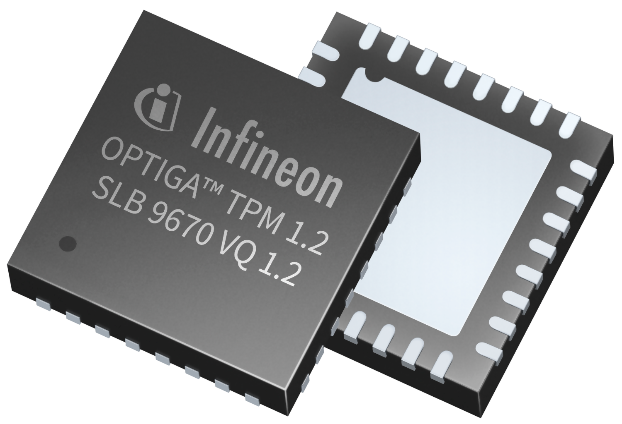
Architecture community converged on
“attested execution”
Bastion
GhostRider
TPM
Iso-X
Ascend
Sanctum
Aegis
Phantom
XOM
Academia Industry
Notes:
Interesting to see that various projects both in academia and industry seem to have converged to a notion of attested execution

Slide 4
Architecture community converged on
“attested execution”
What is “attested execution” ?
What can it (not) express?
Notes:
How to formally define this primitive
How expressive is it
Goal: 2min

Slide 5
Attested Execution
Server
Compute prog on inp
Enclave
Client
outp, σ
Verify
Sign
Attestation that outp is correctly computed from prog and inp
Manufacturer
Notes:
Standard setting: client wants to outsource computation to an untrusted server
Use SGX / terminology as illustration but aim is to cover the “essence” of attested execution
Trust bootstrapped through hardware manufacturer
Picture tells us kind of what we want, but not a precise abstraction

Slide 6
Why Ideal Abstractions?
Formal security proofs for implementations from precise abstractions and security models
Ultimate Goal: Formally verified processor implementing this formal abstraction
Notes:
Goal: 3min
Early systems built on trusted hardware tend to prove security in “ad-hoc” fashion, lack of formal model
Important to note: we don’t claim that any secure processor today actually realizes the ideal abstractions we want (e.g., side channels) => next step
Trusted hardware not used in isolation => part of larger protocols, all of which implicitly share state

Slide 7
Formal Model
Signature scheme
Registry of all platforms with trusted hardware
𝓖_{att}[Σ, reg]
init(): , ⟵ Σ.KeyGen(1^{λ})
getpk() from P: send to P
install(prog, sid) from P ∊ reg:
resume(eid, inp) from P ∊ reg:
(out, M’) = prog(inp, M)
σ = Σ.Sign( , eid, sid, prog, out)
send (out, σ) to P
enclave id
(nonce)
enclave memory
(eid, P)
( sid, prog, M )
’
…
…
Notes:
Interface is relatively simple

Slide 8
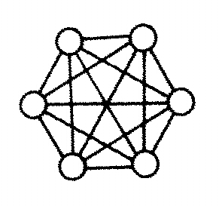
Composability with Global State
Model 𝓖_{att} as global ideal functionality [CDPW’07]
Attestation key is shared across protocols
𝓖_{att}[Σ, reg]
Notes:
Goal: 5min
We model att exec. as an ideal functionality in the generalized UC framework
Why UC => trusted hardware not used in isolation, part of larger protocols => modular composition is a desirable property
Why GUC => source of main technical challenges: protocols implicitly share state!

Slide 9
Composability with Global State
Model 𝓖_{att} as global ideal functionality [CDPW’07]
Example of concrete security issue:
Non-deniability for parties in reg
𝓖_{att}[Σ, reg]
σ
Notes:
Lifetime of attestations (and keys) goes beyond a particular protocol

Slide 10
The more interesting question
What is “attested execution” ?
What can it (not) express?

Slide 11
The good
The surprise
Powerful Abstraction!
𝓖_{att} ➔ ‘’Stateful Obfuscation’’
Impossible even with stateless tokens and cryptographic obfuscation
UC-Secure MPC?
Notes:
Goal: 8min
In interest of time won’t go other this, see paper for formal definitions and constructions

Slide 12
The good
The surprise
Powerful Abstraction!
G_{att} ➔ ‘’Stateful Obfuscation’’
Impossible even with stateless tokens and cryptographic obfuscation
UC-Secure MPC?

Slide 13
Consider 2PC

Slide 14
Consider 2PC
UC-secure 2PC possible if both parties have trusted hardware
Impossible if only one party has trusted hardware!

Slide 15
Consider 2PC
This is counter-intuitive.
Impossible if only one party has trusted hardware!
Notes:
If you recall the informal picture from the beginning of this talk, where a client outsources computation to a server, only the server had a secure processor

Slide 16
Issue: non-deniability
Convinced that some honest party in the registry participated in the protocol
under global pk
Notes:
Most intuitive way of looking at this issue is through the notion of non-deniability
Lifetime of attestation key extends beyond this protocol

Slide 17
Non-issue if all nodes have trusted hardware or if pk isn’t global
Convinced that some honest party in the registry participated in the protocol
under global pk
Notes:
Not an issue if both parties have secure processors, as Bob could have generated the attestation himself => plausible deniability for Alice

Slide 18
What if we really really want to use a single trusted processor?
Extra setup assumption: Augmented CRS
UC-Secure MPC with O(1) crypto operations
Backdoor enclave program: allow simulator to extract inputs and program the outputs for corrupt parties
Notes:
Goal: 14min
Would be much better if not all parties needed a secure processor. ACRS: for honest parties, standard CRS + gives out publically verifiable identity keys to malicious parties
Communication / round complexity independent of program

Slide 19
What if we really really want to use a single trusted processor?
Server
Full protocol replaces σ by a WI-Proof
prog[f,𝓖_{acrs},𝒫₁ … 𝒫_{n}]
Generate pk_{i},sk_{i}
Collect all inp_{i}
Compute outp*
𝒫_{i}
pk_{i}, σ
Key-exchange
Encrypted inp_{i}
Encrypted outp_{i}
Notes:
Gloss over some details: replace attestation by witness indistinguishable proof to circumvent this non-deniability issue (details in the paper)

Slide 20
What if we really really want to use a single trusted processor?
Server
prog[f,𝓖_{acrs},𝒫₁ … 𝒫_{n}]
Trapdoors
check(𝒢_{acrs}, 𝒫_{i}, id_{i})
check(𝒢_{acrs}, 𝒫_{i}, id_{i})
set outp_{i} = v
Sim
Sim can recover inp_{i}
extract(id_{i})
sk_{i}
equivocate(id_{i}, v)
Notes:
How to do simulation?
Simulator needs to obtain / extract the inputs from corrupt parties.
To do this, Sim uses the Augmented Common Reference String to obtain identity keys and calls trapdoor in program
Trapdoor doesn’t harm honest users, as they never call the CRS to obtain their identity keys

Slide 21
Fair 2PC?
Can trusted hardware help with fairness?
Fairness impossible for general functionalities in plain model [Cleve86]
Notes:
Goal: 16min
Let’s now move on to a more positive result, about fairness in multiparty protocols
Here, fairness = if one party obtains result, others also obtain result (maybe after some “short” delay)
Natural question:

Slide 22
UC-Secure Fair 2PC
Enhanced model: Clock-aware secure processor
Fair 2PC possible if both parties have clock-aware secure processors
Fair coin-tossing possible if one party has clock-aware secure processors (+ ACRS)
Notes:
Secure processor with access to trusted source of relative time
In this model, fair 2PC possible BUT only if both parties have secure processors
For some functionalities, e.g. coin tossing, fairness is possible with a single secure processor and a CRS

Slide 23
Enclaves establish secure channel
Enclaves exchange inputs and compute outputs
“Will release to Alice in 2^{λ} time”
“Will release to Bob in 2^{λ} time”
“Will release to Alice in 2^{λ-1} time”
“Will release to Bob in 2^{λ-1} time”
…
Notes:
Secure processors establish a secure channel and perform the two-party computation
Processors withhold outputs for a pre-defined amount of time.
Tit-for-tat

Slide 24
Enclaves establish secure channel
If Alice learns result at time t < 2^{λ}, Bob will learn it at the latest by time 2t
+ no ‘’wasted’’ computation!
“Will release to Alice in 2^{λ-1} time”
“Will release to Bob in 2^{λ-1} time”
…

Slide 25
What next?
Attested execution is a powerful assumption
⟹ Stateful Obfuscation, Efficient MPC, Fair 2PC
Subtle issues unless all parties have trusted hardware
⟹ Non-deniability, Extra setup assumptions
Formal abstractions of trusted hw
Formally verified secure processor design
Secure implementations from formally secure abstractions
Notes:
Goal: 19min
What are the future directions given this work?
Provably satisfy this abstraction
Guidelines for system / protocol development

Slide 26
Thank You
Formal abstractions of trusted hw
Formally verified secure processor design
Secure implementations from formally secure abstractions
Notes:
Goal: 19min
What are the future directions given this work?
Provably satisfy this abstraction
Guidelines for system / protocol development

