Slide 1
Measuring and Enhancing the Security of Machine Learning
Florian Tramèr
Stanford University
Committee members: Mykel Kochenderfer (chair), Dan Boneh (advisor),
Moses Charikar, Percy Liang, Gregory Valiant

Slide 2
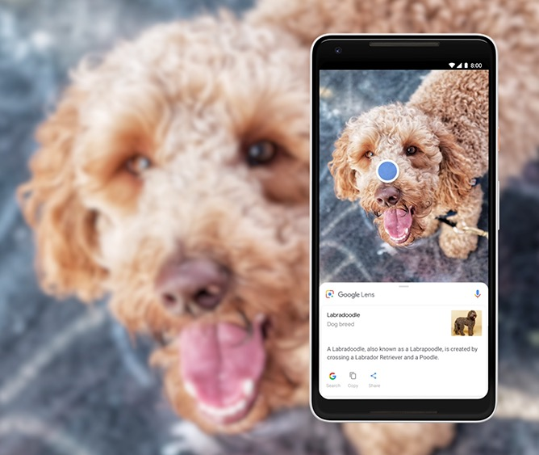
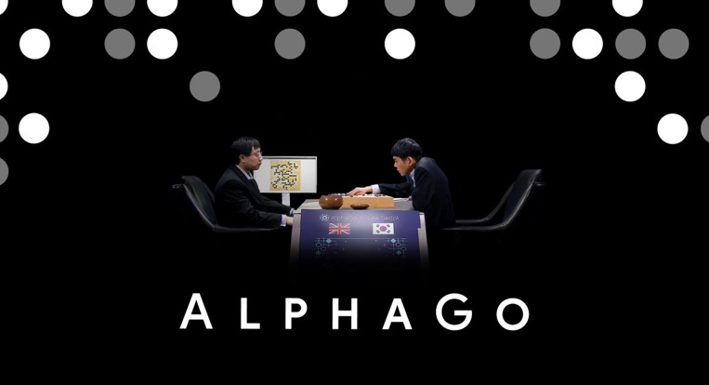

Machine learning works.

Slide 3
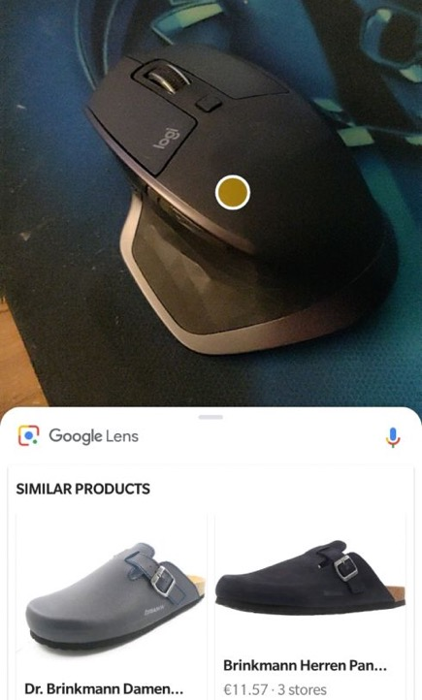
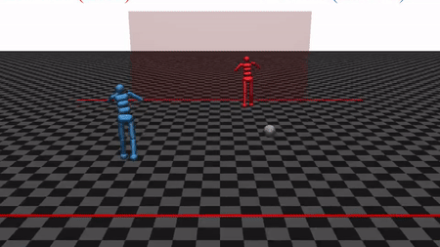
Machine learning works most of the time! many applications tolerate occasional failures
from the Bible (1 Kings 7:2)

Slide 4

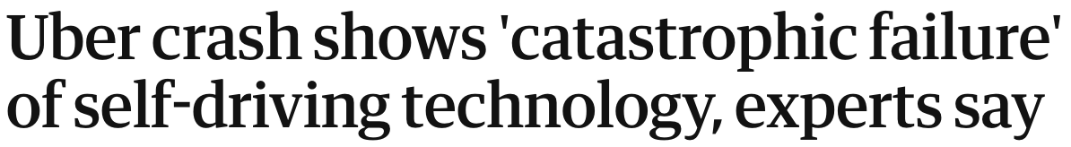
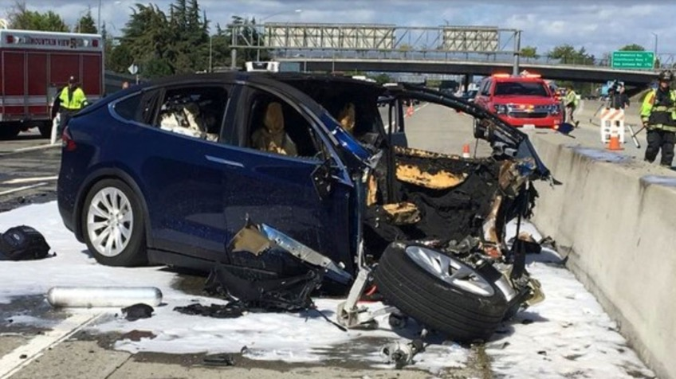
Machine learning can also fail disastrously.
Critical mistakes...

Slide 5
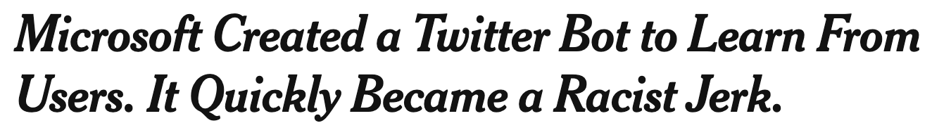
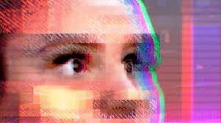
Machine learning can also fail disastrously.
Critical mistakes...
Direct attacks...

Slide 6
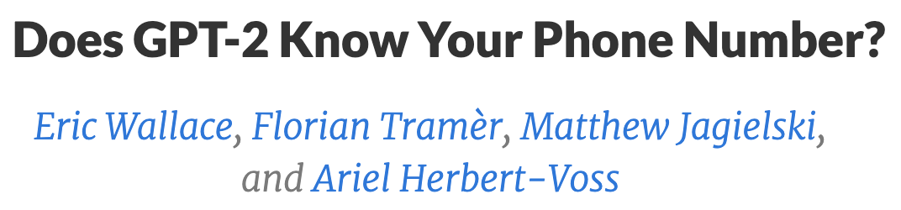
Machine learning can also fail disastrously.
Critical mistakes...
Direct attacks...
Private data leaks...

Slide 7

Challenge: understand and improve the worst-case behavior of machine learning (ML)
Approach: study ML from
an adversarial perspective
  to improve robustness and privacy of ML in adversarial settings
  to build ML that is better

Slide 8
This thesis
Measuring and Enhancing ML security
Modeling the threat of adversarial examples
    Analysis: fundamental limits of existing defenses
    Application: circumventing online content blockers
    (led to design changes in Adblock Plus)
Enhancing data privacy for ML users
    At training time using differential privacy
    At test time using hardware enclaves and cryptography

Slide 9
This thesis
Measuring and Enhancing ML security
Modeling the threat of adversarial examples
    Analysis: fundamental limits of existing defenses
    Application: circumventing online content blockers
    (led to design changes in Adblock Plus)
Enhancing data privacy for ML users
    At training time using differential privacy
    At test time using hardware enclaves and cryptography

Slide 10
This thesis
Measuring and Enhancing ML security
Modeling the threat of adversarial examples
    Analysis: fundamental limits of existing defenses
    Application: circumventing online content blockers
    (led to design changes in Adblock Plus)
Enhancing data privacy for ML users
    At training time using differential privacy
    At test time using hardware enclaves and cryptography

Slide 11
This thesis
Measuring and Enhancing ML security
Modeling the threat of adversarial examples
    Analysis: fundamental limits of existing defenses
    Application: circumventing online content blockers
    (led to design changes in Adblock Plus)
Enhancing data privacy for ML users
    At training time using differential privacy
    At test time using hardware enclaves and cryptography
this talk!

Slide 12
Talk outline.
Adversarial examples for online content blockers
  What’s the threat model?
  Limitations of current defenses
  Industry impact
Enhancing ML privacy
Future work

Slide 13
Talk outline.
Adversarial examples for online content blockers
  What’s the threat model?
  Limitations of current defenses
  Industry impact
Enhancing ML privacy
Future work

Slide 14


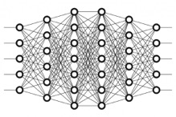
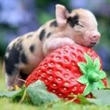
What is Machine Learning (ML)?
collect some “training” data
build a function (model) that learns how to make predictions on new data
f ( ) = “cat”
“cat”
, 90%
“dog”
neural network
(sequence of math transforms applied to the input to assign a ”confidence” to each prediction)
“pig”

Slide 15

Adversarial examples: a curious bug in ML
[Szegedy et al. ‘13], [Biggio et al. ‘13], [Goodfellow et al. ‘14], ...
90% Tabby Cat
Adversarial noise
100% Guacamole

Slide 16
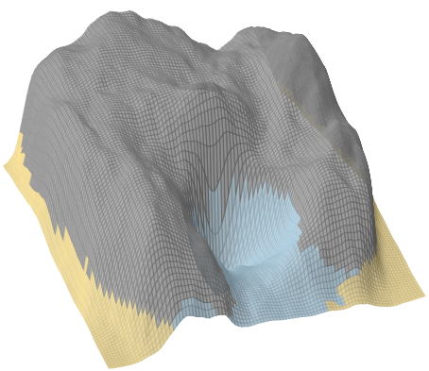
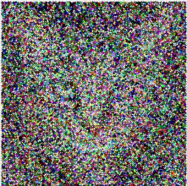
Finding adversarial examples.
Lynx
confidence in the “Cat” class
Cat
Lynx
Guacamole
Guacamole

Slide 17


Why do adversarial examples matter?
For understanding ML
  what is the model learning?
  why do brittle models generalize?
For security:
  will my ML system fail unexpectedly?
  can my ML system be attacked?

Slide 18

Adversarial examples as a computer security problem.
T, Dupré, Rusak, Pellegrino, Boneh (ACM CCS 2019)
  adversarial examples are the perfect tool to attack online content blockers
  using ML for ad-blocking can break Web security
  this work led to design changes in Adblock Plus
100M active users

Slide 19
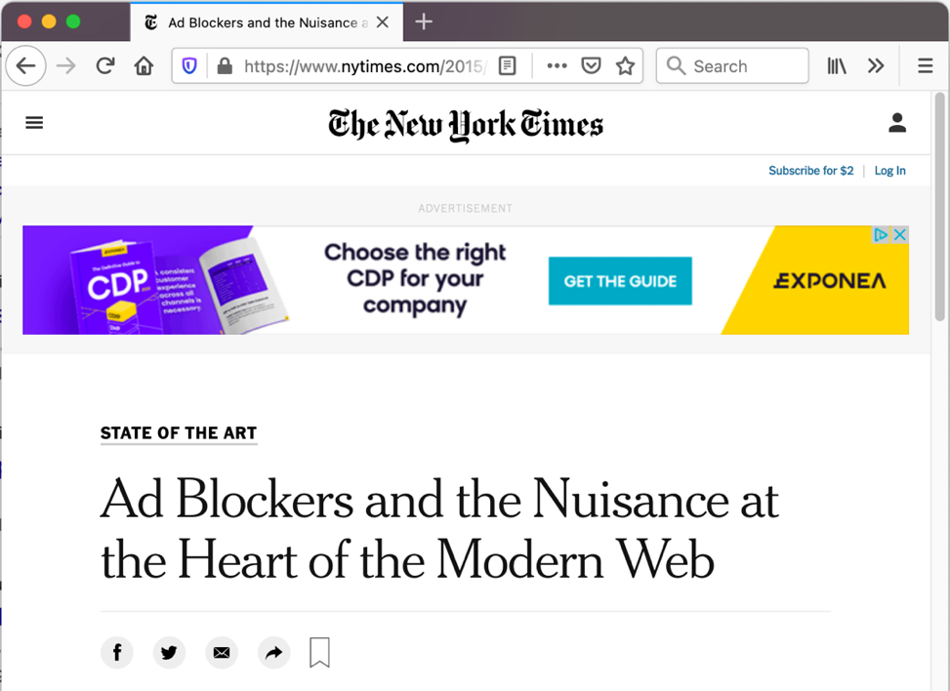

Adversarial examples are a security threat for online ad-blocking.
publishers & advertisers want to show ads to users...
...users don’t want to see ads

Slide 20

Adversarial examples are a security threat for online ad-blocking.
<BLOCKED>
users install ad-blockers to remove ads...

Slide 21
Adversarial examples are a security threat for online ad-blocking.
<BLOCKED>
users install ad-blockers to remove ads...
...using machine learning!

Slide 22

An attacker can use adversarial examples to evade content blocking.
adversaries (publishers & advertisers) modify content to evade blocking...
...without changing the user’s visual perception of ads

Slide 23
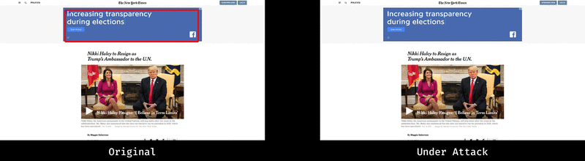
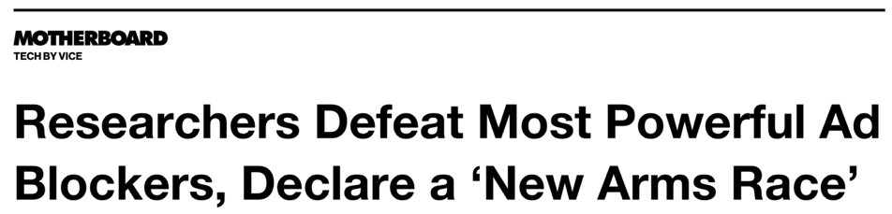
For now, the adversary wins!
“AdVersarial: Perceptual Ad Blocking meets Adversarial Machine Learning”, ACM CCS 2019

Slide 24
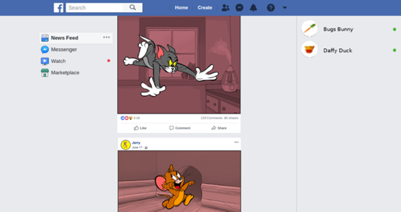
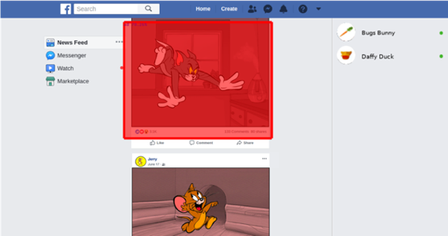

Adversarial examples can cause harm beyond model evasion.
Adblock Plus wants to run a ML model on screenshots of your entire Facebook feed.
AD
… so that Tom’s post gets blocked
Jerry uploads
malicious content
…
“AdVersarial: Perceptual Ad Blocking meets Adversarial Machine Learning”, ACM CCS 2019

Slide 25
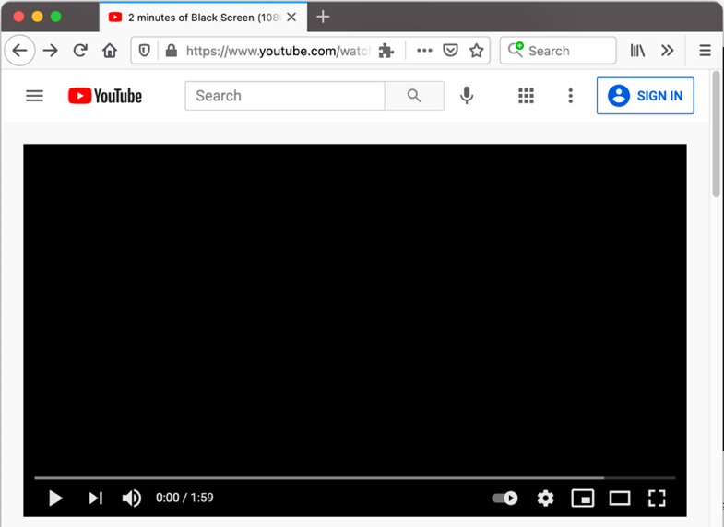
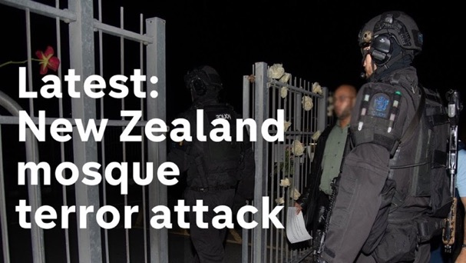

Adversarial examples are a security threat for online content blocking.

Slide 26
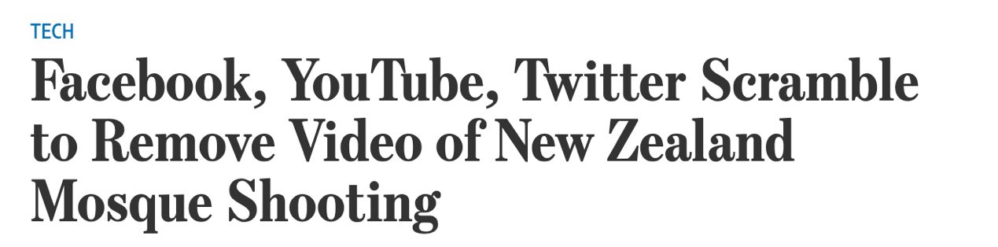
Adversarial examples are a security threat for online content blocking.

Slide 27
Talk outline.
Adversarial examples for online content blockers
  What’s the threat model?
  Limitations of current defenses
  Industry impact
Enhancing ML privacy
Future work

Slide 28
Talk outline.
Adversarial examples for online content blockers
  What’s the threat model?
  Limitations of current defenses
  Industry impact
Enhancing ML privacy
Future work

Slide 29


Why focus on content blocking?
Many systems can be fooled with adversarial examples.
content blockers

Slide 30
Why focus on content blocking?
Many systems can be fooled with adversarial examples.
content blockers
facial recognition
Sharif et al. 2016

Slide 31

Why focus on content blocking?
Many systems can be fooled with adversarial examples.
content blockers
facial recognition
self-driving
Sharif et al. 2016
Eykholt et al. 2018

Slide 32

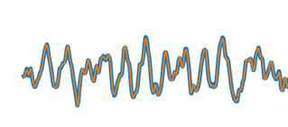
Why focus on content blocking?
Many systems can be fooled with adversarial examples.
content blockers
facial recognition
self-driving
voice assistants
Hey Siri!
open evil.com
Sharif et al. 2016
Eykholt et al. 2018
Carlini et al. 2016

Slide 33
Why focus on content blocking?
Many systems can be fooled with adversarial examples.
content blockers
facial recognition
self-driving
voice assistants
Hey Siri!
open evil.com
Sharif et al. 2016
Eykholt et al. 2018
Carlini et al. 2016
Claim: adversarial examples are “overkill”!

Slide 34


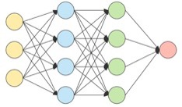
Content blockers always operate in the presence of a human.
content blockers
facial recognition
self-driving
voice assistants
adversary wants to fool the model to get content shown to a human

Slide 35

For other systems, security must hold whether there is a human observer or not.
content blockers
facial recognition
self-driving
voice assistants
adversary wants to fool the model...
adversary wants to fool the model to get content shown to a human
...and there may be a human observer

Slide 36
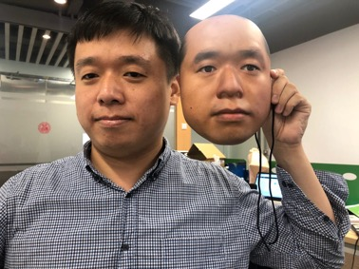

For such systems, security must also hold against “conspicuous” attacks.
facial recognition

Slide 37
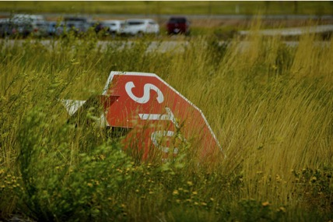
For such systems, security must also hold against “conspicuous” attacks.
facial recognition
self-driving
Olsson 2019

Slide 38
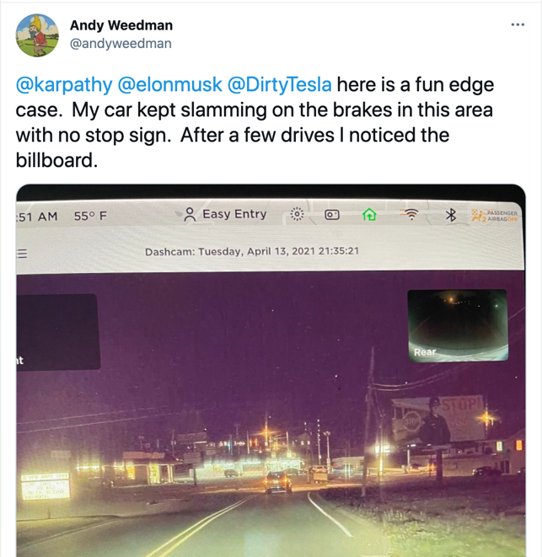
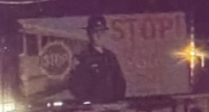
For such systems, security must also hold against “conspicuous” attacks.
facial recognition
self-driving

Slide 39


For such systems, security must also hold against “conspicuous” attacks.
facial recognition
self-driving
voice assistants
Alexa, set alarm for 7am!
Olsson 2019

Slide 40
For such systems, security must also hold against “conspicuous” attacks.
facial recognition
self-driving
voice assistants
Alexa, set alarm for 7am!
Olsson 2019
Content blocking is the only application where “small” perturbations are necessary for a successful attack.

Slide 41
Talk outline.
Adversarial examples for online content blockers
  What’s the threat model?
  Limitations of current defenses
  Industry impact
Enhancing ML privacy
Future work

Slide 42
Talk outline.
Adversarial examples for online content blockers
  What’s the threat model?
  Limitations of current defenses
  Industry impact
Enhancing ML privacy
Future work

Slide 43
Can we build a robust ML model?
“Yes”, but only in a very restrictive “toy” setting,
that has little relevance for practical attacks,
and the best defense only works <50% of the time,
and most defenses don’t work at all.
Short answer: No!

Slide 44

A formal model for robustness.
Train a model $f(∙)$on a distribution $𝔇$ of labelled inputs $\left(x,y\right)$
The adversary perturbs test inputs $x$ sampled from $𝔇$with noise $δ$
Which perturbations $δ$ do we allow?
  Ideal: any “semantically small” perturbation
ambiguous, hard to formalize

Slide 45
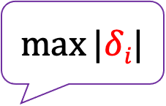
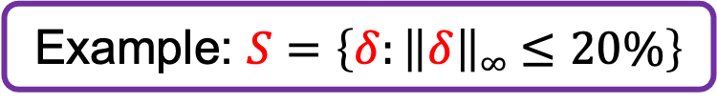
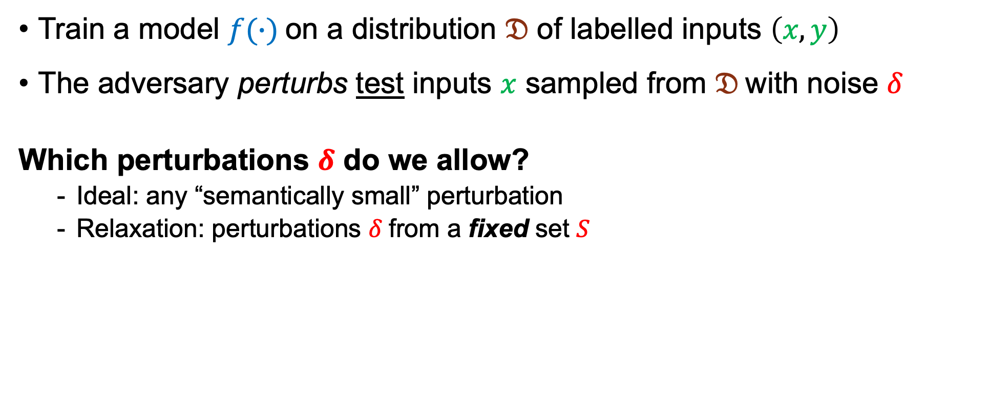
A formal model for robustness.
Train a model $f(∙)$on a distribution $𝔇$ of labelled inputs $\left(x,y\right)$
The adversary perturbs test inputs $x$ sampled from $𝔇$with noise $δ$
Which perturbations $δ$ do we allow?
  Ideal: any “semantically small” perturbation
  Relaxation: perturbations $δ$from a fixed set $S$
$$max⁡|δi|$$
Example: $S=\left\{δ:\left\|δ\right\|∞≤20\%\right\}$
necessary but not sufficient

Slide 46
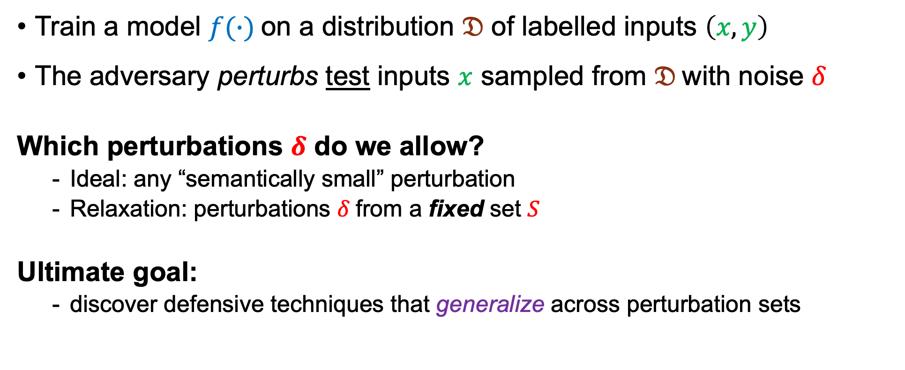
A formal model for robustness.
Train a model $f(∙)$on a distribution $𝔇$ of labelled inputs $\left(x,y\right)$
The adversary perturbs test inputs $x$ sampled from $𝔇$with noise $δ$
Which perturbations $δ$ do we allow?
  Ideal: any “semantically small” perturbation
  Relaxation: perturbations $δ$from a fixed set $S$
Ultimate goal:
  discover defensive techniques that generalize across perturbation sets
Example: $S=\left\{δ:\left\|δ\right\|∞≤20\%\right\}$

Slide 47
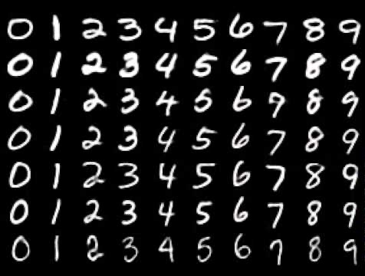
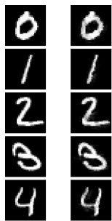
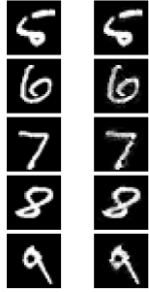
The state-of-the-art in robust ML.
MNIST digit classification [LeCun et al., ’98]
  considered “solved” by ML
  (>99.5% accuracy)
  0% accuracy when each pixel value can be perturbed by 20%
[Carlini & Wagner., ’17]

Slide 48

Most proposed defenses are broken!
[Carlini & Wagner ’17], [Athalye et al. ’18], [T, Carlini, Brendel, Mądry (NeurIPS 2020)], ...
denoising
randomization
dimensionality reduction
input transformations
generative modeling
Bayesian learning
...

Slide 49
Some defenses work.
Adversarial training
Certified defenses
[Szegedy et al. ‘13], [Goodfellow et al. ‘14], [Kurakin et al. ‘16], [T et al. ‘17],
[Madry et al. ‘18], [Zhang et al. ‘19], [Carmon et al. ‘19], [Uesato et al. ‘19],
[Zhai et al. ‘19], [Shafahi et al. ‘19], [Yang et al. ‘19], [Li et al. ‘20], ...
[Katz et al. ‘17], [Wong et al. ‘17], [Raghunathan et al. ‘18], [Gehr et al. ‘18],
[Lecuyer et al. ‘18], [Zhang et al. ‘18], [Mirman et al. ‘18], [Weng et al. ‘19],
[Baluta et al. ‘19], [Cohen et al. ‘19], [Singh et al. ‘19], [Gluch et al. ‘20], ...

Slide 50

Some defenses work, but don’t generalize...
Adversarial training
Certified defenses
recall: we only consider perturbations $δ$from a fixed set $S$
issue: all defenses above are explicitly tailored to a chosen set $S$
[Szegedy et al. ‘13], [Goodfellow et al. ‘14], [Kurakin et al. ‘16], [T et al. ‘17],
[Madry et al. ‘18], [Zhang et al. ‘19], [Carmon et al. ‘19], [Uesato et al. ‘19],
[Zhai et al. ‘19], [Shafahi et al. ‘19], [Yang et al. ‘19], [Li et al. ‘20], ...
[Katz et al. ‘17], [Wong et al. ‘17], [Raghunathan et al. ‘18], [Gehr et al. ‘18],
[Lecuyer et al. ‘18], [Zhang et al. ‘18], [Mirman et al. ‘18], [Weng et al. ‘19],
[Baluta et al. ‘19], [Cohen et al. ‘19], [Singh et al. ‘19], [Gluch et al. ‘20], ...
defenses overfit to the chosen set
T, Behrmann, Carlini, Papernot, Jakobsen
(ICML 2020)
generalizing to richer sets hurts robustness
T & Boneh (NeurIPS 2019 spotlight)

Slide 51




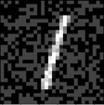


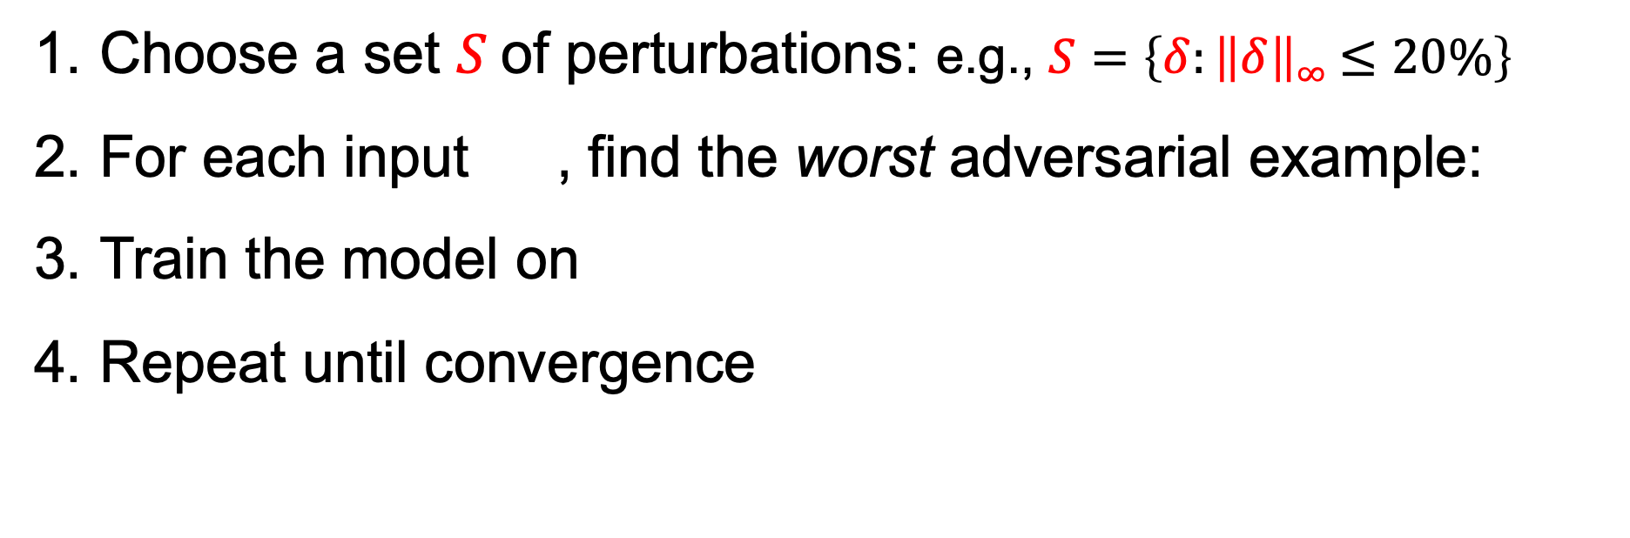
Adversarial training: a defense for a fixed perturbation set.
[Szegedy et al., ’14], [Goodfellow et al., ‘15], [Madry et al., ’17]
max. per-pixel noise
Choose a set $S$of perturbations: e.g., $S=\left\{δ:\left\|δ\right\|∞≤20\%\right\}$
For each input , find the worst adversarial example:
Train the model on
Repeat until convergence
all images in the set are classified as “1”
$$S$$

Slide 52


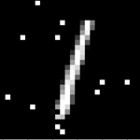



Defenses fail for noise outside the chosen set.
[Engstrom et al., ’17], [Sharma & Chen, ’18]
sum of perturbed pixels
Attack with a perturbation from $S′=\left\{δ:\left\|δ\right\|1≤12\right\}$
$$S$$
misclassified as “8”
$$S′$$

Slide 53



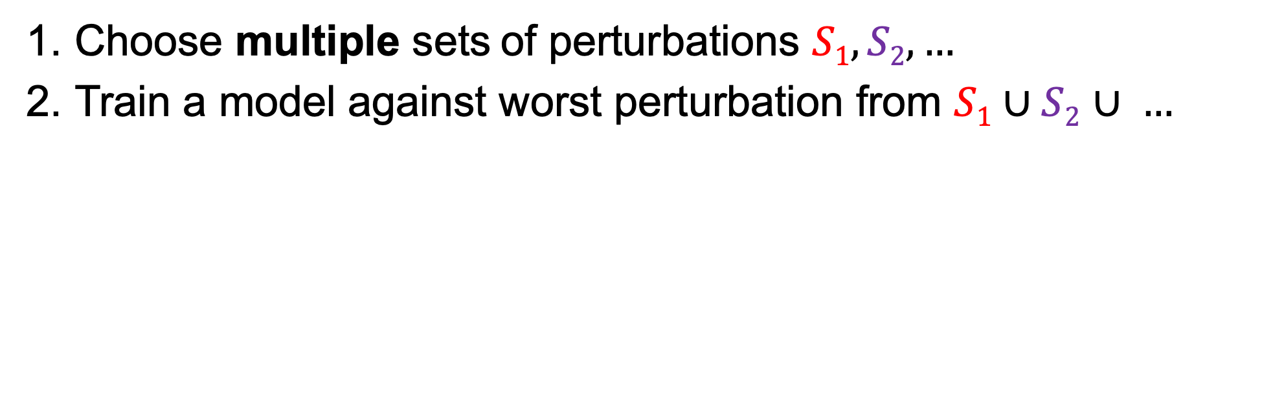
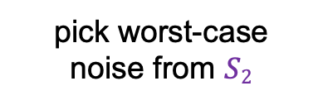
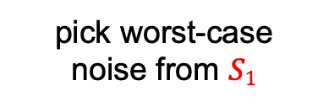

Why not learn to resist multiple noise types?
T & Boneh (NeurIPS 2019 spotlight)
Choose multiple sets of perturbations $S1, S2, …$
Train a model against worst perturbation from $S1∪S2$ $∪ …$
$$S1=\left\{δ:\left\|δ\right\|∞≤20\%\right\}$$
$$S2=\left\{δ:\left\|δ\right\|1≤12\right\}$$
pick worst-case noise from $S1$
pick worst-case noise from $S2$
worst from $S1∪S2$

Slide 54
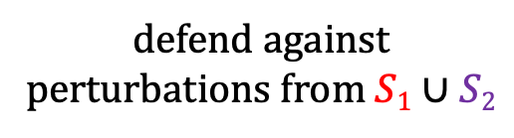
Resisting multiple noise types is costly.
T & Boneh (NeurIPS 2019 spotlight)
Choose multiple sets of perturbations $S1, S2, …$
Train a model against worst perturbation from $S1∪S2$ $∪ …$
+130% error rate!
defend against perturbations from S₁
defend against perturbations from S₂
defend against perturbations from $S1∪S2$

Slide 55
Can adversarial training solve adversarial examples?
recall our ultimate goal:
defenses that are robust to any “small" perturbation
adversarial training requires knowing the perturbation set a priori
Theorem (informal): [T, Behrmann, Carlini, Papernot, Jakobsen, ICML 2020]
Finding a “complete” perturbation set is as hard as building a “perfect” classifier.

Slide 56

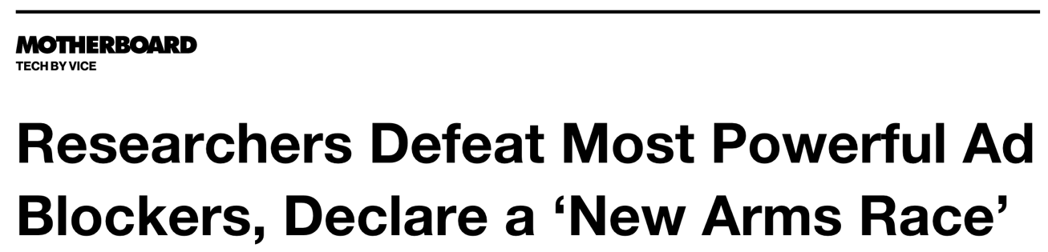
Take away: we don’t have robust machine learning in adversarial settings.

Slide 57

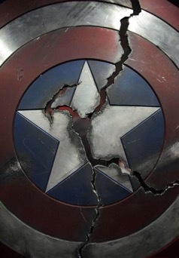
Take away: we don’t have robust machine learning in adversarial settings.
But, we now have:
industry awareness
of security risks
understanding of inherent limitations of defenses

Slide 58
Talk outline.
Adversarial examples for online content blockers
  What’s the threat model?
  Limitations of current defenses
  Industry impact
Enhancing ML privacy
Future work

Slide 59
Talk outline.
Adversarial examples for online content blockers
  What’s the threat model?
  Limitations of current defenses
  Industry impact
Enhancing ML privacy
Future work

Slide 60
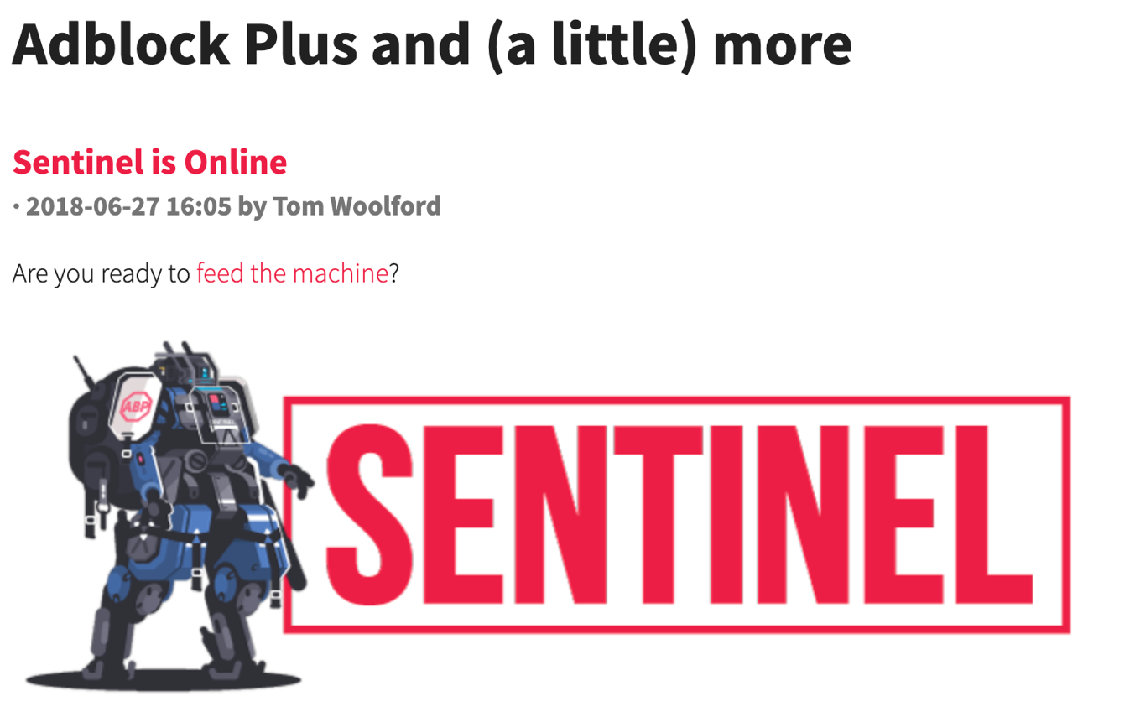

Slide 61


Slide 62

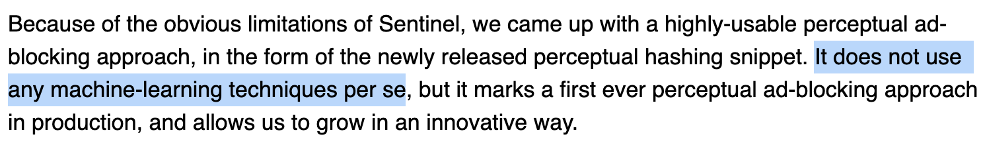
Goal: detect ad disclosures using image hashes
Problem: these techniques are not robust either

Slide 63
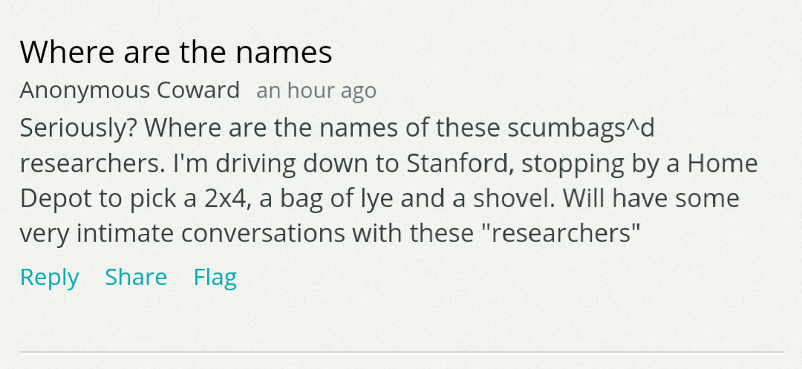
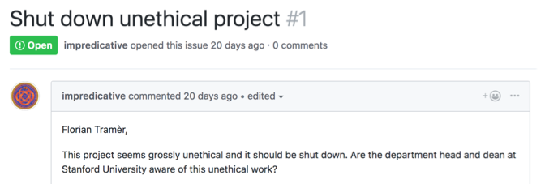

Slide 64
Talk outline.
Adversarial examples for online content blockers
  What’s the threat model?
  Limitations of current defenses
  Industry impact
Enhancing ML privacy
Future work

Slide 65
Talk outline.
Adversarial examples for online content blockers
  What’s the threat model?
  Limitations of current defenses
  Industry impact
Enhancing ML privacy
Future work

Slide 66


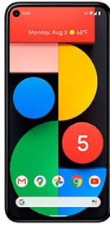


ML models are often trained on private data.

Slide 67

Challenge: models leak their training data.
Carlini, T, Wallace, Jagielski, Herbert-Voss, Lee et al. (preprint 2020)
random input
OpenAI’s language model trained on text from 8 million web pages
someone’s contact information
output by the model
(redacted for privacy)

Slide 68





Data leaks have dramatic consequences!
for users...
for companies...

Slide 69
Preventing data leakage with decade-old ML
T & Boneh (ICLR 2021 spotlight)
provably prevent leakage of training data.
using differential privacy
Extensions: distributed or federated learning
[Dean et al. ‘12], [McMahan et al. ‘16], [Lian et al. ‘17]
better accuracy than with deep learning methods.
using domain-specific feature engineering

Slide 70

Differential privacy prevents data leakage.
[Dwork et al. ‘06]
intuition: randomized training algorithm is not influenced (too much) by any individual data point
for any two datasets that differ in a single element
$$\frac{\text{Pr}[Atrain\left( \right)= ]}{\text{Pr}[Atrain\left( \right)= ]}≤e^{ε}$$

Slide 71

Differentially private learning is possible with noisy gradient descent.
Gradient descent
Private gradient descent
[Chaudhuri et al., ‘11], [Bassily et al. ‘14],
[Shokri & Shmatikov ‘15], [Abadi et al. ‘16], ...
add noise to each step to guarantee privacy

Slide 72


Non-private deep learning can achieve near-perfect accuracy.
“shallow” model
“deep” model
“deep learning era”

Slide 73
Differentially private deep learning lowers accuracy significantly.
“deep learning era”

Slide 74
Differentially private deep learning lowers accuracy significantly.
−40% accuracy!
worse than pre-deep learning
“deep learning era”

Slide 75
Differential privacy without deep learning improves accuracy.
our work: no deep learning!
“deep learning era”
“Differentially private learning needs better features”, ICLR 2021 spotlight

Slide 76


Privacy-free features from “old-school” image recognition.
SIFT [Lowe ‘99, ‘04], HOG [Dalal & Triggs ‘05], SURF [Bay et al. ‘06], ORB [Rublee et al. ‘11], ...
Scattering transforms: [Bruna & Mallat ‘11], [Oyallon & Mallat ‘14], ...
“handcrafted features”
(no learning involved)
simple classifier
(e.g., logistic regression)
captures some prior about the domain: e.g., invariance under rotation & scaling
privacy free

Slide 77
Handcrafted features lead to a better tradeoff between accuracy and privacy.
Better
“Differentially private learning needs better features”, ICLR 2021 spotlight

Slide 78


Handcrafted features lead to an easier learning task (for noisy gradient descent).
high accuracy classifier exists but learning takes
many gradient steps
in feature space, maximal accuracy is reduced but learning progresses faster
bad for privacy
good for privacy
“Differentially private learning needs better features”, ICLR 2021 spotlight

Slide 79

Surpassing handcrafted features with more private data.
(for ε = 3)
“Differentially private learning needs better features”, ICLR 2021 spotlight
79

Slide 80
Surpassing handcrafted features with more private data.
(for ε = 3)
CIFAR-10
“Differentially private learning needs better features”, ICLR 2021 spotlight
80

Slide 81

Surpassing handcrafted features with more private data.
(for ε = 3)
With 10x more private data end-to-end deep learning performs best
collecting more data is good for your privacy!
“Differentially private learning needs better features”, ICLR 2021 spotlight
81

Slide 82





Surpassing handcrafted features with more public data.
train a feature extractor on public data...
public data
...transfer and fine-tune on private data
private data
privacy free
“Differentially private learning needs better features”, ICLR 2021 spotlight

Slide 83
With access to a public dataset, privacy comes almost for free!
5% gap!
with unlabeled ImageNet as the public data
“Differentially private learning needs better features”, ICLR 2021 spotlight

Slide 84
Talk outline.
Adversarial examples for online content blockers
  What’s the threat model?
  Limitations of current defenses
  Industry impact
Enhancing ML privacy
Future work

Slide 85
Talk outline.
Adversarial examples for online content blockers
  What’s the threat model?
  Limitations of current defenses
  Industry impact
Enhancing ML privacy
Future work

Slide 86




Future work.
ML security is a critical challenge for our society.
how do we make ML trustworthy?
robustness
privacy
fairness
interpretability

Slide 87
Future work: robustness & privacy
Intersections:
  Adversarial ML for safeguarding with Evani Radiya-Dixit
  or breaching privacy with Nicholas Carlini @ Google
Scaling private ML:
  Privacy in large NLP models with Percy Liang
  Relaxing differential privacy with Ilya Mironov @ Facebook
Beyond machine learning:
  Robustness & privacy in with Ari Juels @ Cornell
  decentralized finance with Kenny Paterson @ ETHZ

Slide 88
Conclusion
ML is currently not trustworthy.
  it is not robust.
  it is not private.
We can get better robustness than current ML.
  humans are an existence proof.
We can get better privacy than current ML.
  with differential privacy and feature engineering.

Slide 89
Conclusion
ML is currently not trustworthy.
  it is not robust.
  it is not private.
We can get better robustness than current ML.
  humans are an existence proof.
We can get better privacy than current ML.
  with differential privacy and feature engineering.
Thank you!

Slide 90
Acknowledgments

Slide 91












































Many! external collaborators (somewhat chronological since 2017)

Slide 92



Especially fruitful collaborations.
Ari Juels
Cornell Tech
Nicolas Papernot
University of Toronto
Nicholas Carlini
Google
beard
0%
100%

Slide 93





Stanford collaborators.
Giancarlo Pellegrino
Gili Rusak
Blanca Villanueva
Edward Chou
Evani Radiya-Dixit

Slide 94

Stanford’s amazing staff.
Ruth Harris
Megan Harris
Jay Subramanian
Jam Kiattinant
Rolando Villalobos
CS Department
Bechtel International Center
≠
Switzerland
Swaziland

Slide 95




The crypto group, past & present.

Slide 96






The CS-355 staff + students!
David Wu
Henry Corrigan-Gibbs
Sam Kim
Dima Kogan
Saba Eskandarian
Katy Woo

Slide 97







Amazing and infinite sources of advice.
Jean-Pierre Hubaux
EPFL
Ari Juels
Cornell Tech
Nicolas Papernot
University of Toronto
Kenny Paterson
ETHZ
Henry Corrigan-Gibbs
MIT
Giancarlo Pellegrino
CISPA
Ludwig Schmidt
University of Washington

Slide 98




Committee members.
Mykel Kochenderfer
Moses Charikar
Percy Liang
Gregory Valiant

Slide 99


My advisor: Dan Boneh

Slide 100

















Friends & Family

Slide 101


Helen & Tom

Slide 102

My parents & brothers

Slide 103

Mariël

Slide 104

Socially-distant lunch party.
Meet at noon – Escondido Village basketball courts
(in front of McFarland, next to Tennis courts)
Food, drinks & fun

Slide 105
Conclusion
ML is currently not trustworthy.
  it is not robust.
  it is not private.
We can get better robustness than current ML.
  humans are an existence proof.
We can get better privacy than current ML.
  with differential privacy and feature engineering.
Thank you!

