Slide 1
Machine Learning to the Rescue Risks and Opportunities
Florian Tramèr ETH Zürich

Slide 2
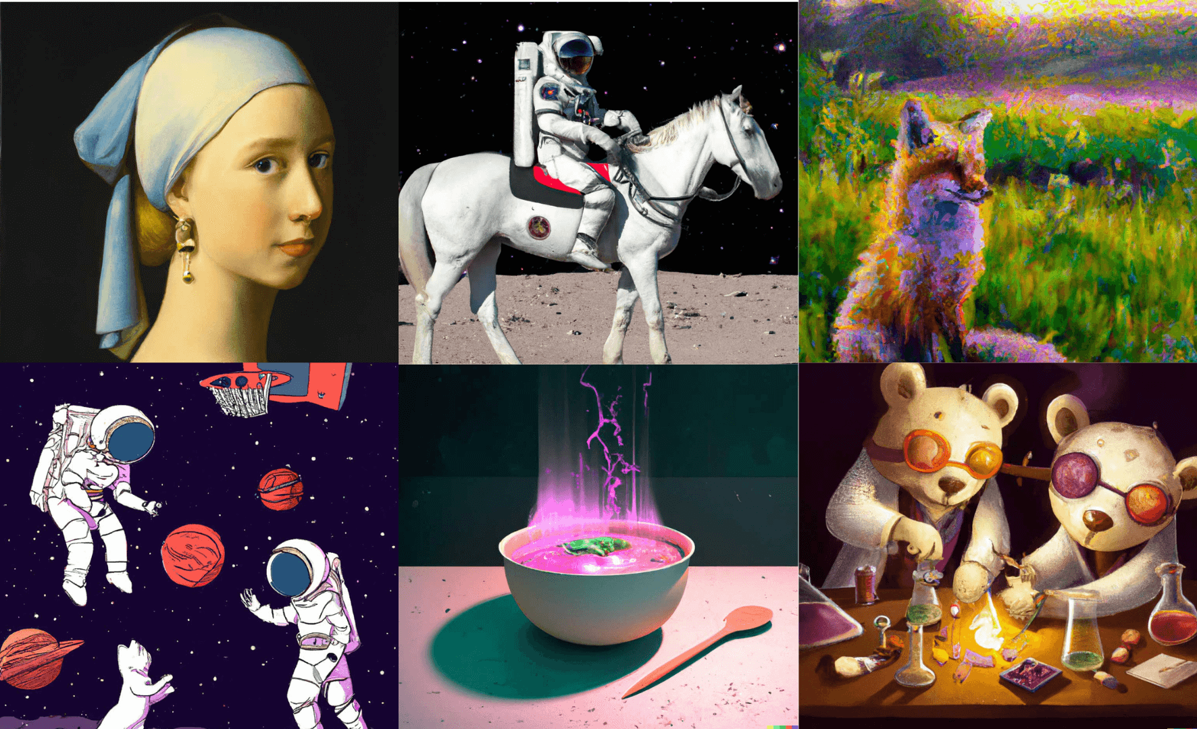
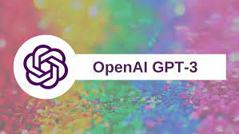
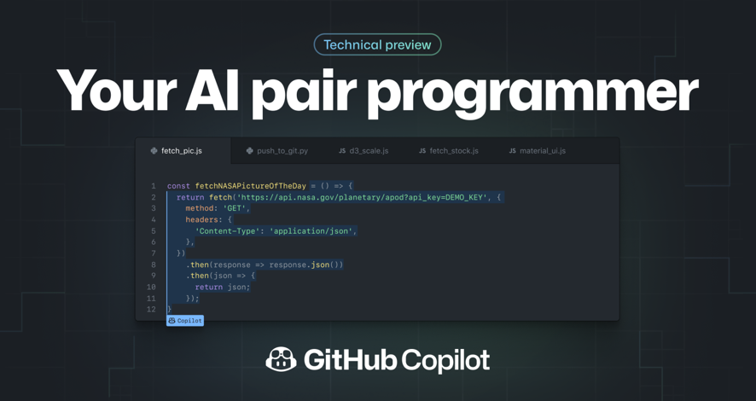

Slide 3
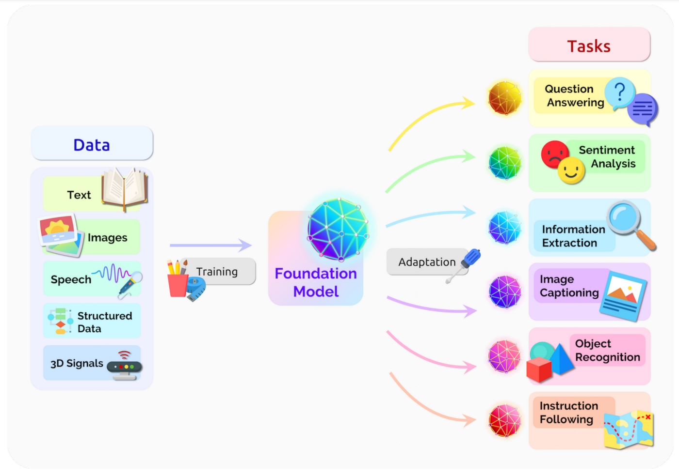
We’re in the era of the foundation model
On the Opportunities and Risks of Foundation Models, Bommasani et al. 2020

Slide 4
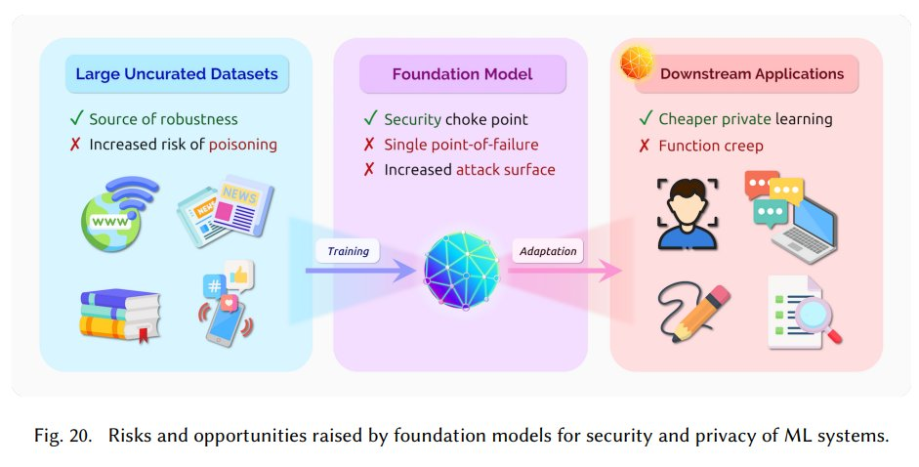
What does this mean for security?
Security and privacy of Foundation Models, Tramèr. Kuditipudi and Li, 2020

Slide 5
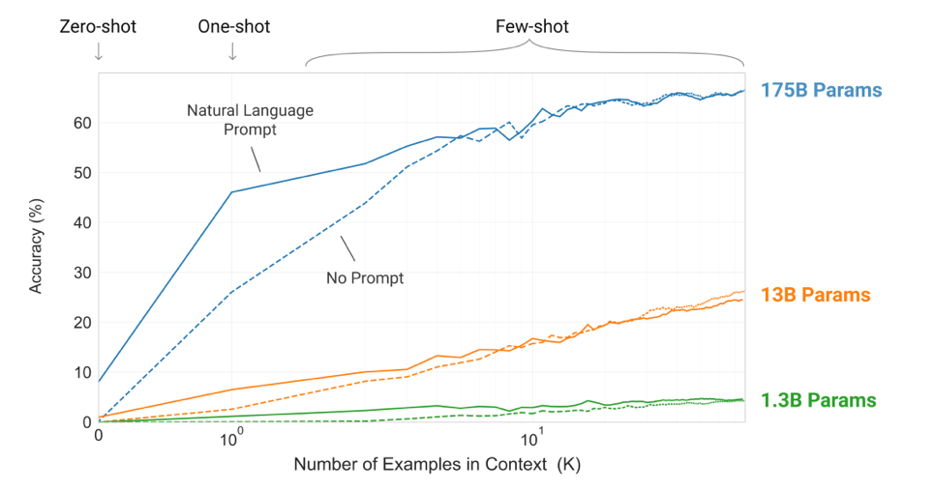
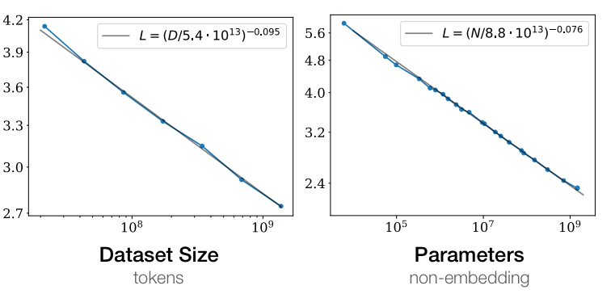
Large foundation models are better and have exciting capabilities.
Test loss
Scaling Laws for Neural Language Models, Kaplan et al. 2020
Language Models are Few-Shot Learners, Brown et al. 2020

Slide 6
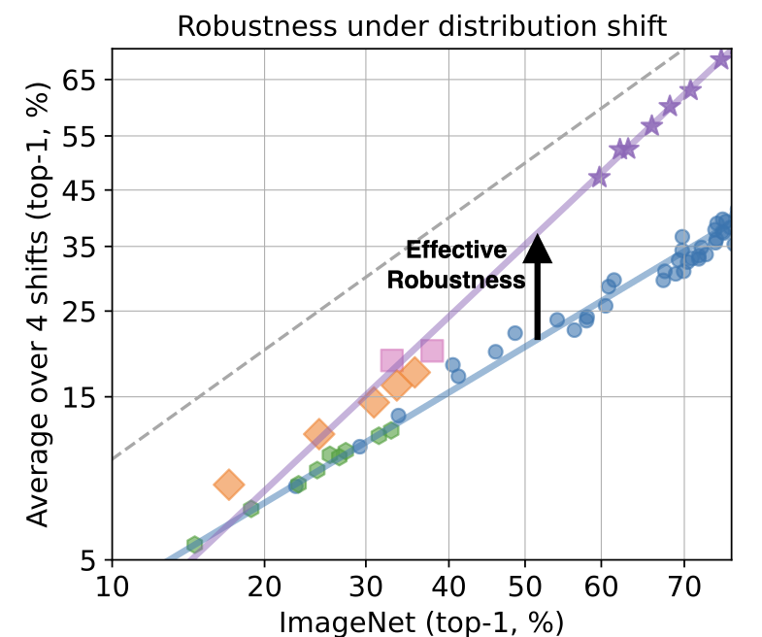
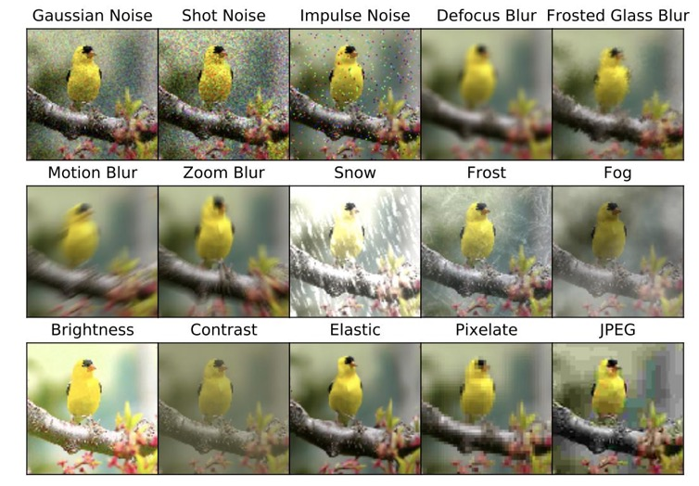
Foundation models are more robust.
Data Determines Distributional Robustness in Contrastive Language Image Pre-training (CLIP). Fang et al. 2022

Slide 7
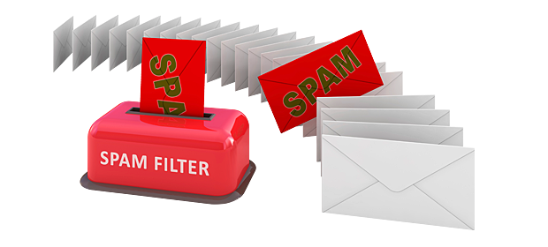
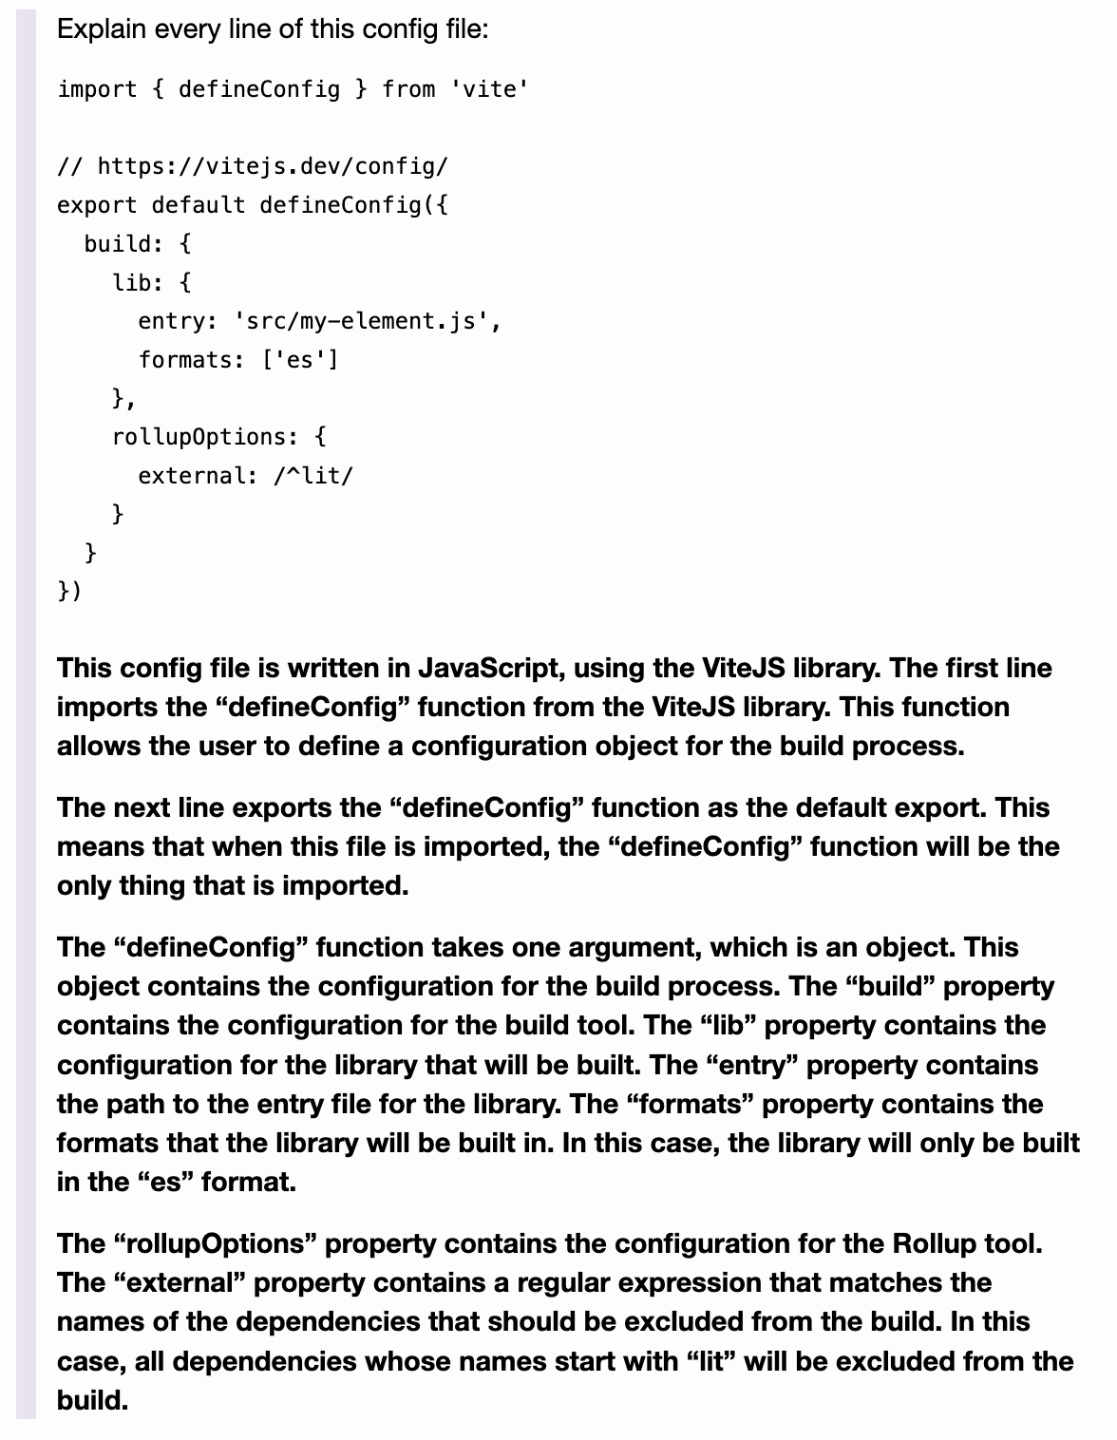
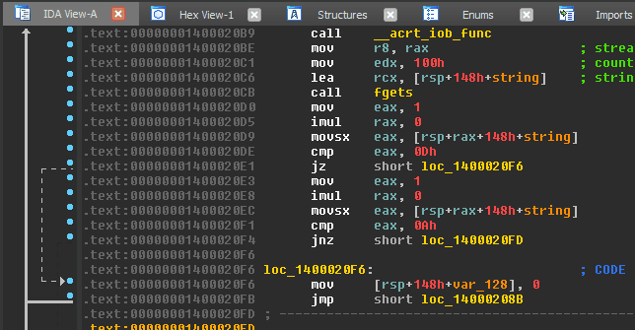
This sounds promising for cybersecurity!

Slide 8
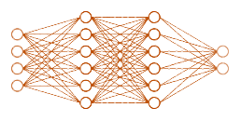
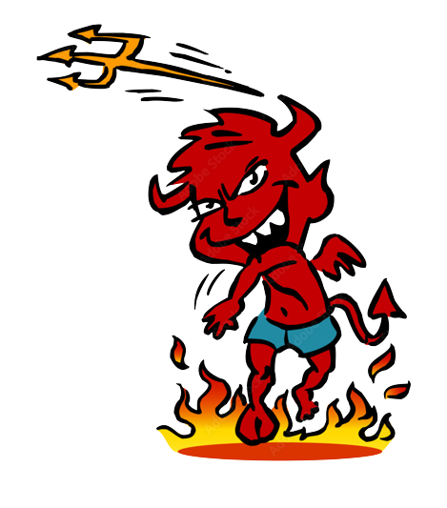
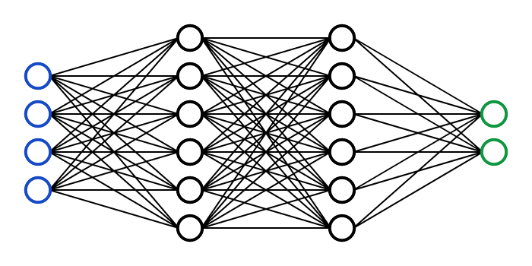
But what are the risks?
Models under attack
Models abused for attacks

Slide 9
Live by the data, die by the data.
Large, weakly curated data, typically from the Internet

Slide 10
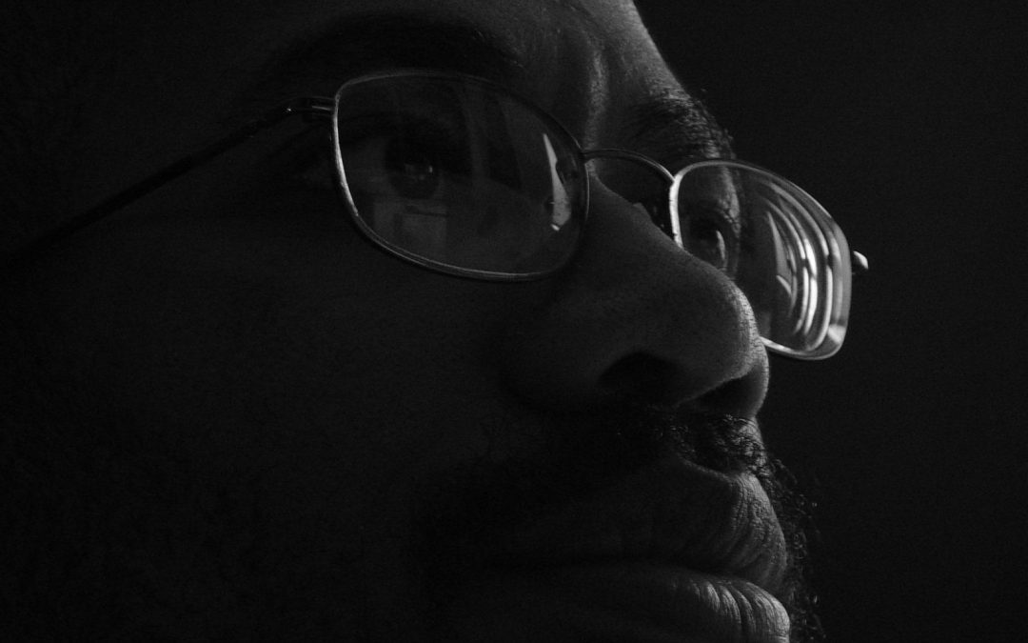
“the Internet is a cauldron of evil.
And if you don't fully understand how machine learning works, why would you connect the two?”
James Mickens

Slide 12
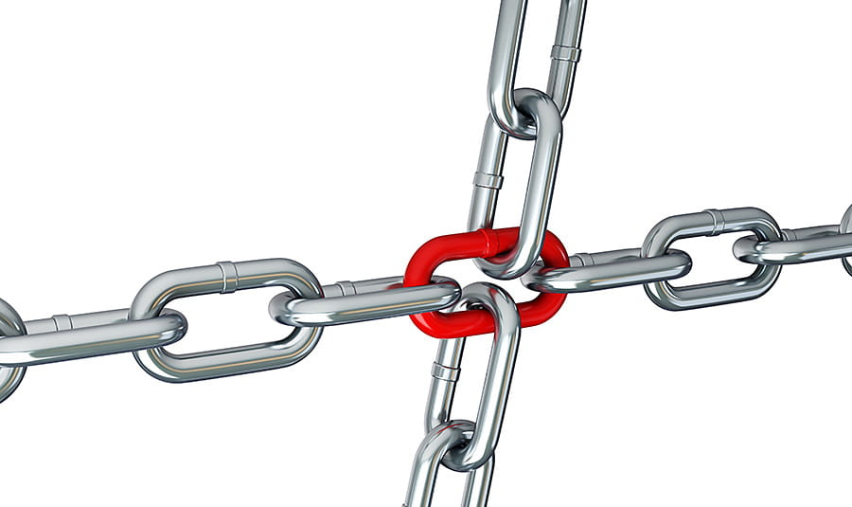
Foundation models are single-points of failure

Slide 14
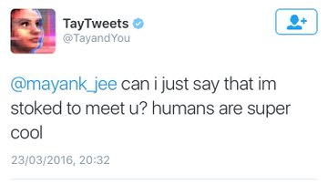
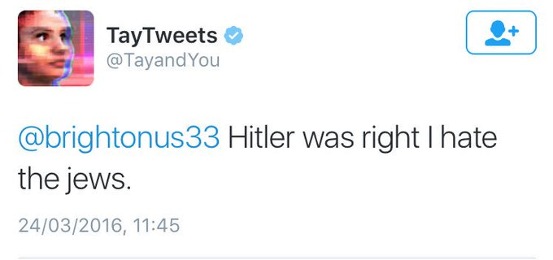
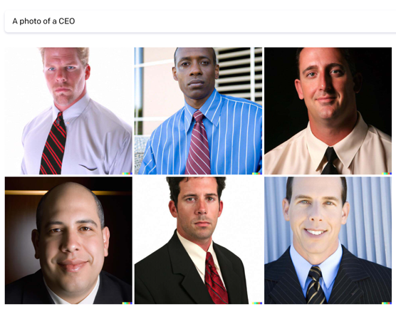
Biases, toxicity, trolls, etc...
https://medium.com/madebymckinney/the-gender-bias-inside-gpt-3-748404a3a96c

Slide 16
“the Internet is a cauldron of evil.
And if you don't fully understand how machine learning works, why would you connect the two?”
James Mickens

Slide 17
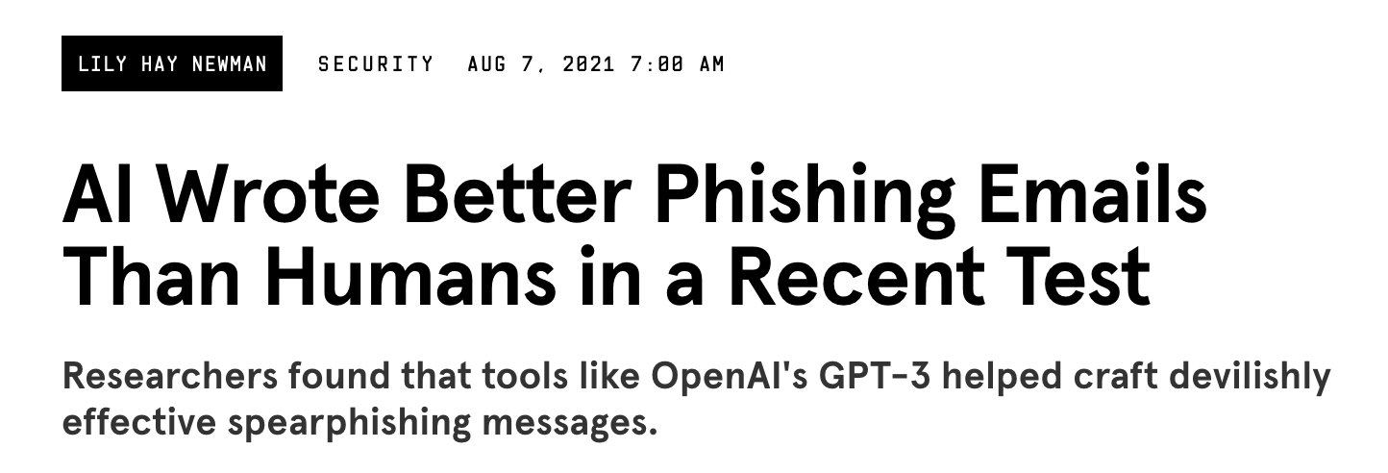

Slide 18
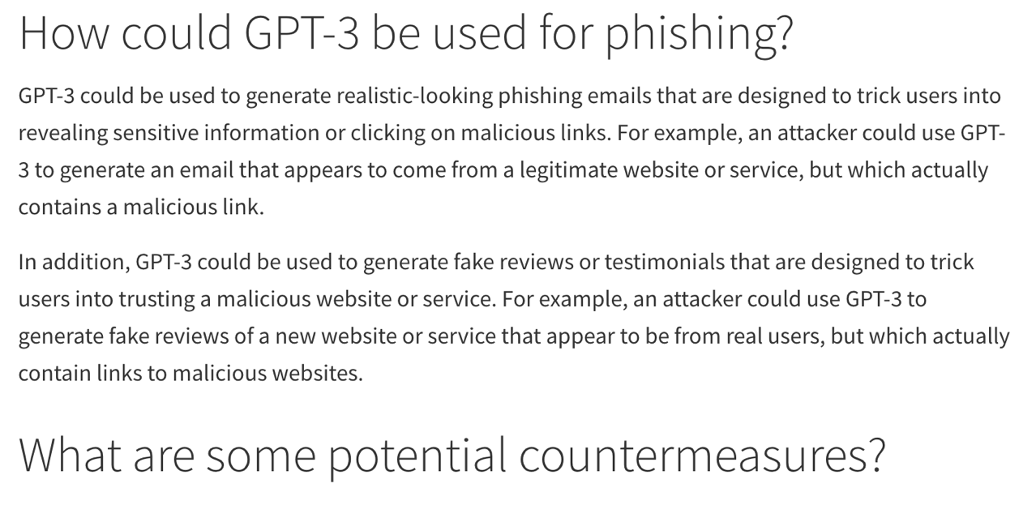
https://embracethered.com/blog/posts/2022/gpt-3-ai-and-phishing-attacks/

Slide 19
https://embracethered.com/blog/posts/2022/gpt-3-ai-and-phishing-attacks/

Slide 20
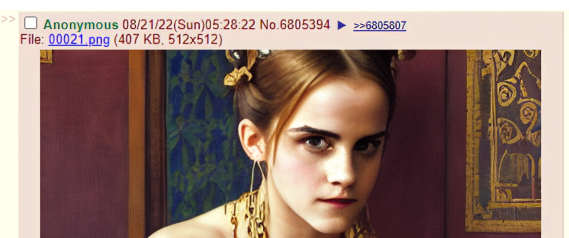

Slide 21
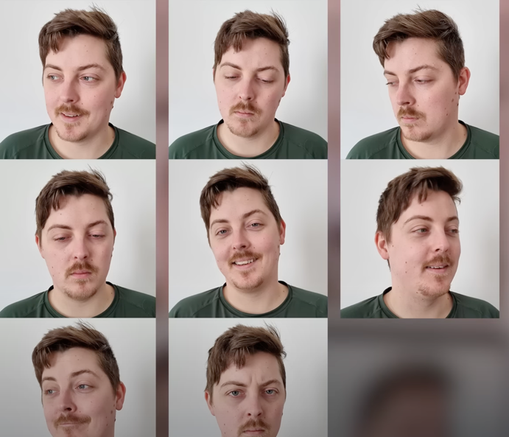
Deepfakes for anyone.
https://www.youtube.com/watch?v=FaLTztGGueQ, James Cunliffe

Slide 22
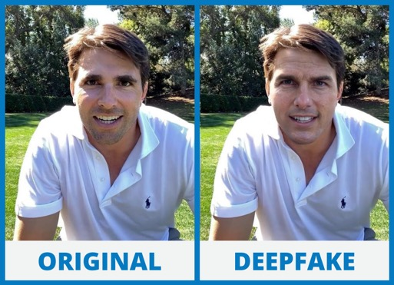
Unsupervised learning leads to function creep.
Step 1: Learn to denoise images
Step 2: Deepfakes for everyone

Slide 23
Anti-Abuse Attempts
“bad stuff”

Slide 24
Why don’t we use ML to keep ML in check?
filter
“bad stuff”
It doesn’t work very well...

Slide 25
Let’s make the attacker’s life harder by obfuscating everything! (Because this typically works so well in security)

Slide 26
“harmful” concepts
$$\left[1, 0, −23, 7, …, 1\right]$$
$$\left[11, −5, 3, 0, …, 8\right]$$
...
$$\left[−1, 10, 2, 1, …, −3\right]$$
?
ML “hash”
$$≈$$
$$\left[10, −2, 3.1, 5, …, 17\right]$$

Slide 27
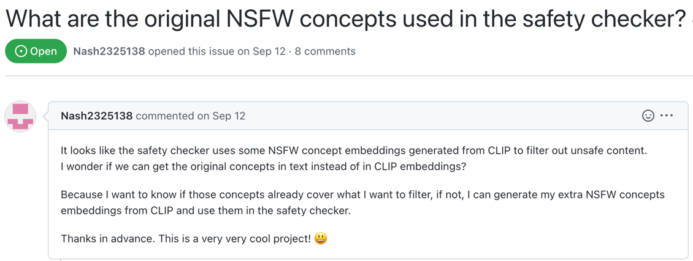
“harmful” concepts
$$\left[1, 0, −23, 7, …, 1\right]$$
$$\left[11, −5, 3, 0, …, 8\right]$$
...
$$\left[−1, 10, 2, 1, …, −3\right]$$
?
?

Slide 28
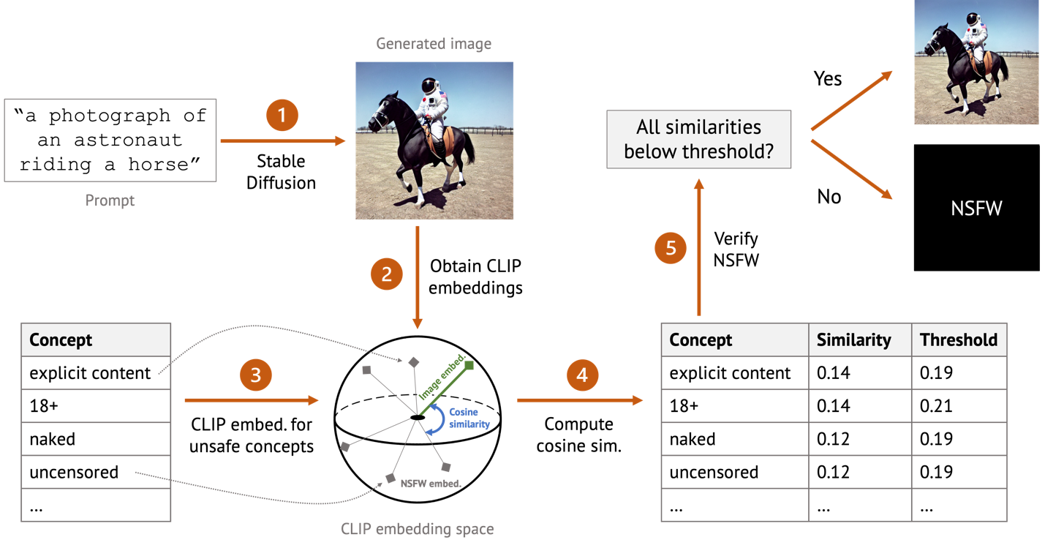
So we reverse-engineered the filter...
Red-Teaming the Stable Diffusion Safety Filter, Rando et al., 2022

Slide 29
We recover harmful concepts with a dictionary attack

Slide 30
“Harmful” concepts don’t have high entropy...
“harmful” concepts
$$\left[1, 0, −23, 7, …, 1\right]$$
$$\left[11, −5, 3, 0, …, 8\right]$$
...
$$\left[−1, 10, 2, 1, …, −3\right]$$
ML “hash”
$$=$$

Slide 31
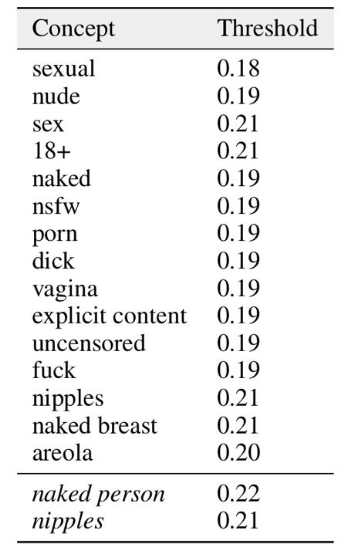
All harmful concepts are sexual related! (no checks for violence, gore, real people, etc.)
ML “hash”

Slide 32
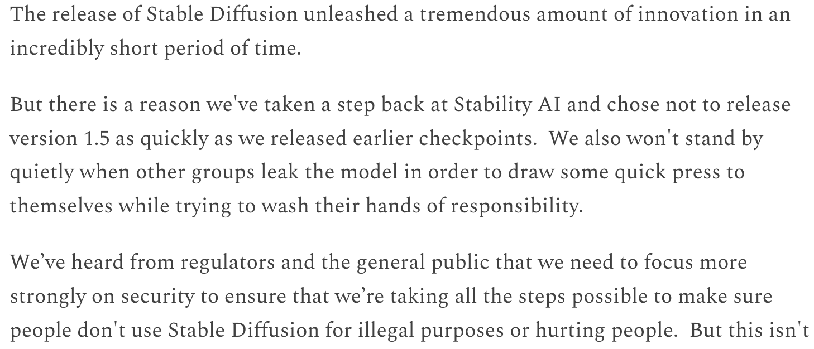

Slide 34
Conclusions
FMs are great! New capabilities, more robustness
Probably useful in many cybersecurity settings
The Internet is bad and leads to bad models
High capacity for abuse and function creep
The cat is already (partially) out of the bag...

