Slide 1
Data poisoning won’t save you from facial recognition
Florian Tramèr
Stanford University
CPVR 2021 Workshop on Media Forensics
(joint work with Evani Radiya-Dixit)
Notes:
The topic for today’s talk will be a little different from media forensics, as we’ll be talking about adversarial ML and facial recognition.
But I think a lot of the lessons we learned about adversarial ML in this project are broadly applicable to work on deepfakes and so on.

Slide 2
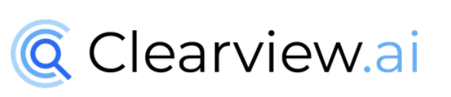
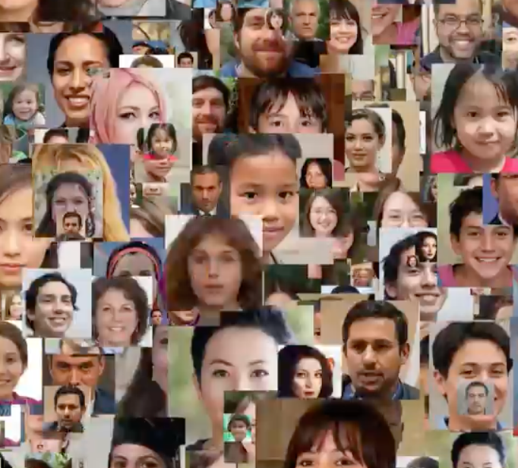
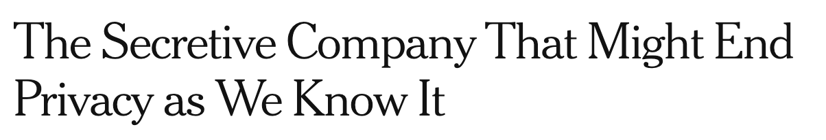
You can’t hide from Big Brother.
Notes:
About two years ago, a company called clearview.ai made for quite scary news headlines.
What this company did is that they compiled a huge dataset of people’s faces by scraping the Web, and then built a large-scale facial recognition model that can presumably recognize all of us.

Slide 3
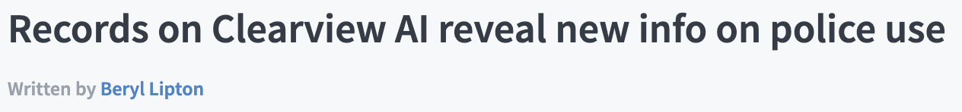
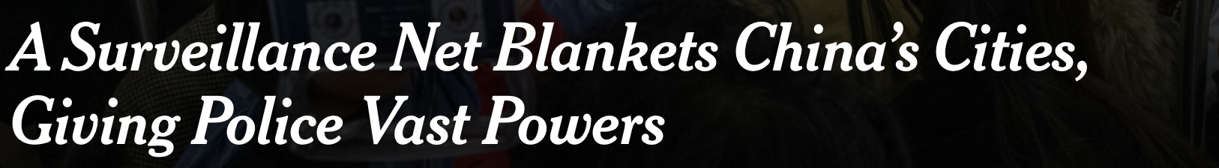
You can’t hide from Big Brother.
Notes:
And they then went and sold this tool to law enforcement agencies in the US.
They were probably not the first to do this, there’s been talk about facial recognition being used for mass surveillance for a while now, and advances in computer vision are continuously making these tools better and better.

Slide 4
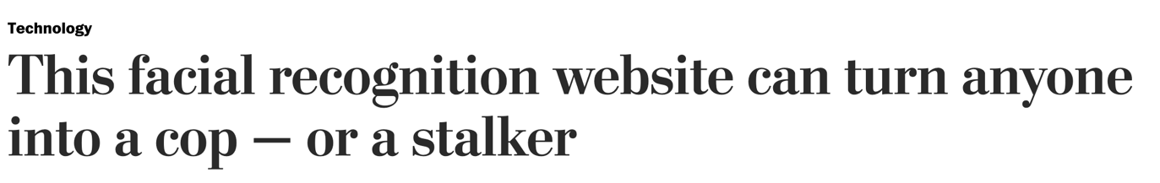
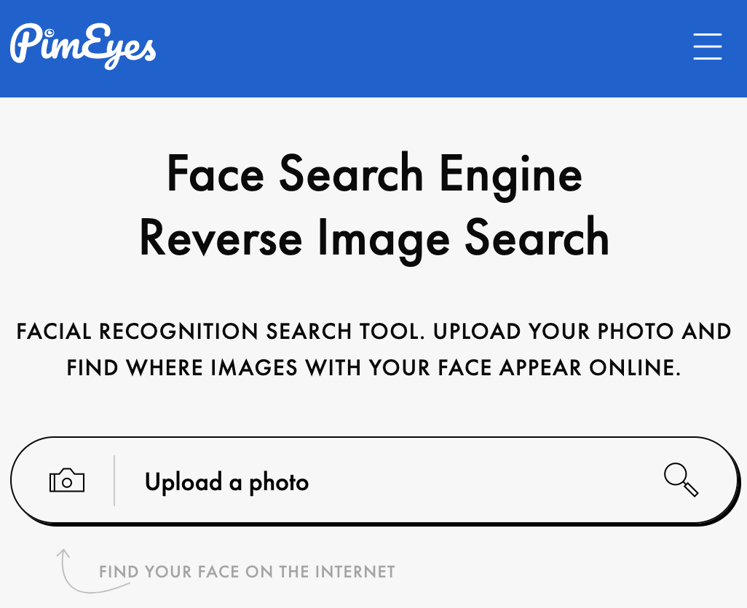
You can’t hide from anyone.
Notes:
To make things worse, these privacy invasive tools are no longer just in the hands of the police.
There are now a few services out there, such as PimEyes, that anyone can use to recognize someone in a picture.
So this really isn’t good for privacy. And it would be really cool if there were a way to protect ourselves from such tools.

Slide 5
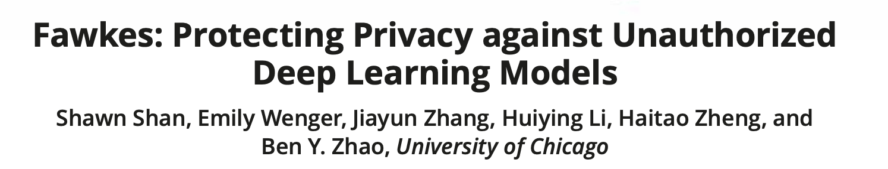
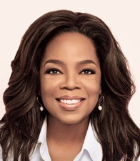



Image-perturbation tools promise to defeat facial recognition.
Fawkes
???
Notes:
Luckily, a solution exists!
About two years ago, some researchers from called the university of Chicago introduced Fawkes, a system that lets users perturb pictures they post online, that the machine learning models used in facial recognition systems like Clearview.AI would fail to learn to recognize the user.

Slide 6
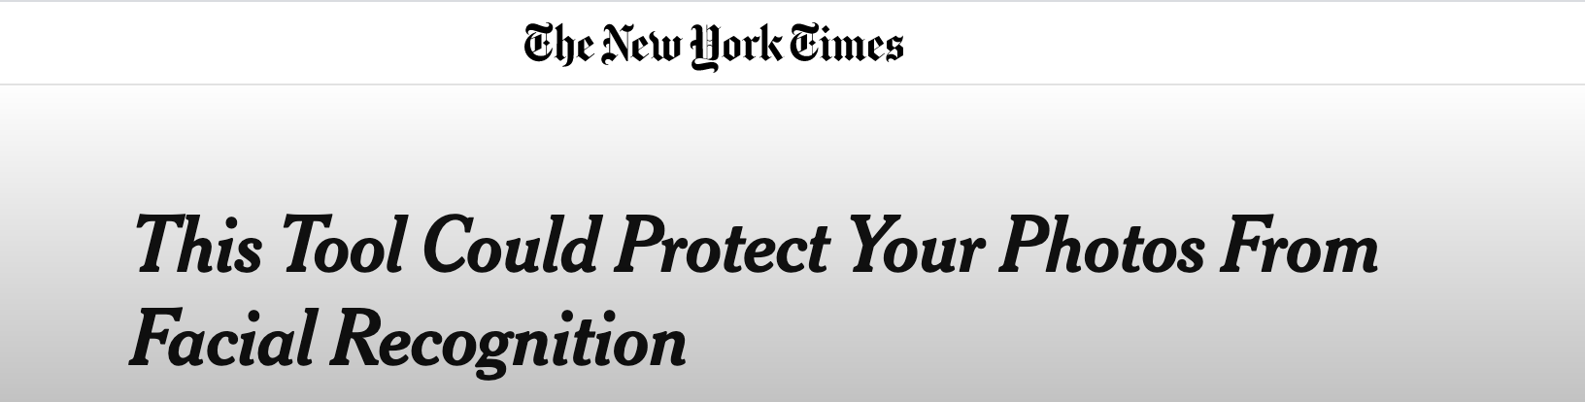
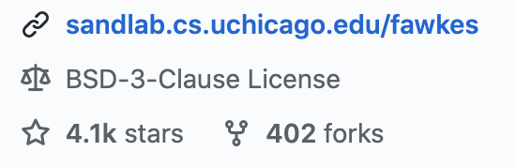
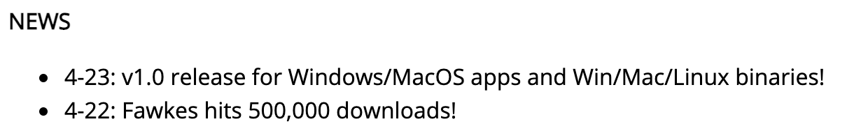
Image-perturbation tools promise to defeat facial recognition.
Notes:
And this got a lot of publicity, including from the NYT, and their tool has now been downloaded over 500,000 times.

Slide 7
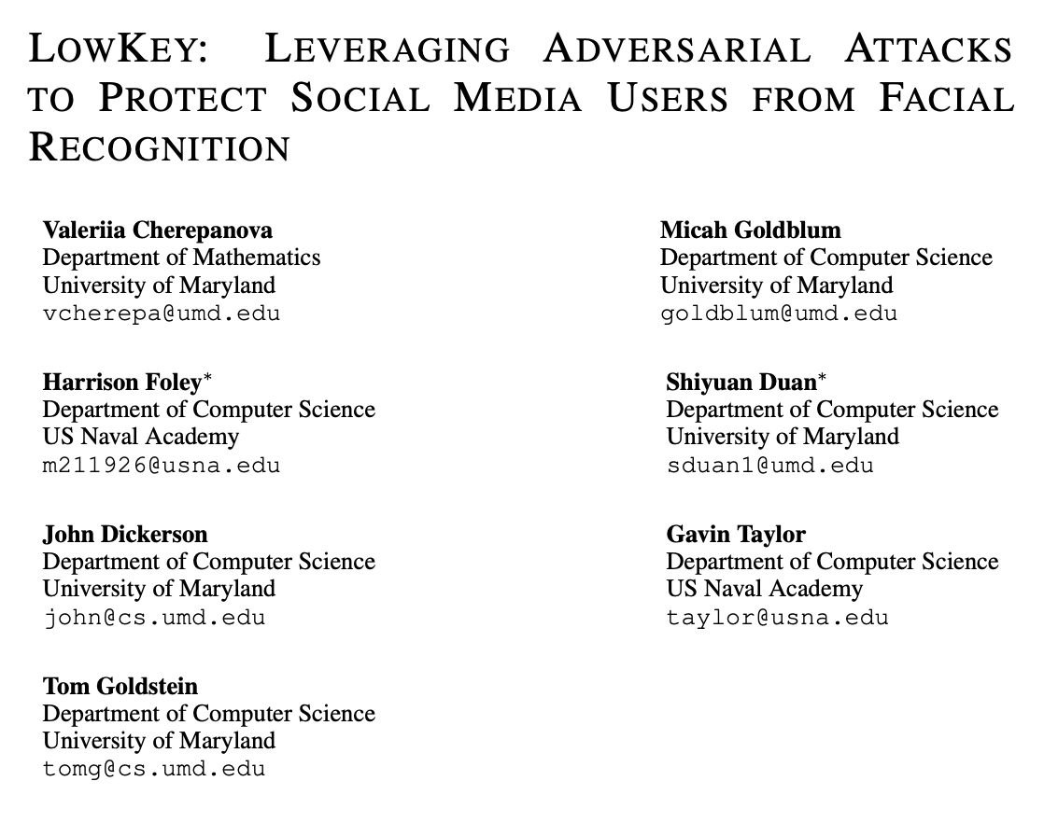
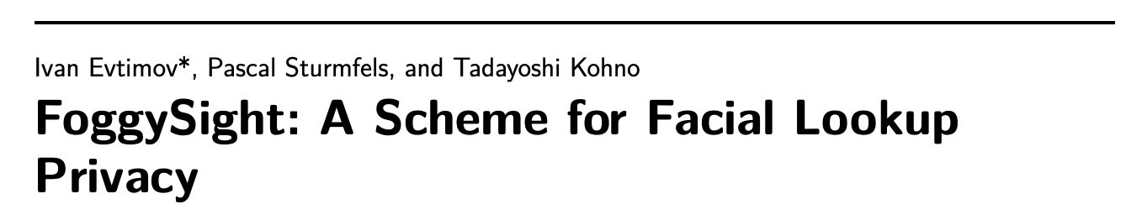
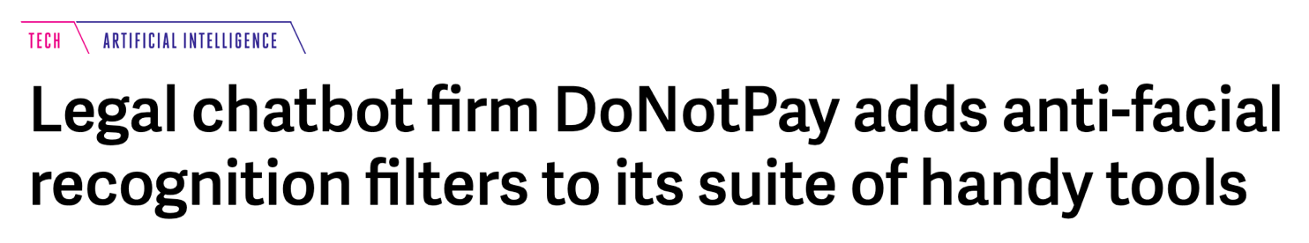
Image-perturbation tools promise to defeat facial recognition.
Notes:
And this has also prompted a lot of follow-up work with similar ideas, either in academia, and also in industry.

Slide 8
These tools give a false sense of security!
Notes:
Unfortunately, we argue that these tools are not going to save you from facial recognition.
And in fact, they may even harm privacy as they provide users with a very compelling but false sense of security.

Slide 9
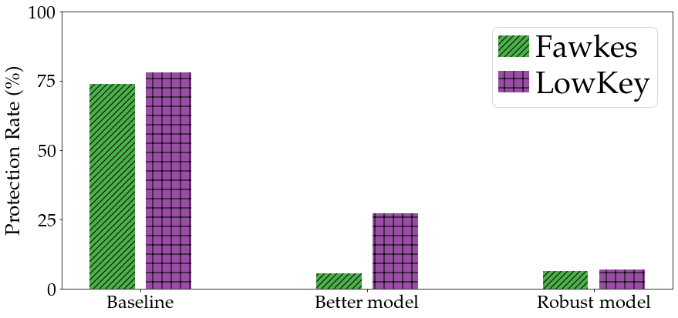
These tools give a false sense of security!
The attacks are easily defeated.
Notes:
We show that these attacks are quite brittle. All it really takes to defeat them is for the facial recognition system to use a slightly better model than the used by the attack.
And if the facial recognition system explicitly tries to harden their model against attack, then it fails entirely.

Slide 10
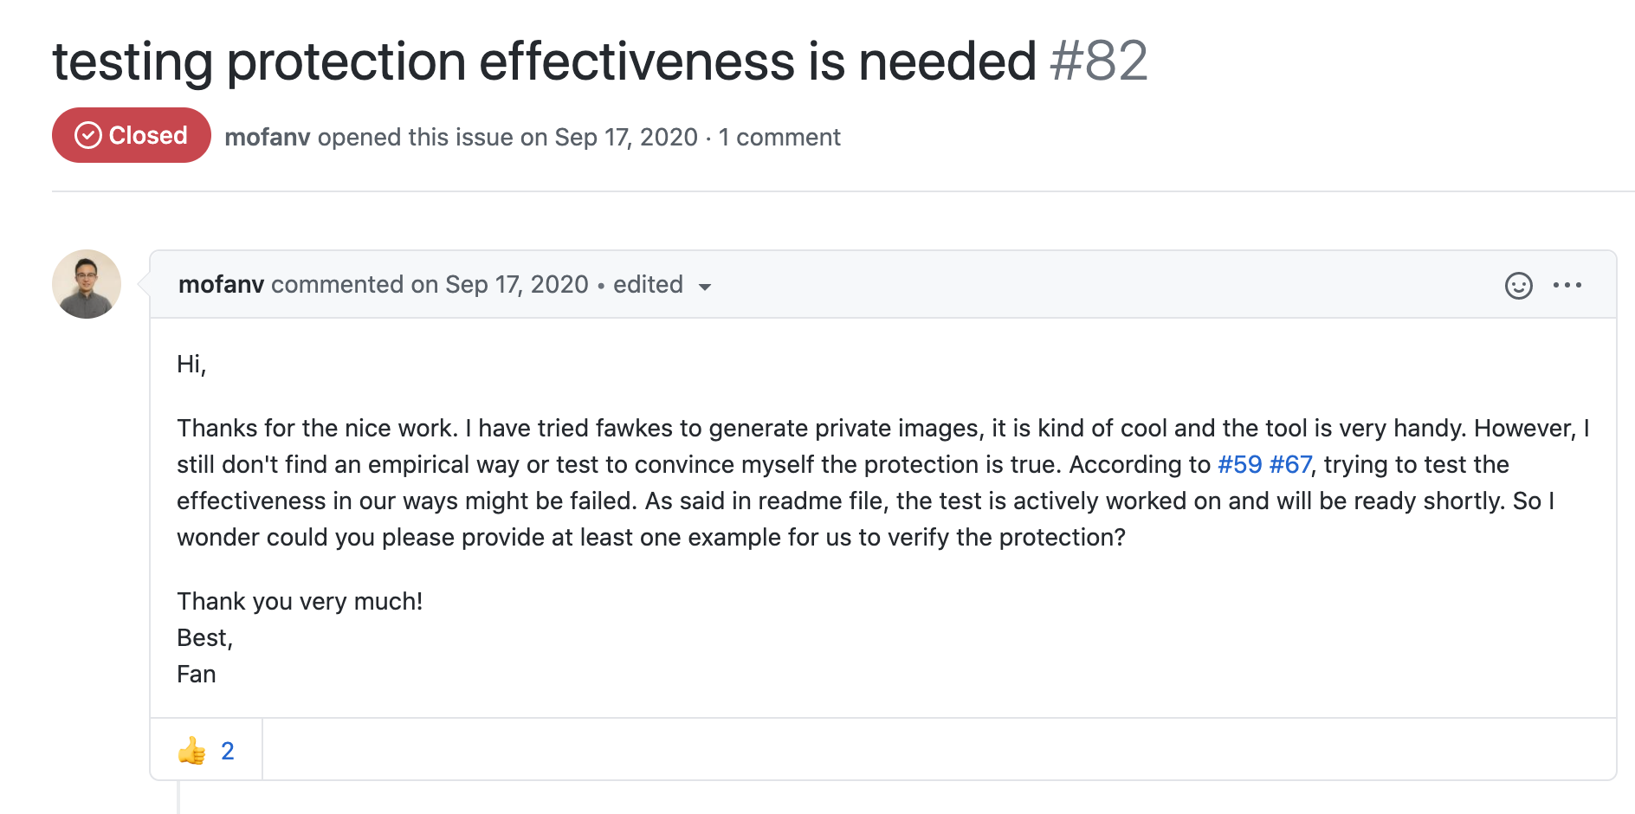
These tools give a false sense of security!
Users don’t know if the attack worked…
Notes:
And to make things worse, users will typically have no idea that their attack failed.
Since systems such as Clearview.AI aren’t accessible to the public, you can never really tell if the attack actually worked.
And so these protection systems could end up doing more harm than good, as they might convince some privacy-concerned users of uploading pictures online with the false belief that they’ll be protected.

Slide 11
This talk.
Attacking facial recognition systems
Misconceptions about adversarial examples
Solutions?
Notes:
So what are we going to talk about today?
First, I’m going to describe in a bit more detail how these attacks on facial recognition systems work.
Then, I’ll argue that the motivation for these attacks stems from some important misconceptions about a class of attacks on machine learning models called adversarial examples.
Finally, I’ll discuss some alternative solutions to protect ourselves from facial recognition.
Spoiler alert: things don’t look good.

Slide 12
This talk.
Attacking facial recognition systems
Misconceptions about adversarial examples
Solutions?
Notes:
So let’s first talk about attacking facial recognition systems.

Slide 13
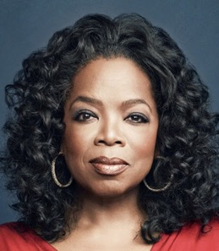



Facial recognition with nearest neighbor search.
Feature extractor pre-trained on large dataset of faces
Database of (labeled) features for collected images
Notes:
Let’s start by describing in a bit more detail how a large-scale facial recognition system works.
These systems use neural networks to extract features from faces. Typically, these feature extractors are trained on huge curated datasets of faces.
Given a trained feature extractor, you can build a facial recognition system using a simple nearest neighbors classifier.
You take all the images you scraped from the Web, extract features, and store these in a large database.

Slide 14
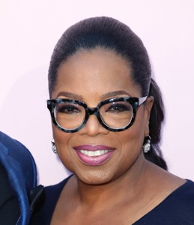
Facial recognition with nearest neighbor search.
It’s a match!
New image to match
Notes:
Then, when you want to identify someone in a new picture, you extract features, and search for a close match in your database.

Slide 15

An attack: adversarial examples.
≠
Notes:
So could we go about attacking such a system?
Attacks such as Fawkes and Lowkey critically rely on adversarial examples.
Even though machine learning models are extremely good at tasks like facial recognition, it turns out that if you add a small amount of carefully crafted noise to a picture, the model won’t be able to tell that these two pictures are of the same person.

Slide 16










Data poisoning with adversarial examples.
Users perturb pictures they post online
Online pictures are scraped to build a model
Unperturbed test pictures aren’t recognized
???
Unperturbed picture taken by the police, or a stalker, etc.
Users’ friends can still recognize the pictures
Notes:
More precisely, systems such as Fawkes and LowKey use adversarial examples for poisoning attacks.
What a user does, is to perturb all the pictures that they post online so that they become adversarial examples.
And since the perturbations are small, their friends will still be able to enjoy these pictures.
But these pictures will look nothing like the original person to a machine learning model that is trained on them.
Then, if someone tries to recognize the user by taking a picture of them and feeding it to the trained facial recognition system, the system wont find them.
Note that we assume here that the picture that is fed to the system, here on the right, is *not* perturbed. So this isn’t a standard evasion attack, which is what adversarial examples are typically used for. Here the attack happens earlier, when the model is first trained.

Slide 17
Poisoning is easy if the extractor is fixed & known.
“white-box” attack
Notes:
Now poisoning a facial recognition system is very easy if the system’s facial feature extractor is fixed and the attacker knows which model is used.
The user can perturb the images they post online so that the feature extractor maps them to a different point in feature space.
Since the feature extractor is known, we call this a white-box attack. Then, when an unperturbed image is fed into the system, no match is found.

Slide 18
The attack should transfer to unknown extractors.
Surrogate model
Unknown feature extractor
Notes:
Of course, assuming that the user knows the feature extractor is quite unlikely.
For opaque systems like Clearview.AI, we don’t really know what kind of model they use. And we can’t even interact with their model either.
So here, existing systems such as Fawkes or Lowkey rely on another surprising property of adversarial examples, namely that they transfer between models.
What this means is that the user can find a perturbation that misleads some feature extractor they know, and then hope that this same perturbation will also work against the unknown feature extractor that is used to build a facial recognition system.

Slide 19
This talk.
Attacking facial recognition systems
Misconceptions about adversarial examples
Solutions?
Notes:
So far all of this seems quite reasonable.
Adversarial examples are a super challenging problem in ML, and it widely believed that we wont solve this issue for quite a while.
But I argue that despite this, these poisoning attacks are doomed to fail.
And this is due to some fundamental misconceptions about what adversarial examples can and cant do.

Slide 20
Misconception #1:
∀ models ∃ attack ≠ ∃ attack ∀ models
this is empirically true (so far)
credit: Nicholas Carlini
Notes:
The main misconception here is essentially an inversion of universal quantifiers.
I’d like to give Nicholas Carlini credit for this formulation of this misconception.
What we know from the adversarial examples literature is the following: for any model, we’ve been able to find adversarial examples for it.
So more formally, forall models, there exists an attack.
In the poisoning setting, we’re asking for something much stronger: we want to find an attack, that will transfer to any model that is used for facial recognition.
We have very good reasons to believe that this is not possible.

Slide 21
Fawkes (v0.3) doesn’t transfer to today’s best models.
The 1st version of Fawkes isn’t very effective, even against a known extractor...
... and fails entirely against newer, better extractors
Notes:
So let’s look at how existing attacks fare against a variety of models that could be used for facial recognition.
We’ll first look at Fawkes. When Fawkes was released last year, it used a fairly weak attack, that didn’t work particularly well even if the attacker knows the feature extractor that’s being used. The user would have only been protected in about 55% of cases (by the user being protected, we mean that the model fails to recognize them in an unperturbed picture).
If we look at newer and better feature extractors, the attack doesn’t work at all.

Slide 22
Fawkes (v1.0) doesn’t transfer to today’s best models.
The new version of Fawkes works well against current and past extractors
... but fails to transfer to the recent MagFace extractor
Notes:
The Fawkes designers realized this, and so they updated the system earlier this year to use a stronger attack.
This new attack works very well against a known extractor, and transfers to older extractors as well.
But it completely fails against MagFace a newer state-of-the-art extractor that was open sourced a few months ago.

Slide 23
LowKey transfers moderately to today’s best models.
LowKey transfers very well against existing extractors...
...but only moderately against a new and very different vision model
?
2022
2023
Notes:
LowKey does a little better as it is a much newer attack, and so it directly targets today’s best models.
It transfers extremely well to the MagFace model. And this isn’t actually too surprising, because LowKey’s attack uses a surrogate model that is very similar to MagFace.
What if we took a very different model? We find that LowKey transfers only moderately to OpenAI’s recent CLIP model.
CLIP isn’t designed for facial recognition, and so it probably learns very different features than standard facial recognition models.
And this hurts transferability.
And who knows how well the attack will fare against the type of models that will be deployed in a few years.
So, really it seems that to defeat the transfer attacks used by Fawkes and LowKey, the model trainer just has to switch to a better model or one that is sufficiently different from the surrogate model used for the attack.

Slide 24

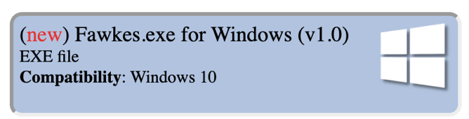
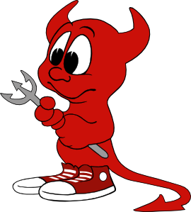
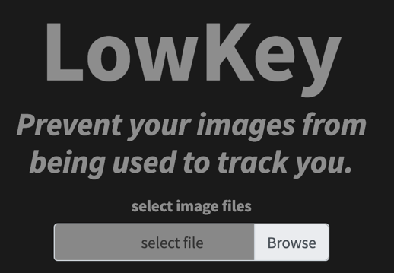
What if the model trainer also uses the attack?
Notes:
Things are even worse if the trainer of the facial recognition system also has access to the attack.
This is true for systems like Fawkes or Lowkey that are publicly accessible.
So the model trainer can perturb some of their own pictures.

Slide 25
Train a robust extractor on attack outputs.
Notes:
What the model trainer can do is train a robust feature extractor

Slide 26
Train a robust extractor on attack outputs.
Notes:
What this. Means is a model that extracts similar features for unperturbed and perturbed images

Slide 27
Train a robust extractor on attack outputs.

Slide 28
Train a robust extractor on attack outputs.

Slide 29
The robust extractor resists poisoning attacks.
robust feature extractor
Notes:
Then, when a user perturbs their own pictures, the feature extractor will have learned to resist the attack

Slide 30
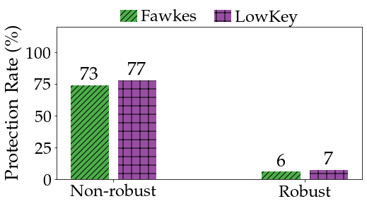
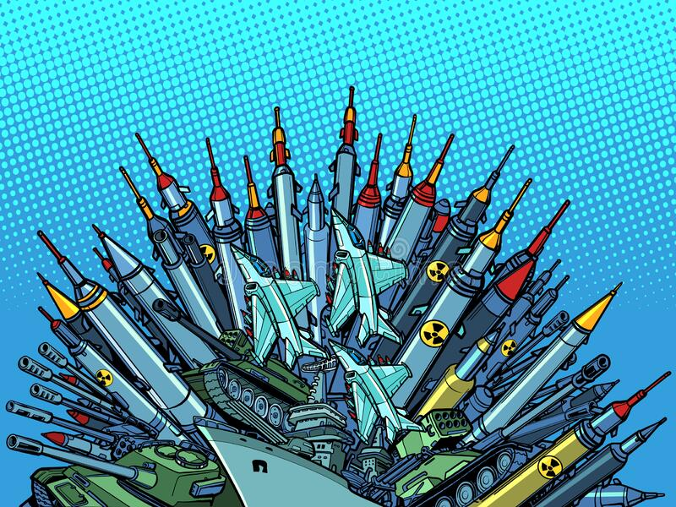
The robust extractor resists poisoning attacks.
Isn’t this just the start of an arms-race?
Notes:
We show that this strategy is super effective.
If we use a robust extractor for facial recognition, the protection of both Fawkes and LowKey becomes essentially null.
Now, people who are familiar with the literature on adversarial examples might say, all I’ve done here is shown a defense against one particular attack.
This robust feature extractor isn’t actually robust against all attacks. And so the user just has to use an adaptive attack, to break this robust feature extractor as well.
So we’re really just entering an arms race here, where attackers will consistently deploy stronger attacks in response to better defenses.

Slide 31
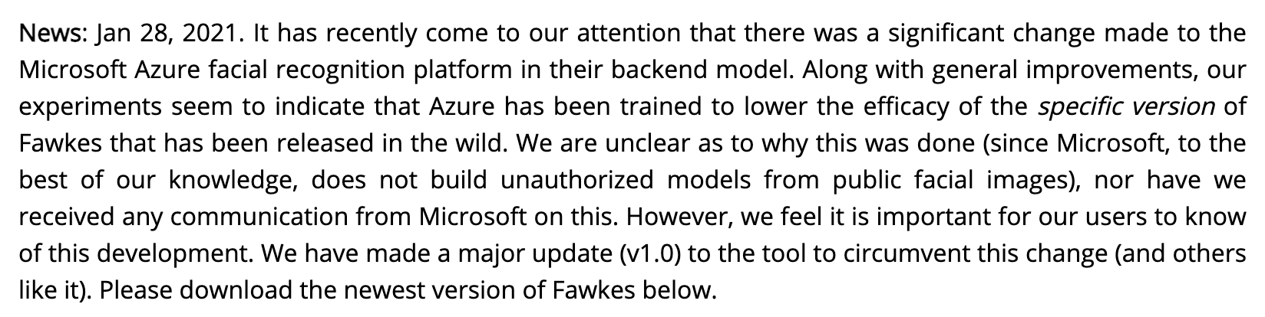
The arms race has already started.
https://sandlab.cs.uchicago.edu/fawkes/
Notes:
And this arms race seems to have already started. As I mentioned earlier, Fawkes recently updated its attack a few months ago. The reason was that the authors noticed that the attack had stopped being effective against the feature extractor used in Microsoft Azure’s facial recognition system.
And it’s likely that they would change the attack again soon to also work against MagFace.

Slide 32
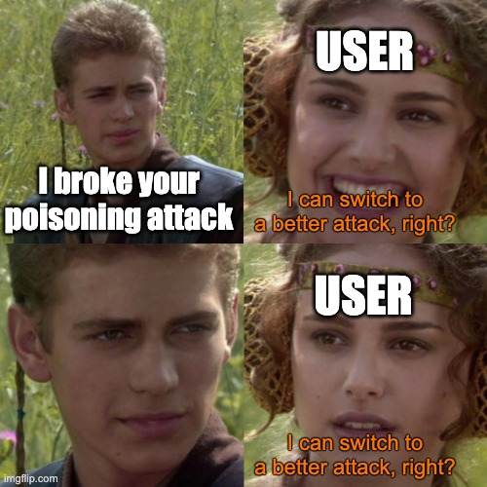
Misconception #2:
Adversarial ML doesn’t always admit an arms-race
Notes:
And this brings us to our second misconception about adversarial examples and adversarial machine learning more generally.
There cannot always be an arms race, and facial recognition is a prime example of a situation where the attacker is poised to lose in the long run.

Slide 33

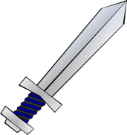
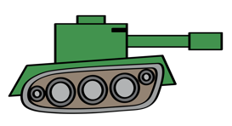
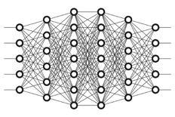
New models can be applied retroactively.
Model trainer scrapes pictures produced with weak attack
Users switch to stronger attacks, but new model can be trained solely on data collected in the past
Notes:
And the reason is simply that once a picture is scraped, the attack that was used on it cannot be changed anymore, and someone can just scrape all these pictures and save them.
And later on, the model trainer can just apply new models retroactively to these scraped pictures.
Even if the users switch to a stronger attack, this is useless as the model trainer can just ignore the most recently uploaded pictures, until an even better model appears.

Slide 34
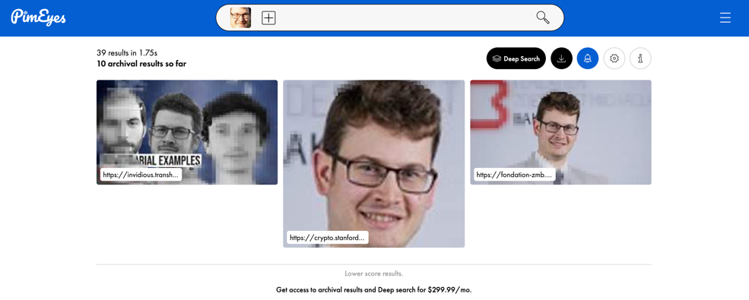
(Biometric) privacy does not admit an arms race.
Facial features cannot be
(easily or quickly) changed
You cannot reclaim your privacy once you’ve lost it!
~6 years ago
Notes:
Taking a step back, the bigger issue here is that biometric privacy doesn’t admit an arms race.
The reason is that our biometric features, such as our facial features, change very little over time. For example, PimEyes finds pictures of me that are over six years old.
What this means is that if we ever lose our biometric privacy, we have no hope of regaining it. We cant just change our face and start over.
And so poisoning attacks face an impossibly high bar: they have to succeed against every single model that’s going to be deployed for many years into the future.

Slide 35
This talk.
Attacking facial recognition systems
Misconceptions about adversarial examples
Solutions?
Notes:
So is there any hope then?

Slide 36



Solution 1: Don’t post pictures online.
Notes:
Well, maybe we just have to stop posting pictures online.

Slide 37
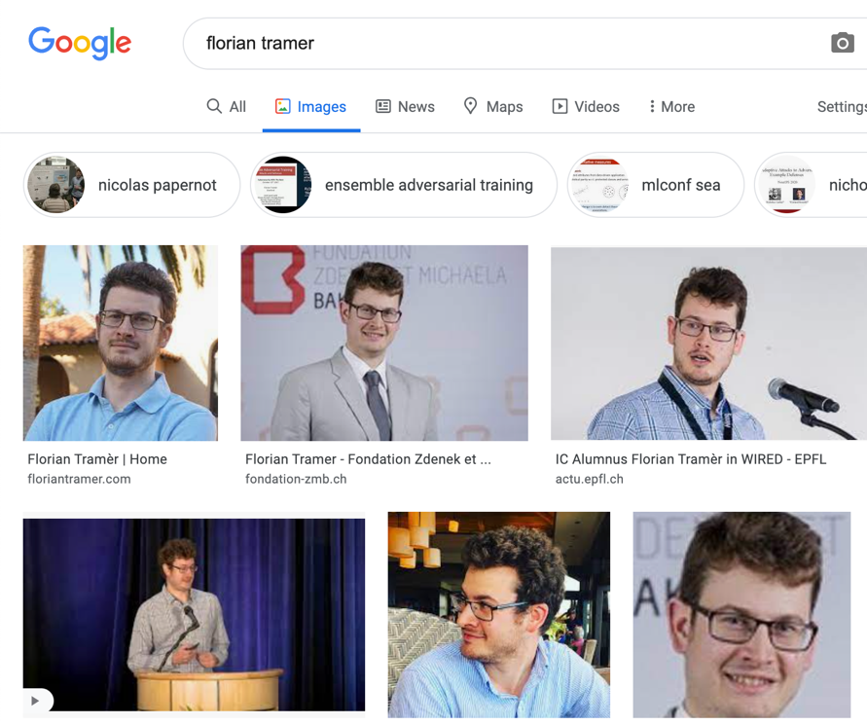
Solution 1: Don’t post pictures online.
It’s already too late.
I didn’t take these pictures or upload them!
Notes:
But this isn’t that easy to do.
There’s a bunch of pictures of myself online that I didn’t upload myself. So even if I really cared about beating facial recognition, I’d still have an issue.

Slide 38
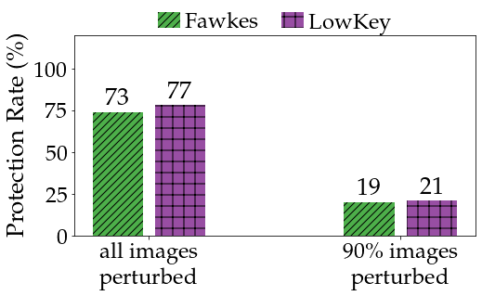
Solution 1: Don’t post pictures online.
It’s already too late.
ultimate retroactive strategy: train only on pictures posted online before 2020...
Notes:
And this is another way of seeing that poisoning attacks were hopeless to begin with.
These attacks actually only work well if every single picture that a user uploads online is perturbed.
If there’s even a small number of pictures that aren’t protected (say 10%), the attack’s performance drops significantly.
Some prior work has suggested some more elaborate attacks to counter this, but again this is hopeless since the model trainer can train models retroactively. So there’s actually an ultimate retroactive strategy here: just train a facial recognition system only on pictures that were uploaded to the Web before last year, when the first poisoning attacks were proposed.

Slide 39
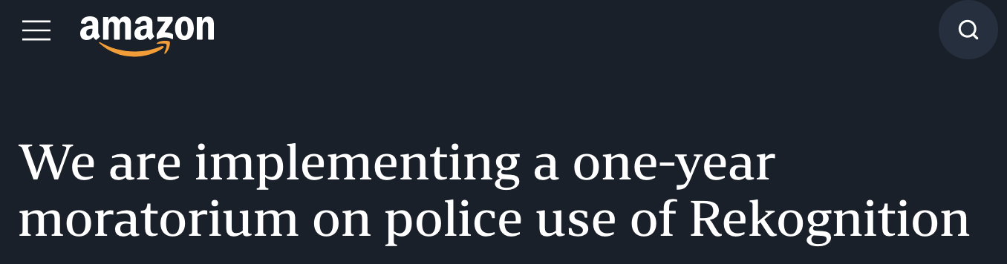
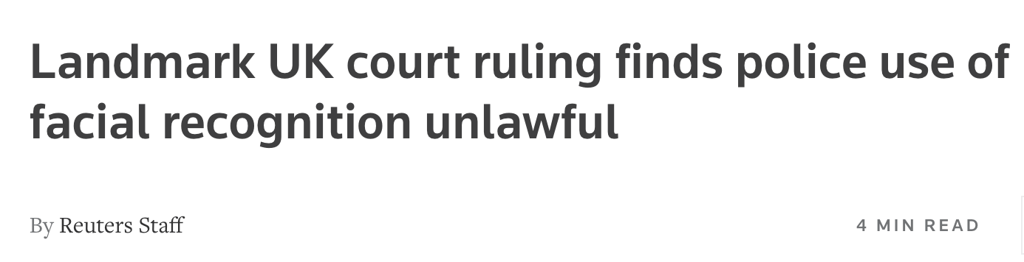
Solution 2: Legislation & policy
Notes:
So I argue that there’s simply no technological solution to this problem.
For someone like me, who already has some of their pictures online, there’s nothing left to do. Companies like PimEyes or Clearview have already trained facial recognition systems that can recognize me.
And even if you just started uploading pictures online today, the attacks you’d be using wont stand the test of time.
So our only hope is probably that these privacy invasive technologies get banned. There’s been some movements in this direction, but given the clear applications of these models in law enforcement, it seems unlikely that they’ll just stop from being used.

Slide 40
Take-Aways
Threat models matter:
  no single attack works against all future models
  biometric privacy does not admit an arms race
Be careful what you can promise users
Thank you!

