Slide 1
Integrity and Confidentiality for Machine Learning
CS521 – April 19th 2018
Florian Tramèr
Notes:
Why this matters, why you should care
Many examples of attacks. Most of it is not my work

Slide 2


Collaborative Machine Learning
ML as a Service (MLaaS)
Centralized learning / inference
Model
Model
Query interface
user
user
user
user
Notes:
Convenience, expertise, performance

Slide 3
What does this mean for security?
Who is:
The data owner?
The model owner?
A potential adversary?
Who do we trust?
How do we prevent attacks?

Slide 4
Outline
Taxonomy of threats and attack vectors
Attacks/defenses at training time
Data poisoning
Private & verifiable learning
Attacks/defenses at evaluation time
(Adversarial examples)
Inference attacks
Private & verifiable inference

Slide 5
Attack Vectors
Breaking integrity
Give incorrect results to some / all users
Model evasion (adversarial examples)
Denial of service
Backdoors
Disparate treatment
Breaking confidentiality / privacy
Infer sensitive information
Training data
Evaluation data
Learned model

Slide 6

Attacks at Training Time
Data/model poisoning
Integrity
Confidentiality!
Centralized training
Confidentiality
Model
user
user
Model
user
user

Slide 7
Attacks at Inference Time
Adversarial examples
Integrity
Inference attacks
Confidentiality
Centralized inference
Confidentiality
Integrity
Model
user
Model
user

Slide 8
Outline
Taxonomy of threats and attack vectors
Attacks/defenses at training time
Data poisoning
Private & verifiable learning
Attacks/defenses at evaluation time
(Adversarial examples)
Inference attacks
Private & verifiable inference

Slide 9
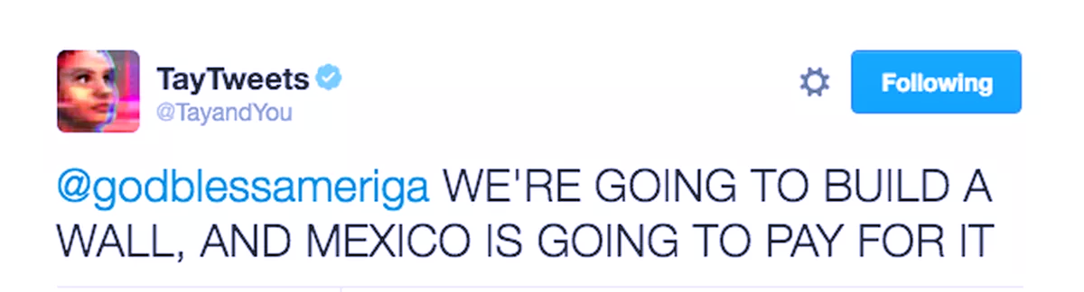
Data Poisoning
Break model accuracy
Biggio et al., “Poisoning attacks against support vector machines”
Koh and Liang., “Understanding black-box predictions via influence functions”
Li et al., “Data poisoning attacks on factorization-based collaborative filtering”
Charikar et al., “Learning from Untrusted Data”
Steinhardt et al., “Certified Defenses for Data Poisoning Attacks”

Slide 10
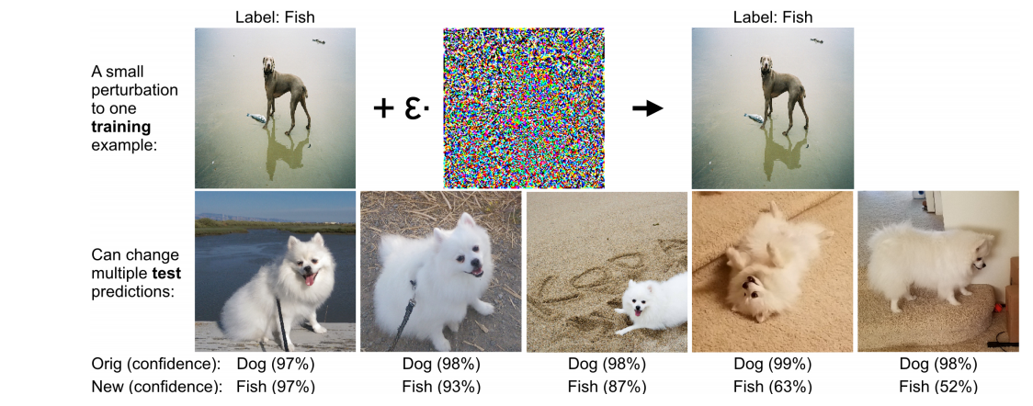
Data Poisoning with Influence Functions
Koh and Liang., “Understanding black-box predictions via influence functions”

Slide 11
Poisoning Model Accuracy: Attacks and Defenses
Attacks work well on linear classifiers but not that well on deep networks
Defenses: Robust statistics
Basically: Outlier removal + classification
Very active research area

Slide 12
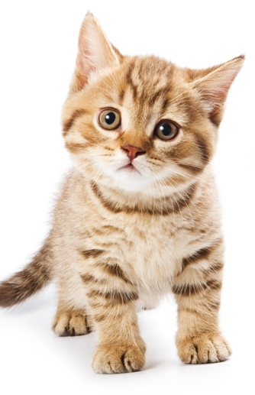

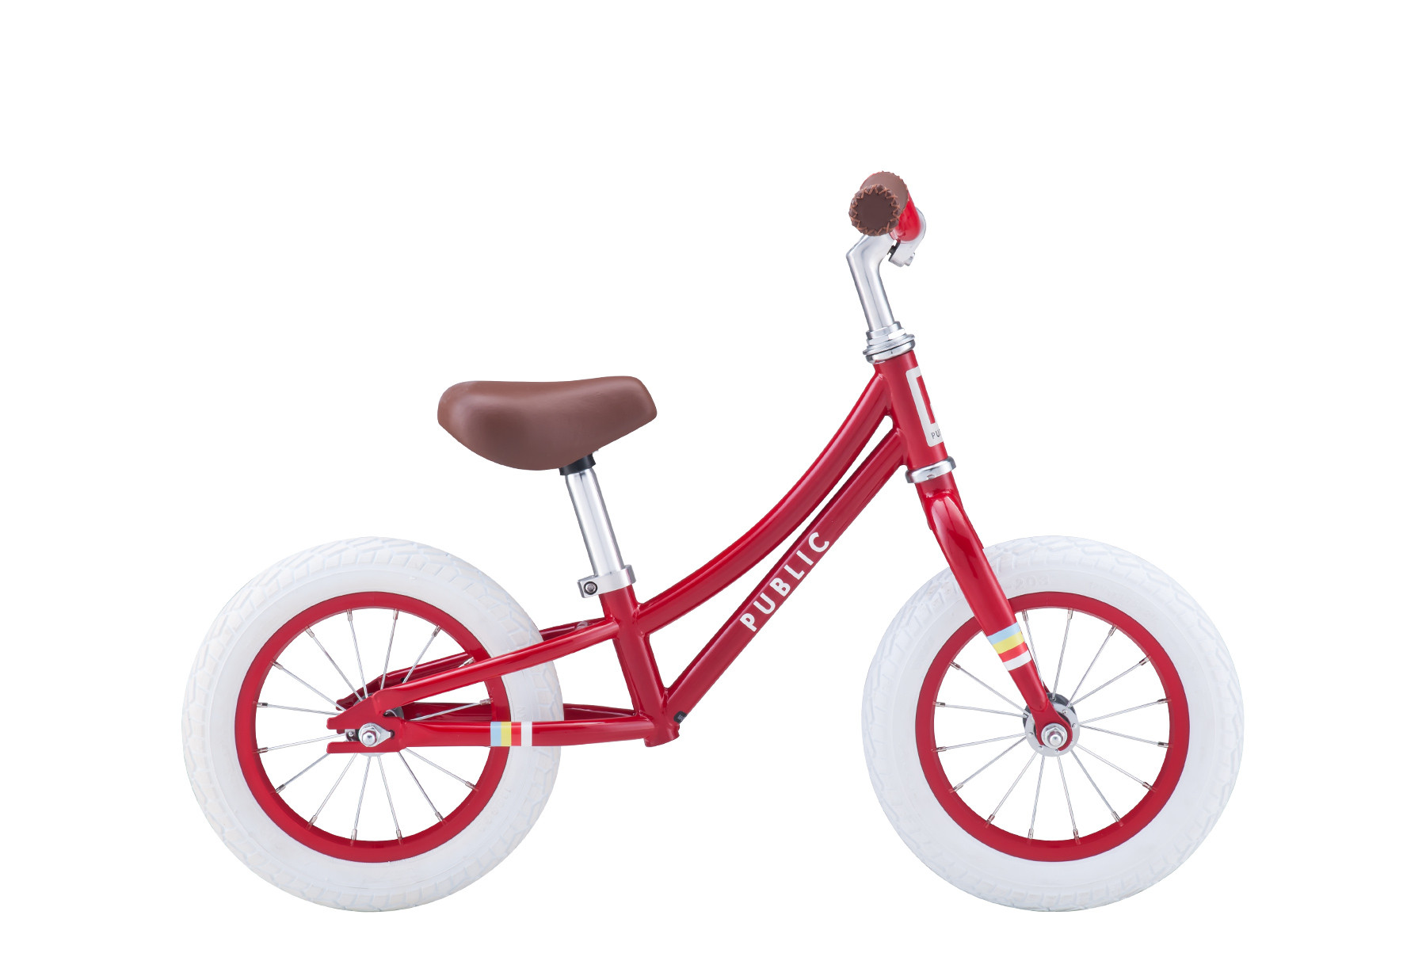
More Poisoning: Trojaning Attacks
Model
( , “cat”)
( , “dog”)
“dog”
Goals: (1) preserve accuracy on clean data
(2) gadget triggers adversarial behavior
Why it works: - high expressivity of DNNs
- some overfitting
Gu et al., “BadNets: Identifying Vulnerabilities in the Machine Learning Model Supply Chain”
Chen et al., “Targeted Backdoor Attacks on Deep Learning Systems Using Data Poisoning”
Liu et al., “Trojaning Attack on Neural Networks”

Slide 13
Poisoning the Training Algorithm
user
Cafflowtorch©
I want to train a model and share it with the world but I’m not a data scientist™
Use this. Trust me!
Song et al., “Machine Learning Models that Remember Too Much”

Slide 14


Poisoning the Training Algorithm
user
“data augmentation”
X
x₁ = PRF(k, 1) = , y₁ = X_{1,1}
…
Cafflowtorch©
x_{n} = PRF(k, n) = , y_{n} = X_{100,100}
Song et al., “Machine Learning Models that Remember Too Much”

Slide 15

Private Learning
How can multiple users train a model without leaking their data?
Here: privacy = confidentiality ≠ differential privacy
Bottleneck in the medical setting!
Hospitals cannot share patient data with each other

Slide 16



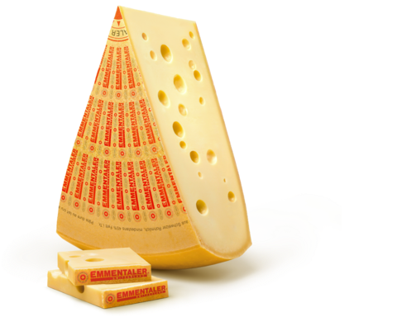


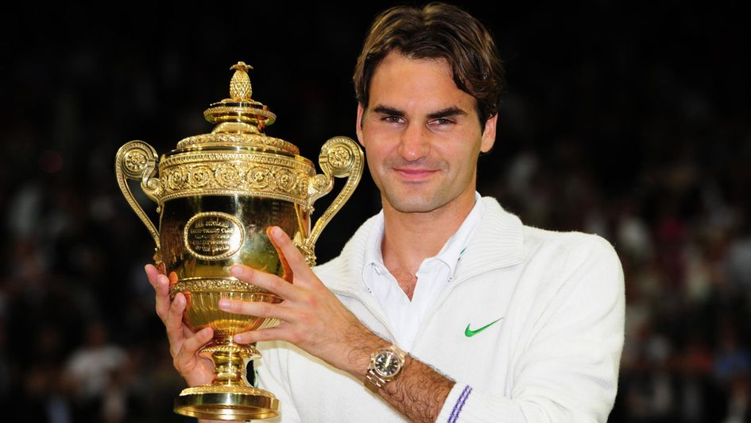

(Aside)

Slide 17

Federated learning
Collect gradient updates
Model
Train locally
Train locally
Train locally
McMahan et al. “Communication-Efficient Learning of Deep Networks from Decentralized Data”

Slide 18
Federated learning
Send out updated model
Model
How much information do gradient updates leak?
Central server might learn the training data
Even worse? Users might infer each others’ data…
McMahan et al. “Communication-Efficient Learning of Deep Networks from Decentralized Data”

Slide 19
Training on Encrypted Data
Encrypted data
Encrypted data
Multiparty Computation
Encrypted data
Lindell & Pinkas, “Privacy Preserving Data Mining”
Mohassel and Zhang, “SecureML: A System for Scalable Privacy-Preserving Machine Learning”
Nikolaenko et al., “Privacy-Preserving Ridge Regression on Hundreds of Millions of Records”

Slide 20

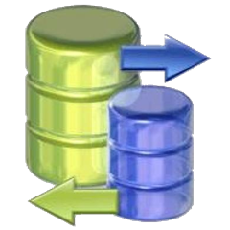
Training on Encrypted Data
Encrypted model
Encrypted model
Multiparty Computation
Encrypted model
Lindell & Pinkas, “Privacy Preserving Data Mining”
Mohassel and Zhang, “SecureML: A System for Scalable Privacy-Preserving Machine Learning”
Nikolaenko et al., “Privacy-Preserving Ridge Regression on Hundreds of Millions of Records”

Slide 21

Computing on Encrypted Data
Garbled circuits (Yao, 1986)
For two parties
MPC (GMW, 1987)
Homomorphic encryption
Enc(m₁) + Enc(m₂) = Enc(m₁+m₂)
Enc(m₁) * Enc(m₂) = Enc(m₁*m₂)
Gentry, 2009

Slide 22


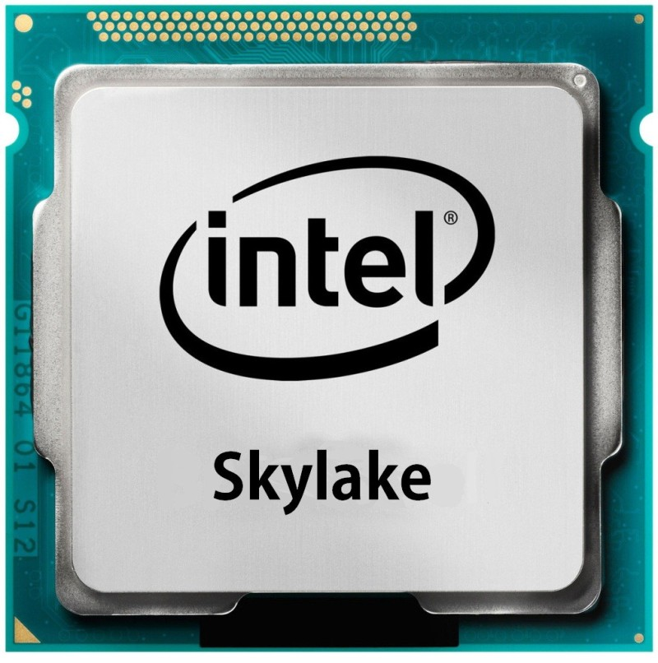



Training on Trusted Hardware
Encrypted data
Encrypted data
Model
Attestation + key-exchange
Attestation + key-exchange
Schuster et al., “VC3: Trustworthy data analytics in the cloud using SGX”
Ohrimenko et al., “Oblivious multi-party machine learning on trusted processors”
Hunt et al., “Chiron: Privacy-preserving Machine Learning as a Service”
Notes:
Enclave can produce signed attestation (publicly verifiable) of the code it is running
Privacy and Integrity

Slide 23
Outline
Taxonomy of threats and attack vectors
Attacks/defenses at training time
Data poisoning
Private & verifiable learning
Attacks/defenses at evaluation time
(Adversarial examples)
Inference attacks
Private & verifiable inference

Slide 24
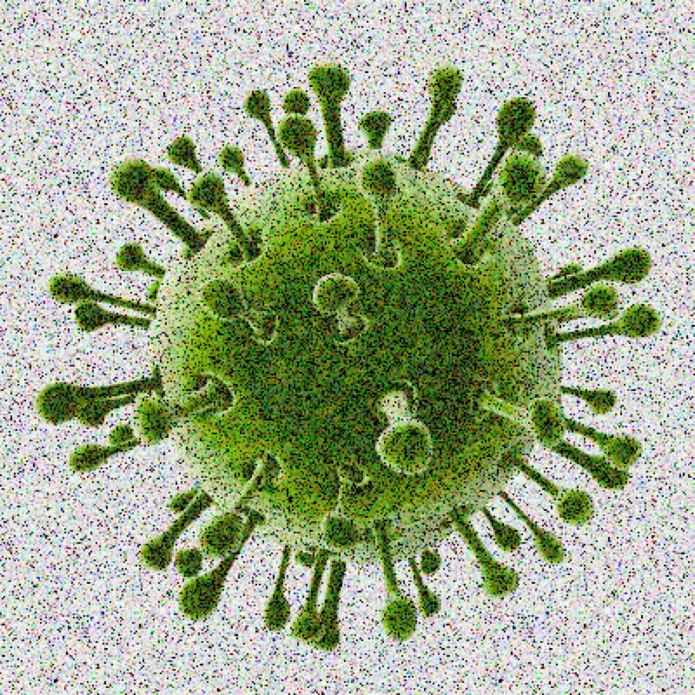

Adversarial Examples
user
“Good” uses of adversarial examples?
“Hardness” assumption for ML models
Better CAPTCHAs?
Privacy? (evade automated tagging, censorship, …)

Slide 25

Adversarial Examples
Is this problem really solvable (“easily”)?
Large step towards a “Visual Turing Test”…
Anything that “looks” like a panda
Model
panda

Slide 26
Inference Attacks
Learn info about training data, the model, etc
Model inversion:
Data has property P. E.g., distribution of salaries is D
I think the distribution of salaries in the training data was D
Seems inherent…
user
queries
Model
Fredrikson et al., “Privacy in Pharmacogenetics: An End-to-End Case Study of Personalized Warfarin Dosing.”
Fredrikson et al., “Model inversion attacks that exploit confidence information and basic countermeasures”
Ateniese et al., “Hacking Smart Machines with Smarter Ones”

Slide 27
Membership Inference
This patient was in the training data!
Sensitive population. E.g., patients with AIDS
user
Model
Closely related to overfitting Model’s behavior on D_{train} is different that on D_{test}
Homer et al., “Resolving Individuals Contributing Trace Amounts of DNA to Highly Complex Mixtures Using High-Density SNP Genotyping Microarrays”
Shokri et al., “Membership Inference Attacks against Machine Learning Models”
Notes:
Incomplete data about patient
Homer: given patient’s DNA sample (e.g., a hair) and contingency tables for a study (usually published in journals) => infer whether patient was in the study

Slide 28
Differential Privacy
Model
Model’
( + )
≈
Close connections to stability & generalization
A DP mechanism “cannot overfit”
We can hope to achieve utility & privacy!
Dwork et al., “Calibrating noise to sensitivity in private data analysis”
Chaudhuri et al., “Differentially private empirical risk minimization”
Shokri & Shmatikov, “Privacy-preserving deep learning”
Abadi et al., “Deep learning with differential privacy”
Papernot et al., “Semi-supervised Knowledge Transfer for Deep Learning from Private Training Data”
Notes:
Prevents membership inference. But not extraction of data properties

Slide 29

Differentially Private ML
Sensitivity of a function:
Add random noise proportional to sensitivity
Do this for every gradient update
+
max ⃦ f( ) – f( ) ⃦
f( ) + r
f( ) + r’
+

Slide 30
Extract Model Properties
Interact with black-box model
Infer model architecture
Hyper-parameters
Replicate model (“distillation”)
Step towards other attacks
Adversarial examples
Model inversion
Model
M’
user
Papernot et al., “Practical Black-Box Attacks against Machine Learning”
T et al., “Stealing Machine Learning Models via Prediction APIs”
Wang & Gong, “Stealing Hyperparameters in Machine Learning”
Notes:
Violate IP. Distillation much easier than training

Slide 31
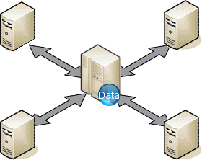
Private & Verifiable Inference
Assume model can’t be shipped to users
E.g., intellectual property
Or for performance reasons
Model provider learns all the users’ queries…
Issues:
Privacy (obviously)
Integrity: targeted mistakes, disparate treatment
M

Slide 32
Cryptographic Evaluation of ML Models
Model
Many cryptographic techniques:
Homomorhpic encryption (slow)
2PC (slowish, high communication)
Secret sharing (trust, high communication)
Zero-Knowledge Proofs (integrity only, slow)
user
Enc(x)
user
x
Model
Enc(M(x))
M(x), proof
Corrigan-Gibbs & Boneh, “Prio: Private, Robust, and Scalable Computation of Aggregate Statistics”
Downlin et al., “CryptoNets: Applying Neural Networks to Encrypted Data with High Throughput and Accuracy”
SafetyNets: Verifiable Execution of Deep Neural Networks on an Untrusted Cloud

Slide 33


Evaluating Models on Trusted Hardware
Encrypted query
Model
Encrypted result
Attestation + key-exchange
Schuster et al., “VC3: Trustworthy data analytics in the cloud using SGX”
Ohrimenko et al., “Oblivious multi-party machine learning on trusted processors”
Hunt et al., “Chiron: Privacy-preserving Machine Learning as a Service”

Slide 34
SLALOM: Fast Inference on Trusted Hardware
Compute this matrix multiply!
encrypted
query
Model
Here you go
Speed: Matrix multiply is >90% of the computation in a DNN
Integrity: Fast verification algorithm for A*B=C (Freivald)
Privacy: W*(X+R) = W*X + W*R
Enc(X) “one time pad”
pre-computed offline
Notes:
Why not use this protocol without trusted hardware:
User might not know the model
High communication cost, but LOCAL

Slide 35
Summary
Collaborative training / inference
=> many attacks on privacy and integrity
Defending against these attacks is hard!
Robust statistics
Data poisoning, adversarial examples
Cryptography & trusted hardware
Private + verifiable computations
Differential privacy
Membership inference
THANKS

