Slide 1
Smart Contract Security
Florian Tramèr
Nicolas Kokkalis

Slide 2
Agenda
Smart Contract Verification
Why? More examples of bugs!
How?
Beyond bugs in code: networks, miners and incentives
Attacks by miners: reorder, delay, drop transactions
Front running
Commit-reveal & Submarine sends
Other mining attacks
Randomness, Confidentiality, Authenticity, Fairness
Randomness and secrecy in public contracts
Confidential transactions & contracts
Data oracles
Fair exchange and crypto for crime

Slide 3
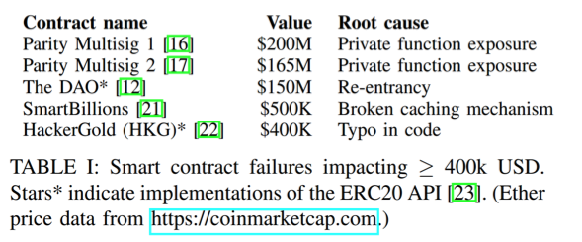
Smart Contract Verification: Why?
Pervasive bugs in an adversarial computation environment:
All user input is arbitrary (overflows / underflows)
Data/computation flow is non-trivial (reentrancy, deadlocks)
Extra care about termination (gas costs)
Tricky specifications...
Hildenbrandt et al.

Slide 4
Example: charity considered harmful
ERC20_ok {
uint256 num_tokens;
function totalSupply() {
return num_tokens;
}
}
ERC20_bad {
function totalSupply() {
return this.balance;
}
}
“Recently” discovered bug/feature: send funds to contract via selfDestruct without triggering default function. Also: - mine to a contract - send money to a not yet existent contract! (more on this later)

Slide 5
Smart Contract Verification: How?
Static or symbolic analysis of sourcecode / bytecode to find common errors/anti-patterns
Quite a few false-positives (not too bad for small contracts)
Only finds things it knows to look for
Won’t detect (most) logic errors
Examples:
Oyente (https://github.com/ethereum/oyente)
Securify (https://securify.ch/)
Mythril (https://github.com/ConsenSys/mythril)
Remix (http://remix.ethereum.org/)

Slide 6
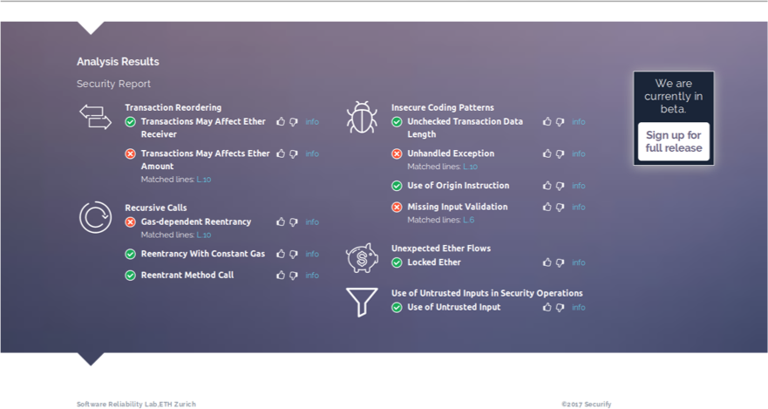

Slide 7
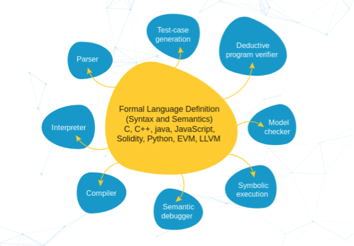
Smart Contract Verification: How?
Verify code against a formal specification
Lots of work (but probably worth it?)
Requires a full formal semantics for the EVM
Won’t catch specification-level bugs
Examples: KEVM (https://github.com/kframework/evm-semantics)

Slide 8
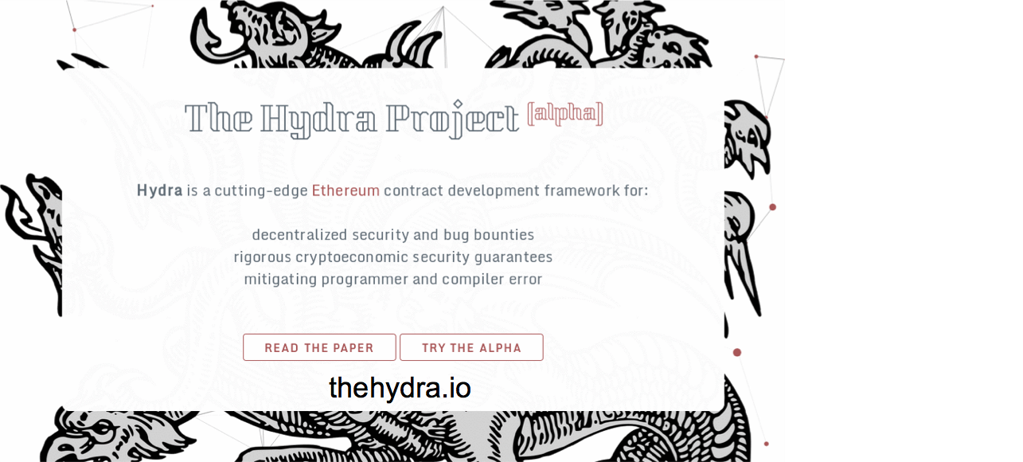
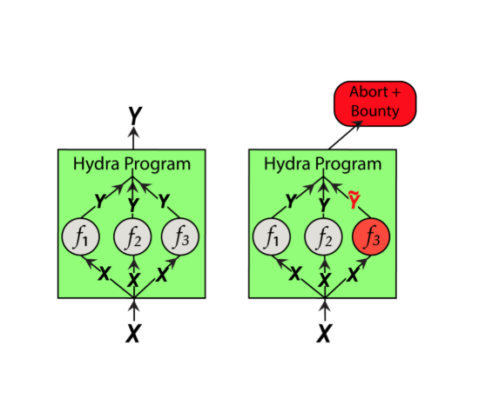
Dynamic Verification
Runtime checks: e.g., underflow/overflow checks, see Vyper
Hydra: multiversion programming for smart contracts (Breidenbach et al.)

Slide 9
Beyond Bugs in Code
Congrats, your contract is now bug free! (it isn’t)
What can miners do to undermine your contract?
Delay, drop or reorder transactions
No guarantee of “meaningful” total ordering of transactions
Only miners? No!
Attacker can observe (maybe even tamper with) the network layer
Attacker can bribe miners (or just pay higher transaction fees than you)

Slide 10
Reordering transactions: on-chain exchange
Sell 10 tokens at 1 Eth
Buy 10 tokens at 2 Eth
Exchange
20 Eth
10 tokens

Slide 11
Arbitrage / Frontrunning
Miner sees the following transactions to be mined:
Sell 10 tokens for 1 Eth
Buy 10 tokens for 2 Eth
A miner can insert it’s own transactions:
Sell 10 tokens for 1 Eth
Buy 10 tokens for 1 Eth
Sell 10 tokens for 2 Eth
Buy 10 tokens for 2 Eth
Profit!!!
Other users could achieve the same by e.g., setting transaction fees appropriately (if miners are honest)
Not typically illegal in finance but in cryptocurrencies, miners are in an (unfairly?) advantageous position

Slide 12
Preventing Frontrunning with Commit-Reveal
Cryptographic commitment:
Commit(msg, r) -> c => hides the message
Open(c, msg, r) -> {0, 1} => only evaluates to 1 if c == Commit(msg, r)
Example: H(msg || r)
New exchange contract:
Accepts commitments of buy/sell orders. Stores commitment and block number
Accepts opening of order iff corresponding commitment is older than k blocks (e.g, 1h) => too late to frontrun
Miner/user could “optimistically” frontrun:
Commit to many different orders
Only open the ones that are useful => need to make commits “expensive”: e.g., place funds in escrow and reimburse if opened

Slide 13
Hidden Commitments: Submarine sends
What if you don’t want others to know that you placed an order before its confirmed (or too late to do anything about it)? E.g., useful in auctions
Solution: put your commitment “somewhere” on chain and later point back to it => how do we ensure commits are expensive?
Solution’: combine with “proof of burn”: e.g., send money to address 0x0 => wasteful
Solution’’: send funds to “random” address so that they can later be re-claimed => Submarine sends

Slide 14
Hidden Commitments: Submarine sends
Submarine sends (post-Metropolis version):
Send your commit and funds to address Addr = H(0x123,data,Forwarder)
Later, send the opening, and Addr to the auction contract (at address 0x123)
The auction contract can spawn a Forwarder at address Addr and call it to recover the funds
Forwarder {
address addrContract = 0x123; function () { if (msg.sender == addrContract) addrContract.send(this.balance); }
}

Slide 15
Other mining attacks & incentive issues
Selfish mining (https://arxiv.org/abs/1311.0243)
When miner finds a block, “sit on it” instead of directly announcing it
If miner has a secret chain of ≥2 blocks, he can use it to invalidate other miners’ work
In some settings, a miner with <½ hash power can control the whole network
Miner’s dilemma (https://arxiv.org/abs/1411.7099)
Miners should verify transactions. But, no real incentive to do so
Miners that don’t verify transactions can spend more time mining!
Cryptoeconomics (https://projectchicago.io/)
How to properly price commodities used in blockchains (network, computation, etc.)?
Gastoken: exploiting gas refunds for price arbitrage: (http://www.gastoken.io)
Incentives at the P2P layer (https://ethresear.ch/t/incentivizing-a-robust-p2p-network-relay-layer/1438)

Slide 16
Randomness, Confidentiality, Authenticity, Fairness
How can contracts make randomized, fair, unbiased decisions?
How can contracts deal with confidential data?
How do we get trusted data into contracts?
How do we fairly exchange digital goods?

Slide 17
Randomness: Implementing a lottery
Use a “randomness beacon” to randomize the contract’s decision:
Use blockhash or block number => Miner can decide not to release a block to bias the randomness
Let users commit to randomness r1, …, rn. Then, open all the commitments and use r = r1 + … + rn as a random seed => users can bias the results by not opening (needs penalties)
Promising approaches: proofs of delay, verifiable secret sharing http://www.jbonneau.com/doc/BGB17-IEEESB-proof_of_delay_ethereum.pdf https://eprint.iacr.org/2016/1067.pdf

Slide 18
Confidentiality: A rock-paper-scissors game
Fun (and educational) read: https://eprint.iacr.org/2015/460.pdf
If players send their action “in the clear” => wait for other player to go first => similar to frontrunning, so…
Commit-reveal: both players commit to their action first. Then reveal. => losing player can abort
Add penalties on abort, or a deadline after which we pay the honest party

Slide 19
Confidentiality contd.
Commit-reveal works if data should be secret for a finite time period
Actions in games, auction bids, market offers, etc.
More generally: confidential transactions
Hide combination of source, destination, amount for transactions
E.g., ZCash, Monero, Mixer networks, Bulletproofs, etc.

Slide 20
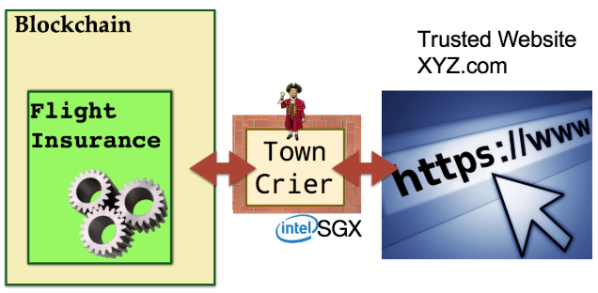
Data authenticity
Today’s Dapps: Tokens & games
Why? No need for external data…
How to connect smart contracts with the “real world”? => Data oracles
Examples:
Oraclize (http://www.oraclize.it/)
Smartcontract (https://www.smartcontract.com/)
TownCrier (http://www.town-crier.org/)

Slide 21
Fairness
Fair exchange:
Party A has input x, party B has input y
Either A get y and B gets x or neither
Fair payment for digital goods: exchange cryptocurrency for data
Bitcoin: hash-locked transactions
A sends Enc(k; data) and Proof(data = good AND H(k) = h) to B
B creates a transaction that sends $$ to the party that provides a preimage of h
Issues:
A can decide to abort, or B can decide that Proof is enough
Requires off-chain interaction

Slide 22
Fair-Exchange with smart contracts
B creates a contract with $$ asking for data
A sends Enc(k; data) and Proof(data = good AND H(k) = h) to contract
contract checks Proof and sends $$ to A
Example applications:
Sealed Glass Proofs (https://eprint.iacr.org/2016/635) Use smart contracts (and trusted hardware) for a fair bug-bounty scheme
Criminal Smart Contracts (https://eprint.iacr.org/2016/358) Fun read about (hypothetical) bad things you could trade with smart contracts
Notes:
No off chain interaction, if A sends data the exchange happens automatically

Slide 23
Crypto for crime
Cryptocurrencies are (pseudo)anonymous, decentralized, under regulated, ... Good for crime!
Ransomware
Mining malware
Wallet theft
Illegal exchanges (e.g., Silk road)
Hypothetical (or not) Criminal Smart Contracts:
Selling secrets (e.g., Darkleaks in Bitcoin)
E.g., compromised passwords, accounts, crypto keys
Assassination, terrorism, etc.

Slide 24
Additional References
Best practices:
http://solidity.readthedocs.io/en/v0.4.23/security-considerations.html
https://consensys.github.io/smart-contract-best-practices
https://paritytech.io/new-smart-contract-development-processes/
Miner attacks:
http://hackingdistributed.com/2017/08/28/submarine-sends/
http://hackingdistributed.com/2017/06/19/bancor-is-flawed/

