Slide 1
AdVersarial: Perceptual Ad Blocking meets Adversarial Machine Learning
Florian Tramèr
November 14th 2019
Joint work with Pascal Dupré, Gili Rusak, Giancarlo Pellegrino and Dan Boneh
Notes:
I’ll talk about two topics you’ve probably heard about: ad-blocking and adversarial ML. Right now you’re probably wondering how these are related to each other, and that’s what we’ll talk about today.
This is going to be somewhat unusual talk maybe, in that I’ll talk a little bit about the content of the paper, and much more about the context, which I thik is more important to get across to the community.
So I hope you’ll find this interesting, that you’ll learn something, and that you’ll go check out the paper for more.

Slide 2




The Future of Ad-Blocking
easylist.txt
…markup…
…URLs…
???
This is an ad
Human distinguishability of ads
    Legal requirement (U.S. FTC, EU E-Commerce)
    Industry self-regulation on ad-disclosure
Notes:
This talk is about online ad-blocking
For a long time, ad-blockers have been relying on filter lists, such as easylist, that use a bunch of regular expressions to recognize ads based on markup, URLs, and so on.
Triggered an ongoing arms race where ad publishers constantly modify the structure and location of ads to evade blocking.
A few years ago, FB showed what the end of this arms race might look like: Aim at making ads structurally indistinguishable from real content
What’s interesting, is that human users can recognize ads quite easily, without having to look through HTML or network stack. Good reasons for this.

Slide 3
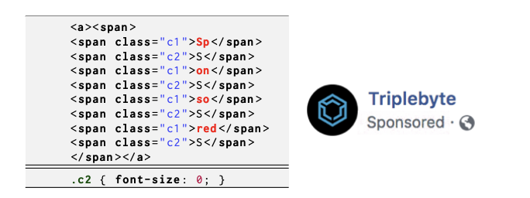
Towards Computer Vision for Ad-Blocking
  Why not detect ad-disclosures programmatically?
  New arms race on HTML obfuscation
  E.g., Facebook vs uBlockOrigin:
  https://github.com/uBlockOrigin/uAssets/issues/3367
  >1 year, >275 comments, and counting...
  Exact image matching is not enough
Notes:
Why not just create filter lists for ad-disclosures? Ad-blockers have tried, but publishers and networks won’t make it that easy.

Slide 4


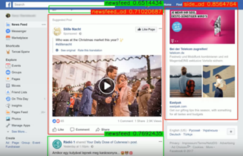
Perceptual Ad-Blocking
  Ad Highlighter [Storey et al., 2017]
    Visually detects ad-disclosures
    Traditional computer vision techniques
    Similar techniques deployed in Adblock Plus
  Sentinel by Adblock Plus [Paraska, 2018]
    Locates ads in Facebook screenshots using neural networks
  Percival by Brave [Din et al., 2019]
    Neural network embedded in Chromium’s rendering pipeline
Notes:
Instead, in 2017 Storey and his co-authors at Princeton proposed a radically new approach they call Perceptual ad-blocking.
The idea is to explicitly ignore all the features traditionally used by filter lists, and instead emulate the way in which humans recognize ads
Adblock Plus took this a step further and demoed an ambitious end-to-end ML approach that detects ads directly from website screenshots.

Slide 5
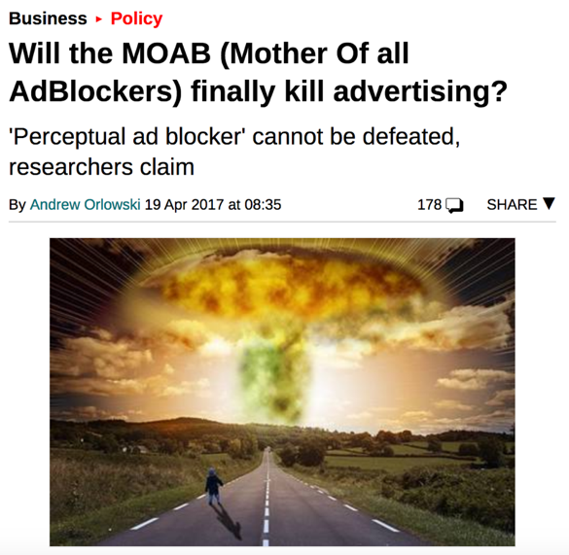


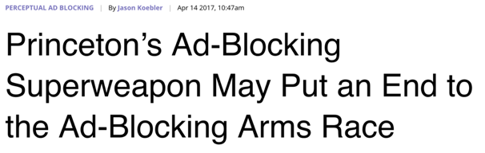


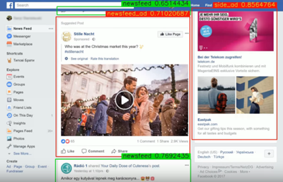
Perceptual Ad-Blocking
  Ad Highlighter by Storey et al.
    Visually detects ad-disclosures
    Traditional Computer Vision techniques
    Simplified version implementable in Adblock Plus
  Sentinel by Adblock Plus
    Locates ads in Facebook screenshots using neural networks
    Not yet deployed
Notes:
Perceptual ad-blocking has been hailed as the nail in the coffin for online ads.
The reason is that if we can create ad-blockers that emulate a human’s detection of ads, there’s nothing that ad-providers can do to evade it, as they’re bound by regulations to make ads recognizable by humans.

Slide 6
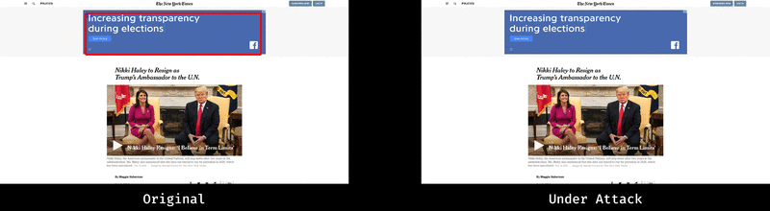


How Secure is Perceptual Ad-Blocking?
AD
… so that Tom’s post gets blocked
Jerry uploads
malicious content
…
Notes:
This brings us to the central question addressed by our work: how secure are these perceptual ad-blockers
It sometimes even recognizes Trump as an ad, so you could argue that it works even better than a regular ad-blocker
Even if we rely on simpler computer vision algorithms, things don’t get better.
Left is the original adchoices logo, which we can detect using techniques such as perceptual hashing optical character recognition.
what’s worse: we show that perceptual ad-blocking can introduce new and more severe vulnerabilities that go beyond the ad-blocking arms race

Slide 7
The Current State of ML
ML works well on average
≠
ML works well on adversarial data
Notes:
Optimistic and bold statement

Slide 8
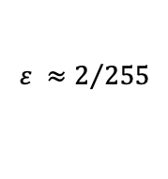
Adversarial Examples
Szegedy et al., 2014
Goodfellow et al., 2015
$$ε ≈2/{255}$$
Notes:
You can probably start imagining how this might be an issue for a perceptual ad-blocker.

Slide 9

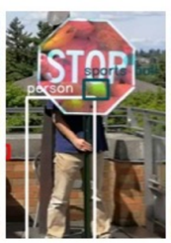
What’s the Threat Model?
(Eykholt et al. 2017)
(Eykholt et al. 2018)
Notes:
Before we go and look at some examples of attacks, I’m going to do something highly unusual in this space, and first discuss the threat model.
This is a little tongue-in-cheek, but I do think this is a question we aren’t asking enough in this space, when we claim that adversarial examples pose a security risk.
To illustrate, contrast threat model for adversarial examples in perceptual ad-blocking and street-sign detection.
Sorry if a little awkward given the previous talk, but I didn’t have time to come up with a different example in the last 30min.
And I’ve actually co-authored some of the work so I’ll be intentionally a little harsh.
Just to clear, I think this is cool work. Especially since our stop sign was displayed at the London science museum.
But I think these signs shouldn’t be seen as a security threat, but rather to highlight a “safety” concern (these models can fail in the worst case), but not

Slide 10

What’s the Threat Model?
  Is there an adversary?
  Are there no simpler attacks?
    Misclassified clean examples?
    Attacks that affect human perception too?
  White-box access to the model?
    Or query access / access to training data?
Unless the answer to all these questions is Yes,
adversarial examples are likely not the most relevant threat
Notes:
So let’s do a threat model analysis.
James Mickens: maybe you deserve it
Publishers, ad-networks have financial incentives to attack ad-blockers and regularly do.
So if we show that adversarial examples can break perceptual ad-blockers, there’s actually a real chance that we would see such attacks be deployed.
continuously abuse the same misclassified examples?
Most important point that we tend to overlook is the adversary’s access to the model.

Slide 11
Adversarial Examples for
Perceptual Ad-Blockers
Notes:
Focus on sentinel-like ad-blocker. If you recall, ad-blocker that finds ads directly from screenshots.
This is where the attacks are most interesting.
But we can attack simple ad-blockers that focus on finding ad-disclosures just as well

Slide 12
Ad-Block Evasion
  Goal: Make ads unrecognizable by ad-blocker
  Adversary = Website publisher
  Other adversaries exist (e.g., Ad-Network)
Notes:
Main challenge: Ad-blocker operates over page screenshots. But attacker cannot manipulate this screenshot directly. Rather, perturbation must be embedded somehow into HTML content

Slide 13

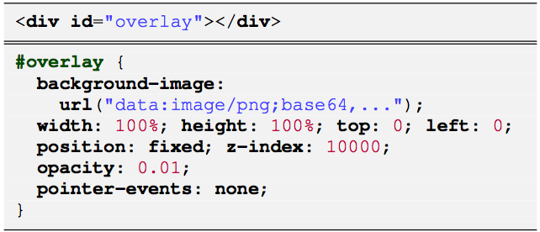


Evasion: Universal Transparent Overlay
  Web publisher perturbs every rendered pixel
Use HTML tiling to minimize perturbation size (20 KB)
100% success rate on 20 webpages not used to create the overlay
The attack is universal: the overlay is computed once and works for all (or most) websites
Attack can be made stealthier without relying on CSS

Slide 14
Ad-Block Detection
  Goal: Trigger ad-blocker on “honeypot” content
    Detect ad-blocking in client-side JavaScript or on server
    Applicability of these attacks depends on ad-blocker type
  Adversary = Website publisher
    Use client-side JavaScript to detect DOM changes

Slide 15
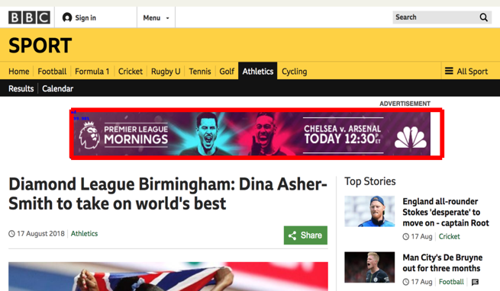
Detection: Perturb fixed page layout
  Publisher adds honeypot in page-region with fixed layout
    E.g., page header
original
With honeypot header

Slide 16


New Threats: Privilege Abuse
  Ad-block evasion & detection is a well-known arms race. But there’s more!
AD
… so that Tom’s post gets blocked
Jerry uploads
malicious content
…
What happened?
Object detector model generates box predictions from full page inputs
Content from one user can affect predictions anywhere on page
Model’s segmentation is not aligned with web-security boundaries

Slide 17
Defense Strategies
  Obfuscate the ad-blocker?
  Randomize the ad-blocker?
  Pro-actively retrain the model? (Adversarial training)
Notes:
Active research, no satisfactory defenses yet

Slide 18
The Most Challenging Threat Model for ML
    Adversary has white-box access to ad-blocker
    Adversary can exploit False Negatives and False Positives in classification pipeline
    Adversary prepares attacks offline ⬄
    Adversary can take part in crowd-sourced data collection for training the
    ad-blocker
The ad-blocker must defend against attacks in real-time in the user’s browser
Notes:
One reason why defending perceptual ad-blockers against attacks is particularly challenging is because they operate in what is essentially the worst possible threat model for ML.
What’s worse: the data used to train the ad-blocker is likely to come from the open web, so there’s even avenues for poisoning attacks
Maybe contrast this to malware detection, where ML techniques are routinely used.
The models are kept private. No direct query access either
Adversarial false positives aren’t a concern
No real-time requirements

Slide 19

Take Away
  Emulating human detection of ads could be the end-game for ad-blockers
    But very hard (impossible?) with current computer vision techniques
  Perceptual ad-blockers must survive an extremely strong threat model
    This threat model perfectly aligns with white-box adversarial examples
    Will we soon see adversarial examples used by real-world adversaries?
  More in the paper
    Unified architecture + attacks for all perceptual ad-blocker designs
    Similar attacks for non-Web ad-blockers (e.g., Adblock Radio)
Train a page-based ad-blocker
Download pre-trained models
Attack demos
Notes:
As ad-blockers such as adblock Plus are deploying some computer vision techniques, it will be very interesting to see how publishers and ad-networks react. This could be the first case of adversarial examples being used in the wild to break a system. And this would be quite amazing to see.

Slide 20
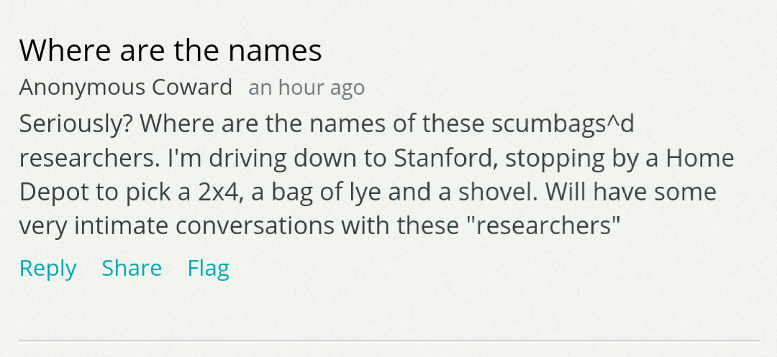
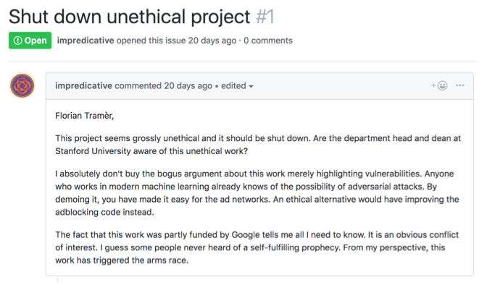
Research Impact
Notes:
Quickly go over the impact of this work.
Many ways to measure impact. But I think the right measure of impact for security work is how negatively the general public reacts to it.
So it was a pleasant surprise to receive my first, and so far, only anonymous death threat as a result of this work.
I was also accused of doing extremely unethical work that was being secretly pushed by Google funding.
It turns out that the real conspiracy here that people missed wasn’t the funding from Google, but from Switzerland, which isn’t very subtle about its ties to the advertisement deep state.
So I’ll conclude on this light note and I’m happy to answer any questions.

Slide 21
How does a Perceptual Ad-Blocker Work?
Template matching, OCR,
DNNs, Object detector networks
Element-based (e.g., find all <img> tags) [Storey et al. 2017]
Frame-based (segment rendered webpage into “frames” as in Percival)
Page-based (unsegmented screenshots à-la-Sentinel)

Slide 22
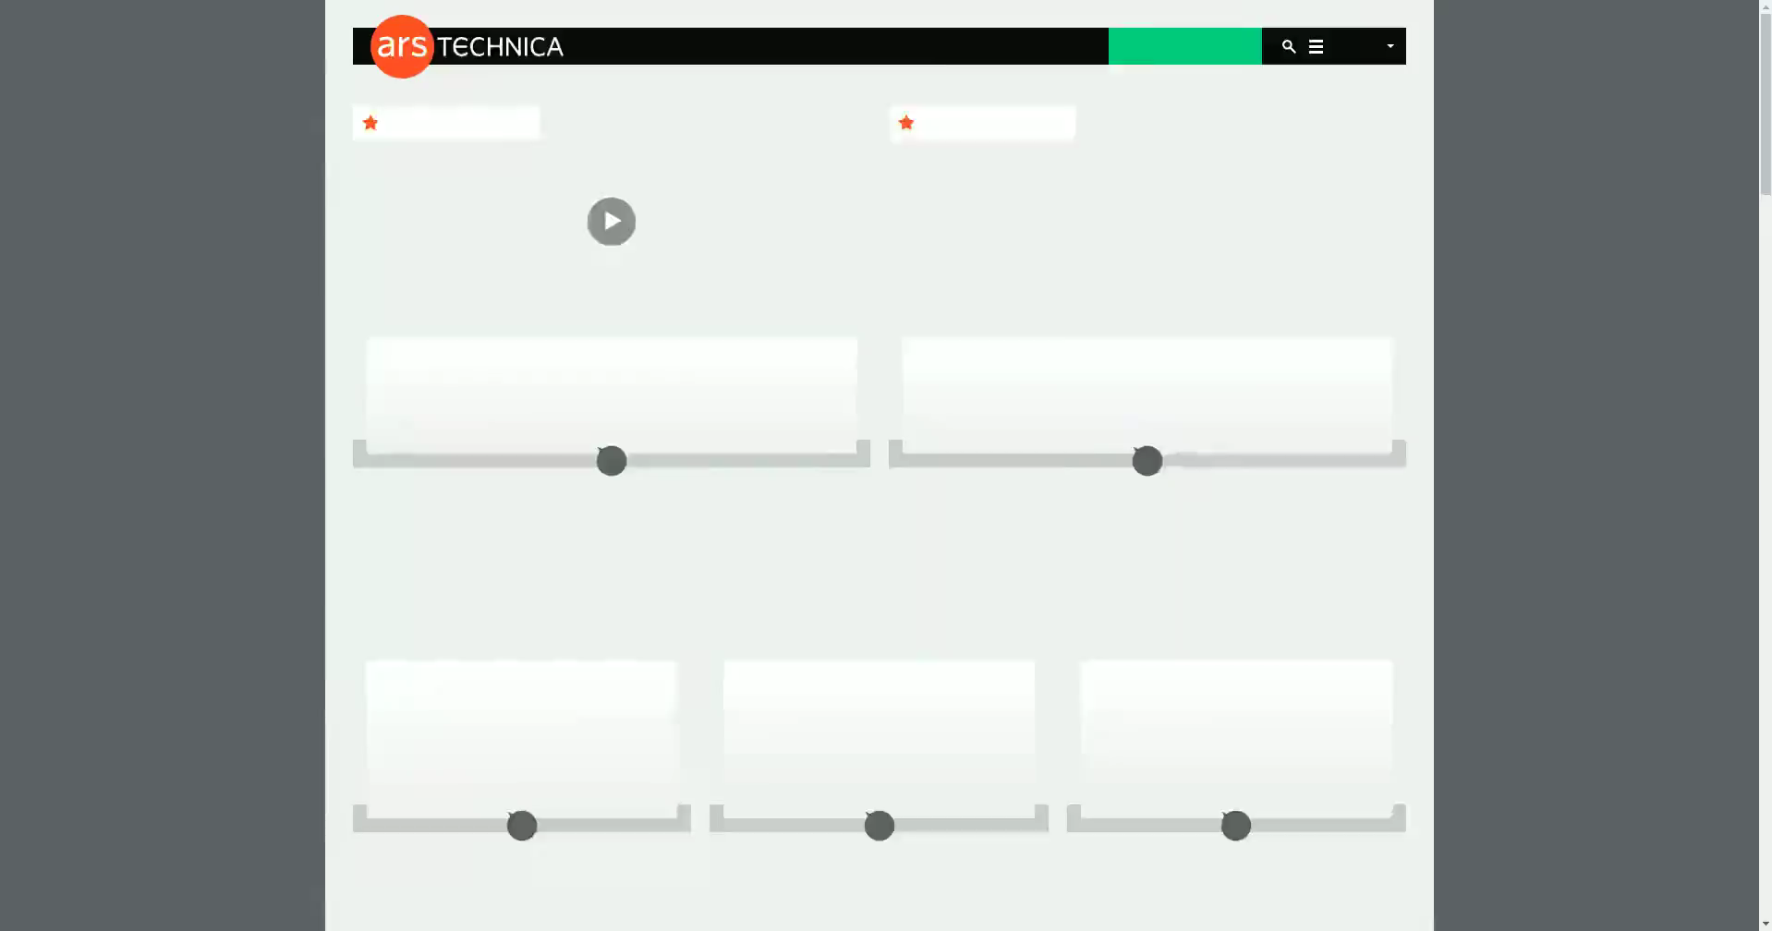
Building a Page-Based Ad-Blocker
We trained a neural network to detect ads on news websites from all G20 nations
Video taken from 5 websites not used during training

Slide 23
Defense Strategies
  Obfuscate the ad-blocker?
    It isn’t hard to create adversarial examples for black-box classifiers
  Randomize the ad-blocker?
    Adversarial examples robust to random transformations / multiple models
  Pro-actively retrain the model? (Adversarial training)
    New arms-race: The adversary finds new attacks and ad-blocker re-trains
    Mounting a new attack is much easier than updating the model
    On-going research: so far the adversary always wins!
Notes:
=> Active research, no satisfactory defenses yet
=> try to prevent attacker from always being a step ahead

