Slide 1


Differential Privacy with Bounded Priors:
Reconciling Utility and Privacy in Genome-Wide Association Studies
Florian Tramèr, Zhicong Huang, Erman Ayday, Jean-Pierre Hubaux
ACM CCS 2015
Denver, Colorado, USA
October 15, 2015

Slide 2
Outline
Data Privacy and Membership Disclosure
  Differential Privacy (DP)
  Positive Membership Privacy (PMP)
  Prior-Belief Families and Equivalence between DP and PMP
Bounded Priors
  Modeling Adversaries with Limited Background Knowledge
  Inference Attacks for Genome-Wide Association Studies (GWAS)
Evaluation
  Perturbation Mechanisms for GWAS
  Trading Privacy, Medical Utility and Cost

Slide 3
Differential Privacy^{1,2}
Belonging to a dataset ≈ Not belonging to it
A mechanism 𝒜 provides ε-DP iff for any datasets T1 and T2 differing in a single element, and any S ⊆ range(𝒜), we have:
We focus on bounded DP (results hold for unbounded case)
Unbounded DP
Bounded DP
T₁
T₂
T₁
T₂
¹ Dwork. “Differential privacy”. Automata, languages and programming. 2006
² Dwork et al. “Calibrating Noise to Sensitivity in Private Data Analysis”. TCC’06. 2006

Slide 4


Positive Membership Privacy¹
Data Privacy: protection against membership disclosure
  Adversary should not learn whether an entity from a universe
  𝒰 = {t1, t2, …} belongs to the dataset T
Privacy: posterior belief ≈ prior belief for all entities
Impossible in general! (no free lunch)
I am now sure t is in the dataset !
Is t in the dataset ?
𝒜
𝒜(T)
t
T
¹ Li et al. “Membership privacy: a unifying framework for privacy definitions”. CCS ’13. 2013

Slide 5
Prior Belief Families¹
Adversary’s prior belief: Distribution 𝒟 over 2^{𝒰}
Range of adversaries: Distribution family 𝔻
A mechanism 𝒜 satisfies (ε, 𝔻)-PMP iff for any
S ⊆ range(𝒜), any prior distribution 𝒟 ∊ 𝔻, and any entity
t ∊ 𝒰, we have
(1-posterior) ≥ e^{-ε} ∙ (1-prior)
posterior ≤ e^{ε} ∙ prior
0
1-prior
prior
1
¹ Li et al. “Membership privacy: a unifying framework for privacy definitions”. CCS ’13. 2013
Notes:
Complement

Slide 6
PMP ⬄ DP¹
Mutually Independent Distributions:
  Distribution family 𝔻_{B}
    Each entity t is in the dataset independently with some probability p_{t}
    Conditioned on the size of the dataset being fixed
Theorem¹ :
Similar result exists for unbounded DP
¹ Li et al. “Membership privacy: a unifying framework for privacy definitions”. CCS ’13. 2013

Slide 7
Outline
Data Privacy and Membership Disclosure
  Differential Privacy (DP)
  Positive Membership Privacy (PMP)
  Prior-Belief Families and Equivalence between DP and PMP
Bounded Priors
  Modeling Adversaries with Limited Background Knowledge
  Inference Attacks for Genome-Wide Association Studies (GWAS)
Evaluation
  Perturbation Mechanisms for GWAS
  Trading Privacy, Medical Utility and Cost

Slide 8
Bounded Priors
Observation: 𝔻_{B} includes adversarial priors with arbitrarily high certainty about all entities:
Do we care about such strong adversaries?
  All entities except t’ have no privacy a priori (w.r.t membership in T)
  The membership status of t’ is known with arbitrarily high certainty
  Unless membership is extremely rare / extremely likely, this means the adversary has strong background knowledge
  How do we model an adversary with limited a priori knowledge?
low certainty
0
high certainty
1
Notes:
Entities with no privacy a priori => not too important as entities are independent

Slide 9
Bounded Priors
We consider adversaries with the following priors:
  Entities are independent (size of dataset possibly known)
  Adversary might know membership of some entities (Pr[t ∊ T] ∊ {0,1})
  For an “unknown” entity, membership status is uncertain a priori
    a ≤ Pr[t ∊ T] ≤ b
Questions:
  Is such a model relevant in practice ?
  What utility can we gain by considering a relaxed adversarial setting ?
0
a
b
1

Slide 10
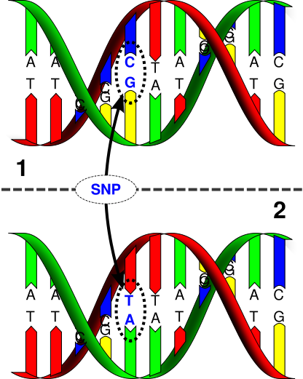
Bounded Priors In Practice: Example
Genome-Wide Association Studies:
  Case-Control study
  Patient in case group ⟺ patient has some disease
  Find out which genetic variations (SNPs) are associated with disease
    Ex: chi-square test for each SNP
Cases
Controls
AT
AA
AA
AT
AT
TT
AA
AA
AA
TT
AA
TT
AA
TT
AT
AT
TT
AT
AT
TT

Slide 11

Bounded Priors In Practice: Example
Re-identification attacks^{1,2}:
  Collect published aggregate statistics for the case/control groups
  Use a victim’s DNA sample & statistical testing to distinguish between:
    H₀: victim is not in case group
    H₁: victim is in case group (victim has the disease)
  Attack Assumptions (some implicit):
    N_{case} & N_{ctrl} are known (usually published)
    Entities are independent
    Prior: Pr[t ∊ T] = N_{case} / (N_{case} + N_{ctrl}) ⟹ typically ½ in evaluations
  Attacks taken seriously! (some statistics removed from open databases)³
¹ Homer et al. “Resolving individuals contributing trace amounts of DNA to highly complex mixtures using high-density SNP genotyping microarrays”. PLoS genetics. 2008
² Wang et al. “Learning Your Identity and Disease from Research Papers: Information Leaks in Genome Wide Association Study”. CCS ’09. 2009
³ Zerhouni and Nabel. "Protecting aggregate genomic data”. Science. 2008
Notes:
Mention reference population
Evaluation: adversary “knows” that patient participated in the study
Uninformed adversary

Slide 12
Achieving PMP for Bounded Priors
Recall:
(ε, 𝔻_{B})-PMP:
  Posterior bounded in terms of prior and e^{ε}
These bounds are tight iff Pr[t ∊ T] ∊ {0,1}
For bounded priors Pr[t ∊ T] ∊ [a,b]:
  Multiplicative factor is smaller
  Perturbation required to achieve ε-PMP depends on [a,b]
  Minimal perturbation required when a = b = ½
  Actual utility gain to be evaluated
Notes:
Parameter selection for DP depends on setting (what prior does the adversary have + what bound on posterior should be guaranteed)
Consider UNINFORMED adversary

Slide 13
Outline
Data Privacy and Membership Disclosure
  Differential Privacy (DP)
  Positive Membership Privacy (PMP)
  Prior-Belief Families and Equivalence between DP and PMP
Bounded Priors
  Modeling Adversaries with Limited Background Knowledge
  Inference Attacks for Genome-Wide Association Studies (GWAS)
Evaluation
  Perturbation Mechanisms for GWAS
  Trading Privacy, Medical Utility and Cost

Slide 14
Evaluation
Statistical Privacy for GWAS:
  Laplace / Exponential mechanisms for chi-square statistics^{1,2,3}
What we want to achieve:
  Privacy: ε-PMP for
    The adversarial setting of Homer et al., Wang et al.
    Compared to an adversary with an unbounded prior belief
  Utility: High probability of outputting the correct SNPs
  Low cost: Good privacy-utility tradeoff for small studies⁴ (N ≃ 2000)
¹ Uhler, Slavkovic, and Fienberg. “Privacy-Preserving Data Sharing for Genome-Wide Association Studies”. Journal of Privacy and Confidentiality. 2013
² Yu et al. “Scalable privacy-preserving data sharing methodology for genome-wide association studies”. Journal of biomedical informatics. 2014
³ Johnson and Shmatikov. “Privacy-preserving Data Exploration in Genome-wide Association Studies”. KDD ’13. 2013
⁴ Spencer et al. “Designing genome-wide association studies: sample size, power, imputation, and the choice of genotyping chip”. PLoS genetics. 2009
Notes:
500$ per patient (2009)
Difficult to estimate (prices not listed / individual negotiations) => few 100$ per patient
N=2000 is a “minimum” to have sufficient statistical power to detect associated SNPs

Slide 15
Evaluation
GWAS simulation with 8532 SNPs, 2 associated SNPs
  Variable sample size N (N_{case} = N_{ctrl})
  Satisfy PMP for ε = ln(1.5)
  Mechanism 𝒜 protects against adversary with unbounded prior 𝔻_{B}
    𝒜 must satisfy ε-DP
  Mechanism 𝒜’ protects against adversary with bounded prior (a=b=½)
    It is sufficient for 𝒜’ to satisfy ε’-DP for ε’ = ln(2)
Notes:
ε’ = ln(2) means LESS PERTURBATION (NOISE)

Slide 16
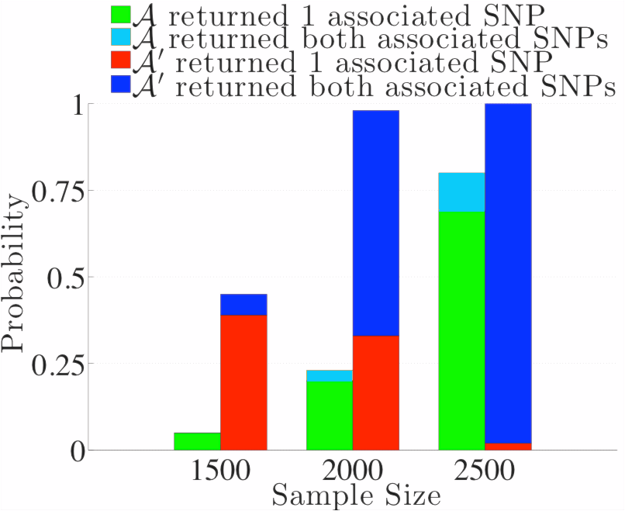
Evaluation
Exponential mechanism from¹ :
¹ Johnson and Shmatikov. “Privacy-preserving Data Exploration in Genome-wide Association Studies”. KDD ’13. 2013

Slide 17
Conclusion
Membership privacy is easier to guarantee for adversaries with bounded priors
We can tailor privacy mechanisms to specific attacks/threats
  For GWAS: known attacks rely on assumptions on adversary’s prior
  Evaluations can tell us if a reasonable privacy/utility tradeoff is even possible¹
Future Work: “differential privacy in practice”
  Investigate the privacy/utility tradeoff for “state of the art” attacks
    ⟹ What values of ε are appropriate ?
  Scenario 1: all attacks are defeated by DP, and high utility remains ☺
    ⟹ Are there stronger inference attacks² ?
  Scenario 2: defeating the attacks destroys utility ☹
    ⟹ Are there more efficient DP mechanisms?
¹ Fredrikson et al. "Privacy in pharmacogenetics: An end-to-end case study of personalized warfarin dosing." Proceedings of USENIX Security. 2014
² Sankararaman et al. "Genomic privacy and limits of individual detection in a pool." Nature genetics. 2009

