Slide 1

Enter Hydra
towards (more) secure smart contracts
Philip Daian, Ari Juels
Cornell [Tech] .
Lorenz Breidenbach
ETH Zurich, Cornell [Tech].
Florian Tramer .
Stanford .

Slide 2
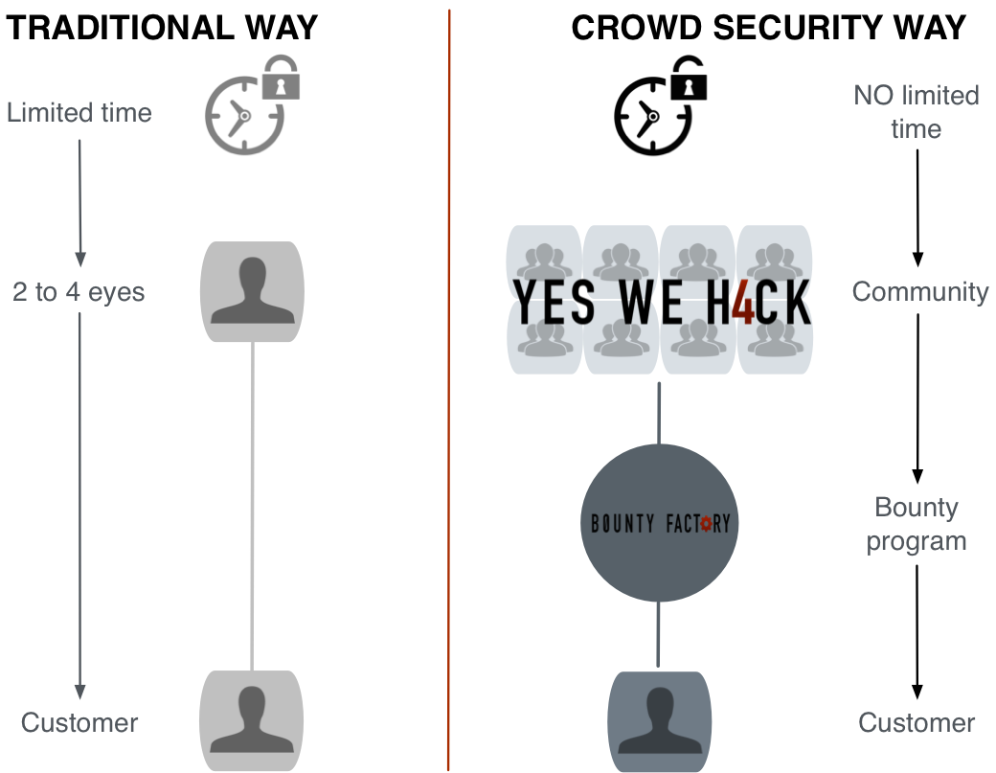
Bug bounties

Slide 3
Problems with Bug bounties
Unaligned incentives (exploit $$$ > bounty $)
Time lag between reporting and action
No fair exchange: bounty admin may not pay!

Slide 4
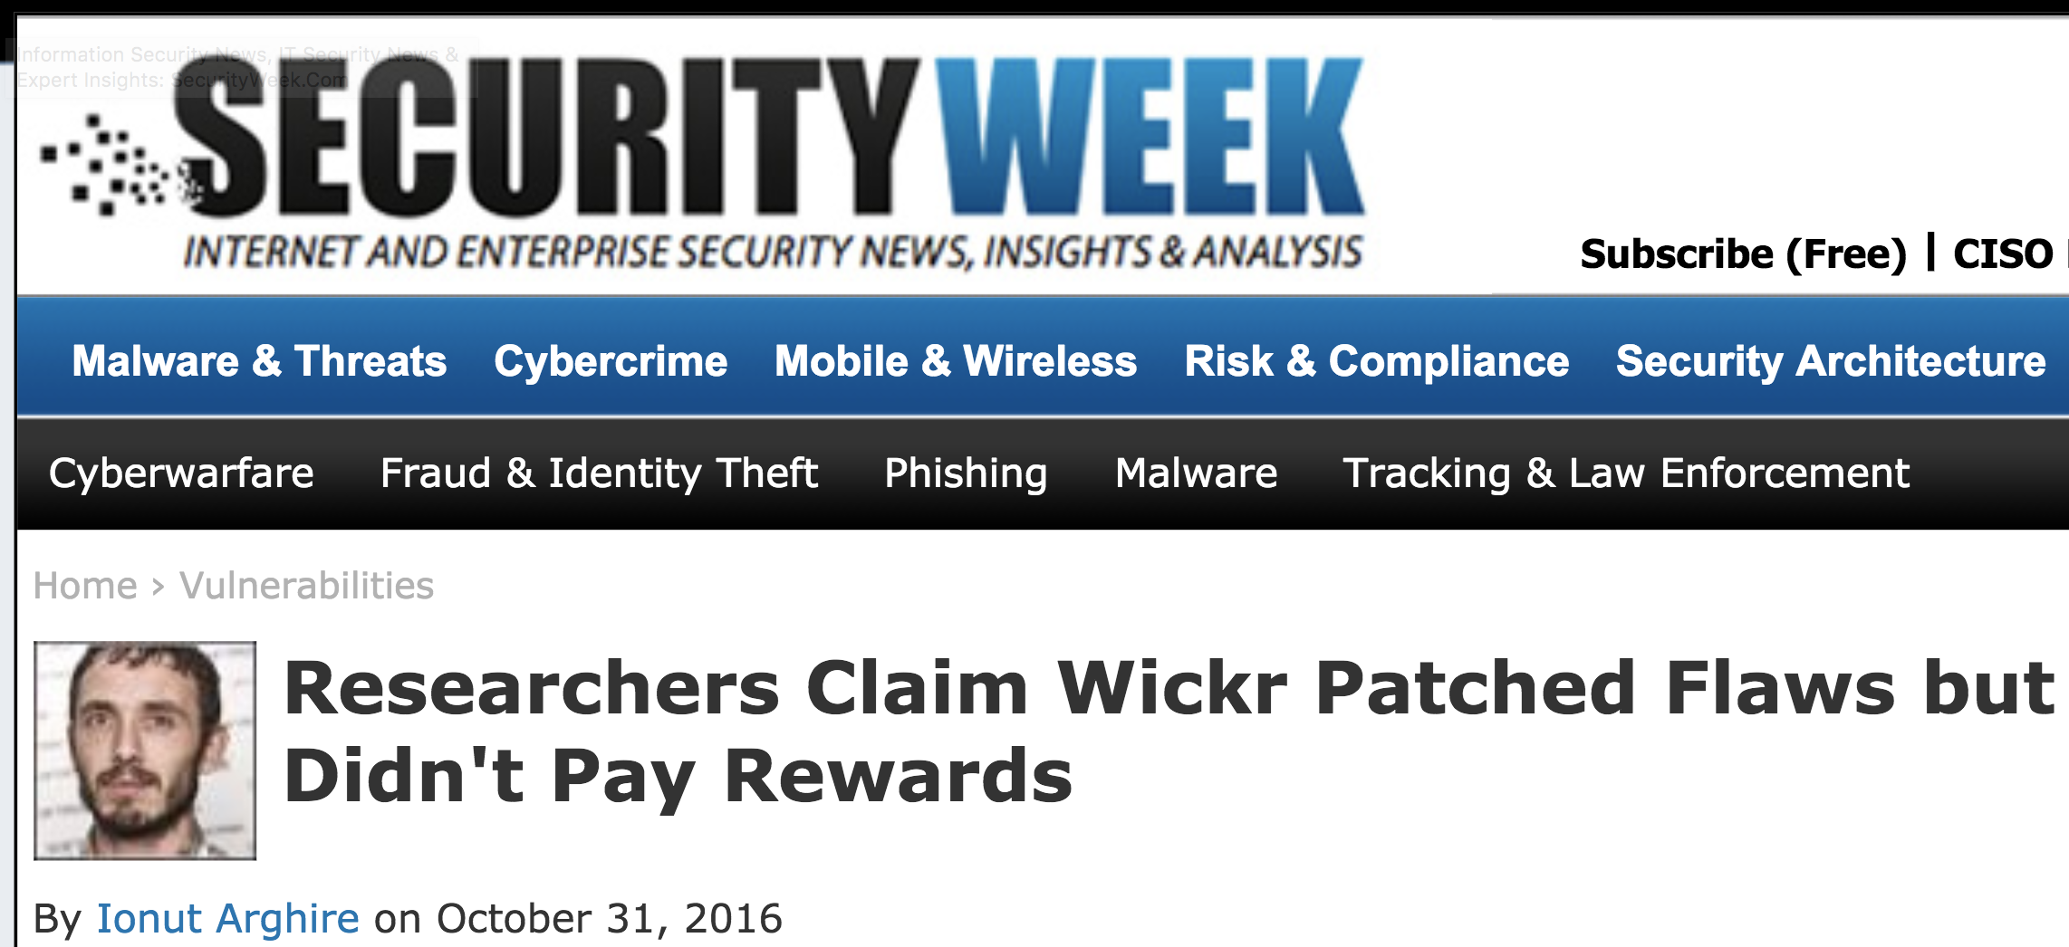
Problems with Bug bounties
Unaligned incentives (exploit $$$ > bounty $)
Time lag between reporting and action
No fair exchange: bounty admin may not pay!

Slide 5

The perfect bug bounty
“Strong exploit gap”: Small bounty incentivizes disclosure for valuable program
Automatic remediation: Immediate intervention in affected software
Automatic payout: Bounty hunter need not trust bounty administrator to pay
  Censorship-resistant, verifiable

Slide 6
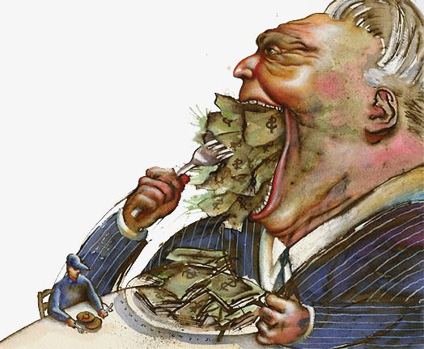
Why bug bounties?
The
rational attacker’s
game

Slide 7
Why bug bounties?
The
rational attacker’s
game
No bounties
Exploit!!
Attack
Disclose
$A
$0

Slide 8
Why bug bounties?
The
rational attacker’s
game
No bounties
Exploit!!
Attack if $A > $0
Always attack
Attack
Disclose
$A
$0

Slide 9
“Good enough” isn’t good enough
The
rational attacker’s
game
Classic bounty
Unknown payout
Exploit!!
Attack
Disclose
$A
$??

Slide 10
“Good enough” isn’t good enough
The
rational attacker’s
game
Classic bounty
Unknown payout
Exploit!!
Attack if $A > $??
Attack
Disclose
$A
$??

Slide 11
Towards a better game
The
rational attacker’s
game
Classic bounty
Known payout
Exploit!!
Attack
Disclose
$A
$B

Slide 12
Towards a better game
The
rational attacker’s
game
Classic bounty
Known payout
Exploit!!
Attack if $A > $B
Attack
Disclose
$A
$B

Slide 13
The ideal game
The
rational attacker’s
game
Hydra bounty
Known payout
Gap to exploit
Exploit!!
Attack
Disclose
$A
-$C
$B

Slide 14
The ideal game
The
rational attacker’s
game
Hydra bounty
Known payout
Gap to exploit
Exploit!!
Attack if $A-$C > $B
Attack
Disclose
$A
-$C
$B

Slide 15
The ideal game
The
rational attacker’s
game
Hydra bounty
Known payout
Gap to exploit
Exploit!!
Attack if $A-$C > $B
So, raise $C….
Attack
Disclose
$A
-$C
$B

Slide 16
… mind the gap!
We call this
barrier ($C) an “exploit gap”
Exploit!!
Attack
Disclose
$A
-$C
$B

Slide 17






Notes:
For the answer, we need to go back to an idea that was popular in the 1980s

Slide 18
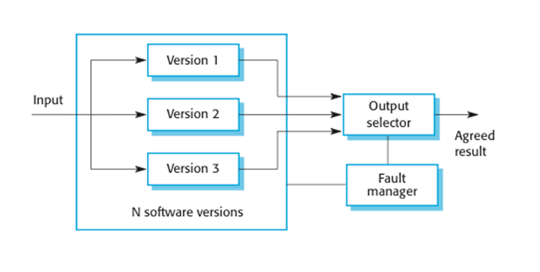
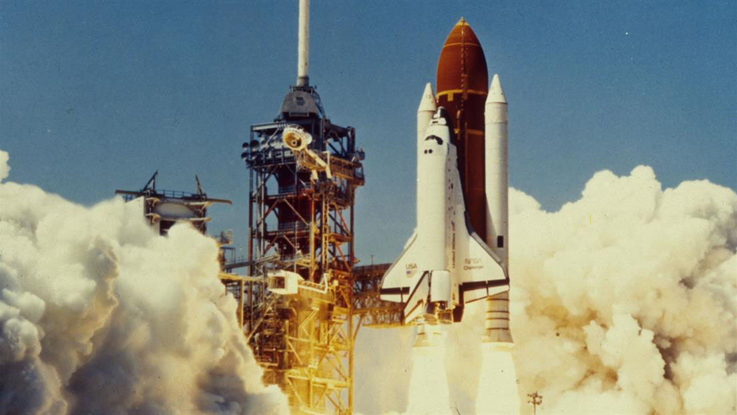
Exploit Gap through Hydra Contracts
Chen & Avizienis, ‘78

Slide 19
… Houston we have a gap
(only one contract has bug)

Slide 20
… Houston we have a gap
(contracts have different bugs)

Slide 21
… Houston we have no gap! Hydra fails!
(all contracts have same bug)

Slide 22
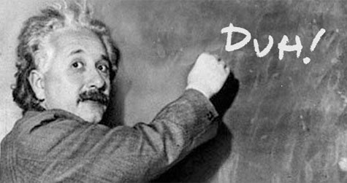

N-Version Programming Criticism
Analysis assumes full independence of faults (correlations are annoying!)
Knight-Leveson (‘86):
« We reject the null hypothesis of full
independence at a p-level of 5% »
Eckhardt et al. (’91):
« We tried it at NASA and it wasn’t cost effective»
Worst-case: 3 versions = 4x fewer errors

Slide 23
But not everything is a space shuttle!
«Classical» N-Version Programming: Availability >> Reliability
- Majority Voting: Always available, but may fail often
Smart contracts: do we really car if it’s down for a while?
- N-out-of-N agreement: better no answer than the wrong one
Numbers from Eckhardt et al. look much better:
  - For 3 versions, 30 − 5087 times fewer failures
  (but some loss in availability…)

Slide 24
The perfect bug bounty
✓
“Strong exploit gap”: Small bounty incentivizes disclosure for valuable program
Automatic remediation: Immediate intervention in affected software
Automatic payout: Bounty hunter need not trust bounty administrator to pay
  Censorship-resistant, verifiable

Slide 25


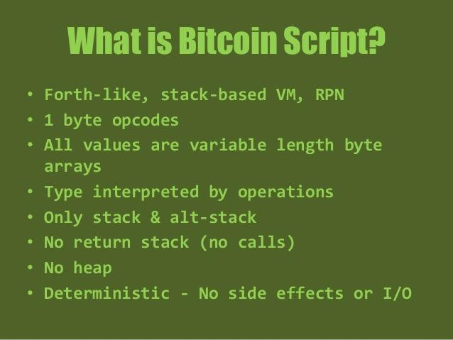

Target Application:
Smart Contracts

Slide 26
Smart contracts are the perfect target
Small programs with astonishing value per line of code
Hydra friendly bug remediation (return money, put in escrow etc)
Automatic bounty payment possible
Bonus: automatic assesment of value at risk
Token | Lines of Code | Value per line
OmiseGo | 396 | ~$1.59M
Tether | 423 | ~$1.11M
EOS | 584 | ~$1.01M
Sources: coinmarketcap.com, 3 Nov., 8:20 a.m. and published contract source code
Sources: coinmarketcap.com, 3 Nov., 8:20 a.m. and published contract source code
Sources: coinmarketcap.com, 3 Nov., 8:20 a.m. and published contract source code
Sources: coinmarketcap.com, 3 Nov., 8:20 a.m. and published contract source code
Sources: coinmarketcap.com, 3 Nov., 8:20 a.m. and published contract source code
Sources: coinmarketcap.com, 3 Nov., 8:20 a.m. and published contract source code

Slide 27
The perfect bug bounty
✓
“Strong exploit gap”: Small bounty incentivizes disclosure for valuable program
Automatic remediation: Immediate intervention in affected software
Automatic payout: Bounty hunter need not trust bounty administrator to pay
  Censorship-resistant, verifiable
✓
✓

Slide 28

Development Challenges
Coordinating multiple smart contracts:
        - The coordinator should be bug free => simple proxy behavior
  - Maintain consistent blockchain state
  - How to recover from a discovered bug => escape hatches
Frontrunning (as always…)
- Attacker can break the exploit gap by witholding bugs
  - Search for full exploit until someone tries to claim a bounty
  - Solution: Submarine sends!
  http://hackingdistributed.com/2017/08/28/submarine-sends/

Slide 29
Bug Withholding and Commit-Reveal
        Sol 1: To claim bounty at time T, must commit to bug at time T- 1
        Problem: Attacker commits in every round and only reveals if someone else does
        Sol 2: To commit, you must pay $$ (in a verifiable way)
        Problem: Attacker commits if someone else also commits
        Sol 3: Hide commitments (e.g., proof of burn to random address)
        Problem: Wasteful

Slide 30
Submarine Sends (post-metropolis version)
Goals: (1) only allow committed users to send a transaction to C
(2) being eternally committed is expensive
(3) attacker can’t know if someone has committed
(4) money isn’t wasted
Submarine sends:
Phase 1: compute addr = H(C || nonce || code) and send $$ to addr
Phase 2: reveal addr to C.
C verifies that addr got $$ in Phase 1
C creates a contract with the specified nonce and code
C collects $$ and allows transaction
addr: {
BAL: $$
CODE: ø
}
addr: {
BAL: $$
CODE: code
}
send $$ to C

Slide 31
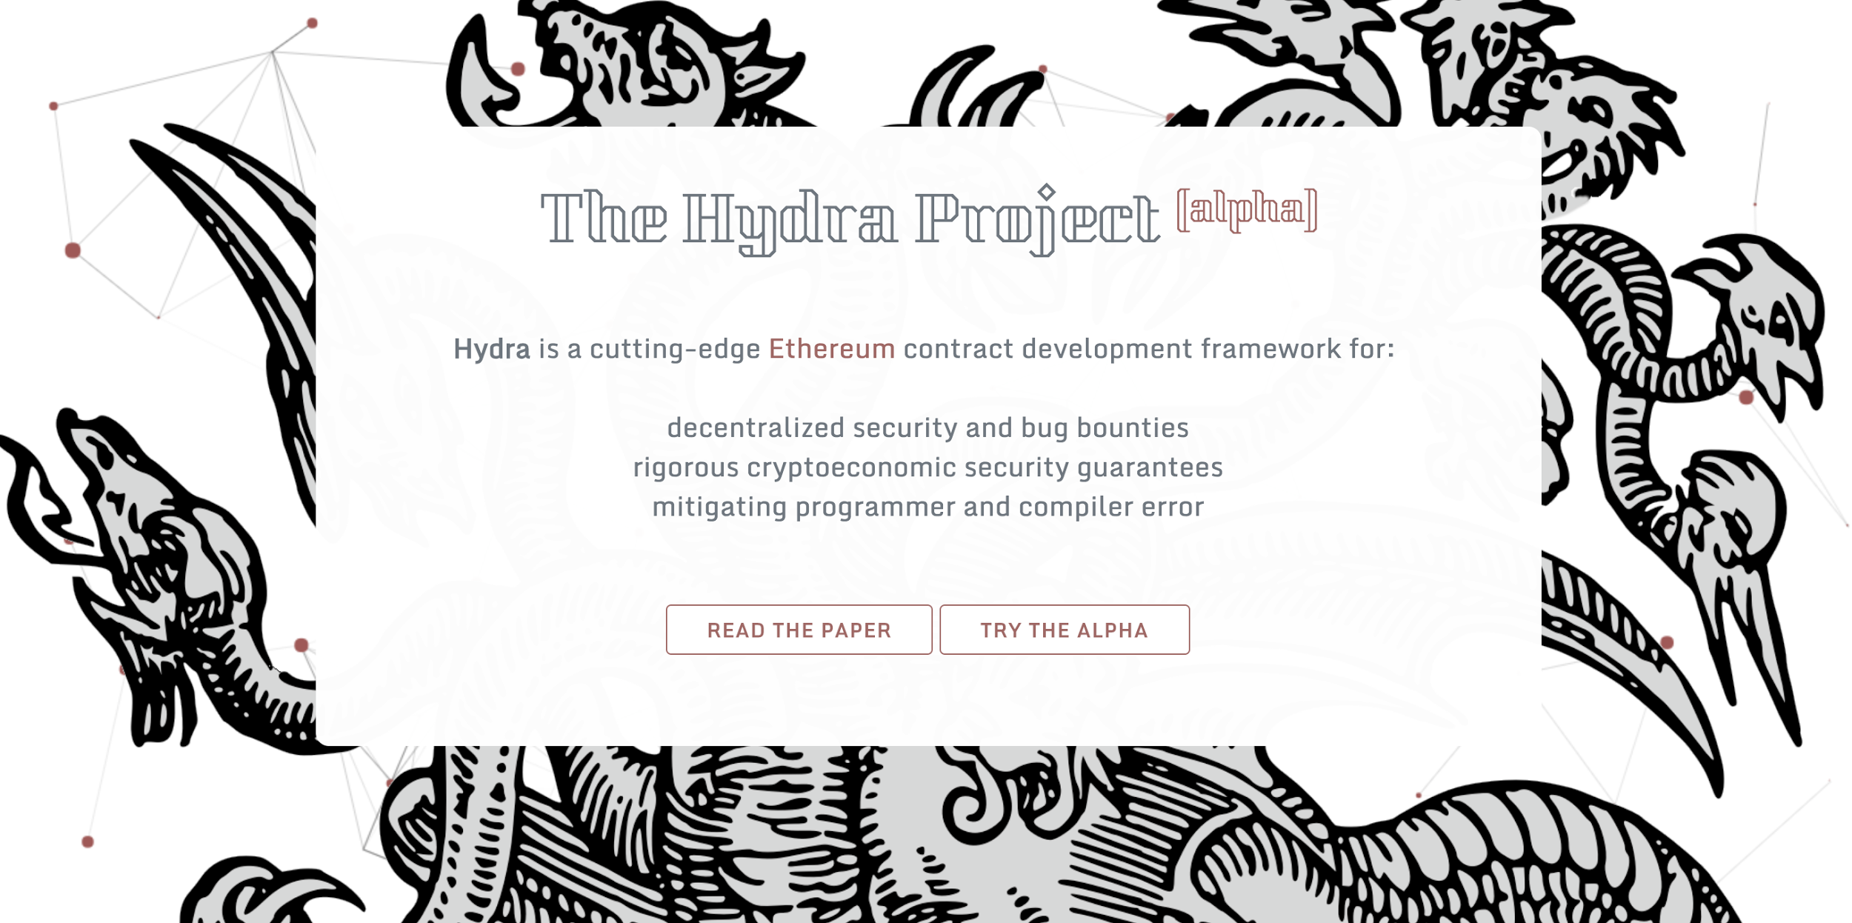
www.thehydra.io
Notes:
The paper is available, as well as code for our ERC20 and Monty Hall hydra contracts. The ERC20 contract is running on Ethereum with a bounty attached.

