Slide 1
Does Adversarial Machine Learning Research Matter?
Florian Tramèr
Stanford University
Notes:
Hi everyone, I’m Florian.
I’d first like to thank the workshop organizers for this nice award and for inviting me to give this talk.
I very recently defended my thesis on adversarial machine learning, and so I thought this could be a good opportunity to take a step back and reflect a bit on what we’ve achieved as a community over the past few years, and where to go next.
So I gave my talk this somewhat ominous Title: does adversarial ML research, this research that we’re all doing and which is why we’re here today, does it matter?

Slide 2
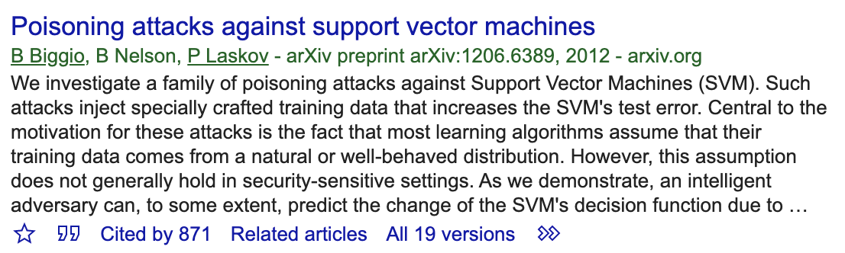
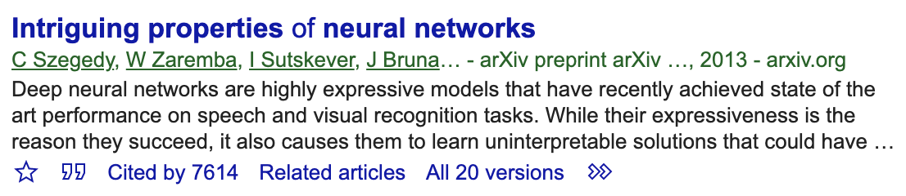
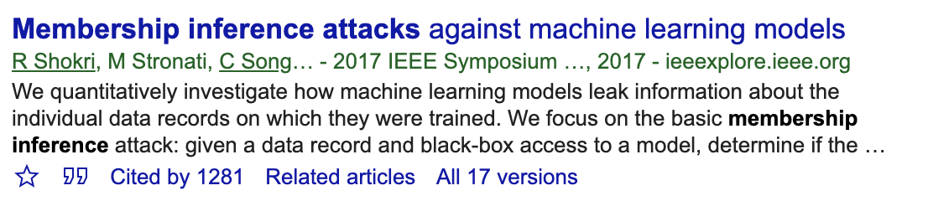
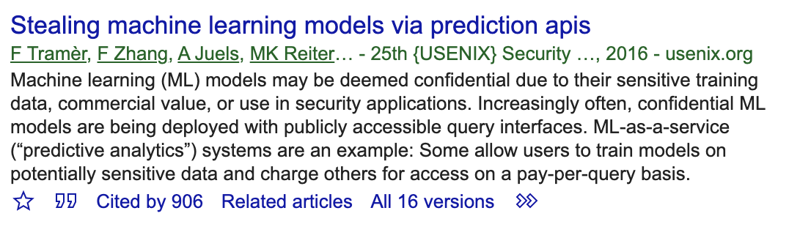
Attacking ML models is popular.
Evasion
Poisoning
Data Inference
Model Stealing
Notes:
One thing undeniable: is that adversarial ML research, and in particular attacking ML models, is popular.
There’s a variety of attacks that have been proposed over the past years, such as evasion, poisoning, data inference, model stealing
And they’ve all led to a huge amount of follow-up work, on attacks and defenses

Slide 3
My talk: “Does Adversarial ML Research Matter?”
Betteridge law of headlines: No
Intentionally a little controversial!
  We’ve done great research so far ☺
  Attacks gives us a sense of what bad things could happen
  But we could & should do a lot more for “real” security!
Notes:
- And yet, in this talk I’m going to ask “does this research matter”?
Usually when one phrases a title as a question, that means that the answer is No. In journalism they call this the Betteridge law of headlines.
So today I’m actually going to defend this somewhat controversial take, that this research we’ve done so far doesn’t matter
And by that I don’t mean to denigrate any of the research we’ve already done in this space, which I think is great and has given us a sense for how vulnerable ML models could be. But I want to argue that we should try to go beyond that and treat adversarial ML as a real security problem.

Slide 4
A blueprint for cool security attack research:
(in my opinion)
Take something “real” that many people use (or will use)
Show how to break it
Ideally, show how to redesign it in safer way
Notes:
So what does it mean to me, to do real security research. I’m going to focus here on attacks.
To me a cool security attack is one that takes some real system that people already use, or where there’s evidence that the system will be used in the future, and then shows how to break this system. And ideally after that we’d obviously also find ways to make better systems.

Slide 5
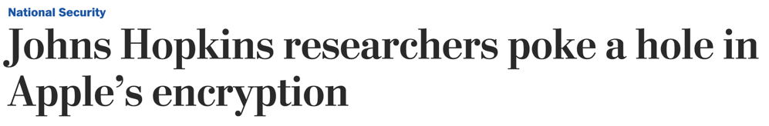

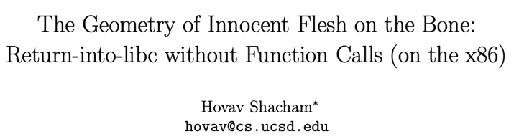
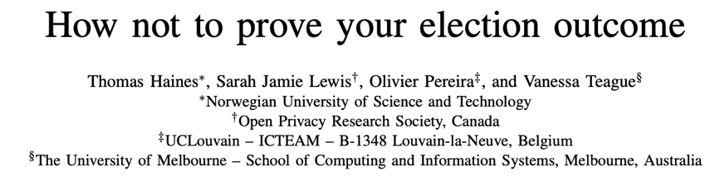




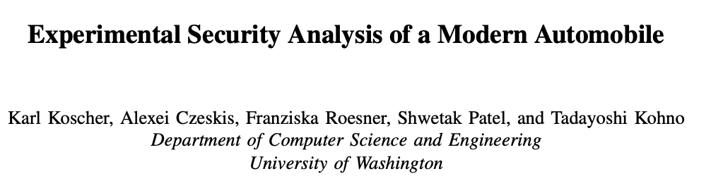
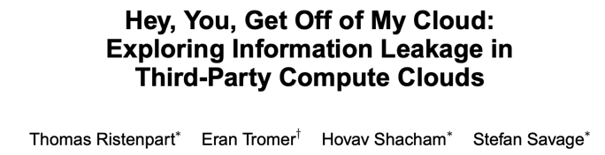
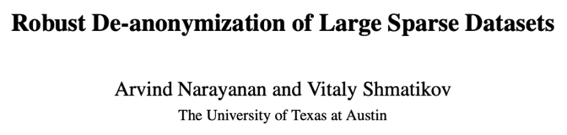
Notes:
And here are just some examples of my favorite security attacks from the past decade or so. I’m sure I’m missing a bunch of cool ones.
Even if you don’t work in security, you’ve probably heard about some of these like heartbleed or spectre.
And really what all these attacks have in common is that they target a real system used by many people.
The authors of the spectre paper didn’t design their own hardware that’s sort of maybe roughly like a real Intel processor. No they attacked an actual real Intel processor.
Heartbleed wasn’t an attack on a protocol like TLS, it was an attack on the TLS protocol as implemented in OpenSSL.
Not all of these attacks are super practical. Many of them are actually really hard to pull off, but they target a real system.

Slide 6
Where are the “real” attacks on ML?
Take something “real” that many people use (or will use)
Show how to break it
Ideally, show how to redesign it in safer way
Notes:
And I argue that we do not yet have many examples of such attacks in the adversarial machine learning literature.
Because what we’re missing is this crucial first step: where we target a real security system, and not some artificial system we’ve come up with

Slide 7
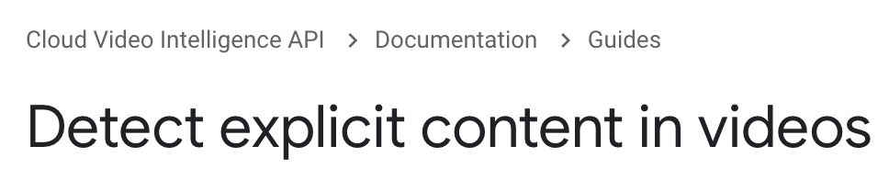
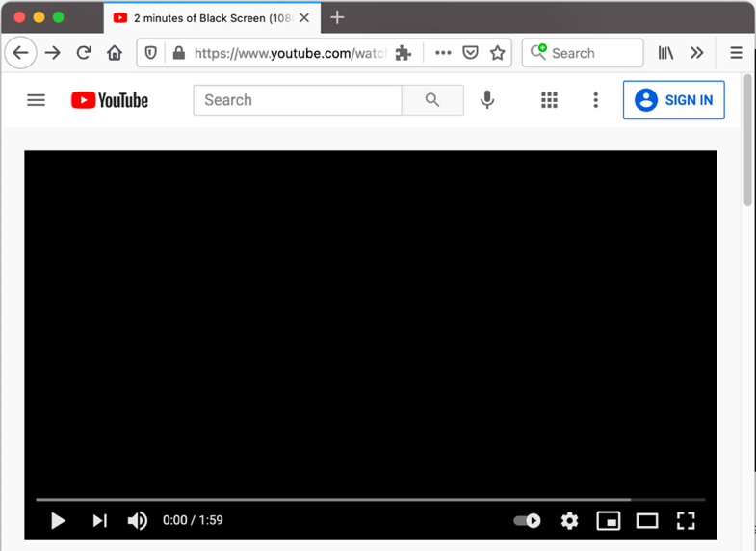

Can we evade a real security model?
Notes:
This means that despite all this attack research we’ve done so far, it’s actually pretty hard to say whether we could use these techniques to attack a real security-sensitive model. Say like Youtube’s content filtering. As far as I know, no one’s demonstrated how to do this.

Slide 8

Can we poison a real security model?
Notes:
The same goes for poisoning attacks. How would one go about poisoning Youtube so that it would block all of Justin Bieber’s videos?
This is a bit of a stupid example, but still it’s a “real” attack on a real system.

Slide 9
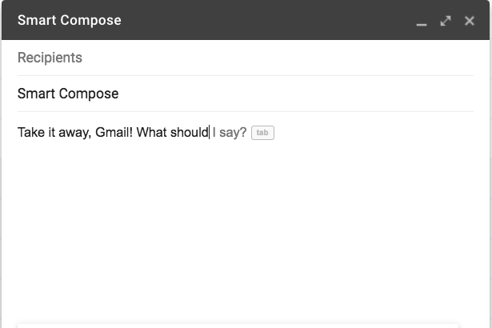
Can we extract real user data?
Notes:
We can ask the same questions about privacy: could we mount an attack on a real model to extract actual user data?

Slide 10
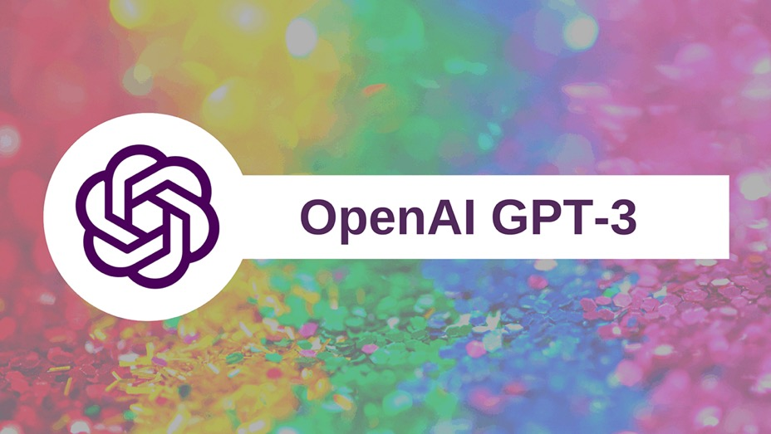
Can we steal a real model?
Notes:
Or we might wonder whether it is actually possible to steal a proprietary model like GPT-3 in order to use it without paying for queries.

Slide 11
Attacking “real” things matters!
Current attacks are not well suited for attacking “real” ML models.
  Maybe we’re making a fuss for nothing?
  Maybe real attacks work with enough tricks?
  Maybe we can design pragmatic defenses?
Notes:
And this research on real attacks, that is currently missing, really matters.
Because, as we’ll see, our current attack techniques are not actually very well suited for attacking real systems.
And so it’s not clear whether we might be making a fuss for nothing for some of these attacks. Maybe it’s actually really hard to pull an attack off in reality, and so we don’t need to invest as much time looking for defenses.
It’s also possible that attacking real systems does work, but it requires a bunch of different tricks. And this in turn might mean that there are pragmatic ways of designing defenses, that might not work when you just consider machine learning models in isolation, but that are helpful in real systems.
And these types of questions are largely not addressed by our current research.

Slide 12
Evasion
Poisoning
Data Inference
Model Stealing
Notes:
So I’m now going to illustrate this gap between research attacks and real-world attacks for these 4 specific classes of attacks.
I’ll focus mainly on evasion attacks and poisoning attacks, and briefly talk about data inference and model stealing towards the end.

Slide 13
Evasion
Poisoning
Data Inference
Model Stealing
Notes:
So let’s start with evasion attacks.

Slide 14

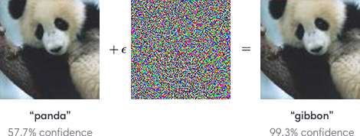

Evading research models vs. real systems
How do we go from this...
...to this?
Notes:
Basically, the question I’m interested in here is how we go from the types of attacks that we currently focus on in academic research, to a real evasion attack on a real security system that services billions of users.

Slide 15
Evading research models vs. real systems
Research: “imperceptible” perturbations
~95% white-box attacks/defenses
~5% black-box with query access
<1% black-box w.o. query-access
Real systems: >99% black-box w.o. query-access
attacks need not be imperceptible
Notes:
And this is actually quite hard to do.
Because research on adversarial examples, for better or worse, tends to focus on a very specific attacker model.
I would estimate that about 95% of papers on this subject consider these kind of imperceptible pixel-level perturbations like the panda on the previous slide, in a setting where the attack has complete access to the model (we call this a white-box attack).
Then there’s a small number of papers, maybe 5%, that looks at black-box attacks where the attacker can only interact with the model via a query interface.
And maybe less than 1% of papers consider a fully black-box setting.
Now if we look at real ML systems, it’s kind of the opposite. I would estimate that 99% of these systems are complete black-boxes to which you cant get direct query access. And on top of this, for most of these systems there are viable attacks that are not necessarily imperceptible.
So there’s a clear gap here. So how do we reconnect this?

Slide 16
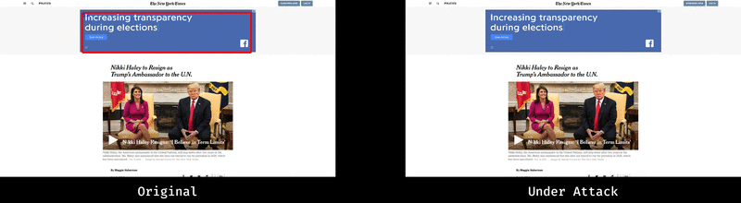
A “real” white-box imperceptible attack: ad-blocking
“AdVersarial: Perceptual Ad Blocking meets Adversarial Machine Learning”, ACM CCS 2019
Notes:
Well one option would be to look for a real security system that is white-box and where imperceptible perturbations matter.
This is actually what my coauthors and I did 2 years ago, when we demonstrated evasion attacks against ML-based ad-blockers.
Ad-blockers are quite peculiar as far as security systems go, because they operate client-side, and so it’s very hard to hide the model from the attacker.
And another peculiarity of ad-blocking is that there’s always a human involved. The goal of the attacker is to evade an automated blocking system, to show ads to an end-user. And so imperceptibility of attacks kind of matters here.

Slide 17
A “real” white-box imperceptible attack: ad-blocking
Take something “real” that many people use (or will use) might possibly use one day
“AdVersarial: Perceptual Ad Blocking meets Adversarial Machine Learning”, ACM CCS 2019
Notes:
And still, I would say that here the setting we considered was still somewhat artificial, because no one’s actually using ML for ad-blocking today.
There’s been some proposals to do this, but we didn’t attack any real systems in this paper.

Slide 18
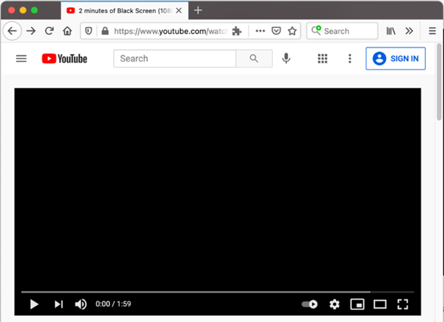

Most real systems are black-box.
Challenge: attack something like this
Not just an engineering exercise!
  you don’t get direct query access...
  you get banned after a few positive queries...
  you likely can’t build a good surrogate model...
Notes:
So the other direction then would be to take a real system, again think of Youtube’s content filtering, and attack that.
And I claim that this is really isn’t just an engineering exercise. This system’s a black-box, you don’t know exactly what kind of techniques are used. And you cannot directly query it either. You could try to upload videos and then see if they get banned, but if you do this a few times your account will get locked.
So you might think of doing some kind of transfer-based attack. But it’s also not clear how you would build a good surrogate model yourself.

Slide 19
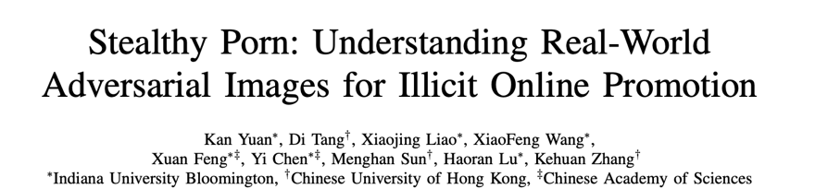
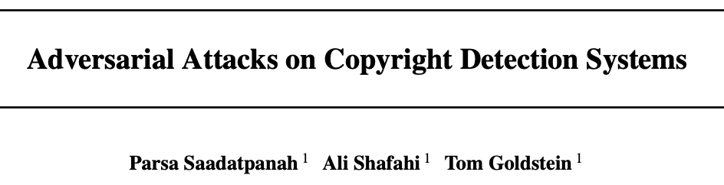
Many research opportunities!
Show how to systematically evade a real model
Notes:
So showing how to systematically evade a real model is a really cool research direction I think.
I want to highlight a few works in this space that already exist. There’s been some successful attempts at using transfer attacks for porn filters, and for copyright detectors, but these attacks are still far from as good as what we’ve come to expect from white-box attacks. So it’s really interesting to see how far a practical attack could actually go.
There’s also some cool stuff happening on this front from industry, like the adversarial threat matrix that compiles known incidents of real ML attacks.
There’s also an ongoing competition sponsored by Microsoft that looks at realistic adversarial malware attacks and defenses, that is worth taking a look at.

Slide 20
Many research opportunities!
Show how to defend a real model
adversarial training,
interval-bound propagation,
randomized smoothing, etc.
are likely not the answer!
Notes:
I think there’s also a lot of interesting research questions here on the side of defenses for real systems.
Because the attacks faces by these systems are presumably quite different in nature from you standard worst-case white-box attack, the type of defenses you’d likely deploy are also going to be different. And there not much research going on yet on this front.

Slide 21
Very recent example: Apple’s CSAM detection
Uses ML to assign a “fingerprint / hash” to images
Goal: hash is robust to small changes, few collisions
Notes:
To conclude on this topic of evasion attacks, I wanted to highlight one specific recent example that I think clearly illustrates the gap between research and practice.
You’ve probably heard of Apple’s recent announcement that it was going to start scanning pictures for child-abuse material.
Basically the way this works is that they run your images through a ML model to compute a fingerprint or as hash, and they then compare this hash to a database of known pictures of abuse. And of course a goal of this hash is that is should be robust to small changes to images, so that you cant just easily evade detection.

Slide 22
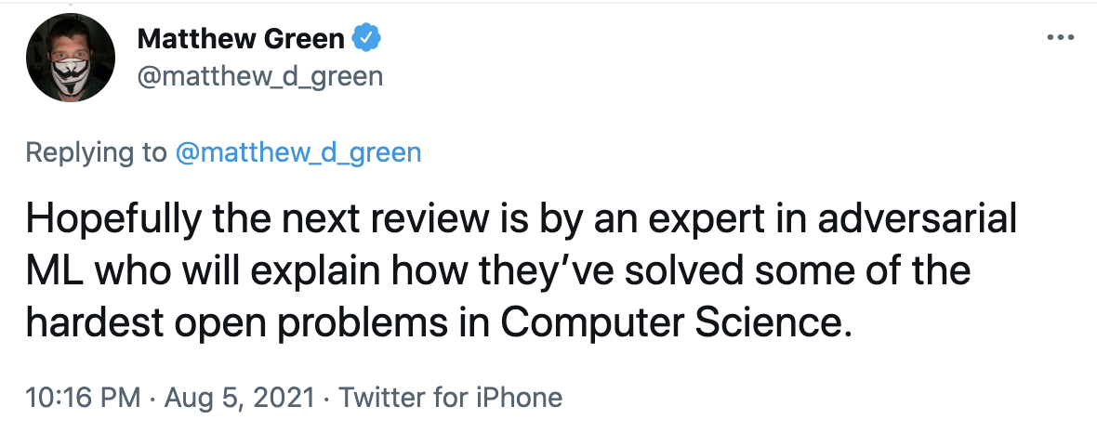
Very recent example: Apple’s CSAM detection
what would we say?
Apple’s hashing algorithm is likely not robust
Does that necessarily mean there’s a practical attack?
Notes:
Apple’s announcement started quite a big controversy around data privacy, but there were also questions about how robust this system would really be to attacks.
And it worries me a bit that despite the fact that we’ve written thousands of papers on adversarial examples at this point, it’s actually really hard to give an answer to this question.
Because I’m fairly certain that Apple’s machine learning model that they use for this image hashing is not robust white-box attacks. But does this necessarily mean that there’s an actual practical attack one could launch against this model if it’s just a black-box? It’s kind of hard to say.
And that’s why I think we need more research on attacking real systems, so we get a better sense of how feasible this actually is.

Slide 23
Evasion
Poisoning
Data Inference
Model Stealing
Notes:
Let’s now move on and talk about poisoning attacks.
There’s maybe not been a thousand papers on this topic just yet, but certainly hundreds on how you can tamper with a model’s training data to cause it to misbehave.

Slide 24





Why did no one poison GPT-X, Copilot, etc?
(as far as I know)
Notes:
And so you could wonder then, well why didn’t anyone actually demonstrate a poisoning attack against say GPT-2, or GPT-3, or Github’s recent copilot model?

Slide 25
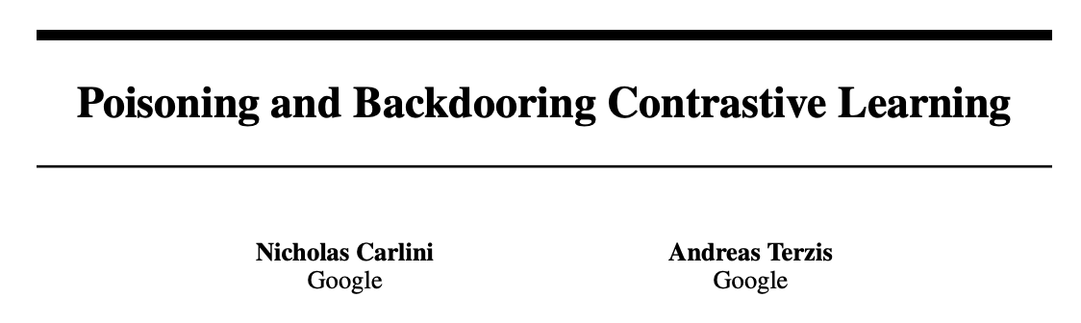
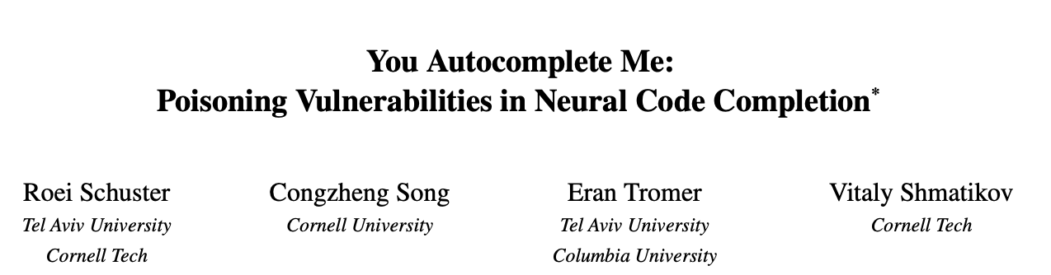
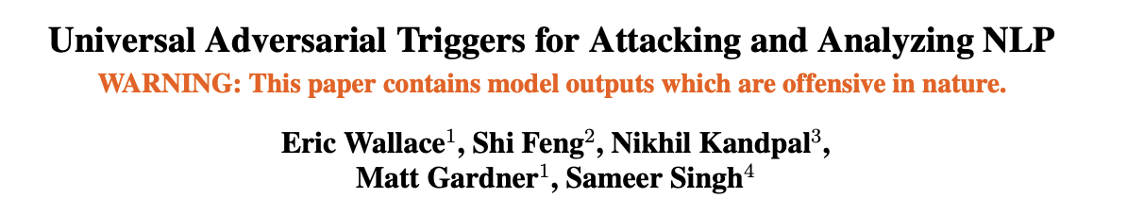
Poisoning these models is possible.
(in principle)
Notes:
We certainly believe that such attacks would be feasible, and yet I think we would learn a lot from just going and actually trying to run such an attack in a real-world scenario, where you typically don’t know a priori what kind of model is going to be trained on your data.

Slide 26

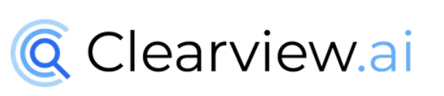
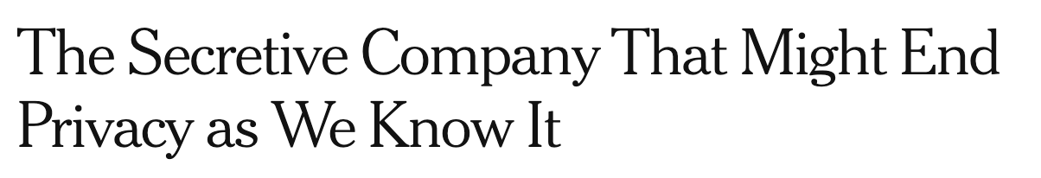
A real example: poisoning facial recognition models
Notes:
There’s actually one specific attempt at poisoning real-world systems that I want to discuss here, because I think it nicely shows how careful you have to be when moving from a research attack environment to a real system.
This example deals with facial recognition systems.
You might have heard of Clearview.ai, a company that made headlines a few years ago because they trained large-scale facial recognition system by scraping public pictures from the Web, and the then sold this system to law enforcement agencies

Slide 27











A real example: poisoning facial recognition models
Users perturb pictures they post online
Online pictures are scraped to build a model
Unperturbed test pictures aren’t recognized
???
Unperturbed picture taken by the police, or a stalker, etc.
“Fawkes: Protecting Privacy against Unauthorized Deep Learning Models”, Shan et al., USENIX 2020
“LowKey: Leveraging Adversarial Attacks to Protect Social Media Users from Facial Recognition”, Cherepanova et al., ICLR 2021
Notes:
So some researchers from University of Chicago proposed this neat idea: why wouldn’t we poison these systems.
The way this would work is that whenever you upload a picture online, you first perturb it using an adversarial example.
These pictures would then be collected by Clearview, to train a model.
And the hope would be that when the model is then asked to identify a clean picture of you (say one that was taken by the police), it would fail to recognize you.

Slide 28
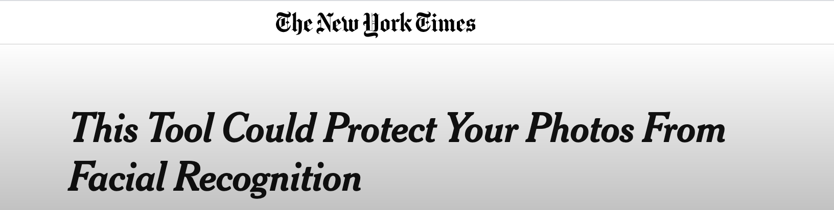
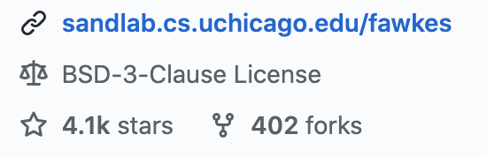

A real example: poisoning facial recognition models
Notes:
This is a natural idea and a cool real-world application of poisoning attacks, and so these researchers actually built a workable tool out of it, that got a huge amount of publicity and has now been downloaded over a half-a-million times.
And this has also prompted follow-up work by other researchers who have proposed similar poisoning attacks aimed at real facial recognition systems.

Slide 29


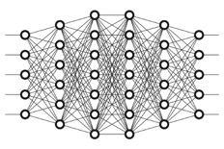
The problem: retroactive defenses
wait one year
Facial recognition provider scrapes pictures produced with attacks that target today’s models
Facial recognition provider trains new SOTA model on poisoned data collected in the past
“Data Poisoning Won’t Save You From Facial Recognition”, https://arxiv.org/abs/2106.14851
Notes:
But recently, with Evani Radyia-Dixit, who is an undergrad at Stanford, we wrote a paper arguing that these attacks weren’t ready for real-world deployment, and that they were luring users into a false sense of privacy.
The core issue that we identified is what we call “retroactive defenses”.
Basically, what Clearview could do is to collect a bunch of pictures today, which might have been perturbed using today’s best attacks.
And then they could just wait one year, and then take whatever the SOTA model is then, and train that model on the data they collected a year before.
And so what this means is that if you want your poisoning attack to be effective, you somehow need to anticipate feature advances in machine learning and ensure that your attack also transfers to future models. And this isn’t something that current research on attacks actually aims for, and we show that current attacks are very unlikely to succeed in staying effective into the future.

Slide 30
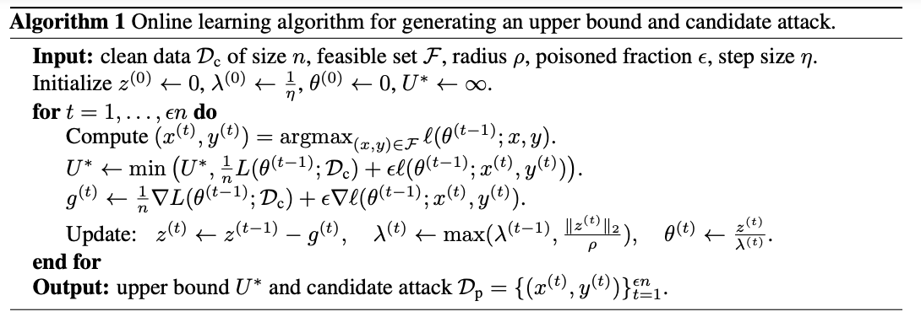
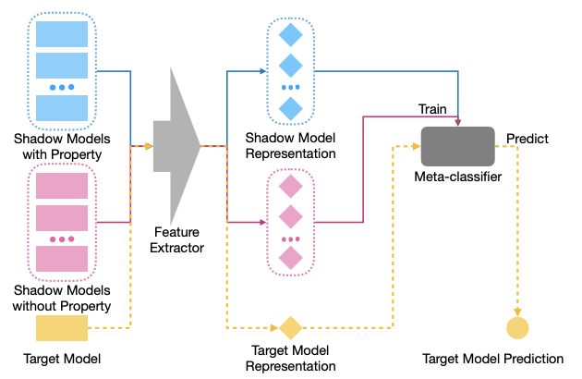
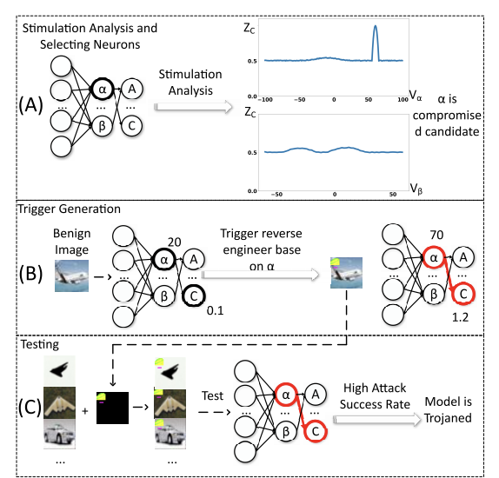
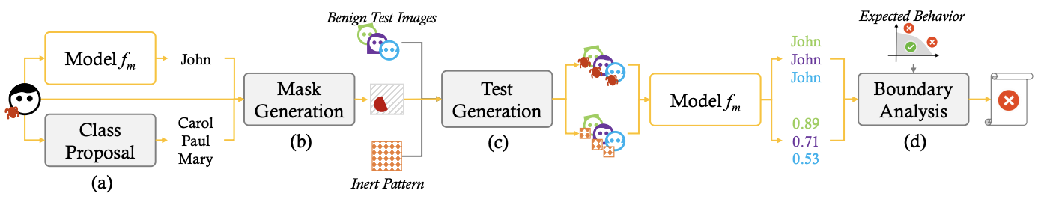
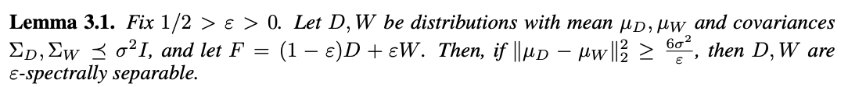
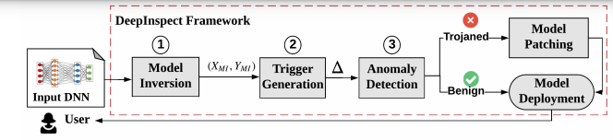
Are poisoning defenses overkill?
Notes:
This idea of a retroactive defense against data poisoning is quite simple, and it’s a defense that only really makes sense when you think of the long-term dynamics of a machine learning system.
In contrast, most research on poisoning attacks and defenses considers a “closed-world” scenario where there’s one training set and the model gets trained on it once.
And this leads to the design of much more complicated defenses, both heuristic and provable ones, with some examples illustrated here.
So I think it’s worth thinking more about what kind of pragmatic defense strategies could exist if we think outside of this closed-world setting.

Slide 31
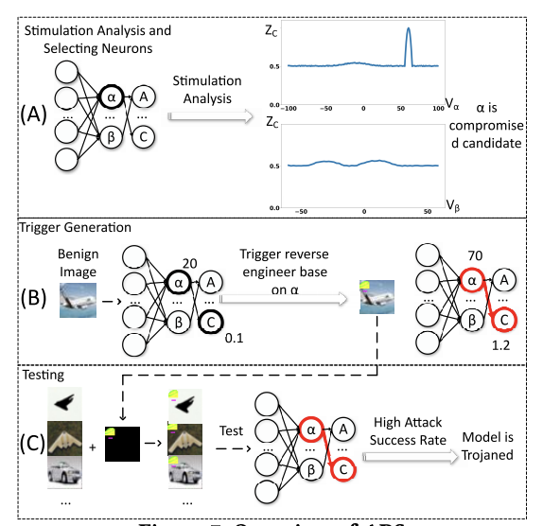
Are poisoning defenses overkill?
ultimate retroactive defense:
only collect training data from before ~2018
Notes:
For example, here’s a really simple yet incredibly strong heuristic baseline defense against data poisoning: just train your model only on data from before say 2018 (which is when the first poisoning attacks on deep learning were proposed).
Now this defense is not always applicable of course. For many applications you need to continuously update your model with new data.
But it goes to show that the design space for defenses of real systems can be much broader than what we may consider in closed-world research experiments.

Slide 32
Many research opportunities!
Better threat modeling for real-world poisoning
Robust attacks against real models
Beyond “closed-world” defenses
  dynamic defenses
  leverage web-ranking methods to filter data?
Notes:
And so again here I think there’s a lot of research opportunities for bridging the gap between poisoning attacks in research and in the real world.
I think it’s worth trying to better understand the actual threat model for poisoning attacks on real-world systems. The attack dynamics here seem to be quite delicate, especially when considering models that can be dynamic and retrain over time.
As for evasion attacks, there are also little to no examples of an actual successful poisoning attack against a real system, and this is definitely something worth exploring.
And finally, as we just saw, there seems to be an interesting design space for real-world defenses against poisoning.

Slide 33
Evasion
Poisoning
Data Inference
Model Stealing
Notes:
Data inference is the setting where I’ll have the least to say, because here I think that the threats identified in academic research can be quite close to the threats that a real system would face.

Slide 34
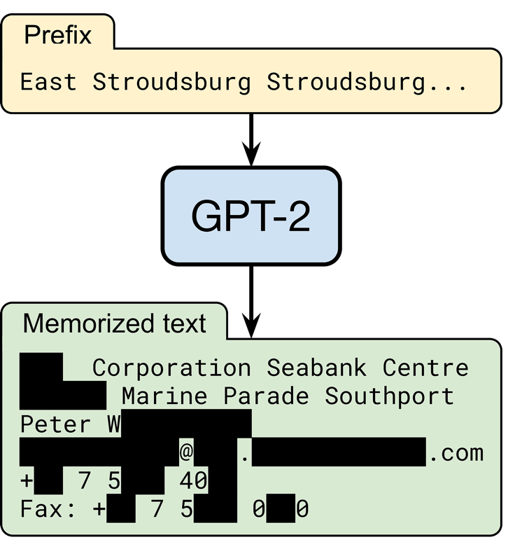
Extracting public data from a “real” model.
random input
OpenAI’s language model trained on text from 8 million web pages
someone’s contact information
output by the model
(redacted for privacy)
“Extracting training data from large language models” (USENIX Security 2021)
Notes:
One of the clearest threats we’ve identified is that generative text models can memorize snippets of training data and output them when given some random prompts.
And here this is getting much closer to what I’d call an attack on a “real” system. Of course GPT-2 is still very much a research model, but the attack principles here are completely black-box and apply to any large language model.

Slide 35
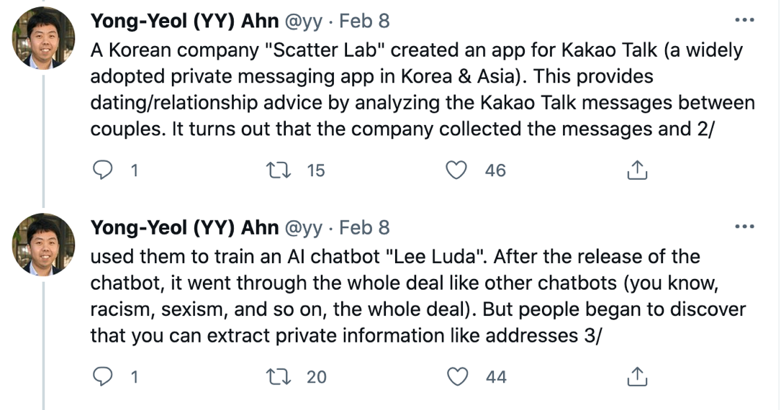
Extracting private data from a real model.
Notes:
And it turns out that these issues are starting to be discovered in models put into production.
For example, there was a Korean messaging app that used private data it collected from users to build a chatbot, and this chatbot then started leaking private information.

Slide 36
Many research opportunities!
extraction of “real” user data?
extraction of non-text data?
  images?
  speech?
  etc.
more pragmatic defenses than differential privacy?
  data de-duplication & filtering?
  detecting data extraction at test time?
Notes:
So I think it’s likely that we’re going to see similar data leaks happening unless companies are very careful in how they train their models.
It would be very interesting to see if these extraction attacks could also work for other types of data than just text.
And of course, there’s still a big open question about how to prevent such data leaks. Differential privacy is often suggested as the solution, but it’s currently hard to apply at scale, and there might be some other defense strategies that are possible here.

Slide 37
Evasion
Poisoning
Data Inference
Model Stealing
Notes:
So finally let’s talk about model stealing. I would say that out of the 4 types of attacks listed here, this is probably the one where we face the biggest hurdles towards seeing a practical attack, because even in research settings, copying a model’s functionality is quite hard to do.

Slide 38
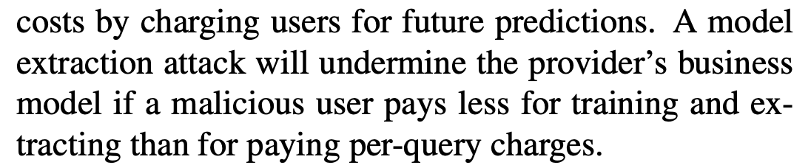
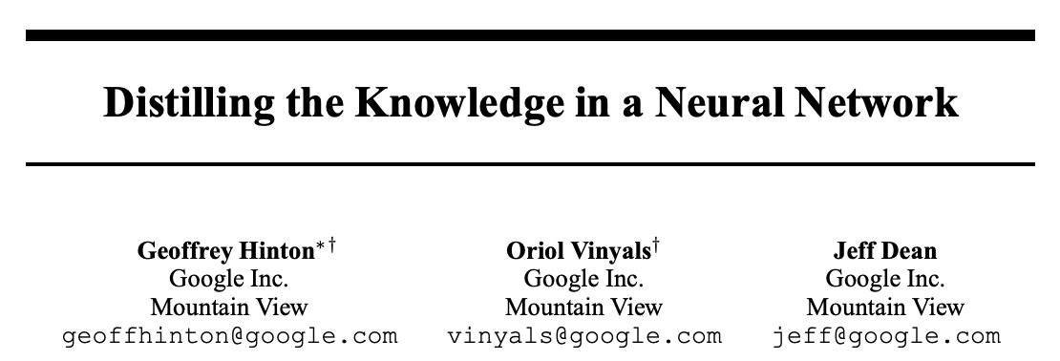

Stealing a pay-per-use model.
“Stealing Machine Learning Models via Prediction APIs”
x, $
f(x)
Notes:
The threat we had originally considered in our paper five years ago, was that you could undermine a pay-per-use API by querying some black-box model a bunch of times (and these are queries you have to pay for), and then you would locally reproduce the model and from there on stop paying for queries.
The principle that’s being exploited here is basically model distillation. If you can query the API for richer information than just labels, say for the model’s internal representations, then empirically we know that you can replicate the model very efficiently.

Slide 39
Could it be practical to steal GPT-3?
Replicating GPT-3 from scratch: ~ $5M in cloud GPUs
Could some form of distillation + active learning be cheaper?
Querying GPT-3 on 10% of its training data: ~ $3M
Source: https://lambdalabs.com/blog/demystifying-gpt-3/
Notes:
So how feasible would this be today?
Let’s take a look at GPT-3, where we have a reasonable understanding of the different costs involved, and all the training data is already public.
It’s estimated that to replicate GPT-3 yourself by training the model from scratch, you’d need to spend about 5million in cloud GPU costs.
So the question then is whether you could reduce this cost by leveraging the fact that you can query GPT-3, and use this to do some form of model distillation.
But querying GPT-3 is actually quite expensive. If you paid 3million dollars, you could obtain GPT-3’s internal representations for just 10% of its training data. And then you’d still need to pay for the cost of training your local model with distillation.
So overall, it’s not quite clear whether a cost effective model stealing attack would be possible here.

Slide 40
Many research opportunities!
better model stealing in a research setting
stealing a “real” model
economics of extraction
Notes:
So here also I think we have quite a gap to close between model stealing as a research problem and as an actual practical attack vector.
First, I think that there’s still a lot of unexplored territory here even from a research setting. Compared to the other classes of attacks we’ve discussed (evasion, poisoning, and data inference), I would guess that model stealing has comparatively received a lot less attention.
And if we find some good attacks, then again it is worth finding out how these attacks would really work in practice, and at what query prices model extraction can really become viable.

Slide 41
Take-aways
We’ve written >10K papers on worst-case attacks
  We know: in principle, any model can be attacked
  We know: the strongest attacks are hard to prevent
What’s next?
  We don’t know: what do real attacks look like?
  We don’t know: can we develop pragmatic defenses?
Notes:
So with this I’ll conclude my talk by re-iterating that there’s been a lot of very cool research on adversarial ML so far, from which we’ve learned that in principle any model can be attacked if you give the adversary enough access, and that it’s very very hard to prevent the strongest possible attacks.
And this gives us an upper bound on how vulnerable ML systems can be. But we don’t quite know how tight this upper bound is,
because these strong attacks aren’t really realistic in the vast majority of practical settings. So there’s a big open question of what real attacks and defenses on ML systems should look like. And I really hope that our field can answer some of these questions over the next few years.
Thanks!

