Slide 1
GasToken: A Journey Through Blockchain Resource Arbitrage
Florian Tramèr Joint work with Phil Daian, Lorenz Breidenbach, Ari Juels

Slide 2
Imagine if…
Monday: It’s $4 for the cappuccino… and the transaction fee is $0.10.
Friday: It’s $4 for the cappuccino… and the transaction fee is $6.25.

Slide 3
Transaction fees / Ethereum gas prices are super volatile

Slide 4
Same in Bitcoin…
source: bitinfocharts.com

Slide 5
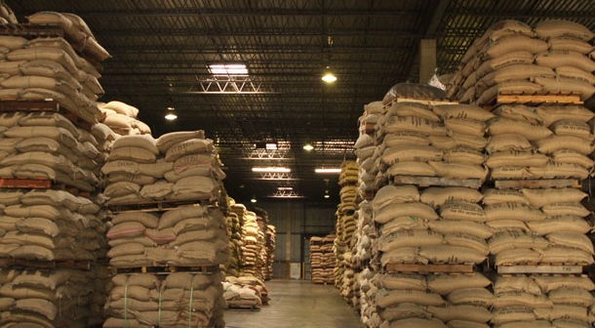
How do ordinary businesses handle volatility?
Stock up when prices are low!
Or buy financial instruments…
How do you “speculate on” or stockpile transaction fees?

Slide 6
GasToken: Stockpiling and trading Ethereum gas
https://gastoken.io

Slide 7
Ethereum Gas
1 GWei = 10⁹ Wei
1 Ether = 10¹⁸ Wei
MyContract
func(x):
a = x + 1
b = hash(a)
Mem[0] = b
3 gas
30 gas
20000 gas
20033 gas
I want to run func(1)
How Much?
User
Miner(s)
1 GWei per gas? (0.00002 eth)
Meh...

Slide 8
Ethereum Gas
1 GWei = 10⁹ Wei
1 Ether = 10¹⁸ Wei
MyContract
func(x):
a = x + 1
b = hash(a)
Mem[0] = b
3 gas
30 gas
20000 gas
20033 gas
I want to run func(1)
How Much?
User
Miner(s)
10 GWei per gas? (0.0002 eth)
OK!

Slide 9
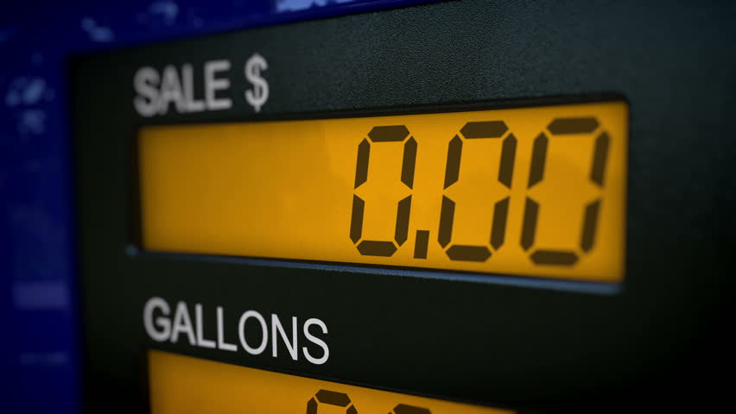
GasToken in a nutshell
Changes to the global state are expensive!
Writing to contract storage, creating a contract
To encourage state cleanup, Ethereum offers gas refunds for:
Released contract storage, destroyed contracts
GasToken part 1: write state when gas price is low
Trade state slots as an ERC20 token
GasToken part 2: erase state when gas price is high
Refund pays up to half of transaction fee
*[caveats]

Slide 10
An Example
Regular
0
0
1
GWei
Store 10 words
Total Gas: 200,000
Price: $0.20
Regular
0
4
0
GWei
Breed kitties
Total Gas: 250,000
Price: $9

Slide 11
An Example
Regular
0
0
1
GWei
Store 10 words
Total Gas: 200,000
Price: $0.20
Regular
0
4
0
GWei
Free 10 words & breed kitties
refund
Total Gas: 250,000 – 100,000
Price: $9 $5

Slide 12
Nifty Details
Two variants of GasToken:
GST1: uses storage, SSTORE(1), SSTORE(0)
GST2: uses contracts, CREATE, SELFDESTRUCT
GST2 more complex but also more efficient
SSTORE: 20k to stock, for 10k refund (50%)
CREATE: 32k to stock, for ~17k refund (53%)
Refund is interesting when gas volatility is >2x

Slide 13
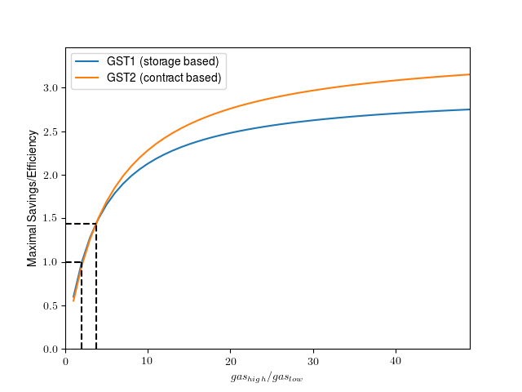
Nifty Details
Two variants of GasToken:
GST1: uses storage, SSTORE(1), SSTORE(0)
GST2: uses contracts, CREATE, SELFDESTRUCT
GST2 more complex but also more efficient
SSTORE: 20k to stock, for 10k refund (50%)
CREATE: 32k to stock, for ~17k refund (53%)
Refund is interesting when gas volatility is >2x
2
3.7

Slide 14
So many 0s...
40 bits

Slide 15
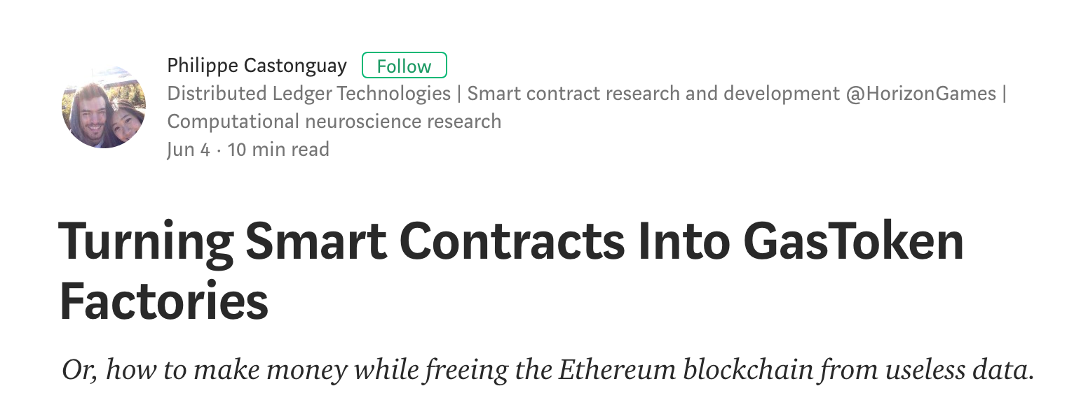
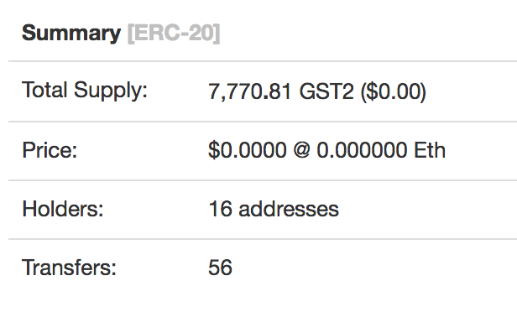
Do people use it?
So far not much…
FCOIN or airdrops might have massively benefited from this, but didn’t
There is some evidence that arbitrage bots are using GasToken-like techniques to boost their margins

Slide 16
The Issue With Storage Pricing
Blockchain state is (a priori) permanent
Smart contract storage, UTXO set, etc.
One time transaction fee ⇒ recurring & indefinite costs to network
Writing to state must be expensive to deter DOS attacks
Yet users should have incentives to clean up
E.g., many transactions in Bitcoin’s UTXO have no positive incentive to be spent
Why 20K gas for SSTORE?

Slide 17
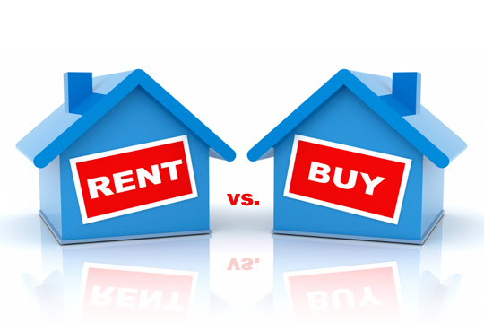
Storage Rent
EIP 35/87: Charge “rent” for contract storage
If rent unpaid, storage is removed from chain
Refund scheme could be removed entirely
Great idea but tricky execution
Developers must guard against storage loss
Entire contracts could disappear if unpaid
Doesn’t work for UTXO set…

Slide 18
The Big Picture: Project Chicago
Blockchain transactions require a number of “raw” resources or commodities
Memory: block space, UTXO set, etc.
Computation: e.g., gas in Ethereum
How do we accurately price and freely trade these commodities (and their derivatives)?

Slide 19
Project Chicago: What’s Next?
More efficient transaction-fee derivatives
Bob: I’ll pay Alice’s transaction on April 1st
Alice: Run my transaction
Avg. gas price is 5 GWei
Transfer funds from Bob to Alice
Other cryptocommodities?
In-protocol futures
Could stable & efficient cryptocommodity markets be supported at the consensus level?

Slide 20
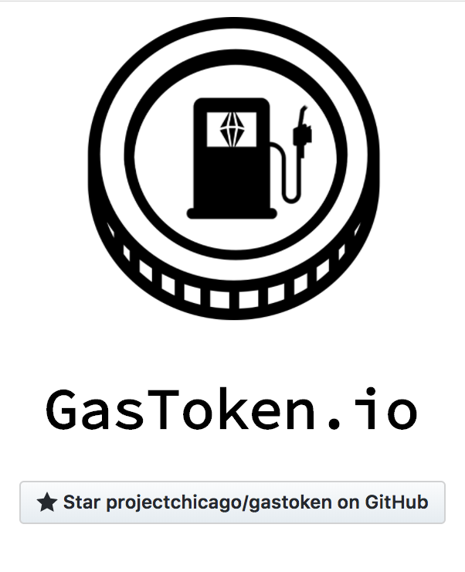
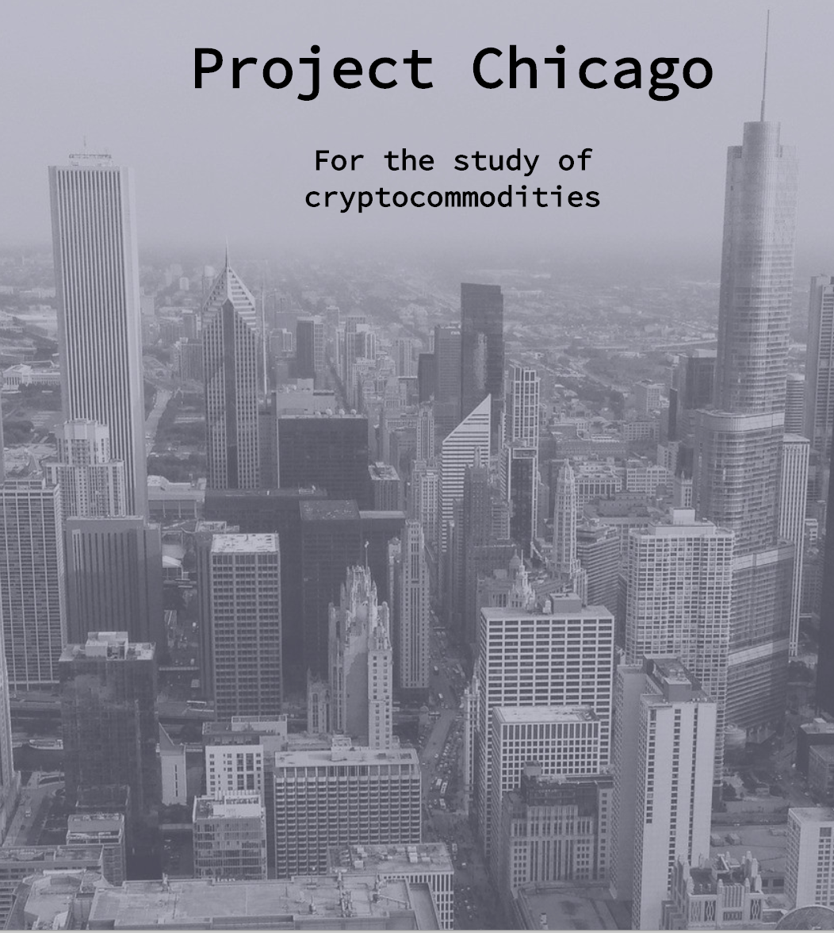
Learn More
https://gastoken.io
https://projectchicago.io

